Slide 1
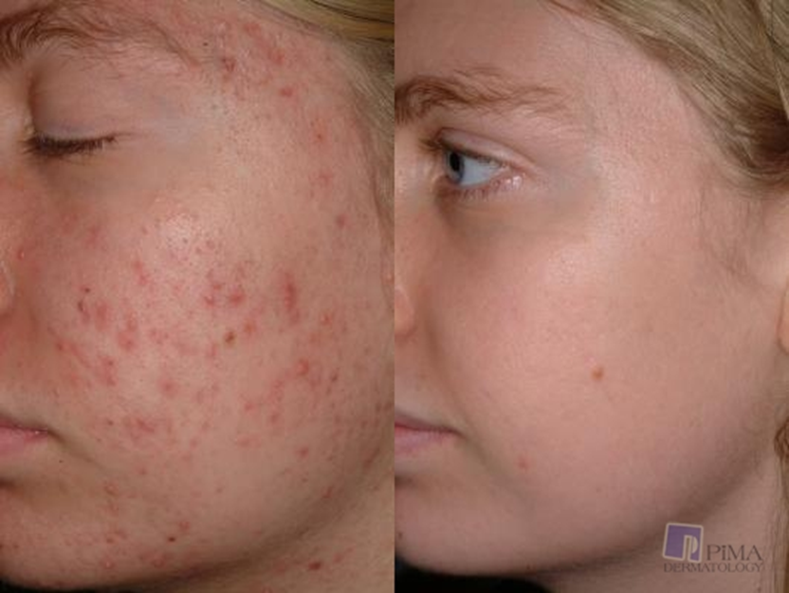
Notes:
Asia: 60 million Americans have acne. 85% are teenagers between the age 12 and 24. 20 percent are adults. Of these 60 million Americans 25% will scar from acne. Sensitive skin is a complex dermatological condition defined by abnormal sensory systems. What if we told you we could fix both problems. Acne free, a homemade organic acne remover can help you improve your confidence and clear your skin.

Slide 2
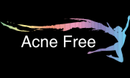
Acne Free
Jessica Beebe and Asia Johnson
Sport & Medical Sciences Academy
December 13, 2016
Notes:
Hi im asia Johnson and im Jessica Beebe and this is acne free.

Slide 3
The problem…
Many acne products contain chemicals
Not everyone’s skin reacts well to acne products
Expensive
66% of teens and adults have sensitive skin
Notes:
Jess: The problem that many people have is that acne cleaning products can cost a lot of money and all the name brand that many see on tv don’t always work and not always do they work. Every person is different and since a lot of acne products have chemicals some people skin doesn’t react well to the skin Acne free has the solutions to all of these problems.
Asia: We did a market research project that allowed us to see how many teens and young adults have sensitive skin. 66% of people do have sensitive skin.

Slide 4
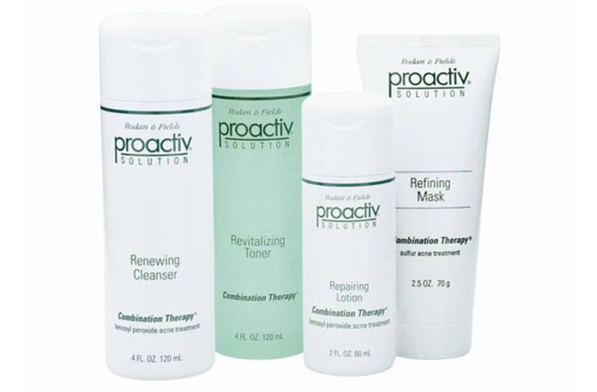
Our Solutions…
Chemical free acne soap
Affordable
Organically made
Notes:
Asia: Acne free has a solution to all of the problems. Our soaps are all organically made and chemical free. Unlike other acne products acne free is cost affordable.

Slide 5
Description of Acne Free
We will ship to you
24 hour easy online ordering
All organic products
Notes:
Jess: Ance free provides different ways to buy and receive our products. Acne free will have a 24 hour online ordering system for you to purchase our product. We also will deliver to any where that you request. Acne free is an all organic soap. As you see in front of you acne frees soap is the solid black bar. It is this color because it is full of activated charcol. The acitvated charcal is what helps the skin become clear. Acne free soap can last up to two months because of this. The other bar only has a swirl of acitvated charcol which will only last a few weeks maybe a month depending on how often you use it.

Slide 6
Our Mission Statement
Our goal is to provide young adults and adults to have confidence and not worry about acne or what is in the products they use.
Our Social Impact
Acne Free will allow people to use a healthy and safe product for their skin and body. We want our customers to have confidence when using our product.
Notes:
Asia: Acne frees mission is to allow young adults along with adults to be able to live a confindent life with out the worry of acne and worrying what is in the products they are using. Our social impact is to make a product that is healthy for the skin and body to allow you to live a happy and confident life.

Slide 7
Business Model
Description of Expenses
Variable Material Expenses | Total: $.85
Item | $
Whole Recipe | $.45
Mesh Bags | $.38
Padded Envelope | $.02
Fixed Expenses | Total: $175.00
Item | $
Salary | $80.00
Advertising | $5.00
Depreciation | $30.00
Utilities | $40.00
Rent | $20.00
Definition of One Unit
One 4 oz. bar of Acne Free soap
Economics of One Unit
Selling Price |  | $20.00
Cost of var. materials exp. | $0.85
Cost of labor | $0.32
Other variable costs | $2.00
Total COGS/ COSS |  | $3.17
Contribution Margin |  | $16.83
Monthly Break Even Units
$175.00 | = | 10.39 | ≈ | 11 four ounce bars
$16.83
63% of people are willing to pay over $15
Notes:
Jess: Acne Frees economics of one unit is one 4 ounce bar of acne free soap. We chose this size because some of our competitors such as dove or proactiuv sell a similar size. We did a market rresearch survey and 63% of our target market said that they would pay over $15 on our product. Therefore we are selling our priduct for $20. We have a variable expesice that consist of the activated charcol powder and the essential oils. The labor is low because we can make more than one bar at a time and all we have to do is mix and pour it into the molds. WE also have $2 for shipping and handling. Inorder to make one bar of acne free soap it cost $3.17. We make a profit of $16.83.
Asia: Acne Free has a fixed expense of $175.00. Our rent is low due to our business being a home office. The utilities are also low because we are helping out. We have $5.00 for advertising set aside and the depreciation of our cell phones computers and other equipment needed to make our soap products. We have a salary of $80.00 a month. And In order to break even every month acne free needs to make 11 4 ounce bars of soap. During our market research 63% of our target market states that they would pay over $15.

Slide 8
Market Analysis
Market Statistics
Industry Name: | Cosmetics ,Beauty Supply & Perfume Industry | Annual Industry Sales: | $20 Billion
Description of Target Consumer
Demographics | Geographics
Parents of teens Ages 13 + Middle to high income | Tolland County Hartford County
Psychographics | Buying Patterns
Boost of Confidence Healthy skin Healthy Life Less harsh chemicals on skin | Every two months By happy customers spreading the word
Target Market Size
Total Population
2 Million
Target Market Population
600,000
Market Size
6,000
Notes:
Asia: Acne free is in the cosmetics beauty supply and perfume industry. Each year Americans spend 20 billion dollars on this industry. We decided to target people who have acne but also people who care about the products they put on their skin.
Jess: Acne Frees target market is aimed towards parent of teens, teens them self and middle to high income people. We see this as our demographics because we surveyed 75 people and the majority were teens or parents of the teens. Acne Free is located in harf5tord and Tolland county as acne free starts. We see in the future explaining. Acne frees goal is to boost our customers confidence and allow them to have healthy skin and a healthy life. By this we see our customers returning every two months because that’s how long a acne bar last. But we also hope to have our customers use word of mouth and drive more customers in.
Asia: Our target population size started at 2 million people between the Hartford and Tolland county. 40% of our target market are parents of teens who are 13 and up and are middle to high income. We decided to focus on only one percent of our target market within our first year of business. -

Slide 9
Marketing and Sales
Social Media
Facebook
Twitter
Instagram
Website
Business cards
Word of mouth
Email
Notes:
Jess: We plan on reaching our target market through social media since most teens are invovled in websites such as facebook twitter and instagram. We also have a website where you can view our product and what is in it. And this is also where you can place your order. IF you were to have any questions you could contact use through our email. Finally we will be sending a buisness card with each order. As you see infront of you each time you place an order you will have a business card that says thank you for choosing our product. By having a happy customer we hope that they would spread the word to family and friends.

Slide 10
Competition
 | Acne Free | Proactiv | Dove
Ingredients | Not Harmful | Harmful | Not Harmful
Location Made | Homemade in Ellington, CT | Factory made | Factory Made
How Long it last | 2-3 months | 1 month | 2-3 months
Our Competitive Advantages
1. Not harmful to skin or linens 2. Homemade 3. Lasts longer
Notes:
Asia: Acne Free has two main competitors. Proactive is a very expensive acne medicine that is made in many different places and contains many chemicals. Our second competitor is expensive as well and is also factory made all over the place and is made with chemicals just like Proactive. Acne free stands out in our own way. Acne Free is very cost affordable for all . We also our locally made and contains no chemicals in our product. By this is makes us original and different from our competition.

Slide 11
Qualifications
Currently operational
Have family friend that makes an acne soap
Have taken Chemistry
We are part of our target market
Have taken an Entrepreneurship and Marketing class
Notes:
Jess: Our qualifications are that we are currently operational. I have a family friend that has tried this acne soap and succeeded with this recipe. We have bothj taken chemistry and we both are members of our target market and we both are participating in a marketing and entrepreneurship class.

Slide 12
Sales Projections
Gross Revenue
$3,720
Total Units
186
Net Profit
$876
Notes:
Asia: Our total untils sold im the first year would be 186 units. Our gross revenue comes out to $3,720. The net profit comes to being $876.00.
Jess: Our units sold varies based on the time of the year. During the falll and winter months we would sell more soap because peoples skin is starting to dry out. We would also sell our most in the months of June and December because most kids semesters are ending and finals are coming up and with stress comes acne.

Slide 13
Start-up Funds
Item | Why Needed | Cost
Equipment | Needed to make soaps | $100.00
Start up ingredients | To make actual soap | $100.00
DBA | To start business | $20.00
Advertising | Business card for each order | $5.00
Computer | All orders through website | Owned
Phone | To answer customers questions | Owned
 | Total Startup Expenditures | $225.00
 | Emergency Fund | $100.00
 | Reserve for Fixed Expenses | $525.00
 | Total Startup Investment | $850.00
ROI: Return on Investment
$876.00 | = | 103% | ≈ | $1.03
$850.00
ROS: Return on Sales
$876.00 | = | 24% | ≈ | $0.24
$3,720.00
Notes:
Asia : Acne free has a total start up investment of $850.00. We have reserved fixed expenses of $285.00 and an emergency fund of $100.00.
Jess: Acne frees start up fund is $225.00 this includes the equipment and start up materials. This also includes a $20.00 DBA which is the walk in fee in Ellington Ct. Advertising we have put $5.00 so we can buy business cards and place them with each order we receive. Finally acne frees computer and phone is already owned so we don't include this in the $225.00.
Asia: Acne free has and 117% return of in vestment and 24% on return on sales

Slide 14
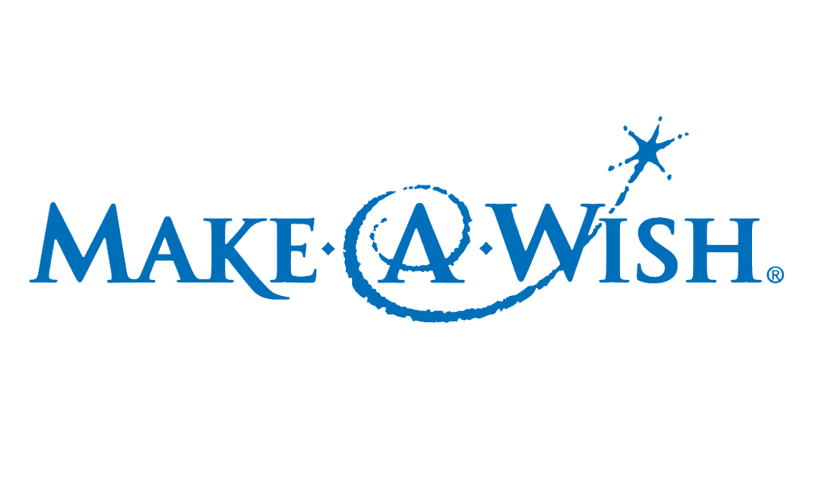
Philanthropy
Future plans
Expand our product line by year 2
To double our profits by year 2
To look into selling at craft fairs in year 1
We will give a total of 5% to the Make-A-Wish Foundation
Notes:
Jess: Ance Free plans within the first 5 years to expand our product line and to open a store front. This way we can allow people to be able to come in and see how acne free works. Our philantrophy is always a safe and healthy product for our consumers and we would love to donate 5% of acne frees profits to the make a wish foundation to contribute to childrens happiness.

Slide 15
Let us fix your Acne story
Thank you for your consideration of
Acne Free
Email: acnefreect@gmail.com
Instagram: AcneFreeCt
Twitter: AcneFreeCt
Website coming soon
Notes:
Asia: Thank you for your consideration of Acne free. Website Instagram and twitter coming soon. And remember let us fix your acne story.

