Slide 1
© Copyright 2013 Oghomwen Ohenhen
Notes:
Before I start my presentation make it known to the judges that all pictures in this presentation were taken by me with my drone. Since the beginning of time, we as a society have always wanted to fly. Whether its just to get up high and take a wonderful look at the view below us, or something even more important. Now just imagine the usefulness of being able to get this vantage point in a swift moments notice, when it is needed most. Well, with todays technology and my business this is no longer wishful thinking, this is reality. Hi, my name is Oghomwen Ohenhen and my business’s name is Aerial Drones. Where technology meets, innovation.

Slide 2
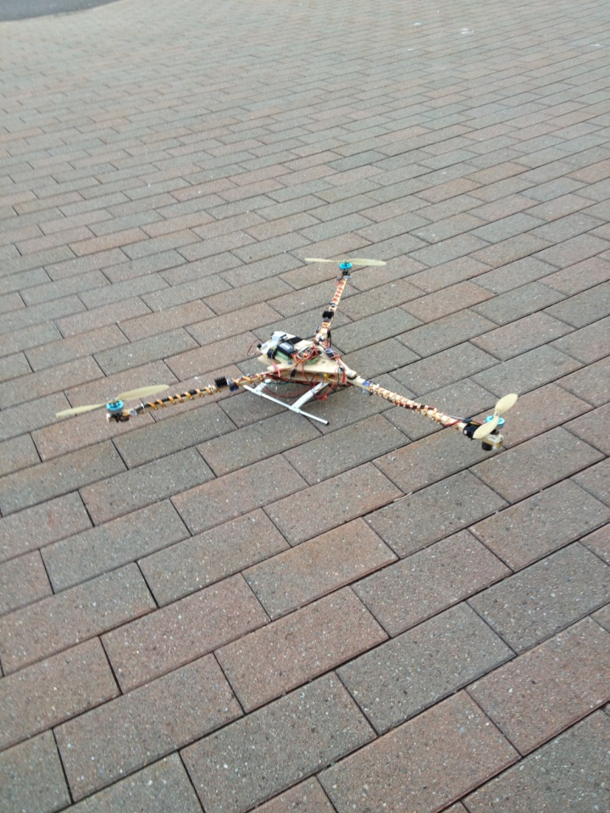
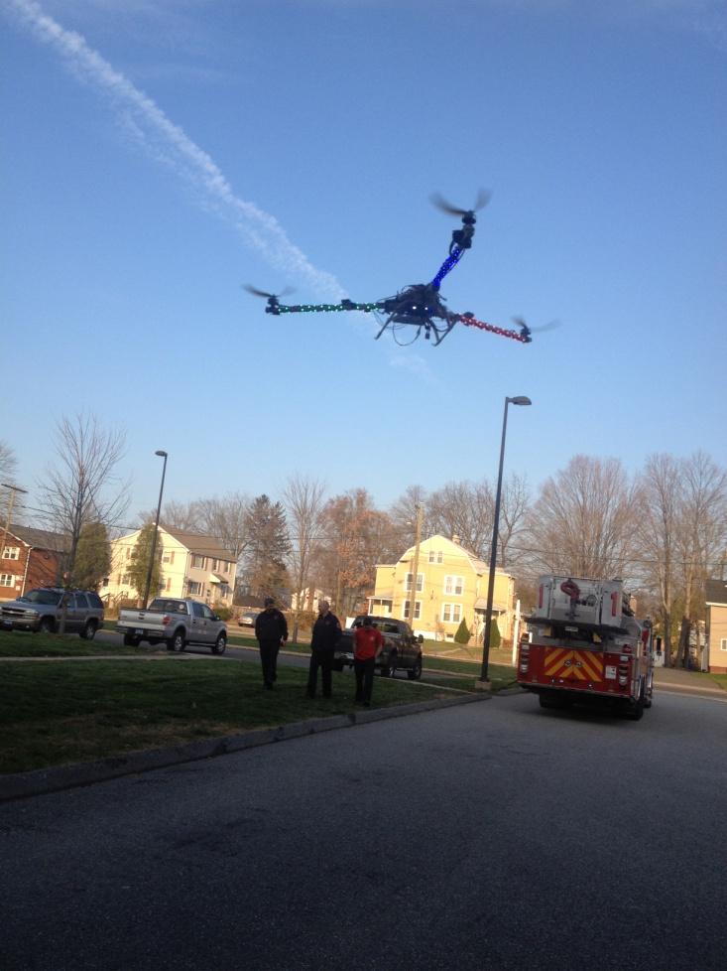
Oghomwen Ohenhen - Hartford, CT
Sport and Medical Sciences Academy
© Copyright 2013 Oghomwen Ohenhen
Notes:
My business, Aerial Drones, takes advantage of the new and emerging technologies in the electronics and aerospace industries. These advancements allow a remote aerial tool such as this to be programmed in moments and carry out tasks automatically, with GPS and sensors even when out of radio control range. Allowing a tool such as this to be used in commercial, industrial, and life saving procedures here and around the world. Named “The Scorpion” by the Manchester Fire Department

Slide 3
Problem
Inexpensive HD Aerial Photographs and Videos
Useful For What?
Professional Aerial Photography
Search and Rescue
Surveillance
Inspection and Mapping Services
Media Reporting
Wild Fire Detection and Monitoring
Aerial Real Estate Photography
Aerial Chemical Testing and Analysis
Remote Chemical Sniffing
Ability to Build 100% Customizable Aerial Drones
My School’s Rooftop
© Copyright 2013 Oghomwen Ohenhen
Notes:
One of an Aerial Drone’s main features is its ability to produce HD Aerial Photographs and Videos inexpensively and quickly. Making it incredibly useful for example with the emergency services departments such as firefighters, search and rescue, and wild fire detection and monitoring. It is also extremely useful for Aerial Chemical Testing and Analysis, which as now must be done by helicopter and with its large blades and great prop wash really hinder their ability to do so very effectively.
Aerial Testing and analysis – Relate the experience the firefighters had when a chlorine fire got worst when a helicopter trying to sample the air blew the chlorine around into the responding firefighters and into damaged about 20 cars in the area. This is a job a drone can easily do, without a single hinch.
Inspection and Mapping – Can be used to inspect windmills, dangerous jobs that previously could only be done by a technician climbing to the top can now be done safely and more efficiently with an aerial drone.

Slide 4
How Does My Business Fill Society’s Needs
? ? ? ? ? ? ? ? ? ? ? ? ? ?
© Copyright 2013 Oghomwen Ohenhen
Notes:
Well I have said a lot about how my business will fill society’s needs but I will like to actually show you… (Show them Examples)
This is where I will introduce two experienced firefighters from the East Hartford Fire Department who will relate how my product will change the way firefighters respond to emergencies.
How Firefighters will introduce themselves: 1. Name, Rank, and # of years experience as a firefighter.
2. Describe their view of my product.
3. I thank them for coming out of their busy schedule to support me.

Slide 5
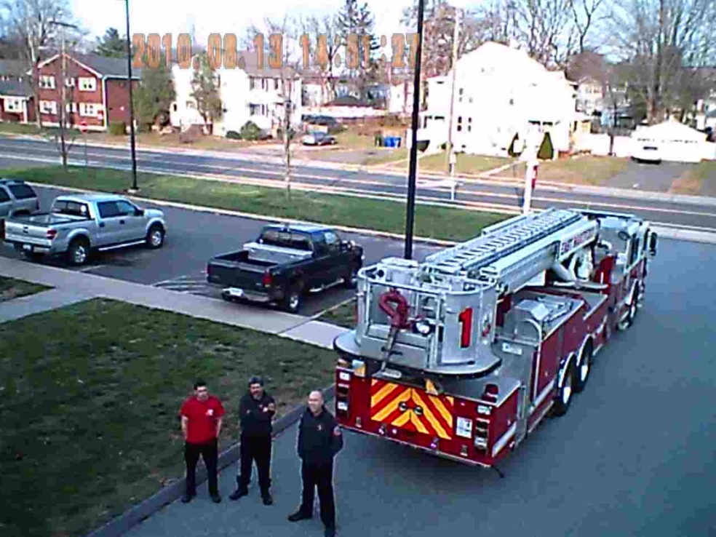
Description of Product
Customizable Aerial Drones
Including, but not limited to:
Live Video Feed
Flight Duration
Lifting Capacity
Control Range
Responsiveness
Structure
Stability
Autonomy
Remote Chemical Testing
Provides Quality Aerial Photos
Online Ordering
Quick and Convenient Ordering
E.H. Fire Department
© Copyright 2013 Oghomwen Ohenhen
Notes:
Having a full say in the design and performance of your Aerial Drone makes our product special. We do this because every clients needs are different. For example, Aerial Drones geared more towards the fire department, need to be more heat resistant, use non-sparking materials, and be really durable. Aerial Drones geared more towards reconnaissance and the monitoring situations need a larger battery for increased flight times, more efficient motors, and increased independence. They can also be equipped with a live video feed, a plethora of sensors and even be controlled from an Ipad or similar device.

Slide 6
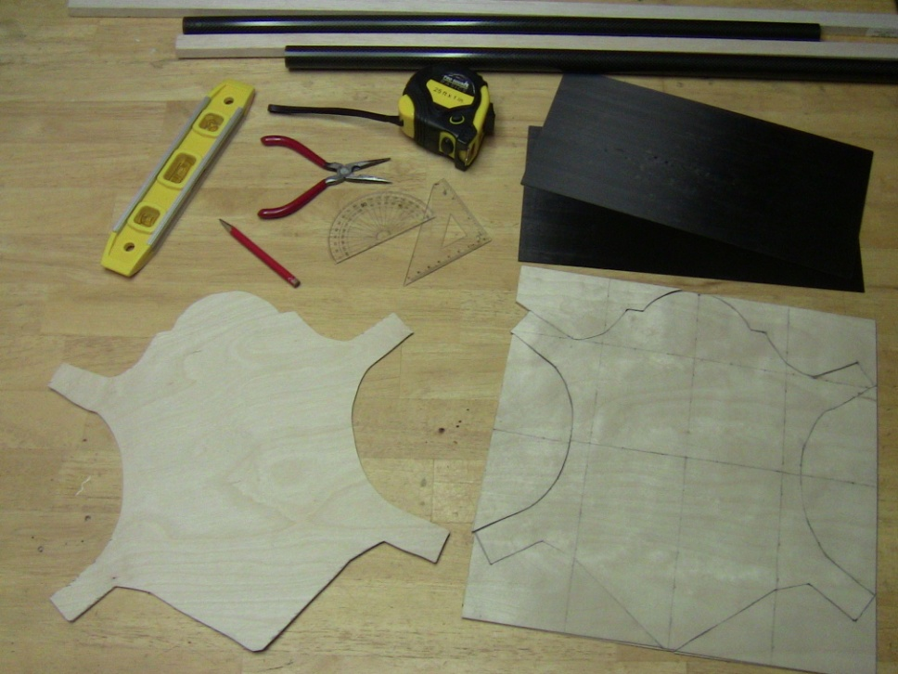
Business Model
Definition of One Unit
One Standard Drone
Economics of One Unit
Selling Price |  | $3,250.00
Cost of materials | $183.00
Cost of labor | $35.00
Other variable costs | $32.00
Total COGS/ COSS |  | $250.00
Contribution Margin |  | $3,000.00
Monthly Break Even Units
$448.89 | = | .149 | ≈ | 1 unit
$3,000.00
© Copyright 2013 Oghomwen Ohenhen
Notes:
Due to high material prices and tricky production techniques we know anyone in the electronics or aerospace industry may have a challenge. So an appropriate product price is key. To accomplish this we surveyed multiple fire and police departments in the Hartford County and learned that over 64% of our civil servants today would pay over $3,000 dollars for this product. So we appropriately priced our product with training to $3,250, after subtracting out COGS, we get an incredible contribution margin of $3,000 and we need to sell one unit every 7 months to breakeven.
____________________________________________________________________________________________
and have thoroughly thought out a 2 point plan to cover this company. The first point is a high contribution margin. This allows our business to constantly have enough money to reinvest in ourselves, allows our business to survive longer even when making minimal sales, and it also allows the business to make much more profit when sales are nominal. The second point in the plan is to keep our price low yet reasonable. In order to accomplish that we surveyed multiple fire and police departments in the Hartford County and found out that over 64% of our civil servants would pay over $3,000 dollars for this product. Thus we appropriately set our price to $3,250. It is important to keep in mind that these prices are setup for businesses not individuals, so this price is very good, and more than likely subject to increase when demand builds up. This price gives us an incredible contribution margin of $3,000.37.

Slide 7
Market Analysis
Market Statistics
Industry Name: | Aerospace Products & Parts Manufacturing | Annual Industry Sales: | $175 Billion
Description of Target Consumer
Demographics | Geographic
Emergency Services Departments Park Rangers Private Detectives and Investigators Security Guards Law Enforcement Training Academies | Initially Hartford County, Then Nationwide and Eventually Worldwide
Psychographics | Buying Patterns
Safety Conscious | Willing to spend their money for the safety and good of society
Target Market Size
Total Departments of targeted geographic area
139,707
Amount of Departments in New England
6,477
Market size
# of FD and PD in Hartford County
115
© Copyright 2013 Oghomwen Ohenhen
Notes:
Our business is in the Aerospace Products and Parts Manufacturing Industry grossing annual sales over $175 Billion dollars. Our target market are mostly the Emergency Services Departments, Park Rangers, Private Detectives and Investigators, Security Guards, and Law Enforcement Training Academies. We are targeting all 115 of these departments in the Hartford County the first year but will grow to target all of the ones in Connecticut then the U.S. and eventually the world.

Slide 8
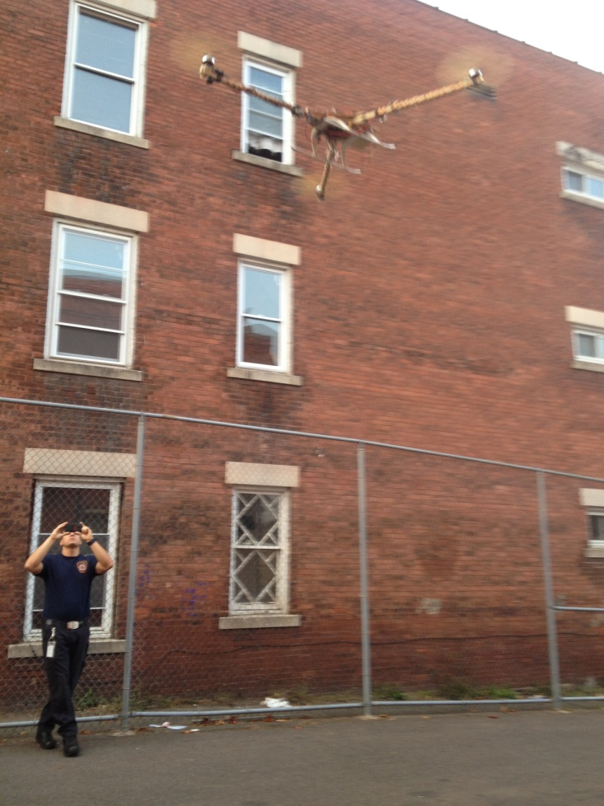
Promotion and Sales
Live Demonstrations
Loyalty Incentives
Online Advertising and Marketing
Trade Shows
Press Releases
Social Media
Hartford Fire Dept.
© Copyright 2013 Oghomwen Ohenhen
Notes:
How we promote ourselves is going to be a huge determining factor on how much business we receive, so we plan on getting it right. One of the ways we are going to do so is through live demonstrations, this allows our potential customers to understand what they are buying before they buy it, thus making them more inclined to place an order. Having repeat customers is an extremely important aspect of any business, so we also offer loyalty incentives for returning clients. We also take advantage of online advertising and marketing including social media, bring this product to trade shows in our target geographic area and make our product available for press releases.

Slide 9
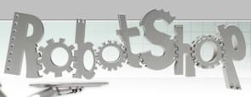
Comp. Advantage
Competition
Quality Built to Specifications
“Operation Succeed” Strategic Market Initiative
Best Prices Industry-Wide
Dedication To Clients
Lack of Customization
Cost Prohibitive (Prices Start at $50,000)
Lack Professionalism
Not Committed to Customer Satisfaction
Lack of Customization
© Copyright 2013 Oghomwen Ohenhen
Notes:
Aerial Drones has the potential mature into a well known and extremely profitable company. We have very great confidence in it, and we will make sure that our clients will to and prefer us than to the competition. Some great ways this is accomplished is through our built to spec drones, our incredible price and our dedication to clients. It only makes sense that when you truly appreciate your clients, you want to provide them with the best prices in the industry, giving them a great deal, and keeping them with you. We also employ a concept, to get a distinct edge, over our competition. Collectively we call it, The Strategic Market Initiative, or “Operation Succeed”. Having Nigerian parents I have a full knowledge of the benefits this tool will have in that region. Thus, “Operation Succeed” involves a rapid yet calculated growth into the Nigerian marketplace. A market having little competition yet numerous uses for this tool (Security and Crop-Dusting), but without the entrepreneurs to make it happen. I, will change that.

Slide 10
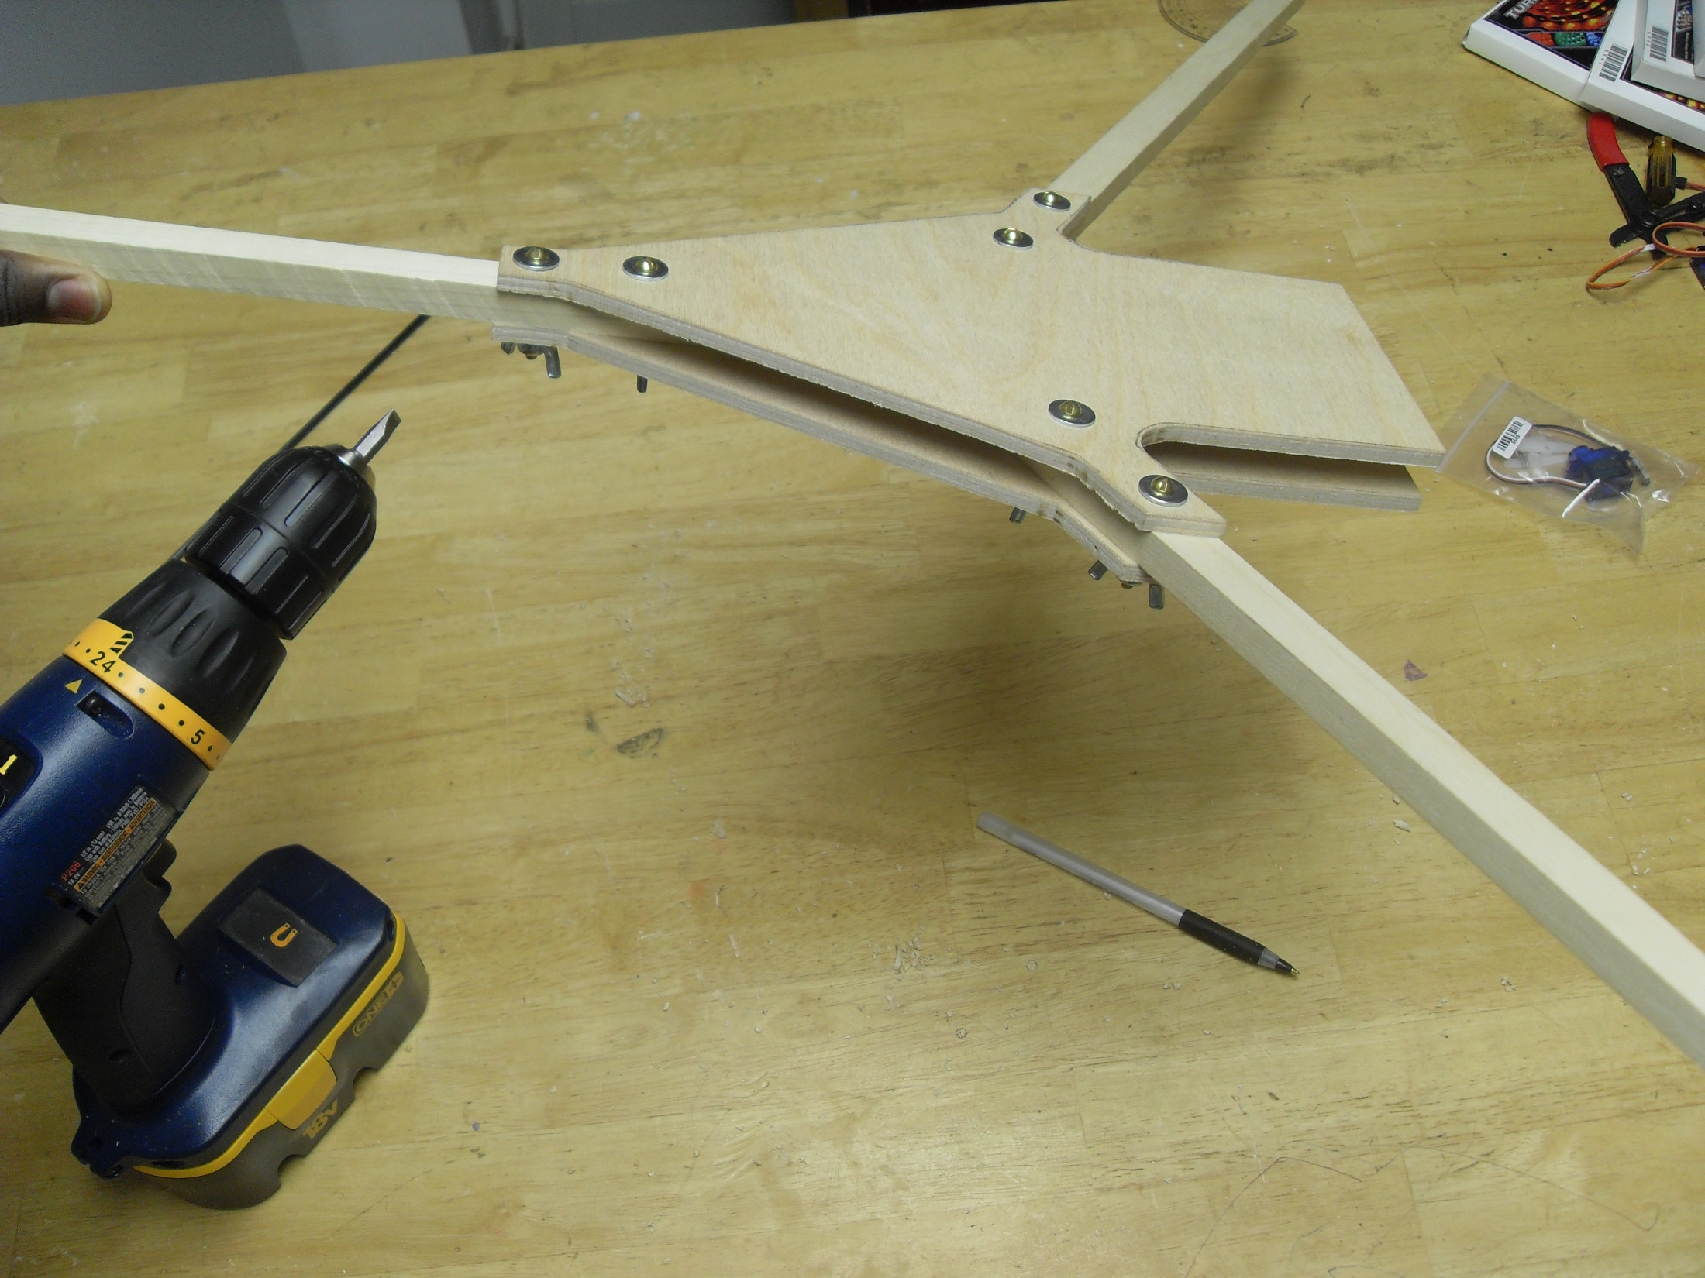
Qualifications
6+ Years Experience in Designing and Building Electronics Systems
Great Sales and Customer Service Skills
Connections to other Knowledgeable People in the Aerospace Industry
Ready to Work Tirelessly
© Copyright 2013 Oghomwen Ohenhen
Notes:
In order to build a quality piece of machinery like this from scratch for commercial customers, you must be well qualified. I myself am not under qualified because as of now I have over 6 years of experience in the designing and building of electronics systems. I have great sales and customer service skills, and when all else fails, connections with other knowledgeable individuals in your area of focus can really help pull you out of any issues or problems you may face. I am also ready to work tirelessly for the success of this business.

Slide 11
Sales Projections
Total Units
33
Gross Revenue
$107,250
Net Profit
$79,582
© Copyright 2013 Oghomwen Ohenhen
Notes:
An interesting thing about this business is that it takes advantage of disasters as potential profit-makers due to the simple fact that my product is extremely useful after one, such as after Hurricane Sandy hit, or Japan’s massive earthquake. Based on this logic my sales projections spike on the riskier months, such as when Winter Nor'easter's, Tornadoes, Hurricanes, and Wildfires are more likely to occur and cause the most damage. When this all added together I project I will sell 33 units in the year, grossing $107,250, and receiving a net profit of $79,582.

Slide 12
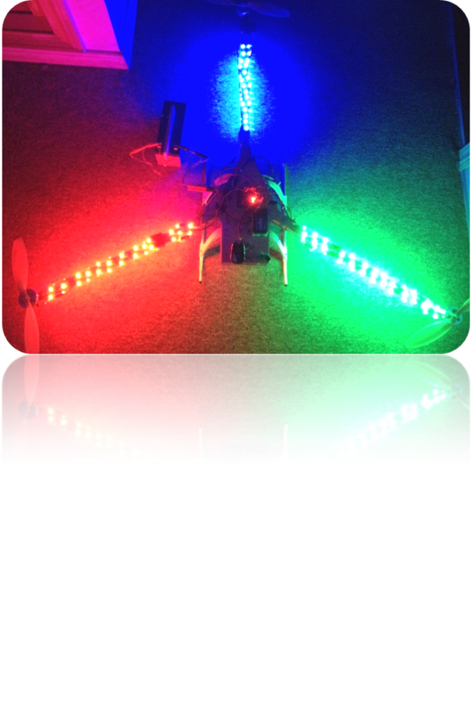
Startup Funds
Item | Why Needed | Cost
Laptop | Ordering and Bookkeeping | Pre-Owned
Cell Phone | Customer Communication | Pre-Owned
Professional Website | Customer Communications + Marketing | $610
Initial Inventory | First Production Run | $622
Paperwork for LLC | Personal Asset Protection | $120
Business Cards | Marketing Essentials | $10
 | Total Startup Expenditures | $1,362.00
 | Emergency Fund | $1,000
 | Reserve for Fixed Expenses | $1,350
 | Total Startup Investment | $3,712.00
© Copyright 2013 Oghomwen Ohenhen
Notes:
All I need in order to start my business is about $3,712. This money covers the costs for a professional website, that allows online customization and ordering. Enough inventory for the immediate production of three drones, paperwork, business cards and even some reserve funds.

Slide 13
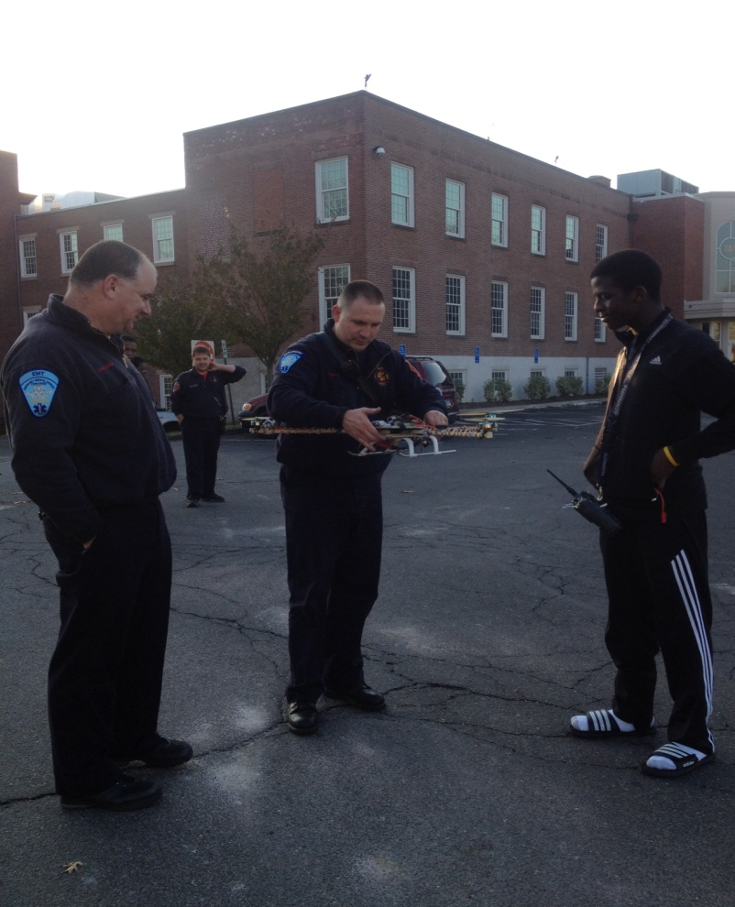
We Appreciate Your Time
and
Thank You for Your Consideration
Visit Us At: www.facebook.com/AerialDrones
© Copyright 2013 Oghomwen Ohenhen
Notes:
Looking back in history we notice that there is always someone who turns something expensive and scarce, into something mass produced and profitable, such as Henry Ford and his Model T. Well, ladies and gentlemen, this is the Model T of the 21st century, Aerial Drones, where technology meets innovation. Thank You
We thank you for your consideration of Aerial Drones, where technology meets innovation, and truly appreciate you for coming out hear and doing this for us. Thank You.

