Slide 1
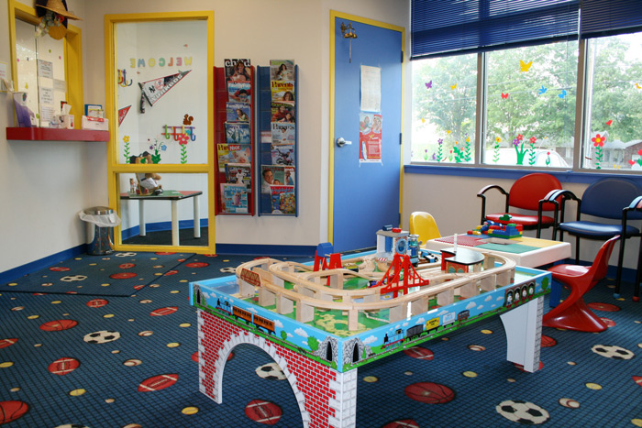
Notes:
Susanne Jones, an 8 year old little girl who loves to play with her friends and watch Sunny With a Chance on the weekends is joyful and always maintain a positive spirit. Well, that’s until she pulls up in the parking lot of the doctor’s office. Whenever she goes, she always fear the worst news possible and hopes that her current visit is better than the last. Watching T.V nor playing with toys helps to make her situation easier. But if there’s a will, there’s a way. My business is a service where I will paint a portioned section of a pediatric, dental, children’s hospitals, daycares wall with a product called dry- erase paint.
You should care and take consideration of this business because this reduces the barriers of doctors’ patients or the children at daycares to be a little less tense and to relax while they may feel alone.
James Alexander is currently in the waiting room of his doctor’s office. I would say he’s patiently waiting, but the look on his face tells me different. Why not play with the toys that’s provided for him?

Slide 2
ANT’s Painting
Ashley Thomas
11th Grade
16

Slide 3
Mission Statement
Mission Statement
Write it out. Draw it out. Don’t let your mind imprison your thoughts.
Opportunity
My business is to allow children and young adults to be and feel creative.

Slide 4
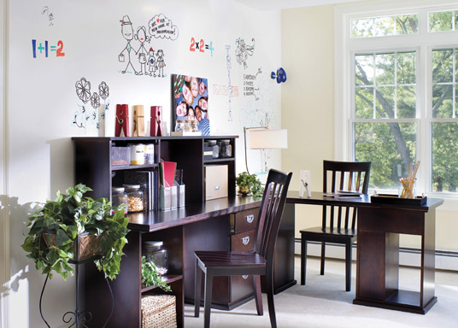
Business Profile
Service
Quality service
Small business
Self pick color of paint
Any purpose paint
Sole Proprietorship
I chose this as my business because I like the idea of being independent and getting work done on my own time.

Slide 5
Qualifications
Youthful and creative
Desire to help young children and the youth
Insured painter
Have taken a Marketing and Entrepreneurship class

Slide 6
Market Analysis
Industry Name | Paint contractors
Industry Size | $ 26,344,800.00
Total
Population
Hartford County
879,835
Target Market
Doctor offices, daycares, and universities
6,380
Potential Market Size
Number of businesses targeted in the first year
91
Notes:
128 hospitals * 10 offices= 1280 offices
19 colleges/ univ. * 250= 4750

Slide 7
Consumer Profile
By Location
Hartford County, Connecticut
By Population
Doctors, college/ university deans, and child care workers
By Personality/ behavior
Businesses that wants to occupy their clients

Slide 8
Competitive Advantage
Lowe’s
E D Painting
ANT’s
Painting
Factors
Quality of
Service
Excellent
Good
Excellent
Price
High
High/ Med.
Reasonable
Location
Nationwide
Connecticut
Connecticut
Brand/Reputation
Good
Good
Good
Unique Knowledge
Multiple Brands of Paint
Loyal Customers
Multi- purpose paint

Slide 9
Marketing Plan
Marketing
Mix
Price
Place
Product
Promotion
People
Hospitals, daycares, universities.
Based on competitor’s pricings.
Word of mouth, business cards
Hartford, Connecticut
To paint on dry- erase paint.
Notes:
9

Slide 10
Marketing Plan
Awareness
Purchase
Retention
Current & Short Term (1 month -6 months)
Word of mouth
Business cards
Personal contact and display a 4x5 ft. demo of Fun Wall
Touch up and expansion
Customer service
Long Term ( 6 months-1 year)
Same as before
Same as before
Same as before
Monthly cost,
by phase:
$ 3.99
$ 100.00
Price less

Slide 11
Cost of Materials/Direct Labor
Definition of One Unit | To paint 50 sq. ft. of Fun Wall
Cost of Sales Per Unit
Direct Labor | Time to make 1 unit | Direct Labor Cost Per Unit
$ 8.25 | 2 hours | $ 16.50
Total Direct Labor Per Unit |  | $ 16.50
Material Description | Cost/Total Quantity | Cost Per Unit ($)
Marker set of 2 + eraser | $ 729.00/ 300 | $ 2.43
Dry- erase paint | $ 175.00/ 50 sq. ft. | $ 175.00
20 Business Cards | $ 3.99 / 250 cards | $ .40
Total Material Cost Per Unit |  | $ 177.83
Total Other Variable Costs Per Unit (gas) |  | $ 3.00
Cost of Sales Per Unit |  | $ 197.33
Notes:
11
http://store.pensrus.com/Merchant2/merchant.mvc?Screen=PROD&Product_Code=PRU-LM2400&Category_Code=LIQUIMARK&Product_Count=5
http://www.absorbentprinting.com/pens-and-more/markers/dry-erase-markers-boards/bullet-chisel-tip-dry-erase-marker
http://www.neoplexonline.com/dry-erase-erasers/
For Service and Manufacturing Businesses only.
Definition of Unit: A quick description of the product or service being sold. Think of this as the minimum number and type of products students’ are willing to sell to a customer. For example, if a student plans to sell retail sunglasses, the minimum number they’ll be willing to sell will likely be 1 pair of sun glasses.
Direct Labor/Unit: This calculation only includes time spent actually building a product or providing a service (On your mark…get set…GO…stop.). It doesn’t include indirect labor, such as time spent passing-out flyers, shopping for materials or sweeping office floors.
Helping students arrive at a direct labor figure can be challenging. There are a number of ways they can look at it:
1. If I’ve never worked before and took a job, what might I be paid?
2. What do others, with my experience level, get paid for similar work?
3. If I had to hire another person to perform this labor for my business,
what would I be willing to pay them given the level of quality and
efficiency I expect?
Materials/Unit: We should encourage students to shop for wholesale prices. These items should likely be purchased in bulk at better prices than retail shopping. There’s room here to enable judges to follow these calculations, which are the numbers behind the Economics of 1 Unit slide.
Many students unnecessarily pay themselves more than once in the business plan. There are four main ways that students pay themselves:
Direct Labor: This is an hourly wage based on the standard pay for the industry in which the student is working. Try to get students to think beyond minimum wage by looking at online resources such as salary.com or craigslist.com to get comparable rates of pay. Steer students towards paying more than minimum wage for skilled or semi-skilled labor (braiding hair, lawn care, computer repair, etc.)
Entrepreneurial Stipend: This can be found on the Fixed Costs slide and is similar to a salary students may pay themselves on a monthly basis.
Comission: This is on the EOU slide and is a variable cost that fluctuates based on the number of units sold.
Salary: This can also be found on the Fixed Cost slide
% of profit: There is no slot on the template for students to indicate they are taking a percentage of profit but students could mention it when they present the income statement.
Whenever students enter any of the above information on the template, have them write it in green to keep track of payments. Then, students must double check their plan to make sure they are not paying themselves more than once.
ACTIVITIES:
Bic pen activity (disassembled in bag – make teams of students assemble them)
Fieldtrip to manufacturing or service business
ZipBin Case Study
Book store owner case study to be written (may be oppty recognition)
Activity for identifying variable costs (vs. direct labor and materials) – packaging, commission,
Variable and fixed cost bingo activity
*Try to keep a ‘math journal’ with your students: Spend first 5-10 mins of class each day doing math calculations based on business financials.

Slide 12
Economics of 1 Unit
Definition of One Unit To paint 50 sq. ft. of Fun Wall
Selling Price per Unit | $ 500.00
Direct Labor per Unit | $ 16.50
Materials per Unit (if applicable) | $ 177.83
Total COGS per Unit | $ 194.33
Total Other Variable Costs per Unit (Gas) | $ 3.00
Total Cost of Sales | $ 197.33
Contribution Margin | $ 302.67
Notes:
http://www.neoplexonline.com/catalog/shopping_cart.php
http://www.absorbentprinting.com/pens-and-more/markers/dry-erase-markers-boards/bullet-chisel-tip-dry-erase-marker

Slide 13
Average Monthly Fixed Costs
Type of Fixed Cost | Monthly Cost
Entrepreneurial Stipend | $ 250.00
Insurance | $ 50.00
Advertising (250 Business cards) | $ 3.99
Depreciation (Computer, Cell phone) | $ 23.61
Utilities (Computer, internet, electricity) | $ 100.00
Rent (Home) | $ 150.00
Total Monthly Fixed Costs | $ 577.60

Slide 14
Time Management Plan

Slide 15
Monthly Sales Projections
Break-Even Units
1
Total Units
91
Full Capacity
100

Slide 16
Projected Yearly Income Statement
Selling Price Per Unit | $ 500.00
# of Units Sold | 91
Total Sales | $ 45,500.00
Total COGS | $ 17,684.03
Other Variable Costs | $ 273.00
Total Variable Costs | $ 17,957.03
Gross Profit | $ 27,542.97
Yearly Fixed Costs | $ 6,931.20
Other Costs/Unforeseen | $ 1,000.00
Total Fixed Costs | $ 7,931.20
Profit before Taxes | $ 19,611.77
Less Estimated Taxes @25% | $ 4,902.94
Net Profit | $ 14,708.83

Slide 17
Start-up Investment
Item | Where I will buy this? | Cost of Item
Business cards (250) | VistaPrint.com | $ 3.99
Computer and phone | Dell and AT&T | Owned
Car | Tony March | Owned
Paint (and tools) | IdeaPaint.com and Home Depot | $ 167.37
2 ANT’s Painting T-Shirts | Ooshirts.com | $ 49.30
CASH RESERVE covering 3 months of fixed expenses |  | $ 1,732.80
Estimated TOTAL START-UP INVESTMENT |  | $ 1,953.46
30 Hours Needed
Wage: $ 8.25
$ 247.50
x
=
Total: $ 2,200.96
Notes:
Paint + Primer( 67.97) + 10 packs of 3 Rollers( 7.97) + 10 paint tray(1.97) = 167.37

Slide 18
Return
…on Investment
668 %
Annual Net Profit
$ 14,708.83
=
$ 6.68
Start-Up Inv.
$ 2,200.96
…on Sales
32%
Annual Net Profit
$ 14,708.83
$ .32
=
Total Sales
$45,500.00

Slide 19
Financing Strategy
Source | Amount | Debt | Equity | Gift
Personal Savings | $ |  | X
Total: $ 2,200.96

Slide 20
Business Responsibility Plan
7 % of ANT’s Painting’s net profit will go to the St. Jude Children’s Research Hospital
I will make the public aware of this by placing it on my business card

Slide 21
Business & Educational Goals
Business
Personal
Find a professional painter who can be hired on an as- needed basis
Create a website so customers can pre- order paint in advance
Graduate high school with a 3.0- 4.0 GPA and attend the college of my choice
Better myself as a painting contractor
Short Term
Open a store front
Expand ANT’s Painting to the neighboring states of Connecticut
Sell business 6- 10 years after graduating from college
Use saving from ANT’s Painting to open my own medical practice
Long Term

Slide 22
Relax. Enjoy. Smile : ]
Thank you for your consideration of
ANT’s Painting

