Slide 1
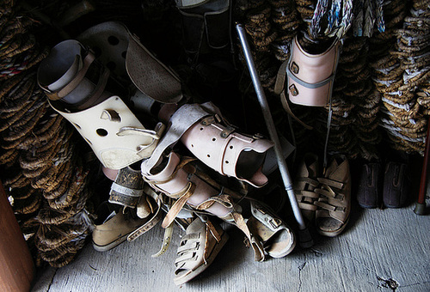
Notes:
When my father was 19 and playing college basketball, he was diagnosed with Muscular Dystrophy. At the time of his diagnoses, there was and still is no cure. There was nothing he could do other than wear generic knee brace and try therapy. Living with him, I see the struggle of this disease hit him harder each day. Luckily, within the past 5 years, customized braces became an option to help him. Yet, as my mother is the only one working, the costs hit us higher each time he needs a new brace. With all this, my business will not only help my family financially find a brace, but also other families of America.

Slide 2

A.B.C.
Athletic Brace Consignment
“Buy used and save the difference”
Anna Mercaldi
Age: 16
Sport and Medical Sciences Academy
Notes:
Buy used and save the difference. My business is called Athletic Brace Consignment, also known as A.B.C. I am Anna Mercaldi.

Slide 3
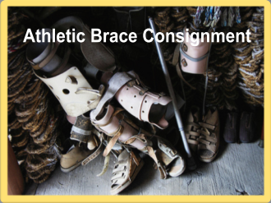
THE PROBLEM
People cannot afford medical insurance
People/companies throw out old braces
There isn’t a company that can provide a medically certified brace for a lower cost
Notes:
A.B.C. is going to attack problems Americans are facing. The biggest problem is that people cannot afford medical insurance. According to my market survey, 100% of people in my target market agreed that medical supplies need to bold sold for a lower cost to all financiaMy company will be the first business that can provide a medically certified brace for a lower cost.

Slide 4

A.B.C.’s Solution
Taking used braces and re-purposing them
To provide a medically certified brace to those in need
Affordable for all
Notes:
A.B.C. will take gently used braces and re-purpose them at an affordable price for all. By providing a medically certified brace to everyone in need, my company is solving the issue of people not being able to have access to a medical brace.

Slide 5
A.B.C.’s PRODUCT
Taking gently used medical braces and re-purposing them
Having donors, hospitals, clinics, and orthopedic offices continue supplying my business with gently used braces (from their patients)
Notes:
I will collect gently used braces from donors, hospitals, clinics and orthopedic offices. I will take those medical braces and clinically check them, assuring they are in proper condition. I will then sell them for a lower cost than buying them brand new.

Slide 6
MISSON & SOCIAL IMPACT
Mission Statement
A.B.C is a business that will serve as a place to receive a quality brace for your specific needs and improve the quality of life for all Americans
Social Impact
People will have less stress financially since they are getting a medical brace for a lower cost and there will be fewer injuries uncared for
Notes:
A.B.C. is a business that will serve as a place to receive a quality brace for your needs, improving the life for all Americans.
The impact on society will be that people can be stressed less financially since they are receiving a brace at a lower cost. Also, there will be less injuries uncared for. By doing this for society, America will become a place of hope and determination to be in your best condition.

Slide 7
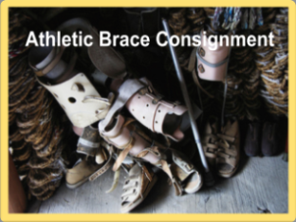

Business Model
Description of Expenses
Variable Material Expenses | Total: $0.92
Knee brace | $0.00
¾” Velcro Roll | $0.32/ft
Box | $0.60
Fixed Expenses | Total: $226.18
Rent | $30.00
Utilities | $110.00
Advertisement | $1.00
Depreciation | $13.18
Insurance | $72.00
Definition of One Unit
One medium sized knee brace with minimal repairs
Economics of One Unit
Selling Price |  | $10.00 (plus shipping & handling)
Cost of var. materials exp. | $0.92
Cost of labor | $2.18
Other variable costs | $0.00
Total COGS/ COSS |  | $3.10
Contribution Margin |  | $6.90
Monthly Break Even Units
$226.18 | = | 32.77 | ≈ | 33 knee braces
$6.90
Notes:
Anna Mercaldi: One unit will be one medium sized knee brace with minimal repairs. The selling price of one medium sized knee brace is $10.00, plus shipping and handling. After subtracting out the total cost of $3.10, my business is left with a profit of $6.90. To pay my fixed expenses each month, I would have to sell a minimum of 33 knee braces.

Slide 8

Market Analysis
Market Statistics
Industry Name: | Medical Equipment & Supplies | Annual Industry Sales: | $273 Billion
Description of Target Consumer
Demographics | Geographics
Male and female Any age Low to Mid income | Harford County and Middlesex County
Psychographics | Buying Patterns
Athletes Risk Takers | More injuries than the normal person
Target Market Size
Total Population
1,064,000
Target Market Population
571,000
Market Size
(based on
survey)
1,500
Notes:
Anna Mercaldi: My business is in the Medical Equipment and Supplies Industry. This industry has annual sales of $273 Billion dollars. My demographics include males and females of any age with a low to mid income. My geographic is specifically in the Hartford and Middlesex Counties. My psychographics are mostly athletes and risk takers that engage in dangerous, high-injury risk activities. My buying patterns are people who need medical braces because they have more injuries than the normal person. My total population is one million, sixty-four thousand people. According to my survey, 54% of people have at least one to three injuries a year. So my market size is around 571,000 people. I will target 1,500 people in my market size in the first year.

Slide 9
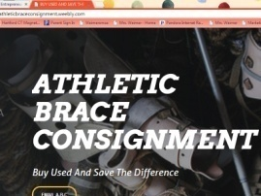


Marketing and Sales
Website
Social Media Strategies
Special Events
Through clinics, hospitals and therapists’ offices
Notes:
For my marketing and sales, I will use my website that I have created. It will be used not only for information but for buyers to put in orders. I also will use business cards that will be placed in each box when a brace is shipped out. Also, my personal relations with therapists and doctors will allow my business to be known. Through my family, friends and I, we can spread the word of my business by mouth, telling others of my business and what I do. Lastly, I will go visit clinics, hospitals and therapists’ offices giving short presentations to the people there about my business and how they can contribute or purchase a medical brace.

Slide 10
Competition
 | ATHLETIC BRACE CONSIGNMENT | The Brace Shop | Betterbrace.com
Price | Affordable for all | Expensive | Expensive
Service | Local and online | Online Only | Online Only
Speed | Have a response within 24 hours | Takes 5 to 7 days | Takes 5 to 7 days
Athletic Brace Consignment’s Competitive Advantages
1. All my braces will be affordable for any family no matter their financial stance 2. My company is both online and local—you can come to me directly or order over online 3. An employee will respond within 24 hours of your request and it will be shipped
Notes:
Athletic Brace Consignment will provide affordable options for everyone. Unlike my competitors, I supply my braces both locally and over the internet. Also, with Athletic Brace Consignment you will never have to wait many days to get a brace; you will always have a response within 24 hours and then the brace will be shipped out right away.

Slide 11
QUALIFICATIONS
Experience monitoring brace quality
Knowledge of the brace repair process
Currently enrolled in UCONN Science courses (Chemistry and Biology)
Connections to doctors (Orthotics)
Notes:
In the year 2019, I will have a bachelors in Sport Medicine, focusing in Athletic Training. I will later go for my masters in Athletic Training. This will allow me to monitor the quality of my products and make sure I give my customers a stable product. I also have connections to orthotics that will ensure I am doing everything correctly. I am self sufficient and this allows me to run this business successfully alone.

Slide 12
Sales Projections
Total Units
750
Gross Revenue
$7,500
Net Profit
$2,091
Notes:
I project to sell a total of 750 gently used braces. My break even point is 33 knee braces. I predict that in January and February would increase due to people engaging in high risk activities like snowboarding and skiing. Then they will decrease in March through May to just above the break even point. Then in the summer points, my sales will increase due to people doing high-risk, summer fun activities. Then they will slowly decrease right above my break even point for the rest of the year.

Slide 13
Start-up Funds
Item | Why Needed | Cost
Braces Business Laptop/Phone | To sell to my customers To communicate with my customers | Donated Already owned
DBA | Town of East Hampton | $5.00
UV Sanitizer | To sanitize braces | $544.00
Brace Repair Supplies | To repair braces | Already owned
 | Total Startup Expenditures | $549.00
 | Emergency Fund | $300.00
 | Reserve for Fixed Expenses | $680.00
 | Total Startup Investment | $1,529.00
ROI: Return on Investment
$2,091.71 | = | 137% | ≈ | $1.37
$1,529.00
ROS: Return on Sales
$2,091.71 | = | 28% | ≈ | $0.28
$7,500.00
Notes:
Anna Mercaldi: Athletic Brace Consignment needs $1,504.00 to start the business. Most of the items needed are already owned. Athletic Brace Consignment would have to purchase a DBA document and a UV sanitizer. Also, Athletic Brace Consignment will have an emergency cash fund of $275.00. My Return on my Investment is 137% equaling $1.37. My Return on Sales is 28% equaling $0.28.

Slide 14

Future Plans
  Receive a BS in Biochemistry
  Expand to serving New England
  Hire employees
Philanthropy
  Donate 5% of A.B.C.’s net profit to the Muscular Dystrophy Association
  Purchase a Gold Star
Notes:
My future plans is to have my business expand, serving people across New England. Also, I would like to hire employees to do the service in the business. This will allow me to be the overseeing manager and can pay myself a steady salary. For my philanthropy, A.B.C. will donate 5% of its net profit to the Muscular Dystrophy Association. I choose this association because I see my dad struggle with Muscular Dystrophy everyday and I want to help him in his battle.

Slide 15
“Buy used and save the difference”
Thank you for your consideration of
A.B.C.
ATHLETIC BRACE CONSIGNMENT
Visit us on the Web: www.athleticbraceconsignment.weebly.com
Follow us Twitter @athleticbrace
Notes:
Buy used and save the difference. Thank you for your consideration of Athletic Brace Consignment. Come visit us on the web at www.athleticbraceconsignment.weebly.com to find out more information.

