Slide 1
180
Notes:
Did you know every 180 seconds an American enters an emergency room because of a reaction to a food allergy. What if I could save someone from a visit to the emergency room? If there was something that could save time, help the disadvantaged, and simultaneously provide the nutrition facts preventing someone from stepping outside of their dietary restriction.

Slide 2
Can iEatThat? By NutriMensa
Don't live harder, live smarter!
Emir Ademovic
Sport and Medical Sciences Academy
May 1, 2017
Notes:
I present to you the food scanning app; Can iEatThat? developed by my health application company, NutriMensa. I'm Emir Ademovic from Sport and Medical Sciences Academy and this is how I plan to help those 15,000,000 Americans with food allergies and the other countless amounts of people around the world with dietary restrictions based on belief or aesthetic motives.

Slide 3
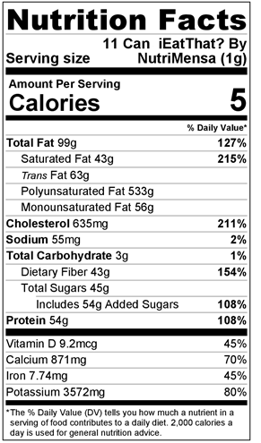
What’s the problem?
Dietary restrictions
Food Allergens
Impaired vision
Inability to read
Nutritional ignorance
Time
Notes:
Many people around the world have dietary restrictions. With the help of my app, they will be able to easily scan barcodes and see if the food item is within their dietary restrictions or not. This includes the 15 million Americans with food allergies. There are also many people that have impaired vision or are unable to read the small fonts that companies use on their nutrition labels. Many people are unaware of what it is that they are consuming. With the help of my app they will be saving time and be aware of what it is that they are consuming.

Slide 4
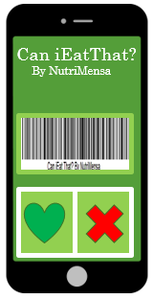
The Solution:
Phone application
Reads the nutrition facts for you
Tells you if you can consume the item
Saves time
Helps those who can’t see well
Stores dietary intake
Provides information about nutrients
Notes:
Here is my solution. My phone application Can iEatThat will read the nutrition facts to you, tell you if you are able to consume the product or not based off of dietary restrictions, save you time, helps those who aren’t able to see well, and store your dietary intake along with information about nutrients.

Slide 5
Description of Product
Apple/Android compatible
Setup an account with your email
Camera scans the barcode
Database has stored nutrition facts based on barcodes
Application will tell you if you can eat it or not based on your preferences
Notes:
I have made a product that will allow anyone to easily scan barcodes anywhere to get nutrition facts and see if they follow their dietary restrictions. The database will store the information based off of the barcodes and will tell you if you can or cannot eat the product based off of your preferences.

Slide 6
My Mission
Can iEatThat? by Nutri Mensa wants customers to be able to save time
have control over dietary intake, and prevent any danger from happening to those with food allergies.
Market research shows 100% of my target market brings their phone to the grocery store
Social Impact
Provide a reliable health tool that can be carried around in your pocket.
Notes:
Can iEatThat?’s mission is to help customers be able to save time, have control over their dietary intake, and prevent any danger from happening to those with food allergies. We provide a reliable health tool that can be carried around on your phone at all times and is easily accessible.

Slide 7
Business Model
Definition of One Unit
One Space of Advertisement
Description of Expenses
Variable Material Expenses | Total: $0.00
None | $0.00
Fixed Expenses | Total: $5,245.10
Depreciation | $10.10
Insurance | $125.00
Utilities/Rent | $100.00
Advertising | $10.00
Salary | $5,000.00
Economics of One Unit
Selling Price |  | $100.00
Cost of var. materials exp. | $0.00
Cost of labor | $10.10
Other variable costs | $0.00
Total COGS/ COSS |  | $10.10
Contribution Margin |  | $89.90
Monthly Break Even Units
$5,245.10 | = | 58.34 | ≈ | 58 units
$89.90
Notes:
My definition of one unit is one space of advertisment on my app. due to it all being technologically adavanced my variable materials are very low.. I mostly have startup prices rather than constant materials I have to buy. I would just have to maintain the app and collect funds, which only takes about 5 min.

Slide 8
Market Analysis
Market Statistics
Industry Name: | Phone Application | Annual Industry Sales: | $77 Billion
Description of Target Consumer
Demographics | Geographics
Parents Families Middle/Upper income | United States of America
Psychographics | Buying Patterns
Afraid to break dietary restriction | Holidays- food is being made. Summer/first few months of the year- people are trying to lose weight.
Target Market Size
Total Population
321 Million
Target Market Population
51 Million
Market Size
15 Million

Slide 9
Marketing and Sales
Email list
Social Media
Facebook
Twitter
Pinterest
Instagram
Guerilla Marketing
Street Art
Dollar marks
Stickers
Word of mouth
Website
Notes:
For Can iEatThat?’s marketing and sales, we will have a facebook, twitter, pinterest, and instagram because these social media platforms have a large portion of my target market. I will also be using guerilla marketing, like street art, dollar marks, and stickers.

Slide 10
Competitive Advantages
 |  | MyNetDuart PRO | ipiit
Cost | Free | 3.99 | Free
Dietary Possibilities | Extensive | Limited | Limited
Additional Features | Extra features | Limited features | Limited features
Your Competitive Advantages
1. The initial download of my app will be free 2. My app runs all food restrictions rather than limited/specific restrictions 3. My app has many more additional features compared to my competitors
Notes:
My app is by far the better product and the more reasonable price compared to my competitors. The initial download will be free, since it isn’t even my most important source of income. My app had more features such as my cart, my coupions, stores near me, top 10 products of the month, and it offers various amounts of languages.

Slide 11
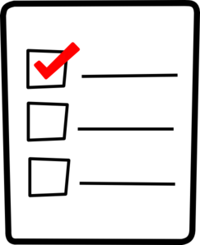
Qualifications
Current business owner
General coding knowledge
Multilingual
Will be pursuing a business degree
Have taken a Marketing and Entrepreneurship class
Notes:
I am qualified to run Can iEatThat? because I have taken a marketing and entrepreneurship class, I have general coding knowledge, I am going to pursue a degree in the health field, and I am multilingual.

Slide 12
Sales Projections
Gross Revenue
$121,500
Net Profit
$38,325
Total Units
1,215

Slide 13
Start-up Funds
Item | Why Needed |  | Cost
App developers | To create the app |  | $30,000.00
Apple/Google store | Cost to publish the app |  | $124.00
Paper | Advertisement |  | $19.00
Printer | Advertisement |  | Owned
Phone | Management |  | Owned
Computer | Management |  | Owned
 | Total Startup Expenditures |  | $30,143.00
 |  | Emergency Fund | $15,000.00
 |  | Reserve for Fixed Expenses | $15,800.00
 |  | Total Startup Investment | $30,800.00
ROI: Return on Investment
$38,325 | = | 124% | ≈ | $1.24
$30,800
ROS: Return on Sales
$38,325 | = | 32% | ≈ | $0.32
$121,500
Notes:
My app is very expensive since I have to get it done by professionals and pay company's to keep my app up. I plan to do guerilla marketing which is low-cost high effect advertisement,.

Slide 14
Future Plans
Add more features to Can iEatThat? By NutriMensa
Create more applications related to health
Philanthropy
Can iEatThat? will donate 5% of our yearly net profit to the National Psoriasis Foundation
Notes:
In the future I plan to add more features to Can iEatThat?, create more health related apps, and go public with NutriMensa with an initial public offering.
For my philanthropy Can iEatThat? will be donating 5% of our yearly net profit to the national psoriasis foundation. The natonal psoriasis foundation is very important to me because my little sister was recently diagnosed with psoriasis which has become tough with my family. I hope by msking these donations to the foundation that not only will I be helping my sister, but families like mine.

Slide 15
Don't live harder, live smarter!
Thank you for your consideration of
Can iEatThat? By NutriMensa
Contact:
Eademovic001@hotmail.com
Notes:
thank you for your consideration of Can iEatThat? by NutriMensa. contact me at anytime through my email and you are guaranteed a response. and remember don't live harder, live smarter!

