Slide 1
Divergence Dance Company, LLC
By: Nayelis Sanchez
Notes:
Hi , my name is Nayelis Sanchez and this is Divergence Dance Company.

Slide 2
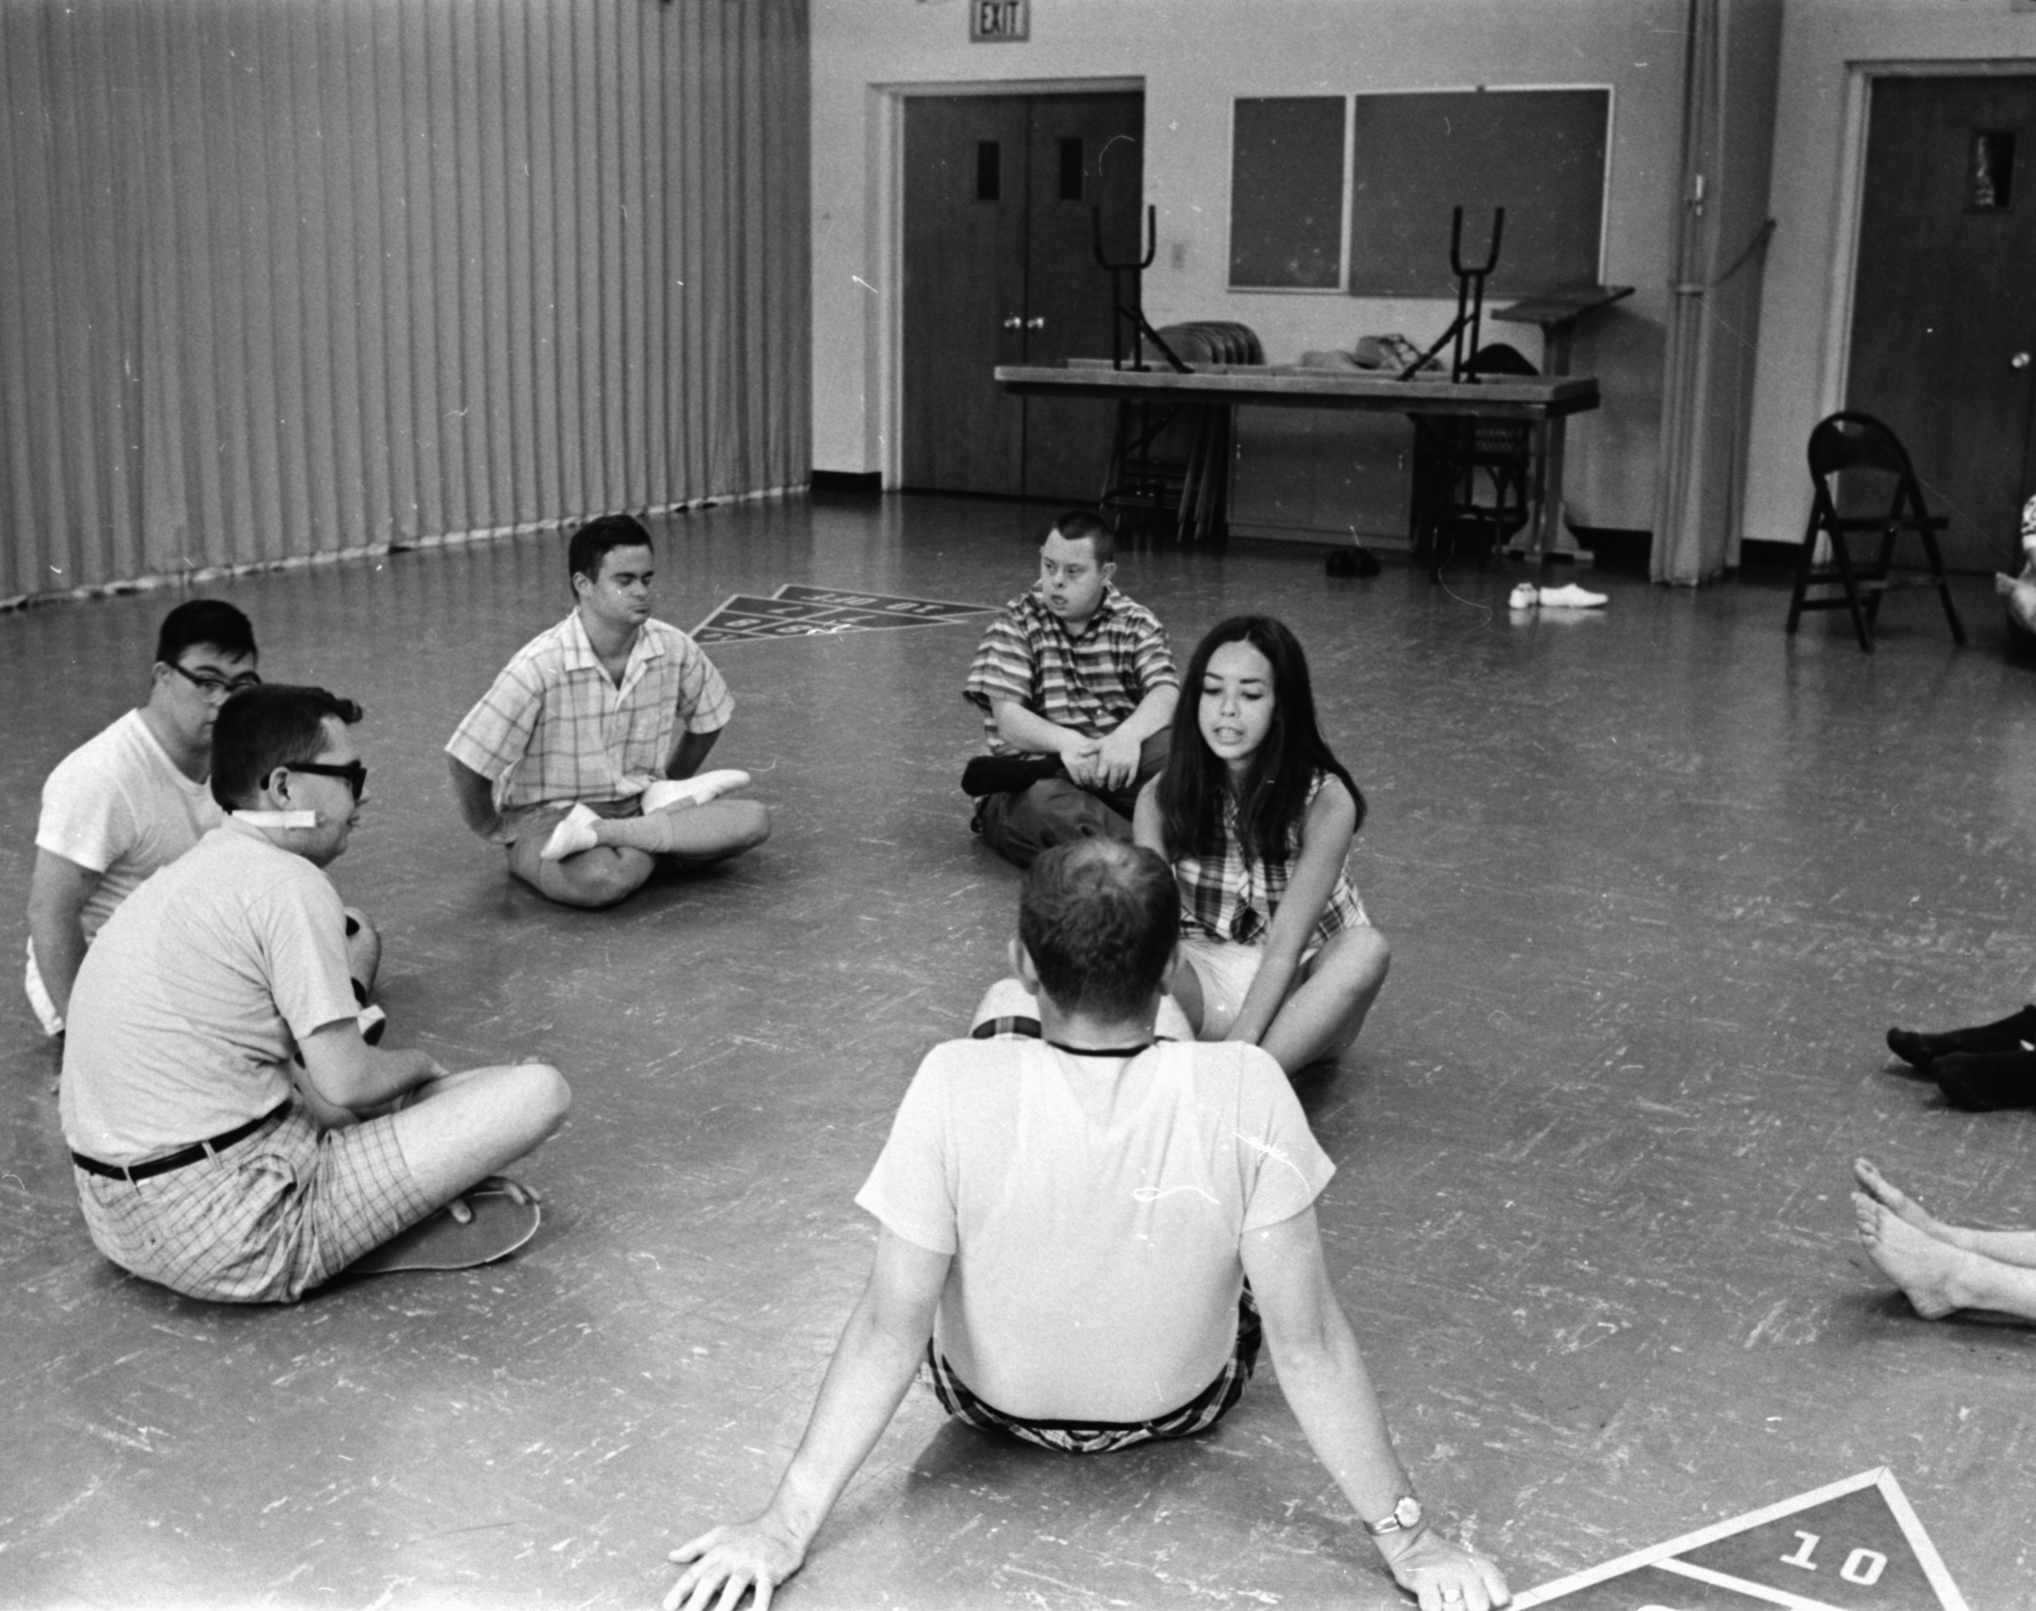
Unmeet Need
None in the Hartford area
Unique Encounter
Communication between Parents and child
Development of Child/teen
Notes:
Growing up my mom and I always focused on the development of my older sister Abelys . Who is currently 19 year old . She was born with a slight form of Autism . Autism as many may know is the impaired ability to communicate and interact. Although my moms options were minimum she in a sense felt alone. All we wanted was to find a fundamental place for my sister to interact , learn , and have a sense of accomplishment fed by her achievement by learning dance techniques/movement.

Slide 3
Notes:
Divergence Dance is a Dance Company that will provide a safe space for children and young adults with or without development disabilities. A place to gain confidence and admiration of unique skill constructed by movement.

Slide 4
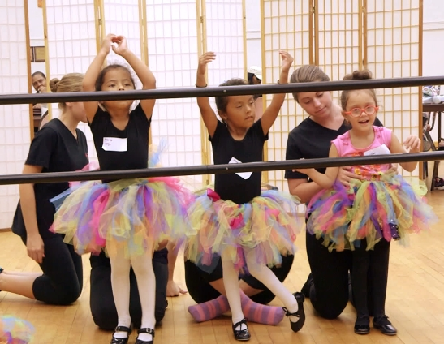
Located in the south end of Hartford
All Children/Young Teens are welcome
Studio Friendly
Educational
Notes:
Divergence Dance will be located in the south end of Hartford. At which will provide a Unique encounter with every single patient and a larger communication span for all types of people. Including parents and teens in current society. We will bring out the happiness and unique abilities of those children and young adults by providing a studio friendly movement space which will be open 3-4 days a week and the time will be determined based on the certain movement class presented on said date . In our company we understand the struggles as a parent and will do the best we can to positively impact the lives of these patients by combining movement , education , and self admiration into one.

Slide 5
Mission Statement:
Providing movement to unleash unique ability and community acknowledgement
Social Impact:
Movement is known to significantly improve behavioral, emotional, and social language skills
Notes:
Divergence Dance will be providing movement to unleash unique ability and society acceptance satisfaction for those children and young adults around the Connecticut area. Movement is known to significantly improve behavioral , emotional and social language skills by providing a healthy form of exercise that can relieve the minds of those parents and families in our current society.

Slide 6
Business Model
Definition of One Unit
One Jazz movement class of 6 children, 90 minutes a day , 3 days a week , for 1 School Year (Sept- May)
Description of Expenses
Variable Material Expenses | Total: $2.82
Water Bottle | $2.32
Rubber Wrist Band | $0.50
Fixed Expenses | Total: $26,990.00
Insurance | $1,200.00
Rent/ Utilities | $400.00
Advertising | $300.00
Depreciation | $90.00
Salary | $25,000.00
Economics of One Unit
Selling Price |  | $12,960.00
Cost of var. materials exp. | $2.82
Cost of labor | $2,908.80
Other variable costs | $36.00
Total COGS/ COSS |  | $2,947.62
Contribution Margin |  | $10,012.38
Monthly Break Even Units
$26,990.00 | = | 2.70 | ≈ | 3 Yearly Contracts
$10,012.38
Notes:
At Divergence Dance we have decided that our economics of one unit is actually a yearly contract. Even though our customers will be able to pay monthly, we feel it I very important to see and experience the special needs child improving not only throughout the course of the month but throughout the course of a school year. So, what I’ve planned to do is that we have 3 classes a week, 1 and a half hour each time for the month. As you can see my selling price is high it’s because there are 6 children in the class and I am pricing this out per class. $12,960.00 is my selling price for a Jazz dance class of 6 children. I can break it down for you and tell you that for each individual child their parent or family member can be paying $240.00 dollars a month which breaks down to at least $20.00 a class. You will see that most of it is my labor, but I do have a variable cost of $36.00 because over the course of the year I am driving back and forth to the dance studio so that is for my gas. Also, if you look at my materials you will see that for each 1 year contract the customer will receive a water bottle and rubber wrist band with the Dance Studio logo and contact information on it. So, when I subtract my cost it leaves me with a profit of $10,012 dollars with 38 cents per yearly contract and we are providing more than one dance class, but this is just one dance class of 6 children. My fixed expenses for the month is $26,990 dollars, and as you can see my rent/ utilities for the month is $400.00 dollars because I am only renting a dance class for about 2 hour 3 times a week. I also have depreciated some of my day to day equipment. Lastly, I also have liability insurance which will be $1,200.00 a month.
Sometime throughout this slide tell the judges that you wont be the only one in said dance class there will be an unpaid college internship who is interested in assisting the dance arena or the learning and development of children with disabilities.
Have about 100.00
Promote your design with most
Ages 5-25
Contribution margin most important number

Slide 7
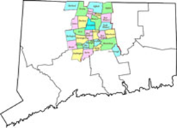
Market Analysis
Market Statistics
Industry Name: | Preforming Arts Companies | Annual Industry Sales: | $15 Billion
Target Market Size
Description of Target Consumer
Demographics | Geographics
Men and women Ages 25+ With children or family member with a disability Mid to high income | Hartford County
Psychographics | Buying Patterns
Opportunity Seeking Time Manageable Economical | Parents who want improvement emotionally, physically, and socially for their child
Total Population
892,000
Target Market Population
70,600
Market
Size
1,400
Notes:
Divergence Dance is the Preforming Arts Industry and Americans spend $35 Billion dollars on this industry every year.
Divergence Dance Company targets men and women ages 25 and up. In specific parents and or families with a child or family member with a disability. Also we target the mid to high income level citizens of the Hartford County who are seeking new opportunities and time manageable activities for the improvement and experience of their child.
So as you can see we started with the population of Hartford which is 892,000 . Then we narrowed it down and said that 8 percent of Hartford's population would have Disabilities in a certain form which would be 70,600 and finally we decided to concentrate on 2% of our target market for the first year.

Slide 8
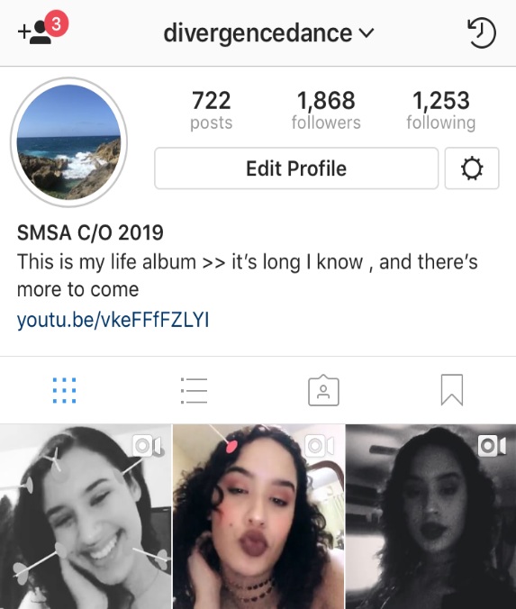
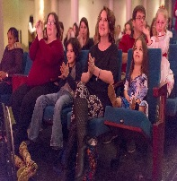
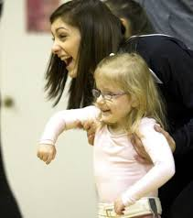
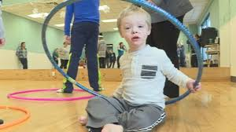
Marketing and Sales
Integrated Social Media Plan
Text Message Campaign
A YouTube Channel
Going live on Media- Recitals / Family Studio Days
Promotions on YouTube
A place where happiness rises and lives are changed, Welcome to the family
Notes:
Divergence Dance will market our service by having an integrated social media plan. We think that the target market will most often use Facebook, so the children and young adults will be posted on a daily basis. On Facebook we will put a link to Instagram. We have decided to also use Instagram because it is a way to showcase the children to the youth of our community , we will also be having the links to Facebook on our Instagram page . But one important thing that we will also include are the links to our YouTube page. Although we can market on Facebook and Instagram we think that YouTube is a fast and entertainable way to show recitals , small dances, family studio days just like as if we would also be having live performances on our Facebook or Instagram media depending on the date or occurrence of the performance . Lastly, along with YouTube we will be asking for paid promotions with large dance corporations or dancers like Matt Stefania , World of Dance and many more.
5 best ways to market and sell your product/service
Integrated social media plan
Word choice makes huge difference
All channels are speaking back to one
You are your market
Promoting on social media is free
Promoted post on ig
Text message campaign
Surveys
Its free
Social media paid promotions
Social media calendar
Build calendars ( New word of mouth ^^^^^^^)
Make a channel . Grab views , showing growth , show your screen shoot , put it on slide , promote it on your page .
ask for promotions
Show cases the students
Media release
Excellence of the students
Proud moment
Recital
Build it as a family
Website showing off the kids
Tip Tuesday with the students
About the dances
Have things scheduled
Life movements
Have the families share their accomplishments
Professional videos
Parents with kids day
Family fun day
Have it on the weekends

Slide 9
Competition
Unique Factors | Divergence Dance Company, LLC | GuiDance Dance Autism | Studio 860
Location | Local ( Hartford, Connecticut) | North Hollywood, California | Local ( Hartford, Connecticut)
Selection of Services | Jazz/ Hip Hop | Aroma and Touch Therapy Sessions, Rhythmic Combination Classes | Jazz, Hip-Hop, Modern, Pop
Group Size | 6-8 | 10-15 | 20-35
My Competitive Advantages
1. We are a local business 2. We offer a specific dance style 3. Smaller Group for a more 1-on-1 experience
Notes:
The unique factors that makes Divergence Dance different are location , selection services and group size . Even though there are many different types of dance studios around the Hartford area , their views and values in how they run their business is slightly different than ours. As you can see Studio 860 is local , its in the Hartford area but their mission statement focuses on the citizens of the community as a whole and not one specific target which in our case would be the children with special needs in their day to day life. In addition their group size Is way larger than the size of Divergence Dance Classes which in my opinion wouldn’t give the total attention and communication span between the teacher and former dancer. Also even though there is a company in similarity to Divergence Dance it is located In North Hollywood which isn’t accessible to others around the United States.
Although GuiDance does have regularly small classes they have volunteers , this would be an example of what I would want my company to be and grow to be but they are located in California and that’s what makes me different , I will be accessible to those in the Connecticut area

Slide 10
Qualifications
I am a part of my own target market
Experienced with special need individuals
Connections with dancers
Bilingual
Operational in the year 2024
Notes:
I am qualified to run this business because I am a part of my own target market. Growing up I've experienced and lived with patients who currently have development disabilities. Having experienced these things gives me the emotional and educational aspect of each patient at which can transfer and relate to many others . In addition I've danced for over 7 years and have connections with dancers from all over the country from Kim Stroud , Corrine Bates , Alexa Fleury and many more . Being bilingual will be a big aspect in my Dance Company for the simple reason that I can reach out and help a larger amount of parents in the Connecticut area. I believe I will be operational In about 6 years by completing a minor in the preforming of arts and majoring in an associates degree for special need teaching starting in 2019.
psychology class to understand how the minds of these children work overtime

Slide 11
Sales Projections
Total Units
50
Gross Revenue
$648,000
Net Profit
$151,758
Notes:
The Divergence Dance sales projections for the first operational year consist of 50 units. These unit are actually the number of yearly contracts we predict we will get on said month.
Our Gross Revenue is above and our total net profit for 1 year is on the far right. As you can see from the graph we can say that the number of units will increase starting in Sept. which will be when the parents will start to come across our company , which will be maintained throughout the school year and will take a peak in May to June when I could withhold more children and a possibility of having a series of classes throughout the day , mornings and afternoons.

Slide 12
Start-up Funds
Item | Why Needed | Cost
Computer/Cell Phone | Communication and book keeping | Owned
Movement Class Materials | Resources for the children/ young adults | $200.00
Car | Transportation from home to dance cite | Owned
Business Cards and Company Banner | For advertisement purposes | $210.00
LLC Paperwork Hartford, CT | Necessary to start business | $175.00
 | Total Start-Up Expenditures | $585.00
 | Emergency Fund | $2,000.00
 | Reserve for Fixed Expenses | $80,970.00
 | Total Startup Investment | $83,555.00
ROI: Return on Investment
$151,758 | = | 182% | ≈ | $1.82
$83,555
ROS: Return on Sales
$151,758 | = | 23% | ≈ | $0.23
$648,000
Notes:
Divergence Dance start up expenditures will cost $585.00. This will include , computer , phone , car , movement class materials like yoga mats and things like hula hoops and colorful banners due to the different kinds of dance classes presented to the customers , business cards and company banner and LLC Paperwork in Hartford Connecticut . Also , we will have emergency funds and the reservance of fixed expenses which will come to a total of Start-up Expenditures will cost $83,555.00 My Return on investment is 182 percent and my return on sales is 23 percent .

Slide 13
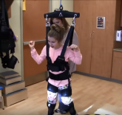
Future Plans:
Connect with schools
Buy specialized equipment
Philanthropy: Divergence Dance plans to donate 5% of our yearly net profits to AADD
Notes:
Divergence Dance future plan is to grow in studio size by the second operational year , connect with schools throughout CT, lastly buy specialized equipment for the company with the remainings of my net profit at the end of the year.
In addition Divergence Dance will also be donating 5 percent of our yearly net profits to All About Development Disabilities Organization in Georgia which focuses on needed services, broad-based education, and effective advocacy for children, adults, and families living with developmental disabilities. They constantly work on the building of strong communities that encourage and support all people to make informed choices, actively participate in activities and live in safe and positive environments.
Also have semi permanent volunteers could be from families or unpaid internships from colleges
Add the other things to buy braces.

Slide 14
Be Creative. Be Unique.
Be You.
THANK YOU FOR YOUR CONSIDERATION
Divergence Dance Company
Website Coming Soon!
Divergencedancellc@gmail.com
Notes:
Thank you for you consideration of Divergence Dance Company . Remember be creative , be unique , be you . Contact us at divergencedancellc@gmail.com.

