Slide 1
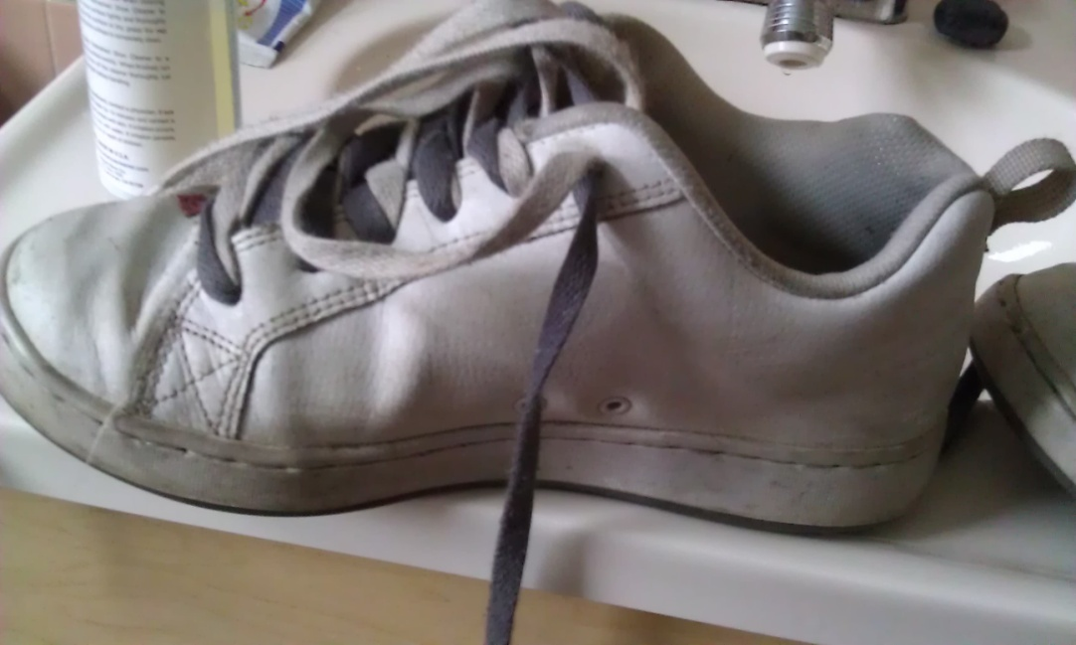
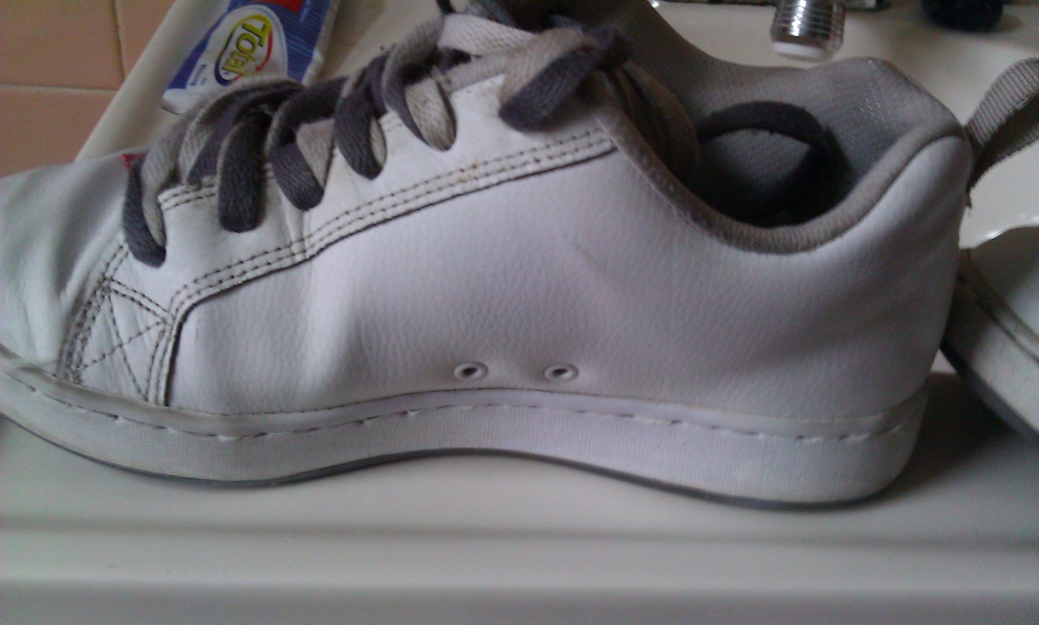
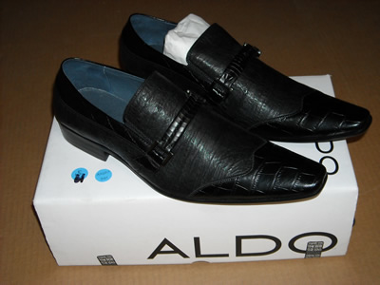
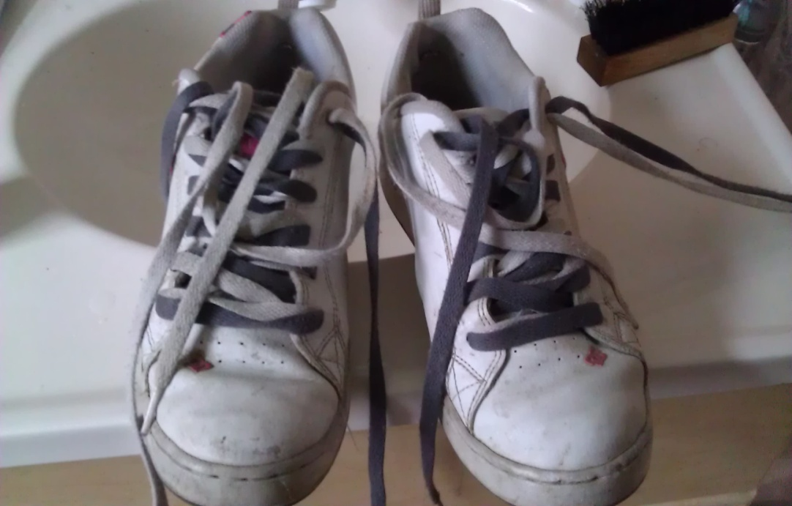
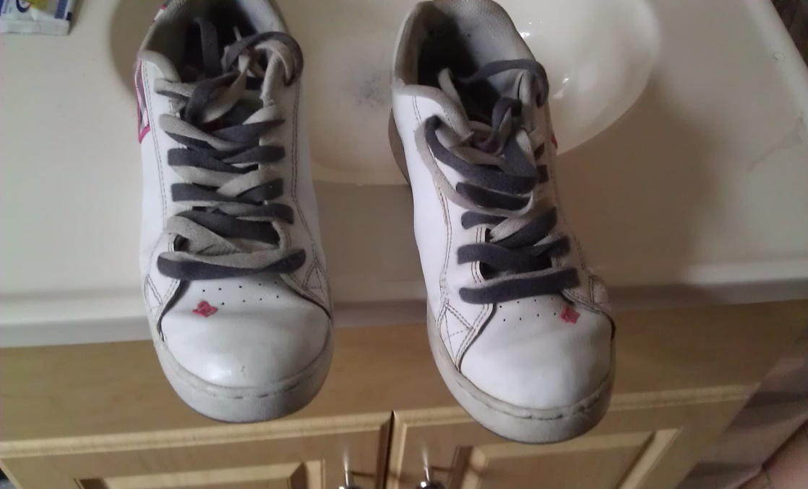
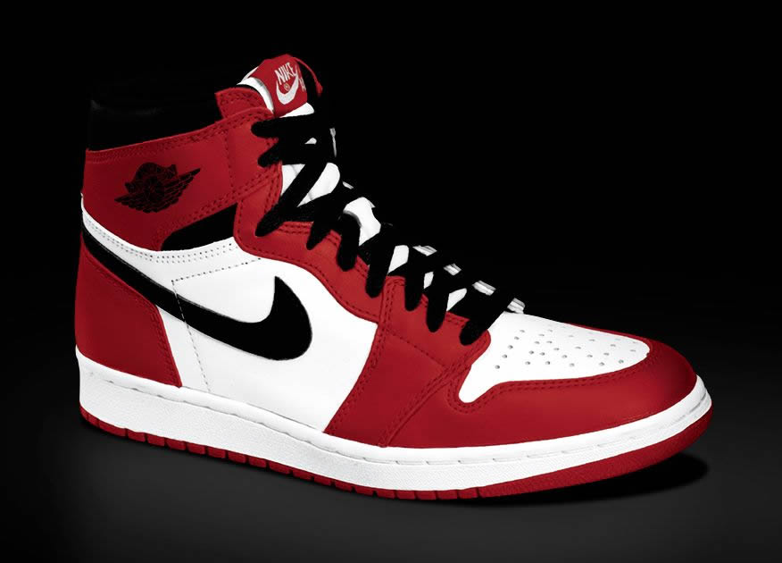
Notes:
Student Notes:
In 30 seconds, potential investors need to be taken through the four important questions on the slide. (Covered on pgs. 140-141 and 146.)
Strategy
Follow these guidelines in preparing your 30-Second Pitch:
Attention: Capture the audience’s attention. Remember that you are competing against numerous distractions.
Excitement: Once your audience is paying attention, get them excited about you and your company.
Engagement: Once the audience is excited, help them imagine becoming involved with you and your company.
Action: Get potential investors to spend time with you to learn about your company, your product, and the investment opportunity.

Slide 2
Fresh Out Of The Box Shoe Clean Comp.
Quintin Reed
Sports & Medical Sciences Academy
Hartford, CT
Notes:
Student Notes:
Make sure your business’s name is clearly shown. Try to show it on one line, without squeezing. If you break your business name over a few lines, make sure to think about where you break the business name.
Optional: Add a few words to describe the type of business if it isn’t obvious from the name. Example: If your business name is “Green Things” you could add “A Landscape Design Company.”
If your business is a partnership or a corporation, you may need to list multiple entrepreneurs on this slide.
As you work on your final presentation, feel free to change the font size, if you need to, when you are asked to fill in answers between brackets. Remember, you don't want to make the type too small. Your audience might have difficulty reading your presentations.
For your presentation you can delete all the notes on this template and replace them with notes that will help with your final presentation.

Slide 3
Mission Statement
Mission Statement
To provide a fast service to those who want or need their shoes, sneakers or boots; polished, cleaned and shined.
Opportunity
Based off of my market survey, 90% said that they don’t know about any shoe cleaning business and would pay a reasonable price for them to be cleaned.
Notes:
Student Notes:
Sometimes judges (or investors) don’t know exactly what you are selling. You have the opportunity in this slide to present your product or service in a clear and compelling way. Sell it! You can show sample products, your brochures, portfolios, or flyers. You need to articulate the unique features of your product or service and how it will benefit your customers. It’s show time during this slide!
Mission statements are covered on pg. 194.
Recognizing business opportunities is covered on pgs. 147-160
Business Plan Exercises
This slide relates to the following business plan exercises:
Section 4.1: “Business Communications.” In Biotech or pg. 251 in the Business Plan Project (Student Activity Workbook). Helps you develop a motto, slogan, or mission and your business card.
If you are using the Business Plan Project (in the Student Activity Workbook), do the exercise on pg. 264, “Begin Filling in Your Business Plan.”
Section 6.2: “Business Opportunity.” In Biotech or pgs. 265-266 in the Business Plan Project (Student Activity Workbook). Leads you through a SWOT analysis of your business opportunity.

Slide 4
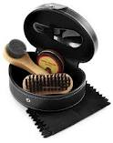
Business Profile
Service
Provide shoe cleaning or polishing to sneakers, shoes and boots.
Sole Proprietorship
Cleaning or polishing footwear does not require many people since it is a small business with a small clientele. Also with a partner I would have to split profit, which is not to great, with them.
Notes:
Student Notes:
Types of Business
Your business might be a combination of two types of business or more. For example, if your business makes baskets, it would be considered a manufacturing business. If you also sell directly to consumers, you would be a retail company as well. And, if you offer lower prices for bulk orders to a local store, you also operate as a wholesale business. So you would be a retail-wholesale-manufacturer. (Covered in Section 3.1, pgs. 51-55.)
Most student businesses are either a sole proprietorship or a partnership. (Covered in Section 3.2, pgs. 56-65.)
The type of business you choose will affect the Economics of One Unit (Slide 14) and the Projected Annual Income Statement (Slide 19).
Assessments
You can complete these self assessments (either in Biotech or the Business Plan Project in your Student Activity Workbook ) to evaluate your response to various types of business and business ownership.
Section 3.1: “Type of Business.” In Biotech or pgs. 240-242 in the Business Plan Project (Student Activity Workbook).
Section 3.2: “Type of Business Ownership.” In Biotech, or pgs. 244-246 in the Business Plan Project (Student Activity Workbook).
Business Plan Exercises
This slide relates to the following business plan exercises:
Section 3.1: “Type of Business.” In Biotech or pg. 243 in the Business Plan Project (Student Activity Workbook).
Section 3.2: “Type of Business Ownership.” In Biotech or pg. 247 in the Business Plan Project (Student Activity Workbook).

Slide 5
Qualifications
I’m qualified to run this business because:
I plan to have a degree in Small Business
I am all ready operational
I have enough in my equity to help with start up costs
Have taken a Marketing/ Entrepreneurship class
Notes:
Student Notes:
Chapters 1 (pgs. 4-21), 2 (pgs. 26-45), and 4 (pgs. 74-97) deal with the characteristics of an entrepreneur and specific knowledge and skills required by entrepreneurs.
For qualifications, consider what you are passionate about and what unique knowledge you may possess. Assess not only your own skills, but those of your network of friends and family.
Assessments
Section 4.1: “Communicating in Business.” In Biotech or pgs. 248-250 in the Business Plan Project (Student Activity Workbook).
Section 4.2: “Assessment: Negotiating.” In Biotech or pgs. 252-253 in the Business Plan Project (Student Activity Workbook).

Slide 6
Market Analysis
Industry Name | Repair and Maintenance
Industry Size | $ 2.2 Million
Total Population | Hartford City, Connecticut has a total population of :3,574,097
Target Market | Males between the ages of 15 to 19
Potential Market | Students in my school and in Hartford
Total Population
3,574,097
Target Market
128,949
Potential Market
200
Notes:
Student Notes:
Market research is covered in Section 7.1 (pgs. 167-175).
Business Plan Exercises
This slide relates to the following business plan exercises:
Section 7.1: “Market Research.” In Biotech or pgs. 267-269 in the Business Plan Project (Student Activity Workbook).
Online Sources of Marketing Information
www.bizstats.org – For information on specific industries (such as average sales, average Return on Sales, etc.)
www.zipskinny.com – Provides a detailed profile of a market by ZIP code
www.chamber of commerce.com – Local demographic info and business support services
www.census.gov – Click “American Fact Finder” for search options.
www.claritas.com – Focuses on market segmentation.
Calculating the Target Market
Multiply the Total Population by the percentage of the population with the characteristics of the target market (age, gender, average household income, etc.).
Calculating the Potential Market Size
Research a sample of your target market to see what percentage would be willing to try your product or service. Multiply the Target Market by the percentage who would be willing to try your product/service.
Multiple Markets
This slide analyzes one market, but a business can have multiple markets. For the purposes of this business plan, use this slide to analyze only the primary market.
Period of Time
In the course of the five years covered by a typical Business Plan, a business’s market can change. For the purposes of this business plan, use this slide to analyze your market for the first year only.

Slide 7
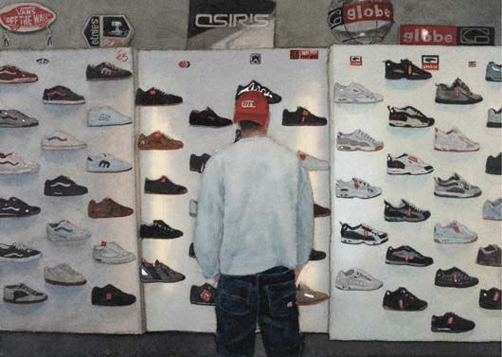
Target Market Segment
Demographics
Ages 15- 19, males in high school
Geographics
Hartford Public Schools
Psychographics
Lively lifestyle, hangs with friends often
Buying Patterns
Check on new sneaker release dates. Is going to spend expensively on each pair of sneakers.
Notes:
Student Notes:
Targeting your market is covered in Section 7.1 (pgs. 170-171).
The more detail, the better!
Demographics and geographics help communicate who will buy. Sources for demographic and geographic data were shown on the previous slide, “Market Analysis.”
Psychographics communicate what makes your target market want to buy.
Multiple Market Segments
Often a product or service will be sold to more than one target market segment. For the purposes of this business plan, use only your primary target market.
Conducting Surveys
You can conduct primary research, such as a written or web-based survey (www.surveymonkey.com), to learn more about your customer’s purchasing behavior. The article, “How Marketing Plans Work,” lists sample questions you can ask to gain psychographic information from customers. It’s available at:
http://money.howstuffworks.com/marketing-plan14.htm.
Psychographic Data
Other sources of psychographic data:
www.quirks.com/topics/psychographic.aspx
www.magportal.com/cgi/search.cgi?Q=psychographic+studies&s=0&c=30&x=31&y=7

Slide 8
Competitive Advantage
Factors
Kiwi
Shoe MGK
FOOTB
Price
High
High
Low
Quality of
Product/Service
Depends
Depends
Good
Location
At your house
At your house
At my house
Reputation/Brands
High
Low
Low
Unique Factors/
Knowledge
Cleaning products
Cleaning products
Cleaning products
Notes:
Student Notes:
Targeting your market is covered in Section 7.2 (pgs. 177-186).
Business Plan Exercises
This slide relates to the following business plan exercises:
Section 7.2: “Competition” and “Competitive Advantage.” In Biotech or pgs. 270-273 in the Business Plan Project (Student Activity Workbook).
Greatest Strength/Greatest Weakness
In relation to your business, what is your major competitor’s the greatest strength? Greatest weakness?
Your competitive advantage should be positioned to exploit a competitor’s weakness or a consumer need/want being neglected by other competitors. It may include strategy the competition can’t duplicate very easily. It should be sustainable competitive advantage that goes beyond price.
Possible Research Site
http://finance.yahoo.com – Provides information regarding major companies in various industries, as well as general industry information.

Slide 9
Marketing Mix
People
Product
Place
Price
Promotion
Males, who enjoy wearing and keeping their sneakers or shoes as presentable as possible
Business Cards
Word of mouth
Website
My house
A clean pair of shoes or sneakers
$5.00 for a first time customer; $10.00 every other time
Notes:
Student Notes:
How to develop your marketing mix is covered in Section 8.1 (pgs. 211-222).
Business Plan Exercises
This slide relates to the following business plan exercises:
Section 8.1: “Marketing Plan” and “Pricing Strategy.” In Biotech or pgs. 274-280 in the Business Plan Project (Student Activity Workbook).
5 Ps
This slide allows you to explain the rationale for each of your 5 Ps. There will be room for further explanation. Don’t put all your thoughts on this slide. Use it to highlight key words.
People: Explain who your business serves and what employees are required to carry out the marketing plan. (Example: “Customers: Students using phones. Marketing employees: People who can know the student phone market.”)
Product: Explain the major benefit of your product or service. (Example: “T-shirts with Velcro pockets. No more broken phones!”)
Place: Explain why you chose this place. (Example: “Direct sales at events. Create word of mouth.”)
Price: List the price and explain why you chose it. (Example: “$15, Great value for colorful, all-cotton T-shirt.”)
Promotion: Explain your strategy for creating awareness of your product/service. (Example: “Concerts, sporting events, Web campaigns, contests”)

Slide 10
Promotional Mix
Promotional Expense
Monthly
Amount
Advertising
Business cards
$ 2.00
Publicity
Word of mouth, Website
$ 0.00
Personal Selling
Wearing Clean shoes publicly
$ 0.00
Sales Promotion
First time customers pay $5.00, Volume discounts
$ 0.00
Total Monthly Promotional Expense
$ 2.00
Notes:
Student Notes:
Promoting Your Product is covered in Section 8.2 (pgs. 223-232).
The principles of personal selling are covered in Section 9.1 (pgs. 239-247).
The Total Monthly Promotional Expenses will be shown on the “Average Monthly Fixed Expenses” slide, under “Advertising.”
Write keywords about your plan for using a particular type of promotion in the spaces provided. Show only the types of promotion you will be using. So, for instance, if you don’t plan on using “Sales Promotion,” don’t include it on your slide.
Other Types of Promotional Expense
This includes visual merchandising, public relations, and any other type of promotion not covered by the first four types.
Business Plan Exercises
This slide relates to the following business plan exercises:
Section 8.2: “Promotional Mix.” In Biotech or pgs. 281-287 in the Business Plan Project (Student Activity Workbook).
Section 9.1: “Selling Your Product or Service.” In Biotech or pgs. 288-290 in the Business Plan Project (Student Activity Workbook).

Slide 11
Cost of Materials/Labor
Description of One Unit of Sale:
One clean pair of shoes
Materials
Material Description | Cost/Total Quantity | Cost per Unit
Cleaning supplies | $ 40.00/ 4 cleaning supplies | $ 1.05
Paper towels | $ 6.97/ 8 Brawny Paper towels. | $ 0.02
Total Material Cost per Unit |  | $ 1.07
Labor
Labor Cost per Hour | Time (in Hours) to Make One Unit | Labor Cost per Unit
$ 8.25 | 10 min. or .16 hr. | $ 1.36
Total Labor Cost per Unit |  | $ 1.36
COGS (per Unit) | $ 2.43
Notes:
11
Student Notes:
Variable expenses are covered in Section 10.1 (pgs. 272-273).
Units of sale are discussed in Section 10.2 (pgs. 275-276)
“COGS (per Unit)” will be used in the next slide, “Economics of One Unit.”
Labor Costs
This calculation only include the time spent actually building a product or providing a service. It does not include such things as time spent passing out flyers, selling, shopping for materials, sweeping floors, or billing customers.
Types of Businesses
Service businesses might not have any materials cost. Don’t show “Materials,” if materials are not part of your unit of sale.
Wholesale and retail businesses typically don’t have any labor costs. Don’t show “Labor,” if labor is not part of you unit of sale.
COGS
COGS (“Cost of Goods Sold”) is appropriate for wholesale and retail businesses. For services businesses, change this to “COSS” (“Cost of Services Sold”). For manufacturing businesses, change this to “COGMS” (Cost of Goods Manufactured and Sold”).
Business Plan Exercises
This slide relates to the following business plan exercises:
Section 10.2: “Economics of One Unit of Sale” and “Estimating Variable Expenses.” In Biotech or pgs. 297-298 in the Business Plan Project (Student Activity Workbook).
Preparing Your Final Slide
Formulas are shown in red type. Replace the red formula with the appropriate calculation (make sure to change the font color to black).

Slide 12
Economics of One Unit
Description of One Unit of Sale:
One clean pair of shoes
Selling Price (per Unit) | $ 10.00
COGS (per Unit) | $ 2.43
Other Variable Expenses (per Unit) | $ 0.00
Total Variable Expenses (per Unit) | $ 2.43
Contribution Margin (per Unit) | $ 7.57
Notes:
Student Notes:
The economics of One Unit of Sale is covered in Section 10.2 (pgs. 275-282).
“COGS (per Unit)” is calculated in the previous slide, “Cost of Materials/Labor.”
“Contribution Margin” is discussed on page 276 of the textbook. It is the amount per unit remaining after all the variable expenses are subtracted from the sales price.
Definition of a Unit
This is what the customer actually buys from you. It is the minimum number and type of product or service you are willing to sell to a customer. For example, if you are selling sunglasses, your unit of sale would be one pair of sunglasses.
COGS
COGS (“Cost of Goods Sold”) is appropriate for wholesale and retail businesses. For services businesses, change this to “COSS” (“Cost of Services Sold”). For manufacturing businesses, change this to “COGMS” (Cost of Goods Manufactured and Sold”).
Other Variable Expenses (per Unit)
This includes such things as commissions and shipping & handling.
Addition/Subtraction Process
Add the Total COGS (per Unit) and the Other Variable Expenses (per Unit) to calculate the Total Variable Expenses (per Unit).
Subtract the Total Variable Expenses (per Unit) from the Selling Price (per Unit) to calculate the Contribution Margin (per Unit).
Business Plan Exercises
This slide relates to the following business plan exercises:
Section 10.2: “Economics of One Unit of Sale.” In Biotech or pg. 298 in the Business Plan Project (Student Activity Workbook).

Slide 13
Average Monthly Fixed Expenses
Fixed Expense | Average Monthly Expense
Salary | $ 15.00
Advertising | $ 2.00
Total Average Monthly Fixed Expenses | $ 17.00
Notes:
Student Notes:
Fixed expenses are covered in Section 10.1 (pgs. 269-272).
The “Projected Yearly Income Statement” slide refers to these fixed expenses as “operating expenses.”
To learn what typical salaries are for your employees go to http://www.salary.com/
Business Plan Exercises
This slide relates to the following business plan exercises:
Section 10.1: “Fixed Operating Costs.” In Biotech or pgs. 295-296 in the Business Plan Project (Student Activity Workbook).

Slide 14
Time-Management Plan Schedule for a Typical Week
Total Hours in a Week = 168
Notes:
Student Notes:
Time management is covered on pages 102-103.
The amount of hours you can spend on your new business directly affects other important decision making (such as your yearly projected sales, selling price per unit, monthly break-even, etc.).
Adding Your Data
This Slide contains sample data only. To change your times: If you are using PowerPoint 2007 and 2010: Right-click on any of the bars in the chart and select Edit data. A spreadsheet appears containing the data used in the chart. Edit the data and close the spreadsheet. The bar chart will be changed. If you are using PowerPoint 2003: Right-click on the chart and select Chart Object/Edit data. Click the data sheet tab and edit your the data. When you close the spreadsheet, the bar chart will be changed
Determining Your Capacity
Once you have defined the number of hours you have to work at your new business each week, determine how much time you will spend managing the business, selling to customers, and building the product or providing the service. For example, imagine a retail manufacturer of T-shirts who plans to spend 10 hours a week work in on the business. If it takes 1 hour to make a T-shirt, only 10 T-shirts can be made per week. This assumes that all the allotted time is spent making shirts. You need to consider the time it takes to sell shirts as well as managing the business (keeping records, making flyers, shopping for supplies, etc.). Perhaps only 6 hours a week can be spent making T-shirts, with the rest of the time spent managing the business and selling shirts. Your capacity for the month would be 24 T-shirts.
Increasing Your Capacity
You can increase your capacity by working more hours at the business or by hiring people to do work that you would normally do (which, of course, increases your costs).

Slide 15
Monthly Sales Projections First Year
Total Units Sold
70
Notes:
Student Notes:
Estimating sales is covered in Section 9.2 (pgs. 249-258).
Monthly sales projections are directly related to your capacity (discussed on Slide 16).
Your monthly sales projections will directly relate to the “Projected Yearly Income Statement” slide.
For the purpose of this slide show, show only the monthly sales projections for your first year.
Business Plan Exercises
This slide relates to the following business plan exercises:
Section 9.2: “Sales Forecasting.” In Biotech or pg. 291-294 in the Business Plan Project (Student Activity Workbook).
Adding Your Sales Information
This Slide contains sample data only. To change the “Units Sold” amounts on the graph, right-click on the chart, choose Worksheet Object/Edit, and select the Sales Projections Data sheet. Click the Sales Chart tab when you are finished, then click anywhere outside the Sales Chart to return to your Slide.
Multiple Products
If you have multiple products, you could chart only your primary product or, if your products were comparably priced, you could add all your products sold in a month and chart that amount. If you are more skilled with Excel, and have only a few products, you could use a separate color to represent sales of each product. (But don’t forget to use a legend to identify the colors representing the various products.)
Sales Assumptions
Along with your capacity (see Slide 16), keep these sales assumption in mind as you build your sales projections. You should explain them as you discuss your projections.
“Extent of Market Interest.” How interested is your target market in your product or service? Will it sell in a high or low volume. Why? Is it new and trendy? A high-end exclusive product likely to sell in low quantities? A low-cost mainstream product likely to sell in high quantities?
“Seasonality.” Are there times of the year when sales will be higher or lower than other times? When is the busiest time for you? The least busy?

Slide 16
Monthly Break-Even Units
Monthly Fixed Expenses
=
Monthly Break-Even Units
Contribution Margin per Unit
$ 17.00
=
2
$ 7.57
In an average month, the company will begin to make a profit after selling units.
2
Notes:
Student Notes:
Income statements are covered in Section 12.2 (pgs. 333-336).
Your Monthly Fixed Expenses comes from the “Average Monthly Fixed Expenses” slide.
Business Plan Exercises
This slide relates to the following business plan exercises:
Section 12.2: “Break-Even Analysis” and “Break-Even Point.” In Biotech or pg. 307 in the Business Plan Project (Student Activity Workbook).

Slide 17
Projected Yearly Income Statement First Year
Selling Price per Unit | $ 10.00
Number of Units Sold | 70
Total Sales | $700.00
Variable Expenses | $170.10
Contribution Margin | $529.90
Fixed Operating Expenses | $ 204.00
Pre-Tax Profit | $325.90
Taxes @ 15% | $48.88
Net Profit | $277.02
Notes:
Student Notes:
Income statements are covered in Section 11.1 (pgs. 289-303).
The “Monthly Sales Projections” slide relates directly to the number of units you plan to sell.
Your Variable Expenses per Unit comes from the “Economics of One Unit” slide.
Your Monthly Fixed Expenses comes from the “Average Monthly Fixed Expense” slide.
For the purpose of this slide show, show only the monthly sales projections for your first year.
Business Plan Exercises
This slide relates to the following business plan exercises:
Section 11.1: “Income Statements and Cash Flow.” In Biotech or pg. 299-303 in the Business Plan Project (Student Activity Workbook).
Multiple Products
If you have multiple products, project the sales of each product and add these together to obtain your total sales. Then multiply each product’s COGS by the number of units of that product you will sell, and add these all together for your Total COGS.
If Your Net Profit is Huge
Double-check your sales projections to make sure they are realistic.
Add more costs into running the business (for example, rent to parents, paying a portion of the utilities, etc.)
Consider additional costs that can enhance the business (monthly insurance fees, brochure development, Website hosting, etc.)
Preparing Your Final Slide
Delete the first column showing the red row labels. Replace the red formulas with the appropriate calculation (make sure to change the font color to black).

Slide 18
Start-Up Investment
Start-Up Expenditures
Item | Where Will I Buy This? | Cost
Office Supplies | Wal-Mart | $ 14.97
Business cards | Vista-Print | $ 10.00
Cleaning Supplies | Wal-Mart | $ 40.00
Total Start-Up Expenditures |  | $ 64.97
Cash Reserves
Emergency Fund | $ 35.00
Reserve for Fixed Expenses | $ 51.00
Total Start-Up Investment
$ 150.97
Notes:
Student Notes:
Start-up investment is covered in Section 13.1 (pgs. 347-353).
Monthly fixed expenses (used in calculating your Reserve for Fixed Expenses) comes from the “Average Monthly Fixed Expenses” slide.
Business Plan Exercises
This slide relates to the following business plan exercises:
Section 13.1: “Start-Up Investment.” In Biotech or pgs. 308-309 in the Business Plan Project (Student Activity Workbook).
Start-Up Expenditures
It’s easy to underestimate the types of things you need to start a business. This can include: the initial inventory, your first run of marketing materials, initial office supplies, business registration fees, insurance fees, legal fees, copyright or trademark registration. Classes, certifications, licenses, etc. High start-up expenditures are a common barrier to starting many types of businesses. If you predict that you’ll be highly profitable, build in more start-up expenditures. This will make the business appear more realistic to judges or investors.
Emergency Fund
Experts say this should be half the amount of the Total Start-Up Expenditures.
Reserve for Cash Reserves
Experts say this should be enough to cover your fixed expenses for at least three months. So, to calculate your Average Monthly Fixed Expenses (from Slide 15) by 3.
Valuing Your Time
Entrepreneurs should always place a value on their time. Estimate how much time you’ll spend planning and developing your business before you sell your first product or service. Multiply this by an hourly rate that you would get working at a job. This is the dollar amount of the time invested in starting your business. It’s your “sweat equity.” You can mention your sweat equity in you presentation as a way to indicate how passionate you are about the idea and its potential. However, it’s the price that an entrepreneur pays for launching a new venture. It would be unrealistic to seek compensation for your sweat equity. The success of your business will be your compensation!
Preparing Your Final Slide
Calculate your Total Start-Up Investment by adding A, B, and C. Make sure to show it with a dollar sign. Delete the red formula and the red letters from your final slide.

Slide 19
ROS & ROI
ROS: Return on Sales
For My Business: | Dollar Equivalent =
$ 277.02
$ 700.00
X 100 = 39%
$0.39
ROI: Return on Investment
For My Business: | Dollar Equivalent =
$277.02
$150.97
X 100 = 183%
$1.83
Notes:
Student Notes:
ROI and ROS are covered in Section 12.1 (pgs. 321-331).
The “Projected Yearly Income Statement” slide relates directly to these two ratios.
The “Start-Up Investment” amount comes from the previous slide, “Start-Up Investment.”
Business Plan Exercises
This slide relates to the following business plan exercises:
Section 12.1: “Return on Sales (ROS)” and “Return on Investment (ROI).” In Biotech or pg. 306 in the Business Plan Project (Student Activity Workbook).
ROS
Return on Sales enables you to communicate how efficiently you’re creating wealth. The “Dollar Equivalent” shows the amount of profit you earn for every dollar of sales. For example, a 30% ROS would mean that $0.30 of every dollar is profit.
Preparing Your Final Slide
In the red formulas, fill in the appropriate amounts for your business and change the font color of the red formula to black. (The top, black formula remains on your final slide so you will have a record of the formula you used to calculate your ROS and ROI.).

Slide 20
Financing Strategy
Total Start-Up Investment
$ 150.97
Source | Amount | Debt | Equity | Gift
Personal Savings | $150.97 |  | x
Totals | $150.97
Notes:
Student Notes:
Obtaining Financing is covered in Section 13.2 (pgs. 355-363).
Total Start-Up Investment comes from the “Start-Up Investment” slide.
Business Plan Exercises
This slide relates to the following business plan exercises:
Section 13.2: “Break-Even Analysis” and “Break-Even Point.” In Biotech or pgs. 310-314 in the Business Plan Project (Student Activity Workbook).
Obligations
One thing to keep in mind when you consider financing strategies is what you obligation is to the person or business who provided your financing. A debt must be repaid in a fixed amount of time, in set payments, at a certain rate of interest, no matter whether the business is profitable. Equity is an exchange of capital for ownership in the business. Investors understand that the business may not be profitable, but if it is, they will be entitled to a percentage of the profit. Shareholders may also wish to share in the decision-making for the company.

Slide 21
Business Responsibility & Philanthropy
Philanthropy
As my business grows I will ask my loyal customers if they will donate their old shoes to me so I can then give them to Kiducation.
Business Responsibility
I simply ask from our customers if they would be willing to donate their old shoes, to us, so we can then give them to "Kiducation“ Also I donate 10% of my net profit to the foundation.
Notes:
Student Notes:
Social responsibility and philanthropy are covered in Section 5.2 (pgs. 115-128).
Be Creative
Start-ups are usually strapped for cash. Be creative in your philanthropy. The effort should be in line with the business or your personal interests. Consider how much your time and talents are worth if they were donated to a particular cause. For example, 5 hours per month of tutoring at $20/hour is an “in-kind donation” of $1,200 a year.
Assessments
Section 5.1: “Ethical Business Behavior.” In Biotech or pgs. 255-257 in the Business Plan Project (Student Activity Workbook).
Section 5.2: “Socially Responsible Business & Philanthropy.” In Biotech or pgs. 258-260 in the Business Plan Project (Student Activity Workbook).
Business Plan Exercises
This slide relates to the following business plan exercises:
Section 5.2: “Social Responsibility.” In Biotech or pg. 261 in the Business Plan Project (Student Activity Workbook).

Slide 22
Business & Personal Goals
Business
Personal
Plan to expand to other schools, as well a other items of clothing
Graduate High school and begin at a Community College
Short-Term
Raise enough money to move into a store front and have a staff of at least five cleaners as well as office manager
Move to a four year college to major in Kinesiology and minor in Liberal Arts
Long-Term
Notes:
Student Notes:
Goal setting is covered in a special section on pages 132-133.
Planning for business growth is covered in Section 21.1 (pgs. 559-566).
The challenges of growth are covered in Section 21.2 (pgs. 567-570).
Exit strategies are covered in Section 22.2 (pgs. 587-598).
Short-Term Vs. Long-Term
Short-term goals are those goals that you set for the next one or two years. Long-term goals can focus on goals that range from 3 years or longer. Remember to relate your goals to your business idea. Make sure you take the steps you to take to meet your long-term goals (certificates, permits, licenses, etc.)
Business Plan Exercises
This slide relates to the following business plan exercises:
Section 21.1: “Planning for Business Growth.” In Biotech or pgs. 351–352 in the Business Plan Project (Student Activity Workbook).
Section 21.2: “Challenges of Growth.” In Biotech or pgs. 353–355 in the Business Plan Project (Student Activity Workbook).
Section 22.1: “Franchising & Licensing.”” In Biotech or pg. 356 in the Business Plan Project (Student Activity Workbook).
Section 22.2: “Exit Strategies.” In Biotech or pgs. 357–362 in the Business Plan Project (Student Activity Workbook).

Slide 23
Your going to want new socks!
Thank you for your consideration of
Fresh Out Of The Box
Schedule appointments at FreshOOTB@gmail.com
Visit at www.FreshOOTB.webs.com
Notes:
Student Notes:
Remember to thank your audience.
This is your last chance to remind the audience of your company’s slogan and its name. Say them slowly. Don’t rush through your closing screen.

