Slide 1
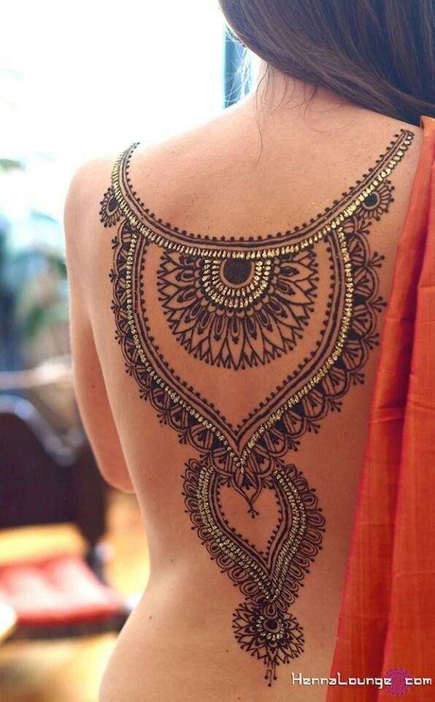
Notes:
Natasha: Studies show that about 50% of people who get tattoos regret having ever got them.
Fatima: We can provide you with a beautiful tattoo without the consequences that come with the permanent marks and regrets.

Slide 2

Holy Henna!
Natasha Khalid & Fatima Velic
Notes:
Natasha: Good morning/Afternoon. I am Natasha Khalid.
Fatima: I am Fatima Velic and this is our business, Holy Henna!

Slide 3
The Problem
There aren’t many places that do henna designs
People don’t know how to do henna for themselves
People want tattoos, but not permanent ones
Notes:
Natasha: The problem that we are trying to fix is that there are people who want to get a tattoo, but aren’t sure if they can commit to the permanent mark on their body. Henna helps them with getting a visual preview of what the tattoo would look like.
Fatima: Currently there aren’t many people or places that provide henna tattoos for those visuals to be seen so they could come to us so that we can help them with that problem.

Slide 4
Our Solution
Customers can come to us or be reached at their preferred destination
We are experienced in doing henna
Henna is temporary
Notes:
Fatima: We provide customers with a destination to go and get henna done. If they would like, we can go to the customer and do the henna for them at their preferred destination. We are experienced in doing henna and know experienced people who would be able to help us out.
Natasha: Since henna is temporary, the customers can get it an unlimited amount of times. Unlike a tattoo, the henna will fade away within a few weeks if you don’t like how it came out. We will also have a no refund policy incase the customer isn’t satisfied with the henna that they got.

Slide 5
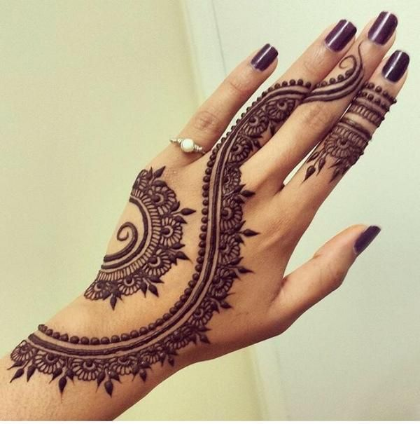
Service
Henna tattoo designs for any special occasion
Open for appointments
Easy to contact us
Consultations
Notes:
Natasha: We provide our customers with henna tattoos for any special occasion that they need.
Fatima: We will be open for appointments whenever one is needed. You can schedule the appointments either by calling us over the phone or leaving us a message on our Facebook page.

Slide 6
Mission Statement: Holy Henna will provide our customers with henna tattoos that are unique and beautiful
Social Impact: Friendship and family bonding is proven to be healthy to the mind and body
Notes:
Fatima: We’re going to provide our customers with henna tattoos that can be customized or they can choose a premade design from our catalog.
Natasha: Getting henna tattoos done with a group of friends or family will allow you to bond and create healthy relationships with them. Spending time with friends and family reduces stress and is proven to be healthy to the mind and body.

Slide 7
Business Model
Definition of One Unit
Party of 10 people
Description of Expenses
Variable Material Expenses | Total: $2.79
Item | $
Disposable Gloves | $0.78
Henna Tubes | $1.04
Paper towels | $0.97
Fixed Expenses | Total: $293.05
Item | $
Insurance | $177.09
Advertising | $2.00
Depreciation | $103.96
Utilities/Rent | $10.00
Economics of One Unit
Selling Price |  | $175.00
Cost of var. materials exp. | $2.79
Cost of labor | $21.75
Other variable costs | $2.40
Total COGS/ COSS |  | $26.94
Contribution Margin |  | $148.06
Monthly Break Even Units
$293.05 | = | 1.98 | ≈ | 2 parties
$148.06
Notes:
Fatima: Our economics of one unit is a party of 10 people. We chose this to be our EOU because we are already operational and have noticed that most of our customers come in a party that averages about 10 people.
Natasha: It costs us $26.94 for each party. In those $26.94, our materials, labor, and other expenses are included in this amount. It will cost of $2.79 for all of the materials that we need.
Fatima: Since it costs us $26.94 for each party, our selling price is $175.00. This leaves us with a profit of $148.06.
Natasha: For our other expenses, we are spending $293.05. Our insurance, advertising, depreciation, and utilities are included in this total amount.

Slide 8
Market Analysis
Market Statistics
Industry Name: | Consumer Services | Annual Industry Sales: | $11 Billion
Description of Target Consumer
Demographics | Geographics
Females of all ages | Hartford County, CT
Psychographics | Buying Patterns
People who like tattoos | People who are willing to spend money on a temporary tattoo
Target Market Size
Total Population
898,000
Target Market Population
462,600
Market Size
(based on
survey)
9,250
Notes:
Fatima: Holy Henna is part of the consumer services industry and Americans spend $11 billion on this industry every year. Our target market in females of all ages who live in the Hartford County. These females are ones who like tattoos and would be willing to spend money on temporary tattoos before getting an actual one.
Natasha: Out of the total population of Hartford County which is 898,000, 462,600 of those people fall into our target market population. We believe that we will be able to get 9,250 people to know about our business and will want us to provide our service to them.

Slide 9
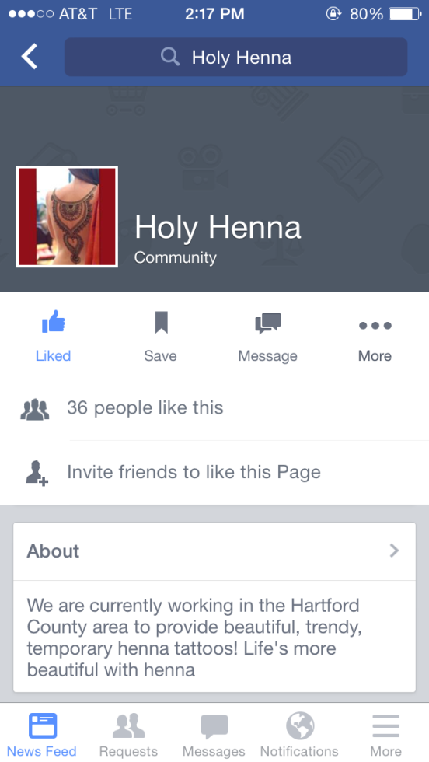
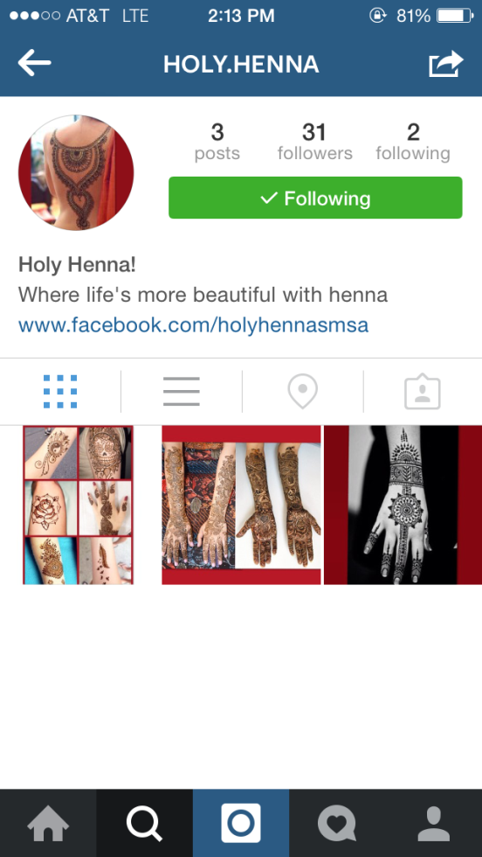
Marketing and Sales
Social media
-Facebook
-Instagram
Word of mouth
Business cards
Car signage
Notes:
Fatima: To promote our business, we are going to be using various types of social media. We will be using instagram so that we could post pictures of our different designs and we will be using Facebook so we can post pictures to get out to our older target market who don’t use instagram.
Natasha: When we go to our customers, we will be handing out our business cards to them after we finish a job. We believe that those customers will be so pleased with our services and talents that they will tell others about our business.
Fatima: We will also be using signage that will go on our car in which we travel to and from different customers so that people from the outside can get familiar with our business.

Slide 10
Competition
 | Holy Henna! | Akiyo Henna Studio | Sacred Body Tattoo
Price | Affordable | High | Affordable
Service | Excellent | Excellent | Poor
Location | Hartford, CT | Astoria, NY | Enfield, CT
Your Competitive Advantages
1. Our prices are very affordable for quality henna tattoos 2. We treat our customers with lots of respect and care 3. We are local and can travel all over the Hartford County area
Notes:
Natasha: These are 2 of Holy Henna’s competitors. Akiyo Henna Studio is a competitor with very high service, but the problem with them is that they are located in NYC which is too far for most of our customers and their prices are too high.
Fatima: Sacred Body Tattoo is another competitor. Even though their prices are affordable the problem with them is that their tattoos are permanent while ours are only temporary. We have read reviews about their services and have found out that they have very poor service and treat their customers very poorly.

Slide 11
Qualifications
Currently operational
Family members and friends with experience
Speak Punjabi and Bosnian
Have taken a Marketing and Entrepreneurship class
Notes:
Natasha: We are qualified because we have already been doing this business with our experienced friends and family members by having henna booths set up at different locations such as fairs.
Fatima: Since we both are bilingual, we will be able to get out to people of all different cultures. We have also taken a marketing and entrepreneurship class that will help us make our business better.

Slide 12
Sales Projections
Total Units
35
Gross Revenue
$6,125
Net Profit
$1,416
Notes:
Natasha: If we have 35 parties of henna in our first year of business, our gross revenue is $6,125 and our net profit will be $1,416.
Fatima: In the months of June, July, and August we expect more sales because we will be out of school and will be able to do more henna jobs since we have more free time.
Natasha: We believe July will be our highest month because that’s the middle of the wedding season and when religious holidays happen.

Slide 13
Start-up Funds
Item | Why Needed | Cost
Computer/Cellphone | Business Communications | Pre- Owned
Car | To go to and from locations | Pre- Owned
DBA | Wethersfield, CT | $15.00
Inventory | To be able to start up our business | $5.00
Business Cards and Paper Goods | To advertise our business | $10.00
 | Total Startup Expenditures | $30.00
 | Emergency Fund | $15.00
 | Reserve for Fixed Expenses | $880.00
 | Total Startup Investment | $925.00
ROI: Return on Investment
$1,416 | = | 153% | ≈ | $1.53
$925
ROS: Return on Sales
$1,416 | = | 23% | ≈ | $0.23
$6,125
Notes:
Fatima: It would take us $925.00 to start up our business. Most of this startup investment comes from our reserved money for our fixed expenses which is $880.00. The other $45.00 comes from our emergency fund and our startup expenditures.
Natasha: In our startup expenditures, we included our computer, cellphone, and car which we already own. We will also need a DBA from Wethersfield, CT and business cards so that we can advertise our business.
Fatima: Our return on investment is 153% equaling $1.53 and our return on sales is 23% equaling $0.23.

Slide 14

Future plans: We plan to hire 2 employees by the end of our second year and expand our services to include doing nails and waxing by the end of the third year.
Philanthropy: We will donate 5% of our yearly net profit to the American Cancer Society
Notes:
Fatima: In the future, we plan to hire 2 employees by the end of our second so they can help us get our appointments done. We also plan to expand our services that will include doing nails and waxing by the end of the third year.
Natasha: We will donate 5% of our profits to the American Cancer Society. We want to donate to them because my uncle passed away recently from cancer and we would like to help find a cure.

Slide 15
Life’s more beautiful with henna
Thank you for your consideration of
Holy Henna!
Visit us at: facebook.com/holyhennasmsa
Notes:
Natasha: Check out our Facebook page to learn more about our business.
Fatima: Thank you for your consideration of Holy Henna! Life’s more beautiful with henna.

