Slide 1
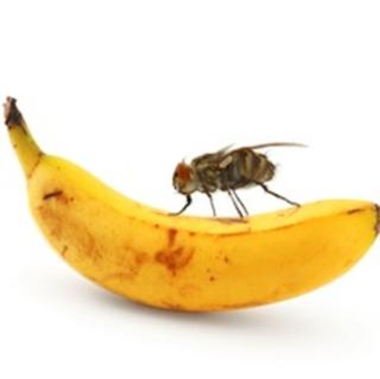
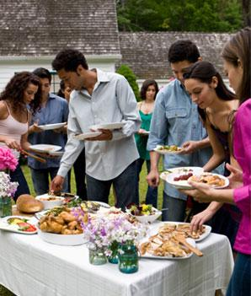
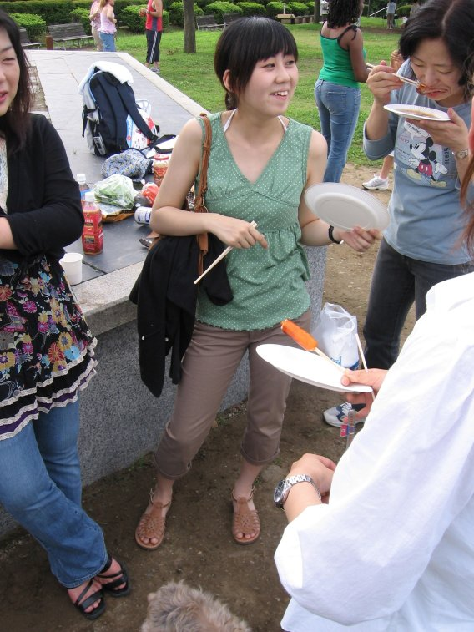
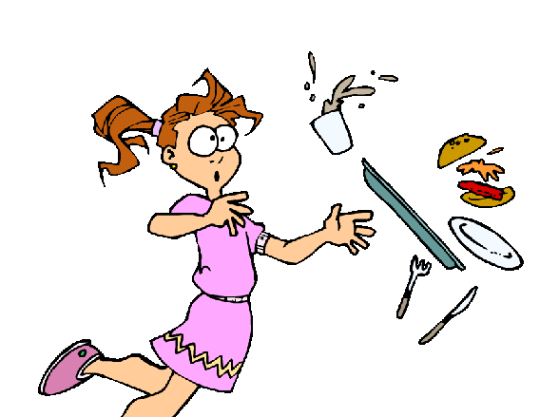
Notes:
I’m sure most of you guys have been to a family outing whether it’s a picnic or a BBQ or even a fair. There’s all delicious food so you grab your drink then you grab your food then you have to go over and grab a napkin then maybe a straw and you’re trying to juggle all these different things and you end up dropping your food all over the ground. Or maybe you get your plate of food and you sit it down on the table then you make a trip back to get a drink or some dessert and you come back to the table and flies or nats are all over your food and now you have to go get a whole new plate of food!! With Sip “N” Eat there’s no need to worry about that it has everything in one! Sip “N” Eat is a plate attached to the top of a cup with a straw coming out of the middle. You’ll be holding the cup and at the same time you’ll be holding your plate. Now you don’t have to leave your food attended for flies to get and you don’t have to worry about juggling multiple items anymore.

Slide 2
Sip- N- Eat by Kre-Ate, LLC
Kasandra Price
Sport & Medical Sciences Academy
Hartford,CT
Age 17

Slide 3
Problem
Handling Food
Juggling Food
Messy
Embarrassing
Wasting Food
Notes:
Sip- N- Eat meets the need of managing the handling of food. It’s hard to juggle many things and juggling food is not only hard but messy. It could spill all over the ground or spill all on your clothes and you could be around a group of prestigious people or trying to socialize or network, then not only have you made a mess but now you’ve become embarrassed. Plus you waste food when you have to throw a plate full of food away and get a whole new plate of food.

Slide 4
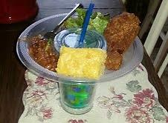
Solution
A unique design
Multi-tasks for you
Saves you Multiple trips
Cuts down on repetitive Spills
Eat on the Go
Unlimited Potential
Notes:
With Sip-N-Eat you don’t have to hold multiple things because it’s built where you can hold your food and drink at the same time. That alone prevents many repetitive spills and saves you the trip of putting your food down so your hands are free then going back to get more food. The design is a plate that’s attached to the top of a cup with a straw through the middle. It can be disassembled so you can dish wash it and use it again and the plate and the cup can come in a variety of colors to suit the theme of your event or just to give the customer options to pick the color that’s most pleasing to them. It also prevents many spills. I came up with my idea because I’ve spilt many plates of food in my life because of trying to juggle multiple things. 70% of the people who took my survey said that their job makes them have to eat on the go periodically. Sip-N-Eat allows you to eat on the go because you can put the cup part in the cup holder and you can eat and drink on the go as well.

Slide 5
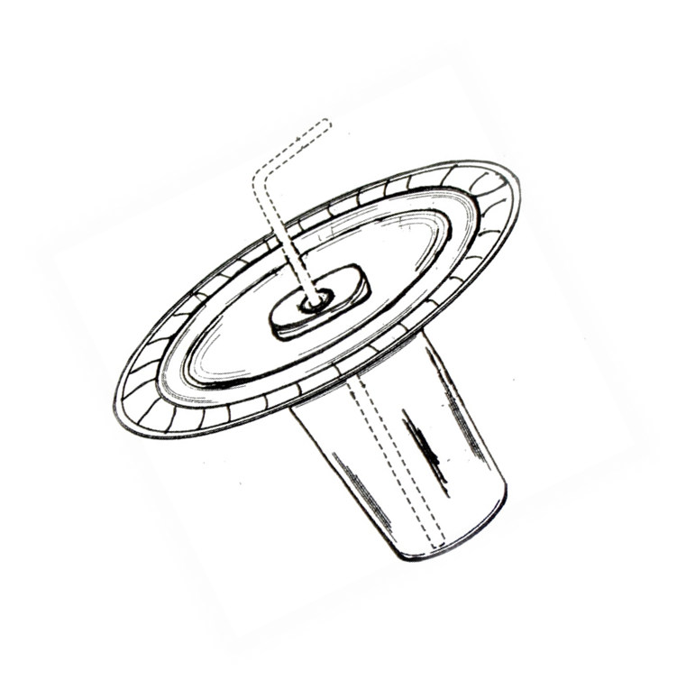
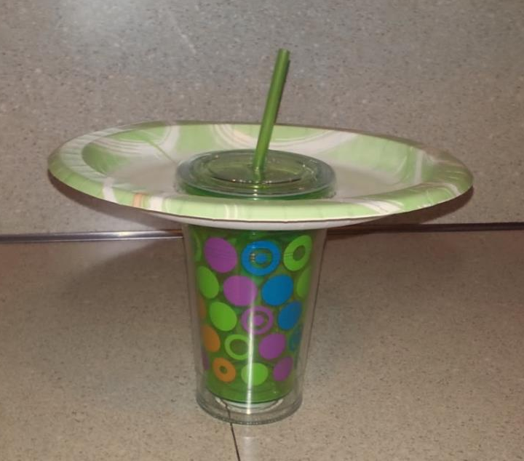
Description
A plate attached to the top of a cup with a straw in the middle
Comes in a variety of colors
Factory made
Disposable or reusable
The cup is the heaviest and the plate is proportioned around it
Notes:
Sip-N-Eat is a plate that attaches to the top of a cup that has a straw in the middle. It disassembles so it is easy to dish wash. It will be created in a factory and sold on the shelves of stores such as Wal-Mart and Target. It will come in a variety of colors to suit the theme of your event or so the customer can pick out a color that is most pleasing to them.

Slide 6
Sip-N-Eat’s Model
Innovative
Definition of One Unit
20 Sip-N-Eat’s (1 Pack)
New
Economics of One Unit
Selling Price |  | $15.00
Cost of materials | $1.00
Cost of labor | $.41
Other variable costs | $0.00
Total COGS/ COSS |  | $1.41
Contribution Margin |  | $13.59
Inexpensive
Monthly Break Even Units
$216.16 | = | 15.90 | ≈ | 16 Packs
$13.59
Notes:
I call the factory and that only takes around 3 minutes of my time and that adds up to $.41. The manufacturing is $1.00 for 20 Sip-N-Eat’s. However for the hard plastics in that package of 20 there will be smaller packages of 4. That includes all variable costs and materials as well. My total adds up to $1.41. I would sell everything for $15.00 having my gross profit be $13.59.
Kasandra Price

Slide 7
Market Analysis
Market Statistics
Industry Name: | Paper and Food Services | Annual Industry Sales: | $90 billion
Description of Target Consumer
Demographics | Geographics
Adults over 18 and under 65 who buy Groceries for the home | Connecticut
Psychographics | Buying Patterns
People who struggle with the handling of food People who like to eat on the go | 60% of the people who took my survey buy paper/plastic plates and cups monthly
Target Market Size
Total population of targeted geographic area
223,947,800
Population of target market
2,253,700
Market size
(based on
survey)
22,537
Notes:
My Direct target market is Retail stores and my indirect target market are the people that buy my product from the stores. I’m a wholesale business and the goal of my business is to sell my product to stores to be bought by people. The paper and Food Service Business is over $90 billion business. My Geographic starts out in Connecticut. My Physhcographics are what is the problem where my product would be of assistance. People who struggle with the handling of food and people who like to eat on the go. For the buying patterns 66% of the people who took my survey prefer plastic/paper plates and cups rather than glass plates and cups. My total population is all the adults over 18 and under 65 in the USA for 2012 is 223,947,800. My population of my target market in Connecticut is 2,253,700 people. For the first year I’m going to concentrate on 1% of my target market and that is 22,537 people.

Slide 8
Promotion and Sales
promotion
SALES
Word of mouth
Pop up Ads
Website
E-mail Lists
Business Cards
Small Business Retailers
Personal Selling
Demonstrations
Trade Shows
Notes:
To start off with getting a contract with Wal-Mart or Target is very profitable but also very risky financial wise. It can cost a lot to get shelf space plus in order to get a contract your product has to go through a few hoops such as getting tested to see if it holds up well. Also you must have proof you can sell hundreds and thousands of your product for cheap. I plan to start off with small independent retailers like Pretzel Wetzel or the food courts. it’s a low risk financial wise plus they might sell on consignment so when they get paid from my product I get paid. This will help get test and get my product out there and possibly catch the eye of some big retailers such as Wal-Mart. So for my promotion it will be by word of mouth, pop up ads, my website and e-mail lists to start off. For my sales it will be personal selling and demonstrations to show people how my product is used.

Slide 9
Competition
My competitive advantages
3 in 1
It allows you to have one hand free at all times
Indirect Competition
Dixie
Gold Label
SOLO
Chinet
Bakers & Chefs
Direct Competition
Party Plates with cup holders
Trays
Notes:
My competitive advantage is the plate and the cup being one piece because normally the plate and the cup come separately. Also my product allows you to have at least one hand free. My direct competition would be Party plates with cup holders because it gives the same function as holding your drink and your food but it does it in a different way. They come in many different varieties of design. My indirect competition would be companies that sell plates such as Dixie, Gold Label, SOLO, Chinet and Bakers & Chef because they provide the function of holding your food and your drink but separately.

Slide 10
Qualifications
I have 3 years of Mechanical and Electrical engineering experience
I have taken a Marketing class
I manage the handling of food every day
I have excellent communication skills
Notes:
I’m very qualified to start my business and make this product. I have taken a marketing Class, I have been on a robotics team for 3years so I have three years of engineering experience. Plus I manage the handling of food everyday because I have experienced spilling food on my self.

Slide 11
Sales Projections
Total Units
540
Gross Revenue
$8,100
Net Profit
$3,964
Notes:
My total units are 484 and my gross revenue is $7,260 and my net profit is $4916.09 and I estimate more units sold during the summer because that’s when people tend to have more gatherimgs/parties outside because the weather is nice and people tend to have more free time. I have a foundation called Y-ADAPT (Youth- Achieving Dreams Are

Slide 12
Startup Funds
Item | Why Needed | Cost
Manufacturing Costs | For first run of my product | $20,000.00
Patent | To protect my product from getting stolen | $9,000.00
LLC | Protection over myself | $300.00
Website | To Advertise | $240.00
Business Cards | To Advertise | $10.00
Business Phone | To place orders/communicate | Owned
Computer | To make a website/communicate | Owned
Business E-mail | Communicate | Free
PayPal | Online business account | Free
 | Total Startup Expenditures | $29,550.00
 | Emergency Fund | $14,775.00
 | Reserve for Fixed Expenses | $648.00
 | Total Startup Investment | $44,973.00
Notes:
My start up fund includes a patent for my product so I can protect it from getting stolen which is at most $9,000 for a simple mechanical product. Since that is the highest price in my startup fund. I have a business phone to place orders to the factory and communicate with other people that will enhance my business and that adds to $50.00. Then there is my computer that I will use for communication and that is $300.00. The DBA is $9.00. My e-mail for my communication is free. My website is $20 per month therefor it’s $240 per year. All of that adds up to $9,599.00. My emergency fund is $4,799.50 and my reserved fix expenses $198.48 and all that adds up to $14,596.98.

Slide 13
changing the world through our kreations
Thank you for your
consideration of
KRE-ATE, LLC
kre-ate@gmail.com
www.kre-ate.webs.com
Website is currently under construction

