Slide 1
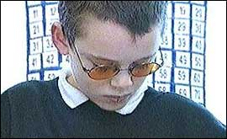
Notes:
Have any of you guys ever had a secret you wanted to keep? Because of a problem you had? An issue that ATE your heart out EVERY. SINGLE. DAY? Well so does Dexter. His secret is that he has Visual Dyslexia. Problem is, he has a hard time keeping this secret because of the brightly colored lens. The color in the lens help him to read and see words more clearly. The kids in his class don’t understand that though. People tease him, and call him names like “dumb”, “stupid”, and “retarded”. Because of the constant teasing, he cuts himself. What’s even worse? He’s ONLY twelve.
That’s where I come in. I chose to keep this little boys secret providing him with glasses that work the same, just with a “not-so-noticeable” tint (:

Slide 2
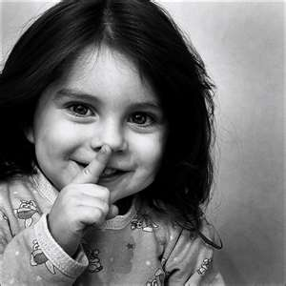
MYSecret
Name: Kianda Hicks
Grade: 11
Age: 17
Notes:
Hi my name is kianda hicks, and my business is MySecret (:

Slide 3
Mission Statement
Mission Statement
MYSecret’s mission is to keep your secret about any issue, problem, disability, or disorder that you want to hide, or haven’t come to terms with, by creating products that will fix and tend to your special needs.
My Opportunity
There are 1,174 dyslexic people in Hartford
Most people buy new eyeglasses once a year
Unassisted market due to small population & lack of understanding (5 out of every 100 receive help or assistance.)
Notes:
MySecret’s mission is MYSecret’s mission is to keep peoples’ secret about any issue, problem, disability, or disorder that they want to hide, or haven’t come to terms with, by creating products to that will fix and tend to their special needs.
For my 1st product, the MYSecret eyeglasses, My opportunity lies within the Hartford, Connecticut region where there are 1,174 dyslexic school-aged children. My market is greatly unassisted because only 5 out of every 100 dyslexics receive help or assistance.

Slide 4
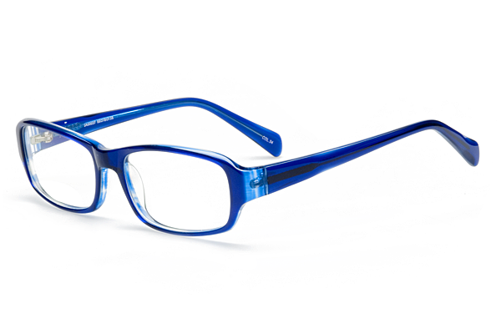
Business Profile
Service
Creating unique product
According to personal style & issue
Keep your secret
Sole Proprietorship
Full control
No consultations before making decisions
Least expensive option for business ownership
Notes:
MySecret is a service-sole proprietorship
MY Secret focuses on one main goal; Creating unique product to help you will any troubling issue.
I chose being a sole proprietorship because I know I’d have full control over my business. I wouldn't have to run back to anyone before making decisions and it’s the least expensive option for business ownership

Slide 5
Qualifications
I have completed a Marketing/Entrepreneurship course
I understand people’s need to have privacy about personal issues
Ability to come up with innovative ideas/product

Slide 6
Market Analysis
Industry Name | Optical Manufacturing
Industry Size | $20,726,900.00
Total Population
Harford, Connecticut
1,188,841
Population of Hartford, CT
Target Market
School-aged children, and teens with dyslexia, in Hartford, CT both male and female with an average household income of about $29, 798
1,174
Visually Dyslexic people in Hartford, CT
Potential Market Size
Based on research I found that people’s glasses usually last for a year before they purchase a new pair. This means that my sales will be fairly predictable
235
Notes:
My first product will land me in the industry of optical manufacturing. Each year Americans spend over 20 million dollars on this industry. This leaves plenty of room for MYSecret.
My target market will be school aged boys and girl in Hartford CT with a medium household income.
The first

Slide 7
Consumer Profile
By Location
Hartford, CT
By Population
School-aged boys and girls with Visual Dyslexia
By Personality/Behavior
Lack of confidence
Low self esteem
Yearning for learning
By Income
Average household income of $29,798
Medium income levels
Notes:
For my first product,

Slide 8
Competitive Advantage
See Right
Rad Prisms
MYSecret
Factors
Quality of
Product//Service
Poor
Very Good
Excellent
Price
$250+
$179
$150
Location
Online
Kentucky
Hartford, CT
Brand/Reputation
Bad
Well Known
Very Good
Unique Knowledge
Research
Shape
Tint
Notes:
What sets me apart from my competitors is that I will have excellent customer service.
I will also have a reasonable price.
Another thing is that I will have and invisibly colored tint on my eyeglasses.
My other competitors will have a noticeable tint that might draw negative attention. That is what I am trying top avoid.

Slide 9
Marketing Mix
Marketing
Mix
Price
Place
Product
Promotion
People
The Visually Dyslexic
Website, word of mouth, flyers, business cards.
$150.00
Hartford, CT
Invisibly tinted eyeglasses
Notes:
9
I will be selling invisibly tinted eyeglasses to the visual dyslexics of Hartford, CT for a low price of 150$

Slide 10
Marketing Plan
Awareness
Purchase
Retention
Current & Short Term (1 month -6 months)
Through my website, word of mouth, flyers, business cards.
Do demonstrations to explain how the eyeglasses work.
Excellent customer service. Get customers to spread the word. Personal relationship
Long Term ( 6 months-1 year)
Commercials
Same
Free shipping for customers
Monthly cost, by phase:
$5.00
$20.00
$0.00
Awareness
Purchase
Retention

Slide 11
Cost of Materials/Direct Labor
Definition of One Unit | One pair of Invisibly Tinted Eyeglasses
Cost of Sales Per Unit
Direct Labor (Labor Cost per Hour) | Time (in hours) to make 1 unit | Direct Labor Cost Per Unit
$ 8.25 | 25 min. or .416 hr. | $3.43
Total Direct Labor Per Unit |  | $3.43
Material Description | Cost/Total Quantity | Cost Per Unit ($)
Prescription eyeglasses | 31.99/1 | $31.99
Glasses case | 4.25/1 | $4.25
Total Material Cost Per Unit |  | $36.24
Total Other Variable Costs Per Unit (shipping, packaging) |  | $7.94
Cost of Sales Per Unit |  | $47.61
Notes:
11
My definition of one unit will be one pair of invisibly tinted eyeglasses. I chose this as my unit because it will be the first product my business will be presenting. Please remember that other products will be developing at this time in line at this time.
I will be paying myself minimum wage and it will take me about 25 mins to make this unit, resulting in a total direct labor of 3.43.
Adding the price of the materials included in the package and my shipping and packaging costs, I get a cost of sales per unit of $47.61

Slide 12
Economics of one Unit
Definition of One Unit: One pair of Invisibly Tinted Eyeglasses
Selling Price per Unit | $150.00
Direct Labor per Unit | $3.43
Materials per Unit | $36.24
Total COGS per Unit | $39.67
Total Other Variable Costs per Unit (outgoing shipping, packaging) | $7.94
Total Cost of Sales | $47.61
Contribution Margin | $102.39
Notes:
I will be selling this unit for 150 dollars. This may seem a little pricy to some, but I think the look on a mother’s face seeing a happy kid that is no longer bullied is priceless.
Subtracting certain costs, I get a contribution margin, or profit per pair of 102.39

Slide 13
Average Monthly Fixed Costs
Type of Fixed Cost | Monthly Cost
Entrepreneurial Stipend | $72.00
Advertising (business cards) | $20.00
Depreciation (laptop, business cell phone) | $23.61
Utilities (internet, phone, etc) | $100.00
Rent (Home) | $75.00
Total Monthly Fixed Costs | $290.61
Notes:
My total monthly fixed cost will be $290.61. Mostly coming from my utilities and rent which isn’t so much because I will be working from home.

Slide 14
Time Management Plan
Business Schedule for a Typical Week (168 hours)
Notes:
My time management plan is pretty decent ; I will be devoting a little over 40 hrs of time to school and this business which I find to be most important, and the majority of my time will go towards my freetime which entails activities such as sleep and church. Only 24 hours will got o my part time job.

Slide 15
Monthly Sales Projections
Break-Even Units
3
Total Units
235
Full Capacity
600
Notes:
For the MySecret Eyeglasses, I projected that I can sell to about 235 units in one year. I also foresaw a highest sales in the
Month of October. That’s Dyslexia Awareness month.

Slide 16
Projected Yearly Income Statement
Selling Price Per Unit | $150.00
# of Units Sold | 235
Total Sales | $35,250.00
Total COGS | $9,322.45
Other Variable Costs | $1,865.90
Total Variable Costs | $11,188.35
Gross Profit | $24,061.65
USAIIRD | $3,487.32
Other Costs/Unforeseen | $1,000.00
Total Fixed Costs | $4,487.32
Profit before Taxes | $19,574.33
Less Estimated Taxes | $4,893.58
Net Profit | $14,680.75

Slide 17
Start-up Investment
Item | Where I will buy this? | Cost of Item
Lens tint kit | www.amazon.com | $9.62
Prescription eye glasses | www.amazon.com | $31.99
Glasses case | www.myeyeglasscase.com | $4.25
Business cards | www.123print.com | $20.00
CASH RESERVE |  | $871.83
Estimated TOTAL START-UP INVESTMENT |  | $937.49
96 hrs
$8.25
$792.00
x
=
Total: $1,729.49
Notes:
To start up, it will cost me about 1,729.49 .
Most of this will be coming from my cash reserve that is needed just in case I don’t sell at.
But I don’t think that’ll happen (:

Slide 18
Return
…on Investment
848.8%
Annual Net Profit
$14,680.75
=
$8.49
Start-Up Inv.
$1,729.49
…on Sales
41.6%
Annual Net Profit
$14,680.75
$0.42
=
Total Sales
$35,250.00
Notes:
My return on investment will be about 849% and my return on sales will be about 41.6%
Yes, this is a little high, but do remember that I am starting this business from home.

Slide 19
Financing Strategy for Total Start-up Investment
Source | Amount | Debt | Equity | Gift
Personal Savings | $1,000.45 |  | X
Relatives/ Friends | $729.00 |  |  | X
Totals: $ 1,729.45
Notes:
To gain the money for my start up, I will be saving most of it by myself, with money from my part-time job, and the rest I will be gaining as a gift from family and friends ; no debt (:

Slide 20
Business Responsibility & Philanthropic Strategy Plan
4 percent of my net profit will go to the Dyslexic Foundation of Memphis
I will make people and potential customers aware of this by placing it on my website and my business cards
Notes:
For the first year of my business I would like to give back a total of 12% of my net profit to different organizations or foundations. Each product will donate to a different foundation. I will spilt the 12% amongst 3 products and give 4% of the MYSecret eyeglasses net profit to the Dyslexic Foundation of Memphis

Slide 21
Business & Educational Goals
Business
Educational
Create a website that takes credit cards
Better define my business
Continue to take AP and Honors classes and graduate with honors
Continue to study Business
Short Term
Expand by selling and creating products for people all sorts of special needs..
Begin to develop next product
Earn a degree in Business
Expand my knowledge of product development
Long Term
Notes:
Short term:
Short term, I would like to establish my business and become well known. This will help launch my business because people would know that my business can be useful to anyone with a hideable issue. Soon, I will have customers lined up, collaborating with the MYSecret team to come up with my next “HIT” product.
Long term:
I would like to start to develop my next product. I want people to know that MYSecret is not a business solely devoted to creating these glasses; it’s devoted to creating products for people with all special needs. For example, the third product in the works will be Sanitary Napkin Dye. Usually girls starting their period have trouble getting used to their cycle, so they bleed through. The dye that I will incorporate into the sanitary napkins will turn the blood to a clear solution so that it looks like a wet spot. You can easily tell friends that you sat in something liquid (:
In the first three years, I would like to develop at least three MYSecret products.

Slide 22
Your secret’s safe with us!
Thank you for your consideration of
MYSecret
Visit us at …
www.MYSecret.weebly .com
MYSecret contacts next year!

