Slide 1
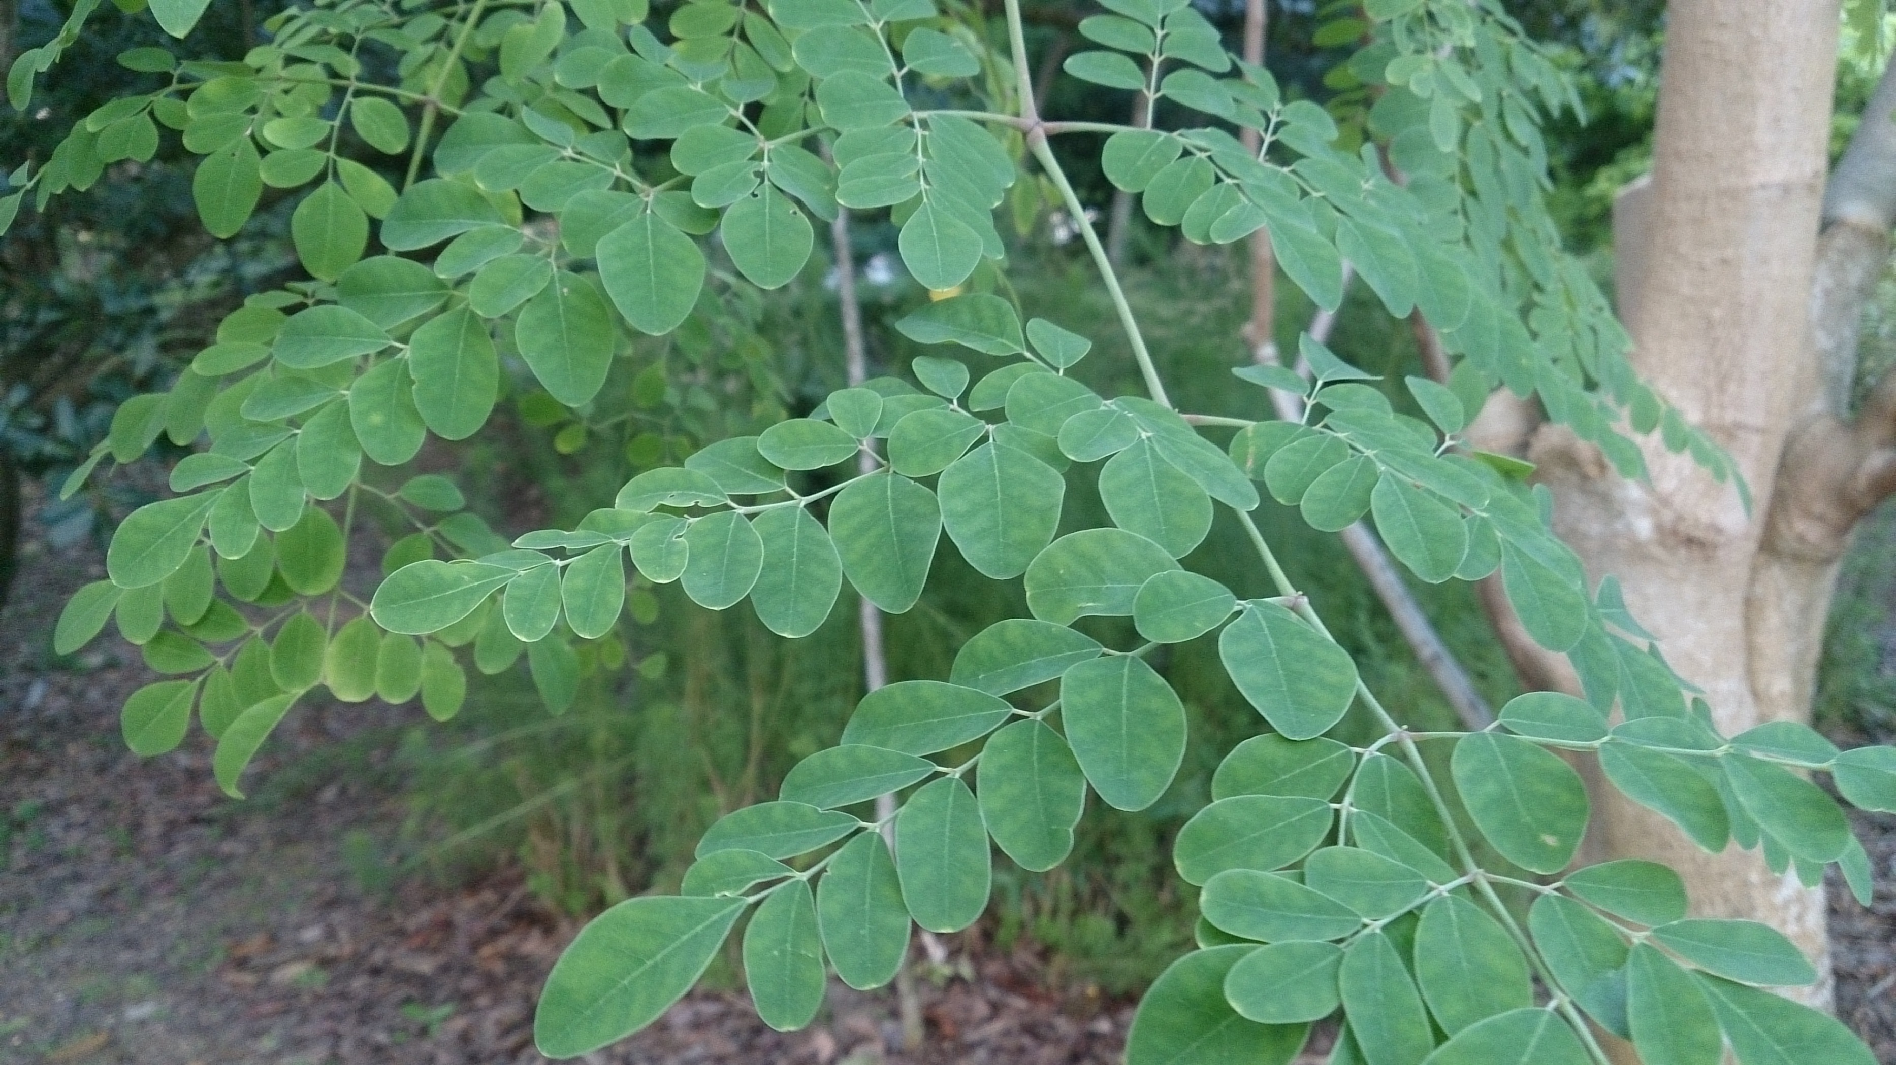
Notes:
Pearce: What if there was a product that could Lower Blood Sugar, Cholesterol, and blood pressure?
Nick: What if it had twice the amount of protein as yogurt, Four times the amount of calcium as cow’s milk, And seven times the amount of vitamin c as oranges?
Pearce: Well our tea is that product. It is also used to treat cancer, diabetes, and chronic headaches, but that’s just scratching the surface of what it can do.

Slide 2
Necessi-tea LLC
Pearce Cannon & Nick Nguyen
Notes:
Pearce: I'm Pearce Cannon
Nick: And I'm nick Nguyen
Pearce: And this is Necessi-tea LLC

Slide 3
What is the Problem?
Don’t know about moringa
Need a healthy alternative
Don’t know how to start a healthy lifestyle
Notes:
Nick: a lot of people would like to have a product that could fulfil all of their health needs at once, yet don’t know where to find one. Nowadays, alot people are trying to live a healthier lifestyle by trying to get away from unhealthy eating habits, such as eating excessive amounts of non nutritional food, which raise their cholesterol levels, blood pressure, and blood sugar. Many people don’t know how to start the change from an unwholesome eating routine to a more wholesome one.

Slide 4
Solution
Provide alternative for unhealthy food/drink
Make moringa accessible and available
Huge health benefits
Is used to treat a wide variety of health-related issues
Notes:
Pearce: We will fill the need for a healthy alternative for many unhealthy eating/drinking habits. We will provide moringa products that can help to start you on the path to a healthier lifestyle. The health benefits you can receive from moringa can reduce or even reverse the side effects of past eating habits. We hope that our moringa business will work to give people the opportunity to have a healthy delicious beverage that is packed with nutrients.

Slide 5
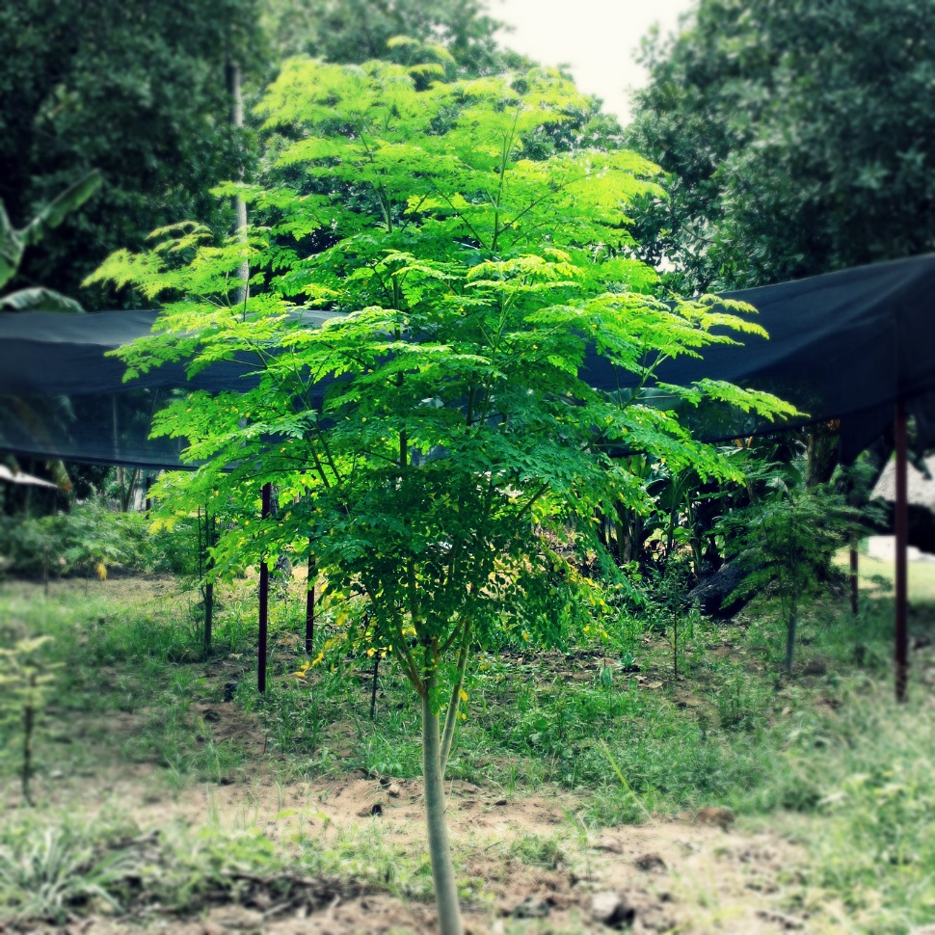
Necessi-tea, LLC
Grown by us
Extremely healthy
24/7 online store
We make moringa
accessible
Notes:
Nick: Moringa LLC well be an online store where customers can purchase their own moringa tea. In the beginning we will be growing moringa tea on borrowed land from a family member in the us, where it can be closely monitored. This land is in florida where the climate and soil are near perfect for the farming of moringa tea.
Los benefitos

Slide 6
Mission and Social Impact
Mission Statement: Our goal is to provide people with a healthy addition or alternative to their diet
Social Impact: Necessi-tea will hopefully cause people to start changing to a healthier lifestyle
Notes:
Nick: Our Mission is to give people a healthy replacement in their unhealthy diet. We will hopefully cause people to start changing their lives to become healthier.

Slide 7
Business Model
Definition of One Unit
1 box of 12 teabags
Description of Expenses
Variable Material Expenses | Total: $.68
Tea box | $0.10
Tea bags | $0.12
Boxes | $0.43
Moringa | $0.03
Fixed Expenses | Total: $1,664.00
Insurance | $150.00
Utilities | $75.00
Rent | $1,000.00
Depreciation | $39.00
Advertising | $50.00
Salary | $350.00
Economics of One Unit
Selling Price |  | $15.00+ sh
Cost of var. materials exp. | $.68
Cost of labor | $1.72
Other variable costs | $0.00
Total COGS/ COSS |  | $2.40
Contribution Margin |  | $12.60
Monthly Break Even Units
$1,664.00 | = | 132.07 | ≈ | 133 boxes of tea
$12.60
Notes:
Our economics of one unit is 1 box of 12 tea bags. This is our economics of 1 unit because we feel that 1 box is enough to last someone at least a week before having to buy more. With a material cost of .68 and with 1.72 for the labor It costs us $2.40 to make one unit and we will be selling it for $10 for a contribution margin of $7.60.
Our total fixed expenses is 1,339.09 .. The cost of our rent is so high because we have to have warehouse space to store our product.
Our selling price also includes shipping and handling because we have to ship to different parts of the country.
In order to break even each monthe we have to sell atleast 133 boxes of tea

Slide 8
Market Analysis
Market Statistics
Industry Name: | Tea and Coffee Manufacturing | Annual Industry Sales: | $13 Billion
Description of Target Consumer
Demographics | Geographics
People age 25-35 | Connecticut
Psychographics | Buying Patterns
People trying to change or live healthier lives | 3 boxes a month
Target Market Size
Total Population
3.5 million]
Target Market Population
429,000]
Market
Size
21,450
Notes:
Necessi-tea is in the tea and coffee manufacturing industry. Americans spend 13 billion on this industry annually. Our Target consumers are people in Connecticut,, age 25-35 and who are trying to live a healthier life. These people will most likely purchase 3 boxes of our tea a month. This is because each box has 12 tea bags so 3 boxes will allow them to have 1-2 cups of tea a day.
Reomove numbers maybe
El

Slide 9
Marketing and Sales
Integrated social media plan
Online ads
Professional reviews
Website
Business cards
Notes:
We will be going after our market with our marketing and sales tactics. We will have an integrated social media plan where we will create accounts for Instagram, twitter. We will share photos of our product, professional reviews, and promote our website 1-2 times a week. We will also have online ads on health and wellness related websites.
More detail

Slide 10
Competition
Unique Factors | Necessi-tea, LLC | Moringa Source, LLC | Moringa Revealed
Products | Moringa Tea | Moringa powder, oils, etc. | Tea, Capsules, etc.
Location | US | Danbury, CT | New Rochelle, NY
Hours | 24/7 | 9am-4:30pm weekdays | 9am-6pm weekdays 10am-6pm Saturdays
My Competitive Advantages
1. We have a focus on tea 2.We can fulfill the needs of customers throughout the US 3.We can sell our product 24/7
Notes:
2 of our competitors are moringa source llc, and moringa reveales. We focus on only tea to make it the best quality possible while they both have other moringa products. We also can ship the the entire us while they have specific areas they cater to. Also since we are online we sell 24/7 while they are open limited hours.
We beat our competition because we have a focus on mainly tea, allowing us to make it the best possible. Also we cater to everyone in the US’s moringa needs. And since we are an online business, you can buy moringa at any time of the day, every day of the week.

Slide 11
Qualifications
We have experience farming in other countries
Have family members with business backgrounds
Will get a certification for importing to the US
We have taken a Marketing and Entrepreneurship class
Notes:
Pearce:

Slide 12
Sales Projections
Total Units
2,260
Gross Revenue
$33,900
Net Profit
$7,230
Notes:
Necessitea is projected to sell 1970 units in its first year of operation. This will land us a net profit of 4124. Our sales will be higher in jan because a lot of peoples new years resolutions will be to get healthier. But lets be honest, how many of those resolutions last, that’s why our sales will dip but will go back up as we get word of our business out there. In the summer months our sales will be low because who drinks hot tea in the heat. Our sales will be higher in the winter months because of the cold and holiday season

Slide 13
Start-up Funds
Item | Why Needed | Cost
Phone/computer | Contact with customers and vendors | owned
Business Cards | Advertising | $10.00
LLC Certificate of Organization | Needed to start business | $120.00
Moringa Seeds | To grow trees | $72.00
 | Total Start-Up Expenditures | $202.00
 | Emergency Fund | $101.00
 | Reserve for Fixed Expenses | $4,992.27
 | Total Startup Investment | $5,295.27
ROI: Return on Investment
$7,230 | = | 136% | ≈ | $1.36
$5,295.27
ROS: Return on Sales
$7,230 | = | 21% | ≈ | $.21
$33,900
Notes:
Notes:
NFTE suggests to have your Emergency Fund equal to half of your Total Start-Up Expenditures
To find your Reserve for Fixed Expenses, multiply your monthly fixed expenses (found on the Business Model slide / slide 13) by 3. This will give you 3 months of cash to cover costs while you initially growing your business
https://www.llcuniversity.com/connecticut-llc/forms/
In order to start our business we will need $4,320.86. Most of the start up funds is money for fixed expenses. We have a small emergency fund because not much could go wrong and we are and LLC. We will also need a llc certification of organization to be able to start the business in ct which will run us $123
No say money for roi and ros

Slide 14
Future Plans / Philanthropy
Future plans:
We will be able to have our own farm
To expand to different flavors of moringa tea
Philanthropy:
We will donate 5% of our profits to the American Diabetes Association
Notes:
Nick: In the future we will hopefully be able to pay nick’s uncle back for allowing us to start our business on his land. We then will purchase our own land, to start a new farm so we will no longer be reliant on anyone. We will be donating 5% of our proceeds to the cure, an Alzheimer charity because my grandfather has alzheimers and this past year has be difficult for my family

Slide 15
“Everything you need, all in one leaf”
Thank you for your consideration of
Neccesi-tea, LLC
Contact us at necessiteallc@gmail.com
Our website is coming soon
Notes:
Nick: Thank you for your consideration of Necessitea LLC
Pearce: and remember, everything you need, all in one leaf

