Slide 1
[E1 PITCH DECK INSTRUCTIONS]
Remove this slide before presenting!
Read the purpose of each slide.
Review the included samples so that you can see the different ways you can present your information.
Choose the format that works best for your business. Be sure to include all of the information listed on the instructions slide.
Delete all instructional slides. You only need your completed slides.
Make this plan yours by customizing and including information that helps you tell your story!

Slide 2
[SLIDE DESIGN TIPS]
Remove this slide before presenting!
Express points clearly and concisely.
Avoid long sentences
A good rule is no more than 5 bullets with 5 words each
Demonstrate numbers with visuals and graphs (Tab: Insert > Chart)
Use tables to organize information (Tab: Insert > Table)
Use consistent language/verb tense throughout
Keep to a simple, on-brand color scheme
Too many colors make text hard to read
Too much animation can be distracting

Slide 3
[TITLE]
Remove this slide before presenting!
This slide is simply a placeholder to be displayed while you introduce yourself to the judges and audience members.
Be sure to include:
Business name
Logo
Your name
Slogan
Social media pages

Slide 4
TITLE

Slide 5
[PROBLEM / OPPORTUNITY]
Remove this slide before presenting!
Clearly explain how your target market has a problem that is not being met by other products or services.
Be sure to include:
A description/image of the target customer​
A description/image of the target customer’s problem
Data that shows this problem affects enough people to create a business opportunity
Lean Canvas: Problem, Customer Segments

Slide 6
PROBLEM / OPPORTUNITY

Slide 7
[VALUE PROPOSITION]
Remove this slide before presenting!
Clearly explain how your business will be able to solve the problem or fulfill the unmet need described on the previous slide.
Be sure to include:
A description of how the business solves the problem
A summary of the features and benefits the business provides to its customer segments
Your value proposition and/or mission statement
Lean Canvas: Solution, Unique Value Proposition

Slide 8
VALUE PROPOSITION

Slide 9
[UNDERLYING MAGIC]
Remove this slide before presenting!
Explain what your product or service is, what its special features are, and the special sauce that gives it its edge.
Be sure to include:
A description or images that show the technology, secret sauce, or magic behind the business (e.g. how it works, what's under the engine, non-tangible benefits)
Your unique knowledge that contributes to the magic
Lean Canvas: Unique Value Proposition, Unfair Advantage

Slide 10
UNDERLYING MAGIC

Slide 11
[TARGET MARKET]
Remove this slide before presenting!
Provide a detailed look at the customers in your target market.
Be sure to include:
Profiles of your target market, organized by customer segment
Info about your customer segments such as demographics, geographics, psychographics, and buying patterns
Research data that show:
Your potential customers believe your business can solve their problem or unmet need,
Your potential market size
Lean Canvas: Problem, Customer Segments

Slide 12
TARGET MARKET

Slide 13
[MARKETING PLAN]
Remove this slide before presenting!
Show how you plan to promote your product or service to potential customers and engage with your target market.
Be sure to include:
Marketing goals and the key metrics used to measure the effectiveness of your marketing campaign
A description or images of chosen promotional channels and why they were chosen (cost, effectiveness)
A description or images of chosen retention/engagement strategies and why they were chosen (cost, effectiveness)
Lean Canvas: Channels, Key Metrics, Customer Segments

Slide 14
MARKETING PLAN

Slide 15
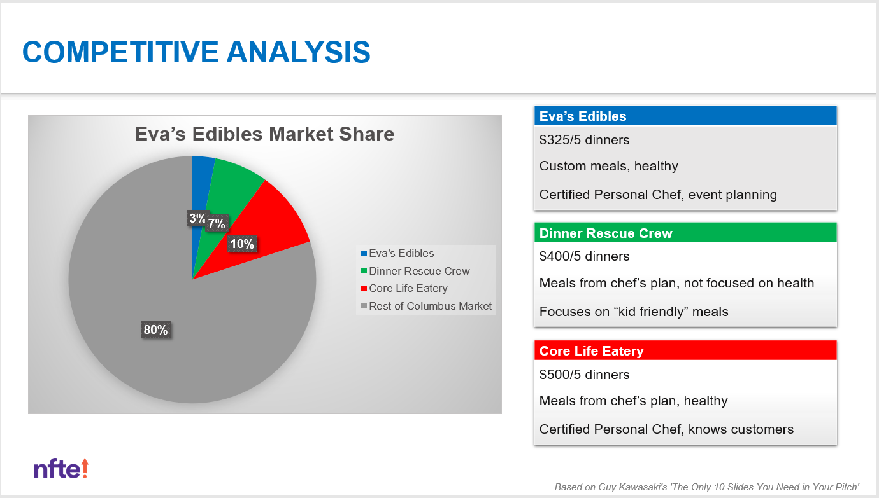
[COMPETITIVE ANALYSIS]
Remove this slide before presenting!
Show you have thoroughly researched your industry and competitors, and that your business has at least one feature that makes it unique from your competitors.
Be sure to include:
Data that show your industry is growing and competitive
A description or images of your main direct/indirect competition
An explanation or design of your competitive advantage
Your estimated market share
Lean Canvas: Unique Value Proposition, Unfair Advantage

Slide 16
COMPETITIVE ANALYSIS

Slide 17
[QUALIFICATIONS]
Remove this slide before presenting!
Show you have the knowledge, skills, and determination required to start and then manage your business. Remember: Judges aren’t just investing in your business; they’re investing in YOU.
Be sure to include:
A bulleted list or pictures of your relevant accomplishments, group affiliations, leadership positions, and past experiences
An explanation of how your unique qualifications are part of the business’s value proposition and unfair advantage
Lean Canvas: Unique Value Proposition, Unfair Advantage

Slide 18
QUALIFICATIONS

Slide 19
[COST STRUCTURE]
Remove this slide before presenting!
Show you can feasibly produce your product or execute your service in a cost-effective and time-efficient manner.
Be sure to include:
Definition of One Unit
COGS or COSS
EOU
Description of Fixed and Variable Expenses
Break-Even Units
Lean Canvas: Cost Structure, Revenue Streams

Slide 20
COST STRUCTURE
Definition of One Unit
[text]
Description of Expenses
Variable Material Expenses | Total: $
Item | $
Fixed Expenses | Total: $
Item | $
Economics of One Unit
Selling Price |  | $[value]
Cost of variable materials | $[value]
Cost of labor | [value]
Other variable costs | [value]
Total COGS/ COSS |  | $[value]
Contribution Margin |  | $[value]
Monthly Break Even Units
$[month exp] | = | [value] | ≈ | [value] units
$[con margin]

Slide 21
[CURRENT STATUS & FUTURE PLANS]
Remove this slide before presenting!
Explain what you would do at launch and beyond the first year. Highlight business growth goals and opportunities for additional education, training, or funding.
Be sure to include:
An overview of your business’s current status (near future) plus next steps, including 2–3 next steps you need to take to make your business fully operational
An overview of what costs are expected / money will be needed once the business is up and running
2–3 education, training, or mentoring opportunities to help with your business
Immediate social responsibility plans and long-term philanthropy goals

Slide 22
CURRENT STATUS & FUTURE PLANS

Slide 23
[TITLE]
Remove this slide before presenting!
This slide is simply a placeholder to let judges know you are finished and to be displayed during judge’s questions.
Be sure to include:
Business name
Logo
Your name
Slogan
Social media pages

Slide 24
TITLE

