Slide 1
Using Office 365

Slide 2
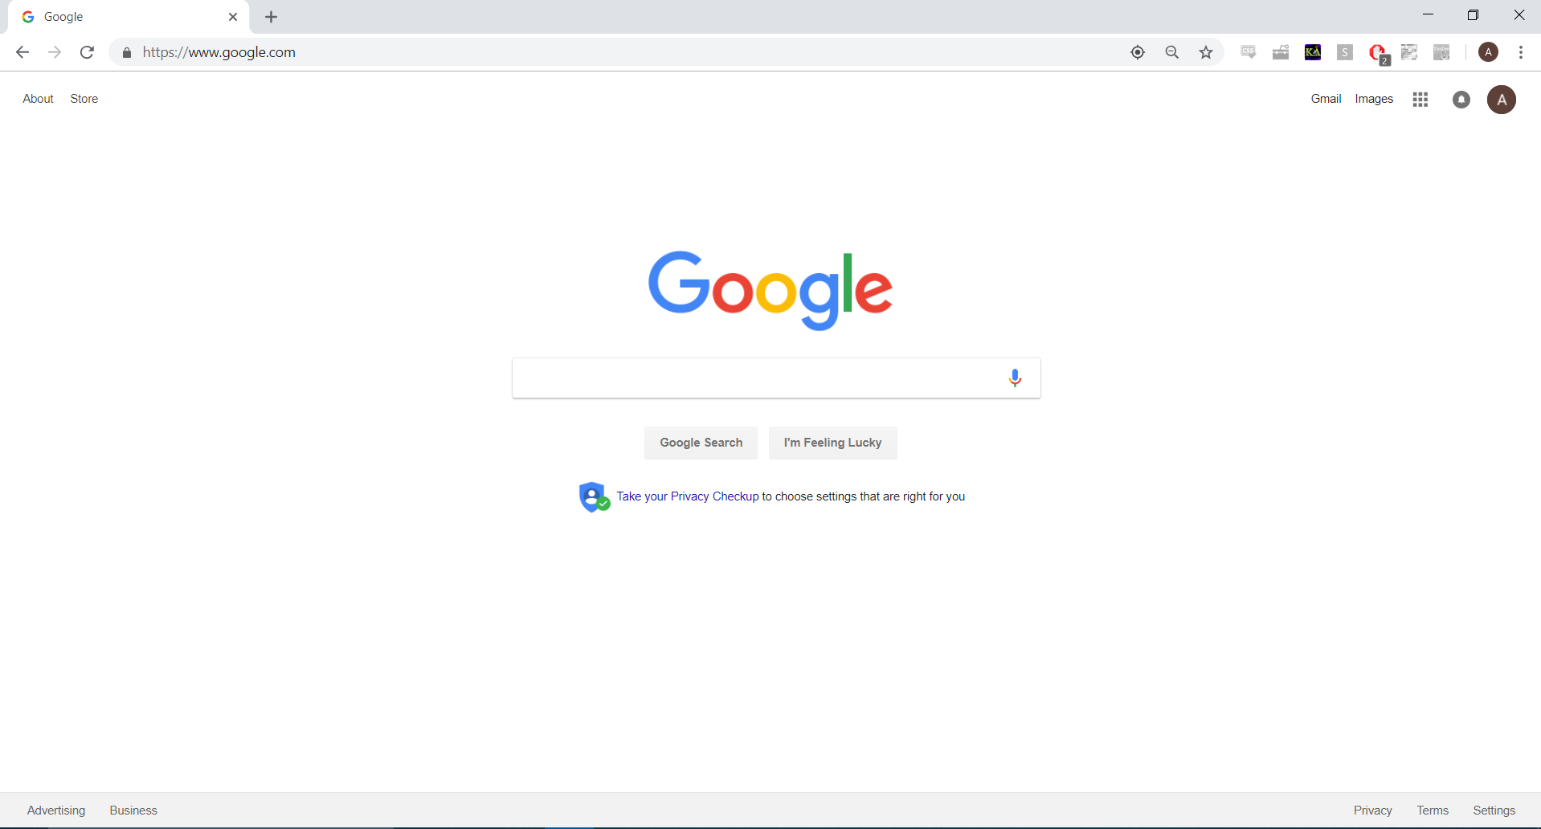
Search “Office 365” here.

Slide 3
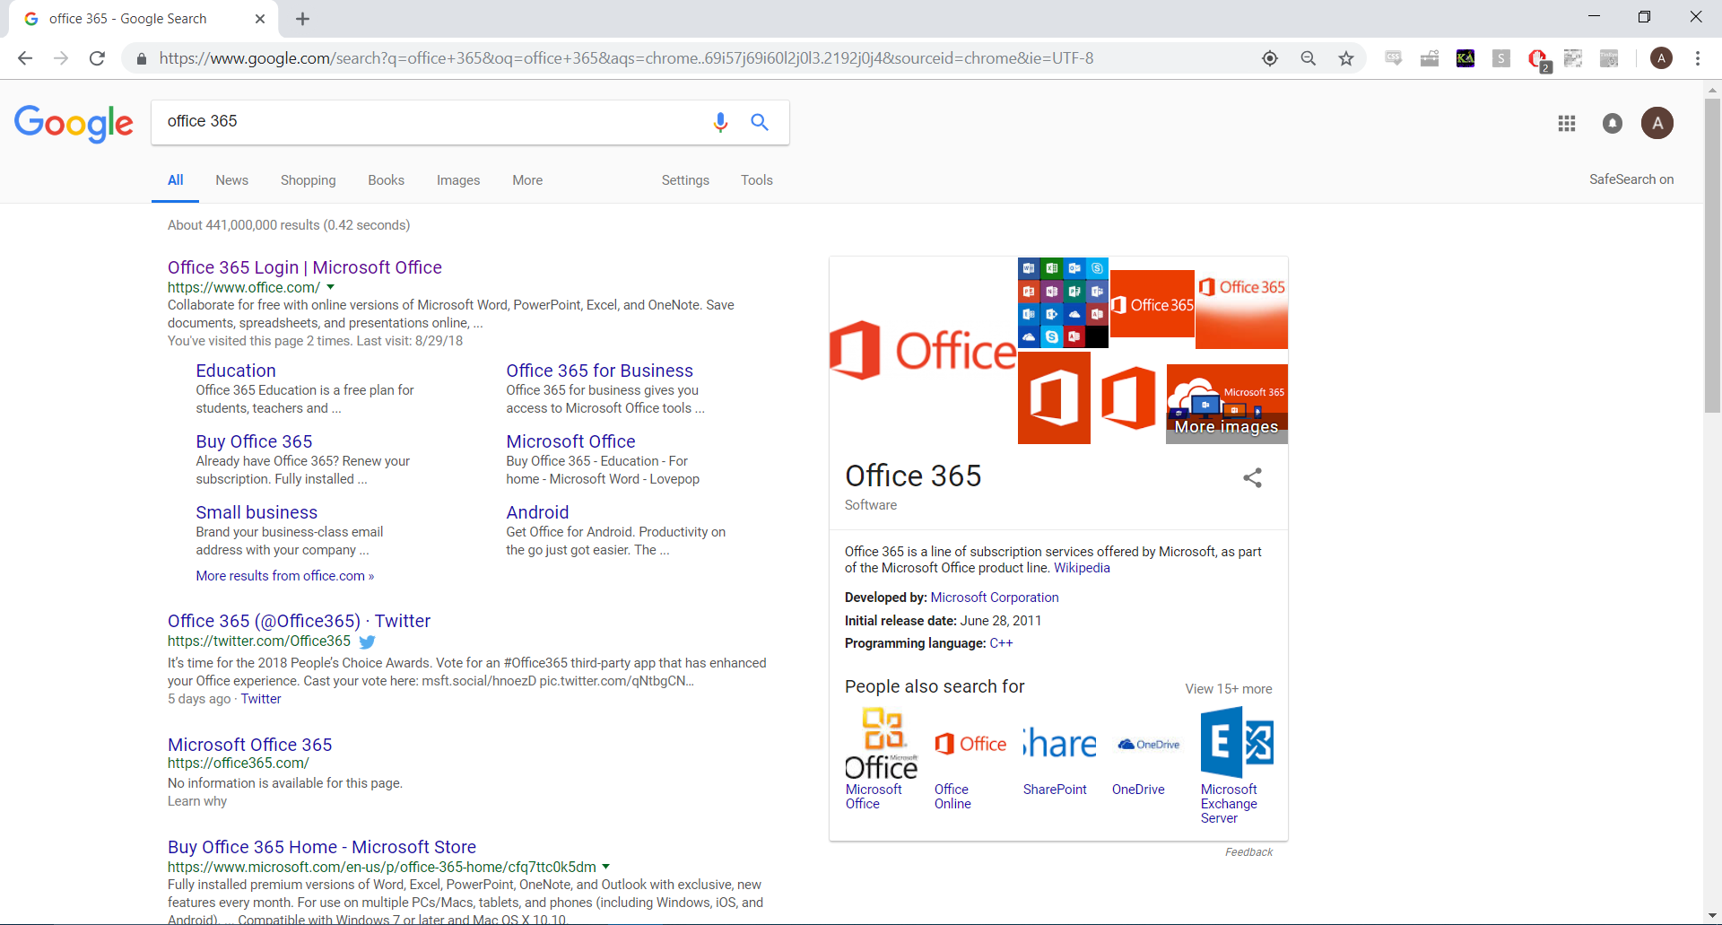
Click the first result.

Slide 4
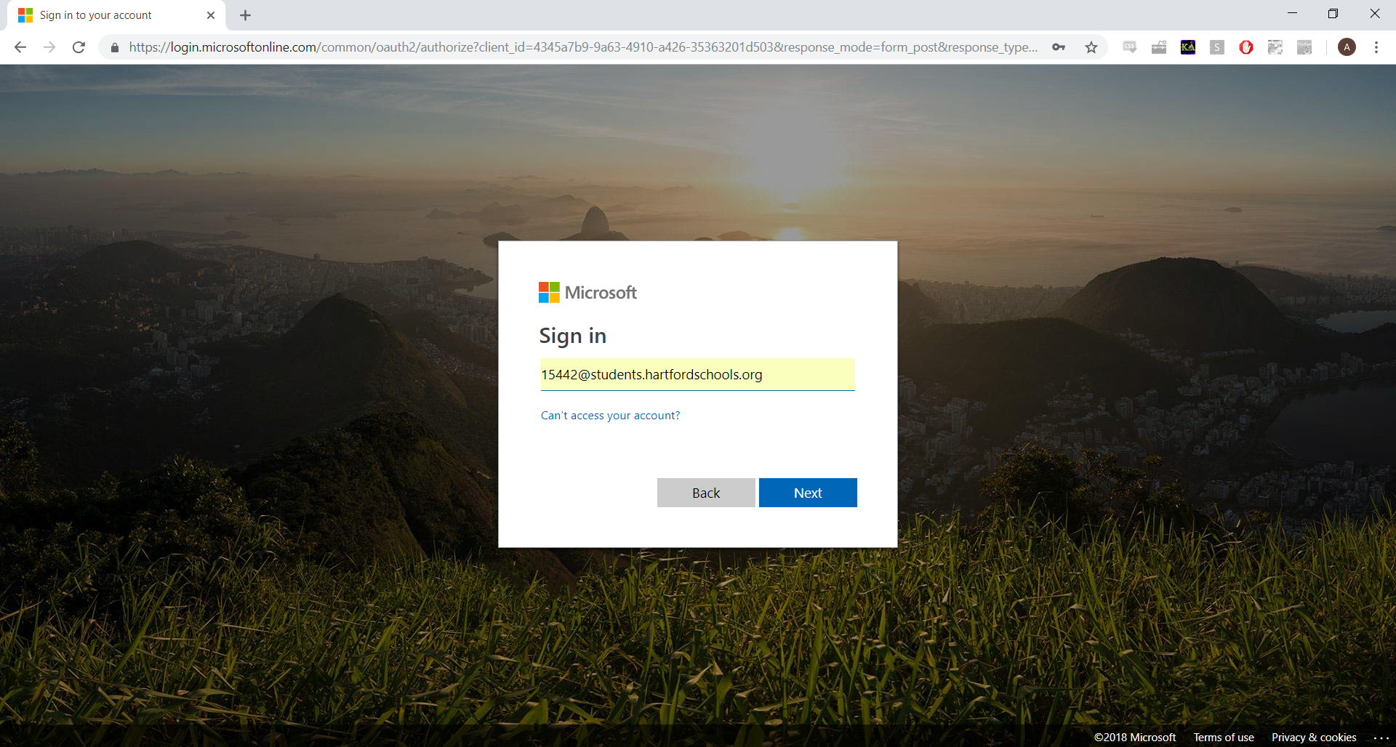
Enter your school email in the following format:
studentid@students.hartfordschools.org

Slide 5
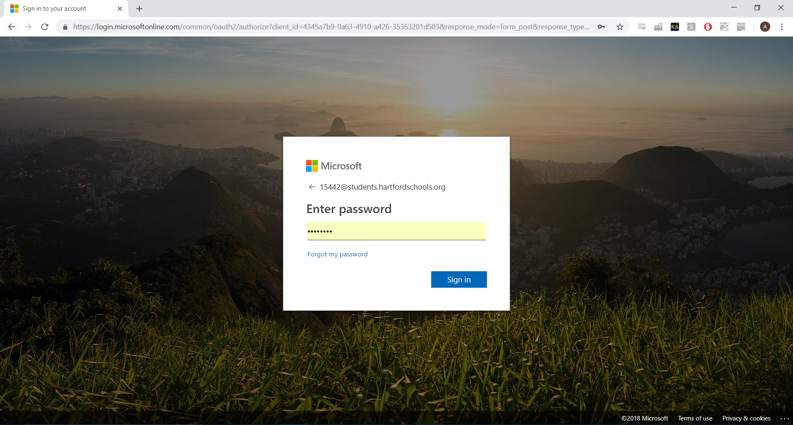
Enter your date of birth in the following format:
YYYYMMDD

Slide 6
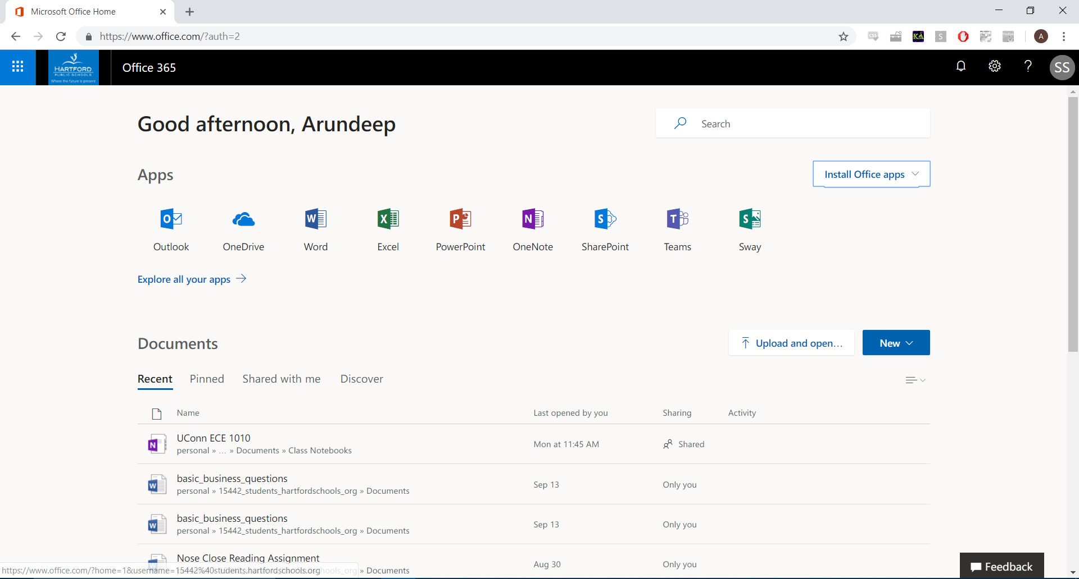
You should now be logged in.
Note: You may not have any documents listed below. Any documents you upload will be saved here and can always be accessed using your Office 365 login from any location

Slide 7
To upload a document to edit using Word or PowerPoint online, click here.

Slide 8
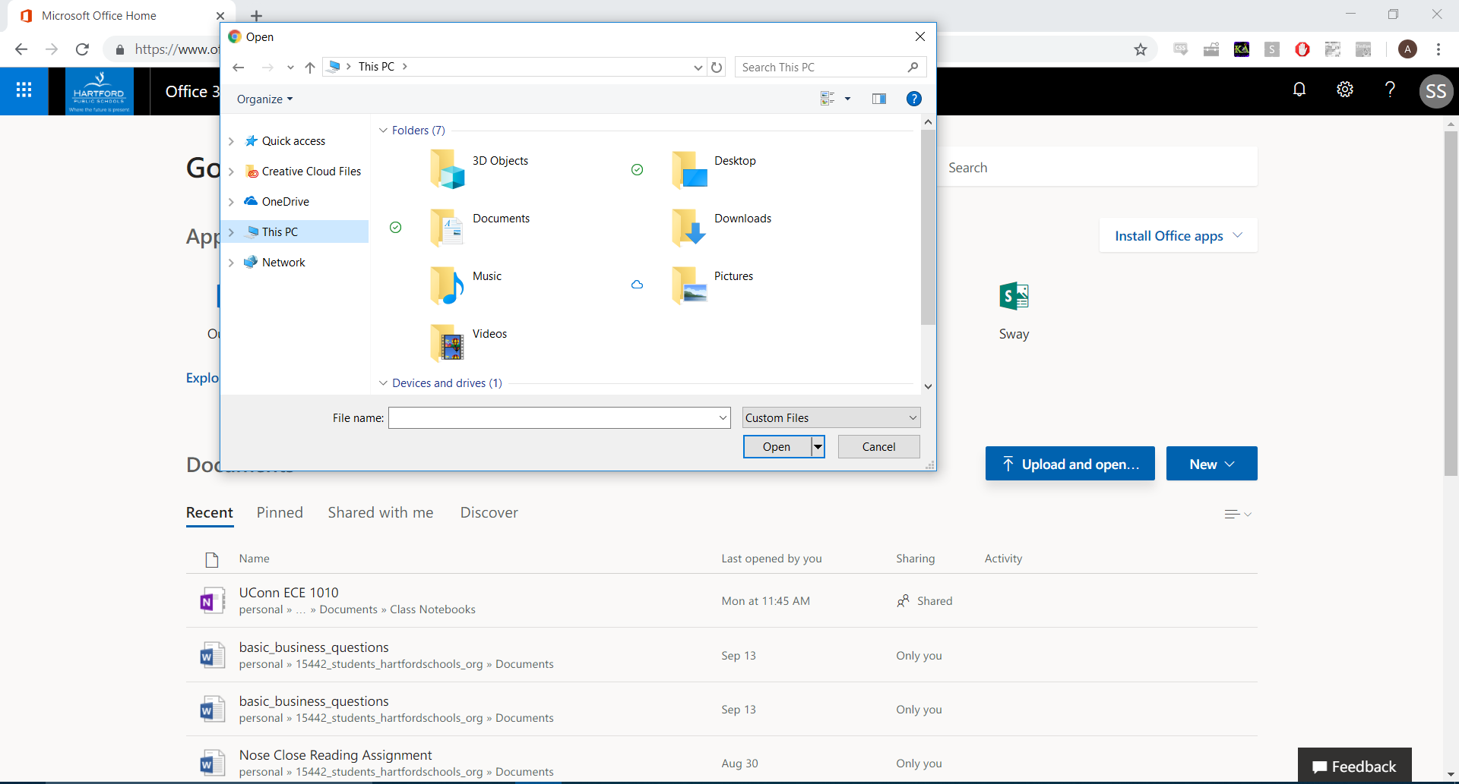
Locate the file you would like to open, and click open.

Slide 9
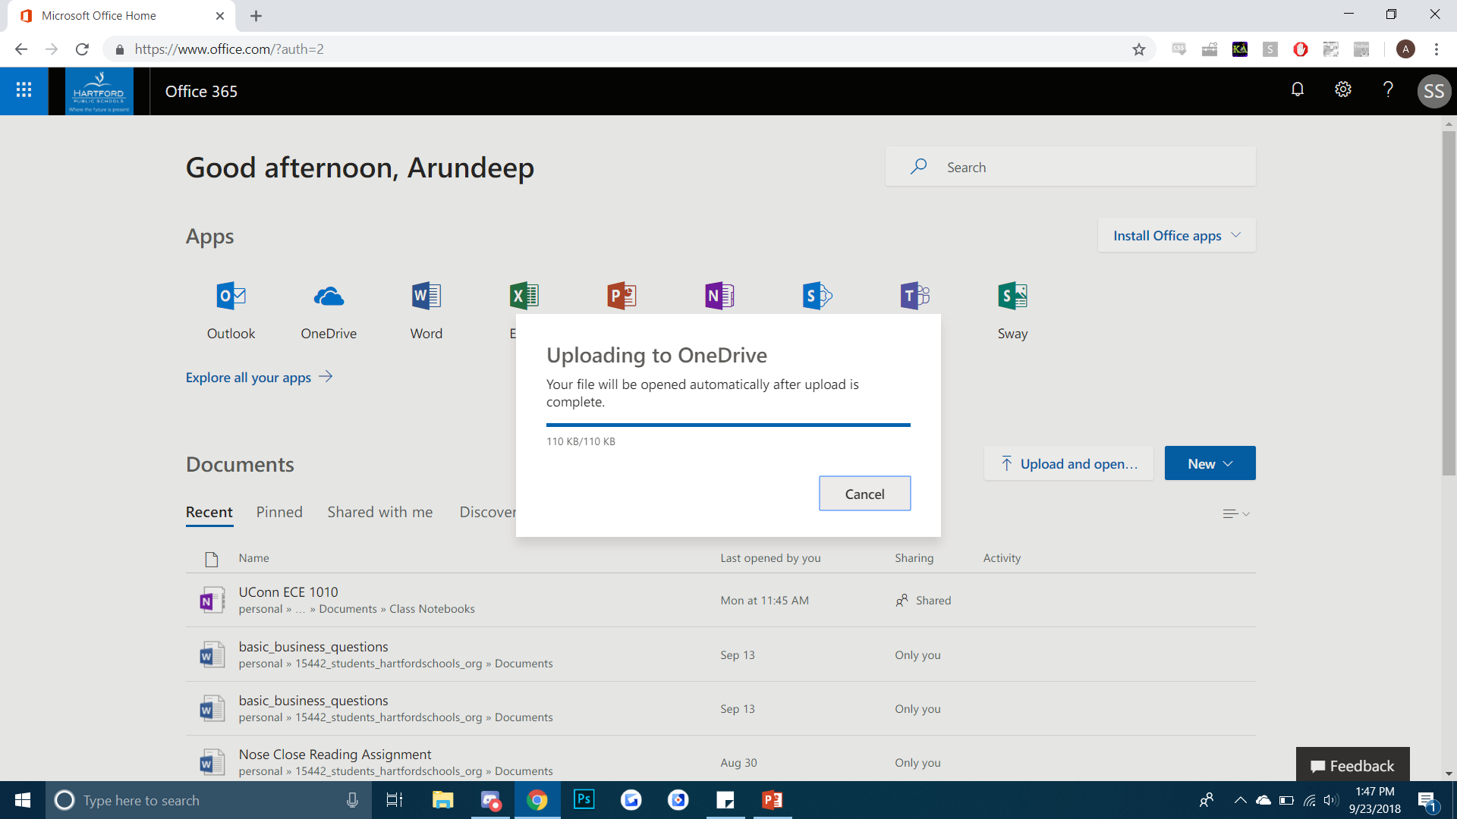
The file will be uploaded to OneDrive and automatically be opened.

Slide 10
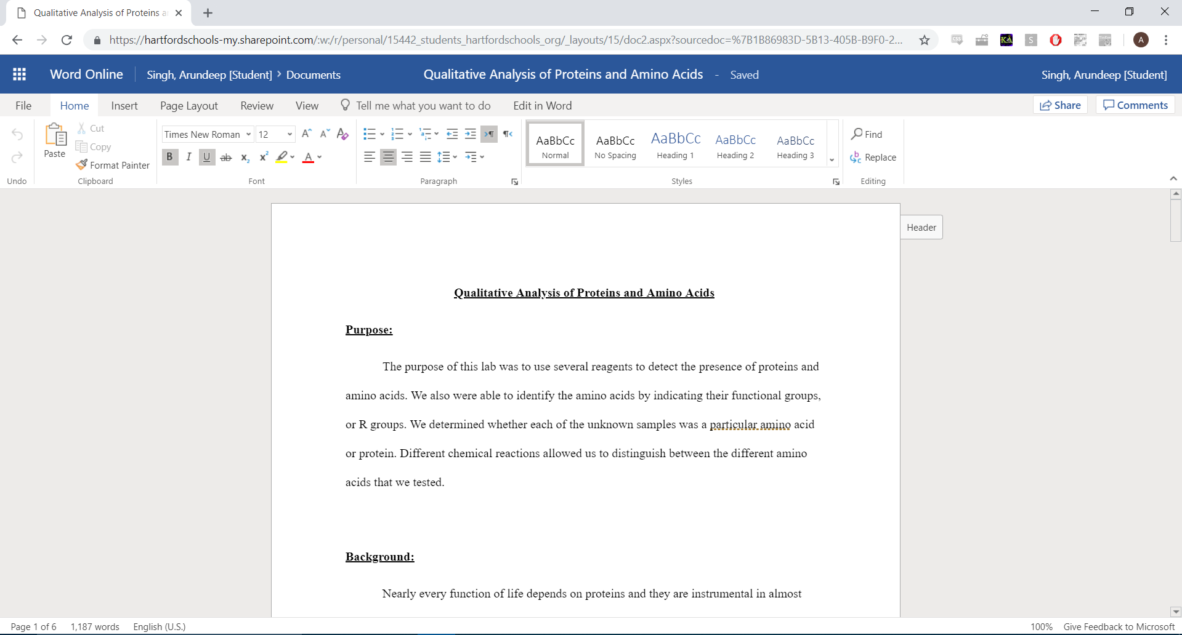
Now that the document is open, you may edit it. Word Online will automatically save.
To save this file to another location, such as a flashdrive, click File > Save As

Slide 11
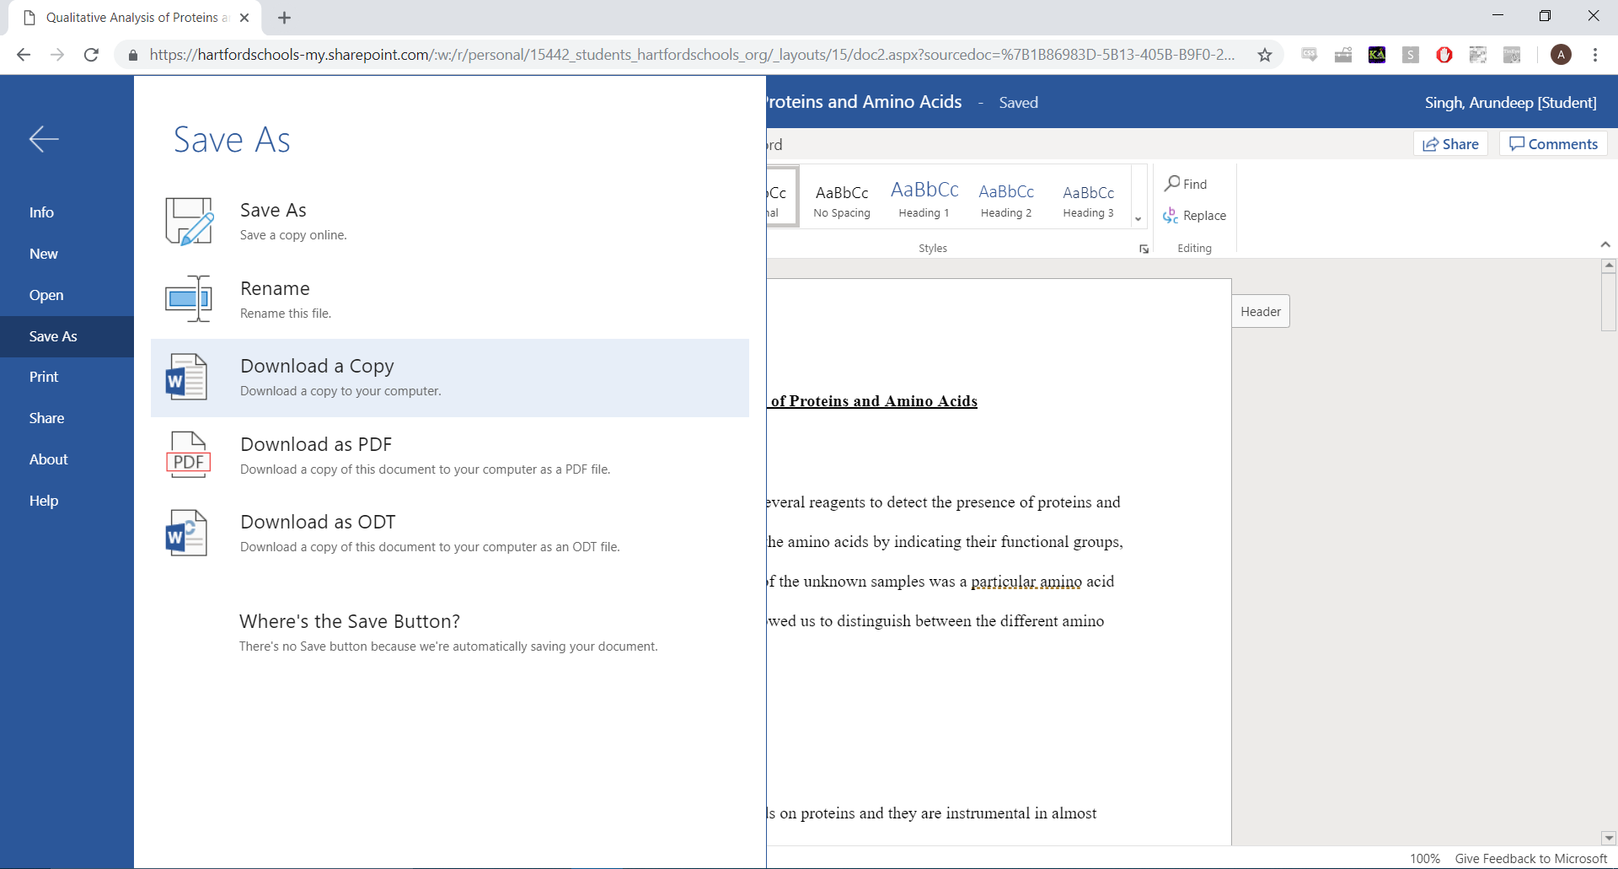
Click “Download a Copy” and save the download to the flash drive.

Slide 12
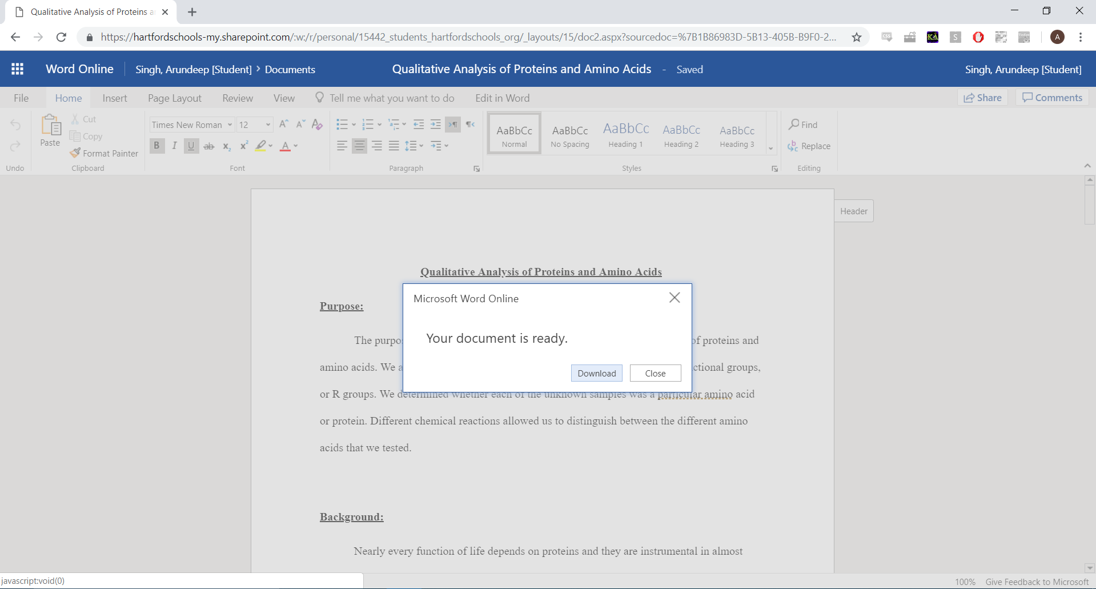
Click “Download”

Slide 13
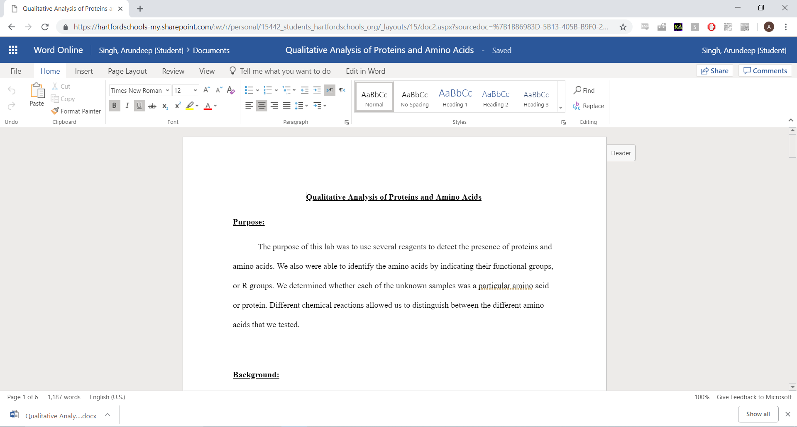
The file will be downloaded to wherever you have downloads go, which is usually the downloads folder.

Slide 14
You can access the file in the downloads folder and drag it into any other location, such as a flash drive, to save it there.

