Slide 1
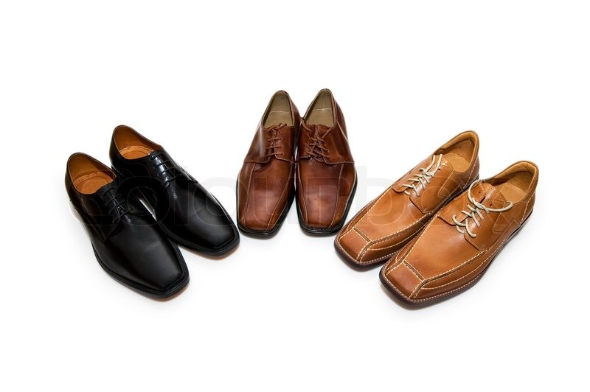
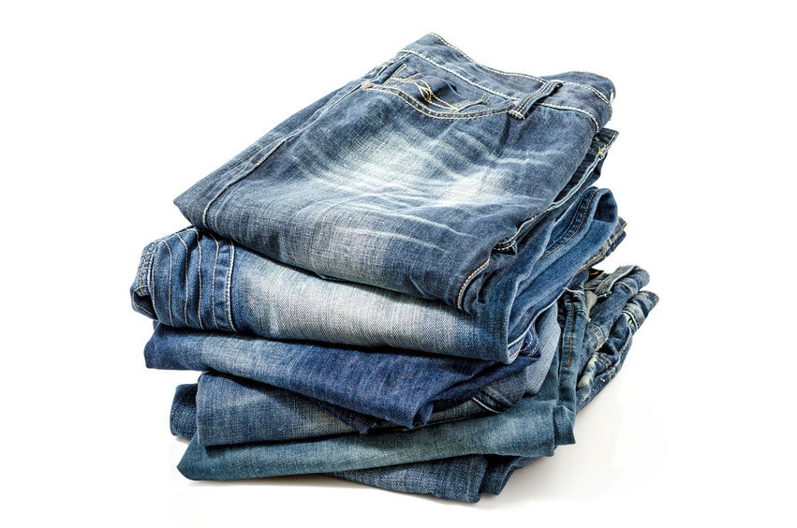
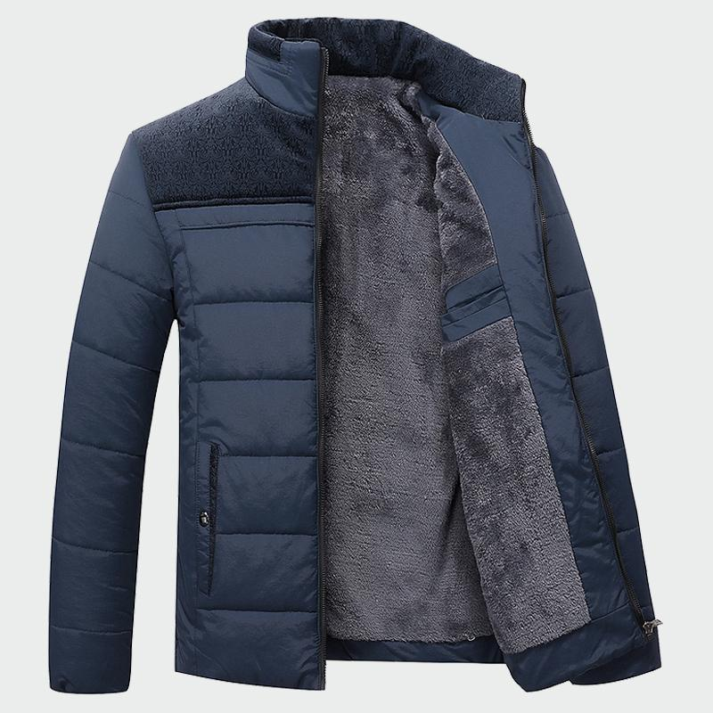
370 × 325Images may be subject to copyright. Learn MoreImage credits
Notes:
Michelle: How many times have you flown someone and knew exactly what you were going to bring
Victoria: you were going to bring 5 pairs of shoes
Michelle : 5 pairs of pants
Victoria: 2 suits
Michelle: and 2 jackets
Victoria: Happens all the time right
Michelle: Yeah probably not. But what if we told you we have a solution
Victoria: our app will put a stop to the stress
Michelle: and handle the rest

Slide 2
Pack & Go, LLC
Travel Like an Expert!
Email: packandgocustomerservice@gmail.com
Facebook: Pack & Go
Instagram: packandgoapp
Victoria Adler
Michelle Wegrzyniak
Notes:
Michelle: My name is Michelle Wegrzyniak.
Victoria: My name is Victoria Adler and this is Pack & Go, LLC.

Slide 3
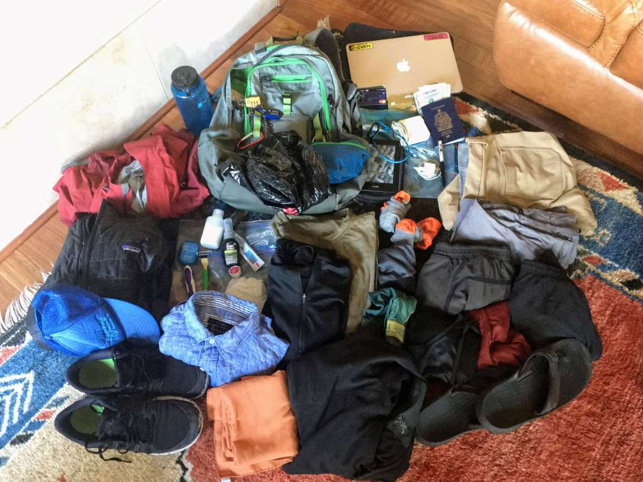
Problem
Lacking knowledge of how to pack
Space inefficiency
Unexpected changes in weather
49% of travelers
experience stress because of packing
Notes:
Michelle: The most stressful part of traveling for most people is packing their suitcase. They will stress out because they don’t know what to pack, worry about forgetting a couple of items, and they will also TSA regulations, this basically limits what items you can bring on your carry on. Travelers will also worry about fitting everythinginto their suitcase and even ask themselves if they should you fold it or roll it. There are factors that you can not control and one for sure is the weather. It can change in just a couple days and interrupt your plans that you are unaware of.

Slide 4
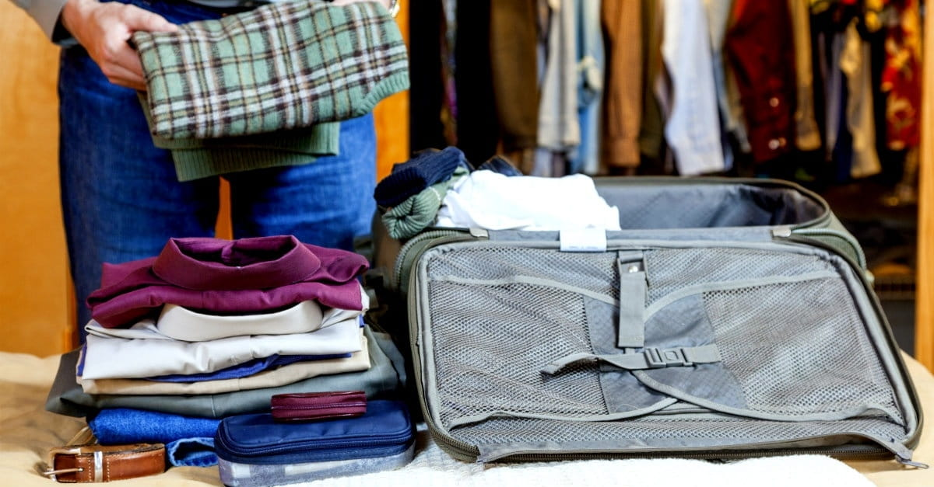
Value Proposition
Checklist of basic necessities
Virtually pack your belongings
Notifications of weather changes
70% of those surveyed need help folding/packing their items
Notes:
Victoria: We have the solution for our travelers that have these problems. With Pack & Go’s customizable checklist, users can check off the basic necessities and other items they may want to bring. We will also inform our customers of TSA regulations so passing through security wont be a hassle. Our customers will also have our support when they start packing into their suitcases or bags. We will have a feature that will virtually pack your suitcase or carry-on. We also ensure our app is updated regularly and notify the users of changes in weather on their specific trips.

Slide 5
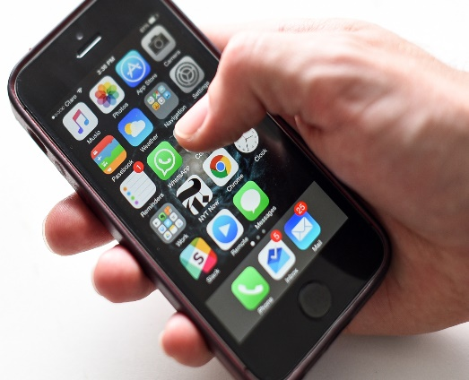
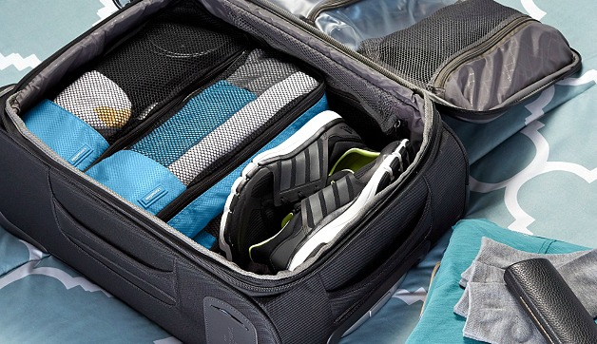
Pack & Go
IOS Compatible
Checklist based on your destination, activities and weather
Virtually packs your belongings in your suitcase
Instructions how to fold and pack items into suitcase
Notes:
Michelle: The app, Pack & Go, will be compatible on only on IOS devices. Users can use the customizable checklist that is based on their destination, length of travel and the weather at the destination. There will also be updated notifications of any changes in the weather. Our app will also provide TSA regulation information to make it convient for users to check whether or not they can bring a particular item or specific amount of substance.
Victoria: Pack & Go will give helpful visuals on how to pack all of your belongings into your suitcase or carry-on. The virtual packing feature is where they will receive a visual of how to pack and fold the items into their virtual suitcase on the app (dimensions reported to us) and we will do the rest. This will relive our customers of the stress that comes along with packing and ensure that they have everything they need for a successful trip.

Slide 6
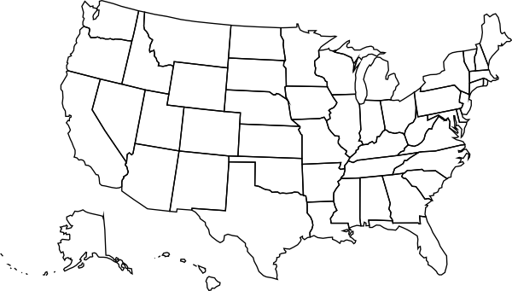
Target Market
Market Statistics
Industry Name: | Software Publishing Industry | Annual Industry Sales: | $250 Billion
Description of Target Consumer
Demographics | Geographics
Males Inexperienced packers Business professionals | U.S. app users
Psychographics | Buying Patterns
People that want a relaxing trip People who enjoy traveling | People willing to pay for an app
Target Market Size
Total Population
224 Million
Target Market Population
7,400,000
Market Size
74,000
Notes:
Victoria: Pack and Go is in software publishing industry. Americans spend $250 billion towards this industry every year. Pack & Go targets 74,000 males who are inexperienced packers or/and business professionals.
Michelle: Pack and Go will be targeting 1% of our target market, which is 74,000 people. We choose to target males based on a survey that we conducted on where over 80% of males responded that they have difficulty packing. We will also have a secondary target market which includes other Travel Businesses and companies.

Slide 7
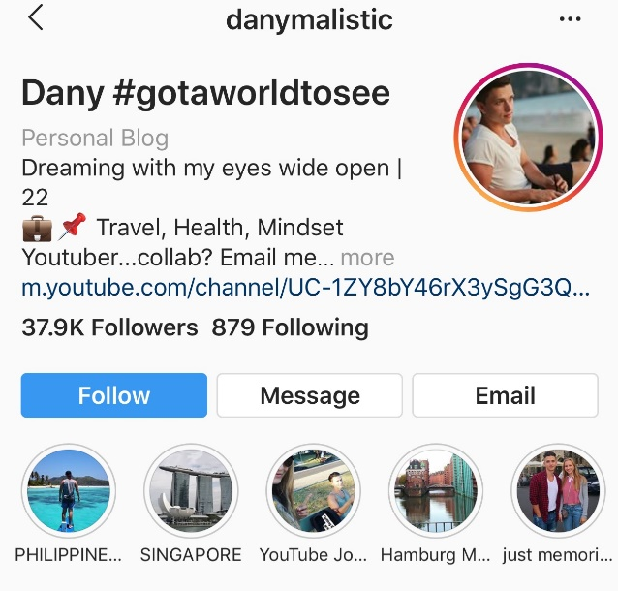
Marketing Plan
Awareness
Purchase
Retention
Advertisement of Pack & Go on other sites
Notes:
Michelle: The users will be aware of our app through YouTube sponsorships, podcasts, and on social media like Instagram and Facebook. With our YouTube sponsorships, we will reach out to smaller YouTubers to use our app and post a video of them using it. We will also have our own YouTube channel to show our users how to use our app. Users can purchase our app on the app store. People can also learn and find out about our app through word of mouth and advertisements on other pages. An example of a traveler is this one above who videos himself traveling around the world.
Victoria: Our app will have continuous users as well as new users. New users will see our app being advertised on other platforms like travel companies such as Trivago and Expedia.

Slide 8
Competitive Analysis
Unique Factors | Pack & Go | Packing Pro | PackPoint
Packing List | Customized packing list | No customizable options. Basic item list | Customized packing list (Premium only)
Virtual Image | Offers a virtual packing feature | Not included | Not included
Weather Notifications | Updated regularly | No weather notifications | No weather notifications
Notes:
Victoria: Pack & Go will provide a customizable checklist based on your location and the activities you will be doing compared to our other competitors PackPoint and Packing Pro where you have to have the premium package to customize the list.
Michelle: Pack & Go is also the only app on the market that virtually packs your suitcase or carry-on.
Victoria: Pack and Go will notify our users of any weather changes that may affect your trip.
Michelle: We are in the software publishing industry which is dominated by businesses such as Apple, Samsung, travel companies, etc. Since they have so much of the market, we will aim for 2% of the market share.

Slide 9
Qualifications
Knowledge of computer programming, website/app design
Have taken AP Computer Science and AP Calculus courses
Have a Master’s Degree in Computer Science in 2026
Bilingual in Polish and have taken Spanish curriculum
Notes:
Victoria: We will be qualified to run this app because we will have the knowledge of computer programming and website and app design. We are also taking AP Computer Science and AP Calculus Courses. Our plan is to have a master’s degree in Computer Science in 2026. We plan to be operational in 2024 when we have our Bachelor degrees.

Slide 10
Business Model
Definition of One Unit
1 Download of Pack & Go
Description of Expenses
Variable Material Expenses | Total: $0.00
Fixed Expenses | Total: $1515.40
Item | $
Rent/Utilities | $150.00
Advertising | $100.00
Depreciation | $125.00
Update | $40.40
Salary | $1,100.00
Economics of One Unit
Selling Price |  | $1.99
Cost of var. materials exp. | $0.00
Cost of labor | $0.01
Other variable costs | $0.60
Total COGS/ COSS |  | $0.61
Contribution Margin |  | $1.38
Monthly Break Even Units
$1515.40 | = | 1,098.1 | ≈ | 1,099 Downloads
$1.38
Notes:
Victoria: At Pack & Go our economics of one unit is one download because our users will only download one app.
Michelle: Our selling price for one download of Pack & Go is $1.99. Since all our app is already programmed there will no other variable material expenses. We will create one update per month, which takes us four hours, meaning it will be $40.40 but since we are only having a unit of 1 download our labor will cost $0.01 per download. Apple takes away 30% of one download each time meaning they will deduct $0.60. This ends up with our total Cost of Goods Sold of $0.61. We end up with a profit of $1.38.
Victoria: Our app will be $1.99 with the virtual feature but there will be on ads. To get rid of ads, the users will have to pay $0.99. Our total fixed expenses is more than $1,500 and this includes our depreciation, update and salary of $1,100. We breakeven at 1099 downloads per month.

Slide 11
Philanthropy
Future Plans
Create more apps such as a flight tracker with updated notifications
Grow on social media
Partner with other travel apps and clothing companies
Donate 5% of our yearly net profit to the World Spine Care
Notes:
Victoria: In the future, we will create more apps, especially for first time travelers, such as a flight tracker that would update you on your flight. We aim to grow on social media during our second and third years of being operational. During these years, we will partner with other travel apps and clothing companies to make traveling more convenient for our users.
Michelle: Our partnership with clothing companies will include renting items and sending it to our users destination to reduce the need for a suitcase. To give back to the community, Pack & Go will donate 5% of our yearly net profit to the World Spine Care. We chose this organization because…(Michelle tells story).

Slide 12
Pack & Go, LLC
Travel Like an Expert!
Email: packandgocustomerservice@gmail.com
Facebook: Pack & Go
Instagram: packandgoapp
Website and YouTube Coming Soon!
Victoria Adler
Michelle Wegrzyniak
Notes:
Michelle: Thank you for your consideration of Pack & Go.
Victoria: You can contact us at our email and our website is coming soon. And always remember,
Both: Travel Like an Expert.

