Slide 1
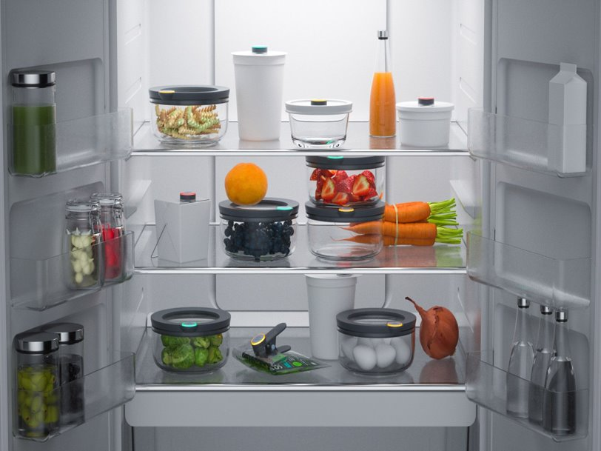
Notes:
Sumeja: Ever since we were young, Azerina and I have enjoyed cooking or rather destroying her mom's kitchen. Whether it was the Nutella rice krispie treats, which we don’t recommend, or the watermelon pops, which we also don’t recommend, we are lucky to be alive and not have burned her house down.
Azerina: Even though we were little and had no idea what we were doing, we still loved to cook despite being pretty terrible at it. This is a common problem that young adults face, they have all of these ingredients and they want to cook, but they don't know how to combine the ingredients to make a meal.
Sumeja: With Pic-a-Dish, you can simply use your phone to take a picture of ingredients you already have and recipes according them will come up.

Slide 2
Pic-A-Dish
It's always delish with Pic-A-Dish
Sumeja Guster
Azerina Muskic
Sport and Medical Sciences Academy
picadishcustomerservice@gmail.com
Notes:
Sumeja: Good Morning Everyone, my name is Sumeja Guster.
Azerina: And my name is Azerina Muskic
Together: And we are Pic-A-Dish

Slide 3
Problem/Opportunity
Struggle to combine ingredients
People overspend on eating out
Food waste
Notes:
Sumeja: With Pic-a-Dish, the problem were trying to solve is that younger individuals don’t know how to combine ingredients to make themselves a meal so this results in them overspending on eating out.
Azerina: Did you know that only 45% of 16-24 year olds consider themselves good cooks and most individuals don’t even know how to combine the ingredients they have to make themselves a meal. Also, according to one study, 16-24 year olds spend about $84 on take out every week. And lastly according to the Department of Agriculture and EPA, as much as 40% of food in America goes uneaten.

Slide 4
Value Proposition
Provides recipes according to ingredients
Decreases spending on eating out
Reduces food waste
Notes:
Sumeja: With Pic-a-Dish, individuals can simply use their phones to take a picture of the ingredients they have in their fridge and recipes according to them will come up. Using our app would also help solve two other problems, like how much money younger individuals spend eating out and how much food ends up being wasted in America.
Azerina: As we said before, the average young adult spends $84 eating out every week, with Pic-a-Dish, this expense can be avoided by providing delicious recipes at your fingertips. Pic-a-Dish also solves food waste by encouraging individuals to use the ingredients they already have in their home instead of wasting it.

Slide 5
Notes:
Azerina:
Sumeja:
Azerina:

Slide 6
Target Market
Description of Target Consumer
Demographics | Geographics
Male and Female Age: 20 to 35 | United States of America
Psychographics | Buying Patterns
Interested in learning how to cook | Download apps to get recipes Buy groceries before finding recipes
Target Market Size
Total Population
328 Million
[value]
Target Market Population
66 Million
Market
Size
660,000
According to our survey, 76% of our target market is interested in learning how to cook.
Notes:
Azerina: Our primary target market is 16-24 year old males and females who live in the US and are interested in learning how to cook. After doing our own target market survey, we found that 76% of our target market is interested in learning how to cook.
Sumeja: We started off with the total population of the United States and brought it down to16 to 24 year olds in the United States and finally narrowed it down to 310,000 people by taking 1% of the total population.

Slide 7
Marketing Plan
Notes:
Instagram: cooking life hacks and informational videos and paid promotions from influencers
Twitter: cooking fails from our users and outside sources
Facebook: same as Instagram but the older end of our target market
Youtube: longer cooking videos and paid promos from influencers
We will use instagram and facebook to show cooking life hacks (explain target market)
Twitter for cooking fails and youtube for longer cooking videos.

Slide 8
Competitive Advantage
 | Pic-A-Dish | RecipeGen | Cravings: Hungry for More
Price | Free | $4.00 | $30.00
Features | You take a picture of the ingredients you have | You type in/select the ingredients you wish to use | You search the book for a recipe you want to make.
Language | Recipes available in English, Bosnian, and Spanish | Recipes only available in English | Recipes only available in English
My Competitive Advantages
1. Pic-a-Dish is a free app 2. You are able to take a picture of as many ingredients you want or have 3. Recipes will be available in English, Bosnian, and Spanish
Notes:
Azerina: Two of Pic-a-Dish’s competitors are RecipeGen and Cravings: Hungry for more. Both Pic-a-Dish and RecipeGen are apps, while Cravings: Hungry for more, is a cookbook.
Sumeja: Pic-a-Dish is free to use, while RecipeGen costs $4 and Cravings: Hungry for more costs $30. Our app also allow you to just take a picture of as many or as little ingredients you have unlike RecipeGen which requires you to type in or select the ingredients, and Cravings: Hungry for more where you find the recipe you want and not the ingredients.
Azerina: In addition, Pic-a-Dish will also include recipes in English, Bosnian and Spanish unlike our competitors who only include them in English.

Slide 9
Qualifications
Experienced in cooking
Financial Skills
Bilingual
MBA & degree in Software Engineering
Notes:
Azerina: One of the qualification that we have to run Pic-a-Dish is that we are both experienced in cooking meaning we know how to combine ingredients to make it into a meal.
Sumeja: Our other qualifications are I am currently taking Calculus and this will help us in all the financial aspects of our business and I plan to learn how to develop an app. Both of us are fluent in Bosnian and English and are taking a Spanish class.
Azerina: Also, by 2026, I will have an MBA and Sumeja will have a degree is software engineering.

Slide 10
Cost Structure
Definition of One Unit
3 Thirty Second Advertisements per Advertiser
Description of Expenses
Variable Material Expenses | Total: $0.00
N/A | $0.00
Fixed Expenses | Total: $7,550.00
Utilities/Rent | $250.00
Salary | $7,000.00
Advertisement | $200.00
Depreciation | $100.00
Economics of One Unit
Selling Price |  | $4,050.00
Cost of var. materials exp. | $0.00
Cost of labor | $2.53
Other variable costs | $0.00
Total COGS/ COSS |  | $2.53
Contribution Margin |  | $4,047.47
Monthly Break Even Units
$7,550.00 | = | 1.87 | ≈ | 2 Advertisers
$4,047.47
Notes:
Azerina: Our economics of one unit is three thirty second advertisements. We predict that the average amount of time one user would spend on our app is 45 minutes with all the prep and cook time involved. Our app will show one 30 second video advertisement every 15 minutes, meaning each user will see 3 ads per use.
Sumeja: We estimate to have 3,000 people using our app a day, meaning 9,000 total impressions. If we charge $15 per 1000 impressions, that gives a total of $135 in ad revenue daily. Our cost of labor is $2.53, making our contribution margin $132.47

Slide 11
Current Status & Future Plans
Current Status
Available in English, Spanish, & Bosnian
Expansion
Make app available in more languages
Create partnership with Food Network
Hire professional chefs to create recipes in our own kitchen
Giving Back
5% of our yearly net profit to food banks located in Bosnia and Herzegovina
Notes:
Expansion: For our first year the languages we are available in are English, Spanish, and Bosnian, to expand we want to make our app available in more languages for example for our second year we plan to expand to Mandarin and Arabic. We also plan to create a partnership with Food Network and use their recipes on our app
50 percent of the population depends on agriculture even though much of the land in Bosnia is not suited to agriculture. Farmers also lost 90 percent of their livestock in the war. Children face disproportionate levels of poverty and, according to UNICEF, 170,000 children in Bosnia are poor.

Slide 12
Pic-A-Dish
It's always delish with Pic-A-Dish
Sumeja Guster
Azerina Muskic
Sport and Medical Sciences Academy
picadishcustomerservice@gmail.com
Instagram, Twitter, & Facebook Coming Soon
Notes:
Sumeja: Good Morning Everyone, my name is Sumeja Guster.
Azerina: And my name is Azerina Muskic and this is Pic-a-Dish.

