Slide 1
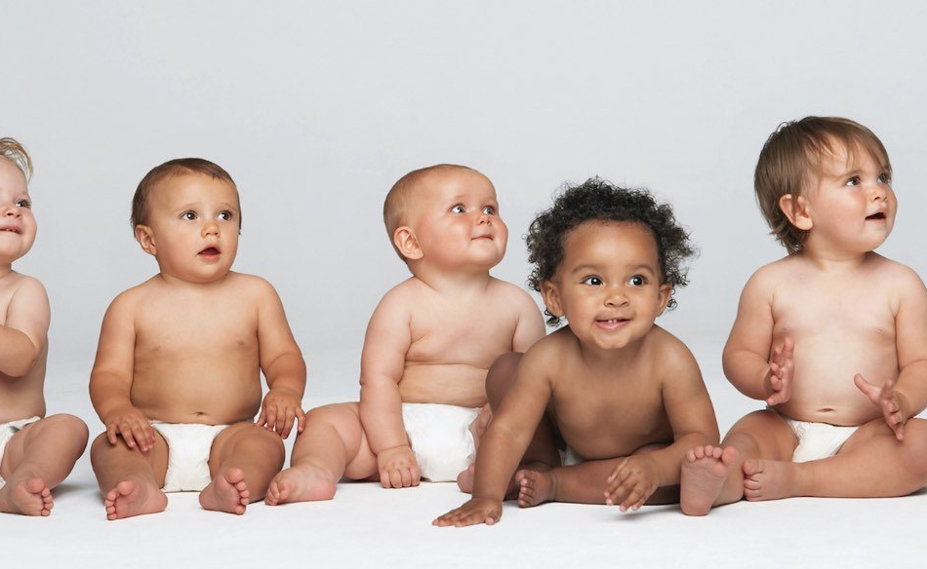
Notes:
A new baby on the way always has people’s pockets running.
How many of you know someone who’s had a baby or is having a baby? Are they planning on having a baby shower, if so, do you know what you would get the mother to be? “With 4 million babies born in the U.S. each year, and the average amount spent on each baby shower itself ranging from $200 to $1000, the potential contribution to the American economy is sizable.”

Slide 2
Premium Tots, LLC
Keely Matthews
Notes:
Good morning my name is Keely Matthews and this is Premium Tots.

Slide 3
Problem
High priced items on the baby’s registry
Last minute shopping
New mothers aren’t provided true necessities
Notes:
When baby shower invites get sent out, family and friends tend to stress out on what they are going to get the parents to be. New mothers have a tendency to put only high prices on their baby’s registry, but very few of their family or friends will get be able to get it. Most people have a tendency to shop last minute because they have plenty of other things on their mind. New mothers necessarily aren’t provided true necessities that they want or need so in a sense the gift goes to waste.

Slide 4
Solution
Save money
Convenience
Satisfaction
Notes:
Premium Tots wants to provide an way for customers that will help them save money, be convenient, and be satisfied all in one.

Slide 5
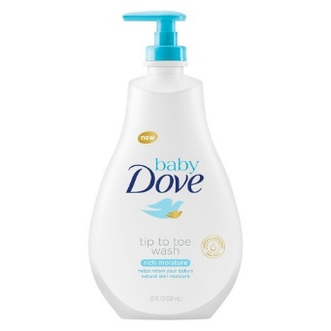
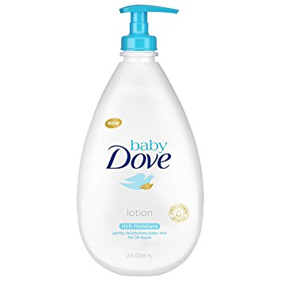
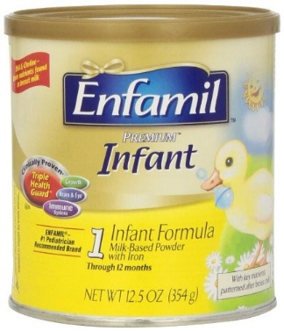
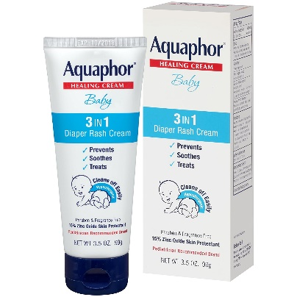
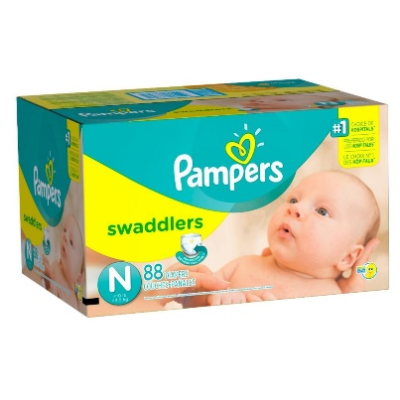
Description of Product
Fits every need of a newborn/ mothers to be/ fathers to be
Standard items plus personal customization
Tracking number
Adjustable shipping date
Cancellations
Notes:
The Premium Tots gift basket is a fabulous way to present to the new parents at their baby showers.
We specialize in making sure that the gift baskets fits every need of the new parents or the newborn baby itself.
The standard items in the basket will be diapers, wipes, baby formula, diaper rash cream, baby body wash and lotion plus additional items of your choice. The gift basket is customizable to the customer’s choice, where we will have a section for when you are assembling the gift basket together. On our website, there will be a set of lists on suggested gift baskets from us.
Customers will be provided with an tracking number in your confirmation email from us and from you will be able to track your package to make sure it safely reaches you.
Customers will be able to access their shipping date anytime and pay once their gift basket has shipped and is to their liking.
Customers will be able to cancel their gift basket order with no charge from us.

Slide 6
Mission Social Impact
Premium Tots' goal is to meet our customers’ approval and needs. We ensure our customers have personalized gift baskets that suits their taste.
Use environmentally friendly packaging
Notes:
Premium Tots’ goal is to meet our customers’ approval and needs. We ensure our customers have personalized gift baskets that suits their taste.
Premium Tots’ social impact is to use environmentally packaging so we can push our customers to be cleaner towards our environment.

Slide 7
Business Model
Description of Expenses
Variable Material Expenses | Total: $8.30
Item | $
Shipping boxes | $0.012
Bamboo basket | $1.60
Bubble wrap | $0.35
Items in the basket | $6.34
Fixed Expenses | Total: $514.00
Item | $
Rent/ Utilities | $100.00
Salary | $300.00
Advertising | $100.00
Depreciation | $14.50
Definition of One Unit
Practical for baby gift basket with customization
Economics of One Unit
Selling Price |  | $37.00+ SH
Cost of var. materials exp. | $8.30
Cost of labor | $0.84
Other variable costs | $0.00
Total COGS/ COSS |  | $9.14
Contribution Margin |  | $27.86
Monthly Break Even Units
$514.00 | = | 18.47 | ≈ | 19 baskets
$27.86
Notes:
Premium Tots has decided that our economics of one unit is one practical for baby gift basket with customization. We offer other specialty gift baskets such as baskets made specifically to pamper mothers and fathers. Premium Tots chosen this gift basket because I took a survey of my target market and I found out that 70% of them buy baby necessities as baby shower gifts.
Our selling price is $37.00 plus shipping and handling and that will leave me with contribution margin of $27.86. As you can see, my cost of labor is relatively low because it does not take me that long to assemble an gift basket together.
My fixed expenses come up to $514 due to rent/utilities, salary, advertising, and depreciation. In order for Premium Tots to break even, we need to sell about 19 baskets per month.

Slide 8
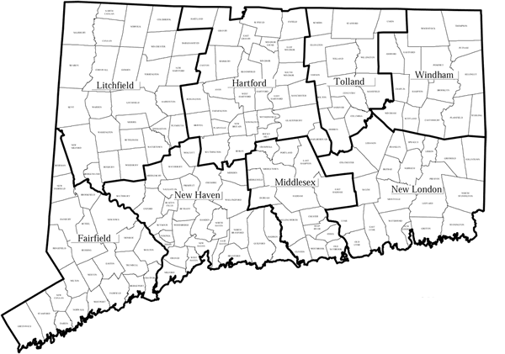
Market Analysis
Market Statistics
Industry Name: | Gift, Novelty & Souvenir Stores | Annual Industry Sales: | $19 Billion
Description of Target Consumer
Demographics | Geographics
Females & Males Ages 25+ Family-oriented Middle Income 51% shop online | State of Connecticut
Psychographics | Buying Patterns
Prefer online shopping Tend to do last minute shopping Busy | People willing to spend money on an prepackaged, customizable gift basket
Target Market Size
Total Population
3.6 Million
Target Market Population
1.5 Million
Market
Size
15,000
Notes:
Premium Tots is in the Gift, Novelty, and Souvenir Industry and Americans spend typically 19 billion dollars in this industry every year. As you can see, we started with a total population of 3.6 in the state of Connecticut and brought that down to 15,000 people within my target market, who are females and males, ages 25 and up, and who are family oriented. About 51% of Americans shop online, but Premium Tots plans to reach our target market through our … (transition to marketing and sales)

Slide 9
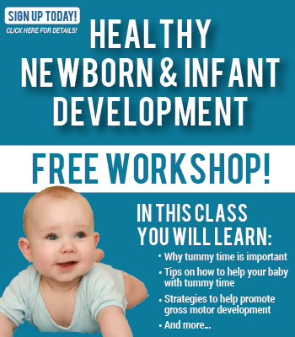
Marketing and Sales
Integrated Social Media Plan
Facebook
Twitter
Instagram
Pinterest
Website
Email
Flyers
Baby showers
Baby workshops
Health clinics
Ob-gyn offices
Business cards
Notes:
Premium Tots aims to reach our target market through our integrated social media plan which consists of our facebook, twitter, Instagram and pinterest.
On each of our social media accounts, there will be a link to our website as to provide easier access for potential customers.
Premium Tots plans to send out emails to potential customers to let them know what’s hot and why they should shop with us.
We also plan to hand out our flyers at baby showers with the consent of the baby shower host and post our flyers at baby workshops such as mommy and me classes that pregnant women tend to attend with their family and friends and other places such as health clinics an ob-gyn offices.
We also plan to hand out our business cards along the way and put a business card in with every gift basket order.

Slide 10
Competition
Unique Factors | Premium Tots LLC | Etsy | Bed Bath and Beyond
Selection | Customizable arrangements | Pre-packaged, but no customer choice | Pre-packaged, but no customer choice
Affordability | Reasonable | Expensive | Expensive
Convenience | Local shipping | Long waiting time | Go out and pick it up in the store
My Competitive Advantages
1. Premium Tots offers a variety of products to choose from when creating your gift basket. 2. Premium Tots’ gift baskets will be affordable for my customers. 3. Premium Tots saves you time.
Notes:
Premium Tots is in competition with Etsy and Bed Bath and Beyond, but what sets us aside from our competition is our selection, affordability, and convenience.
Premium Tots offers a variety of products to choose from when creating your gift basket.
Premium Tots’ gift baskets will be affordable for my customers.
Premium Tots works for your convenience and we want to save you time.

Slide 11
Qualifications
Bilingual
Experience with taking care of children
Recent purchasing issues identified within this market gap
Related statements for business
Taken a Marketing/ Entrepreneurship class
Notes:
I am qualified to run my business because I am bilingual so I’ll be able to communicate with more people within target market. I have identified recent purchasing issues with this market gap because it is often neglected. I have people’s statements of their past experiences from going to pervious baby showers, who were not pleased with what they had given or what they have seen that looked just like theirs. I have taken a marketing and entrepreneurship class.

Slide 12
Sales Projections
Total Units
355
Gross Revenue
$13,135
Net Profit
$2,280
Notes:
Give overall reasons as to our increases and decreases
Premium Tots has projected that we will sell 355 gift baskets throughout our first year. I have researched and found out that my popular months are the mid to late summer months.
Our gross revenue is $13,135 and our net profit is $2,280.

Slide 13
Start-up Funds
Item | Why Needed | Cost
Phone | Management | Owned
Computer | Management | Owned
LLC | To start my business | $300.00
Business Cards | Advertising | $5.00
Website | Customer convenience & marketing | $10,000.00
 | Total Start-Up Expenditures | $10,305.00
 | Emergency Fund | $5,152.00
 | Reserve for Fixed Expenses | $1,543.00
 | Total Startup Investment | $17,000.00
ROI: Return on Investment
$2,280.00 | = | 13% | ≈ | $0.13
$17,000.00
ROS: Return on Sales
$2280.00 | = | 17% | ≈ | $0.17
$13,135.00
Notes:
Premium Tots needs a total of $17,000.00 to start mainly because the creation of our website is the most expensive thing needed.
We are going to make sure we have our LLC paperwork in effect for our first customer along with the other necessary office supplies such as our computer and phone. We have a emergency fund and a cash reserve for our fixed expenses.
Premium Tots’ return on investment is 13% and our return on sales is 17%.

Slide 14
Future Plans Philanthropy
Buy back secondhand products
Double my customer base in 2nd year
To donate 5% of our net profit to the United Negro College Fund Charity
Notes:
In the future, Premium Tots plans to buy back secondhand products such as carriages and car seats and we will provide waivers to our customers to let them know that we have cleaned and disinfected the products before reselling them to our customers. We also plan to double our customer base in our 2nd year.
Premium Tots plans on donating 5% of our net profit to the United Negro College Fund, where their motto is “a mind is a terrible thing to waste.” UNCF funds scholarships for black students and general scholarship funds for 37 private historically black colleges or universities.

Slide 15
“Just Do Premium”
Thank you for your consideration of
Premium Tots, LLC Website coming soon!
Phone: (860)709-5763
Email: PremiumTotsLLC@gmail.com
Instagram: PremiumTotsLLC
Pinterest: PremiumTotsLLC
Twitter: PremiumTotsLLC
Notes:
Thank you for your consideration of Premium Tots LLC. If you need to contact us, email us at premiumtotsllc@gmail.com. Remember JUST DO PREMIUM.

