Slide 1
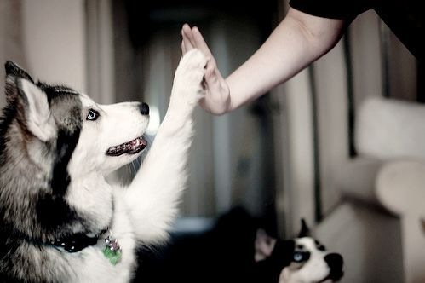
Notes:
Most pet owners consider their pets to be a part of their family. Losing them can be hard and you come to a situation where you have to decide what to do with that pet. My business has a way of keeping your pets beauty in a unique artform.

Slide 2
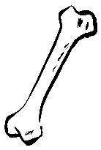
Rainbow Bridge Taxidermy, LLC
Sarina Thomas
11th Grade
Notes:
Good morning/afternoon, my name is Sarina Thomas and my business name is Rainbow Bridge Taxidermy, LLC.

Slide 3
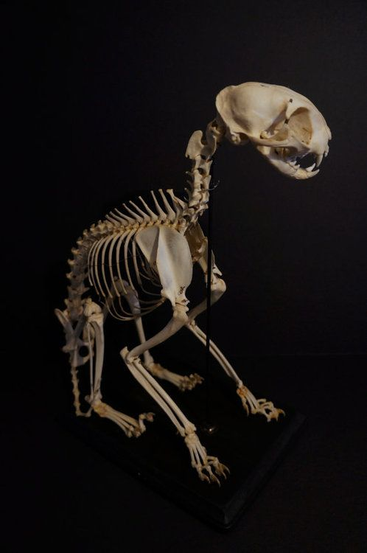
The Unmet Need
Most pet owners get their pets cremated or bury them
Some people want something different
Notes:
Most pet owners get their pets cremated or they bury them once they have passed. Though, quite a few people enjoy keeping a part of their pet to remember them by. Having a variety of choices gives pet owners a wider option to keep their pet in a more memorable way.

Slide 4
How My Business Fills Needs
Provide a different form of art
Different options
Use of all of the animal so nothing is wasted
Notes:
My business provides a different form of art for those interested in memorable ways to keep their pet without having to cremate or bury them. I offer many different services to ensure that pet owners can remember their pet in the best way possible. I also guarantee that all of the animal is used and nothing is wasted.

Slide 5
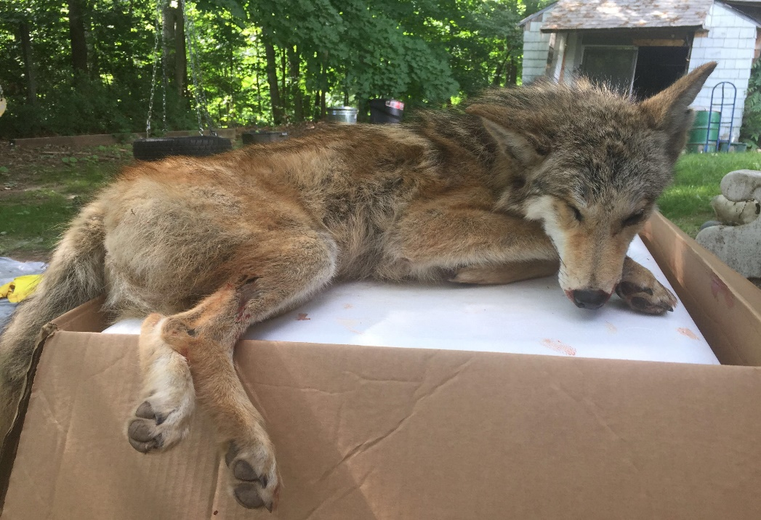
Description
Handled with care
Soft and traditional mount, articulation, etc.
Progress photos
Cancellation
Notes:
Rainbow Bridge Taxidermy covers all mounts and articulation poses that allow the buyer to personalize their pet’s preservation the way they would like. All mounts and articulations come with the option of a base to ensure security of the animal. Customers will be updated with progress photos as the animal is worked on. Customers will be provided with an tracking number in your confirmation email from me and you will be able to track your package to make sure it safely reaches you. Customers will be able to cancel their order within 3 days of commissioning me, however, after those 3 days, cancellation is no longer an option.

Slide 6
Mission
Remembering the animal in a memorable way
Allows people to more quickly recover from loss
Social Impact
Helping to cope with loss
Honoring the beauty of the animal
31% of my target market said it takes them over 6 months to grieve
Another 31% said it takes 2-5 months
Notes:
MISSION
Research shows that many pet owners continue to grieve over a lost pet for many months to even decades. Rainbow Bridge Taxidermy's mission is to provide a way to remember an animal’s beauty in a memorable way, thus allowing people to quickly recover from loss of their pet.
SOCIAL IMPACT
Rainbow Bridge Taxidermy will help you cope with the loss as we help honor the beauty of the deceased animal.

Slide 7
Business Model
About 75% of my target market said they’d pay more for personalized work
Description of Expenses
Variable Material Expenses | Total: $376.29
Poly Foam | $186.90
Taxidermy Eyes | $13.10
Wood Base | $164.75
Ear Forms | $9.25
Clay | $1.58
E6000 | $0.71
Fixed Expenses | Total: $780.00
Rent/Utilities | $25.00
Advertising | $20.00
Insurance | $125.00
Depreciation | $70.00
Salary | $540.00
Definition of One Unit
One Medium-Sized Traditionally Mounted Dog
Economics of One Unit
Selling Price |  | $900.00 + SH
Cost of var. materials exp. | $376.29
Cost of labor | $70.70
Other variable costs | $0.00
Total COGS/ COSS |  | $446.99
Contribution Margin |  | $453.01
Monthly Break Even Units
$780.00 | = | 1.72 | ≈ | 2 Mounted Animals
$453.01
Notes:
At Rainbow Bridge Taxidermy, LLC, I chose one medium sized dog that is traditionally mounted as our economics of one unit. I chose this because we figure that a medium sized dog would be the average animal that would be mounted. One traditionally mounted medium sized dog will cost roughly $900 plus shipping and handling if I’m shipping your pet back to you - and this price can vary greatly due to size and type of the animal. About 75% of my target market said they’d pay more for personalized work. This price is a good competitive price. The total COGS comes to $446.99 and I make a profit of $453.01. Rent and utilities will cost me $25 because I am currently working from home and will be paying my mother for the use of electricity and space. Just in case, I would like to be protected with liability insurance for a million dollars, costing me $125 every month. I am able to pay myself an additional $275 for my salary. I break even at 2 mounted animals per month.

Slide 8
Market Analysis
70% of my target market said they’d be comfortable shipping their deceased animal to me per my instructions
Market Statistics
Industry Name: | Consumer Services | Annual Industry Sales: | $350 Billion
Description of Target Consumer
Demographics | Geographics
Pet Owner Middle to Higher Income Male Female 18+ | National (Online) Shipping per my instructions
Psychographics | Buying Patterns
People who adore their pet greatly Preservation of animal in unique art form | Customers spread the word
Target Market Size
Total Population
312 Million
Target Market Population
214 Million
Market
Size
5,000
Notes:
At Rainbow Bridge Taxidermy, LLC, we are in the consumer services industry and Americans spend $350 billion on this industry every year. I already concentrate on both males and females who are in the United States that have middle to higher income. I’ve provided a website that helps people all over the United States who adore their pet greatly and would like to preserve their animal with a unique art form. Due to being already operational, I would like to focus on getting my business name out to about five thousand more people.

Slide 9
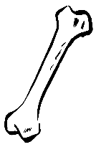
Marketing and Sales
Social Media
Tumblr
Instagram
Website
YouTube
Bracelets and business cards
Partnering with Veterinarians
Notes:
To reach more people, I will be posting on tumblr and Instagram, updating my customers and people interested in my work on Mondays, Wednesdays, and Fridays. Weekends will be for extra posts, updates, and more. I will also be running a website that will have specific instructions on how to ship me their deceased animal for me to be able to refer to. I will also keep stock and availability up on the website to keep customers engaged and aware of when I am available and when I am not. I will run a YouTube channel that has videos of me working on the deceased animal (with permission of owner) to show people the process I go through to get their pet customized the way shown in photos of the pet when he or she was alive. Every purchase from me will come with rubber bracelets that include my business name and number. I will also be partnering with veterinarians, asking if my business cards or flyers could be used in their clinics.

Slide 10
Competition
Unique Factors | Rainbow Bridge Taxidermy, LLC | Perpetual Pet | Eterneva
Price | $900 per med. sized dog | $825.00 per 7 - 10 lbs dog | $2,999 .1 - .19 carat diamond
Personalization | Personalize to photo provided | Freeze drying No personalization | Pet ashes to diamond No personalization
Location | Online + local | Online | Online
My Competitive Advantages
1. Priced competitively 2. Personalization your pet to look like the animal shown in the provided photos 3. Located in Connecticut and I am available nationally with my website
Notes:
At Rainbow Bridge Taxidermy, we definitely have competition. Two of our competitors are Perpetual Pet and Eterneva. Perpetual Pet offers freeze drying to the pose you want and while online, freeze drying can be risky because you have to get your pet to them as quick as possible. While it preserves your animal, it’s not always guaranteed that it’ll result in the product you may want for a memorial. Eterneva offers to turn your pet’s ashes into a diamond and they’re also a more expensive route.

Slide 11
Qualifications
Currently operational
Member of target market
Connections to other taxidermists
College level Biology class experience
Foundation would be a veterinary background
Notes:
As you can see, I am currently operational and have been since year 2017. I am a member of my target market and therefore have an affinity for wildlife, anatomy, and hunting. I have many connections to other taxidermists who have helped me grow as a taxidermist after extensive apprenticeship. Since taxidermy offers the opportunity for self-employment, a basic knowledge of business and marketing is important for success and a veterinary background can help create a foundation for my business in later years.

Slide 12
Sales Projection
Total Units
33
Gross Revenue
$29,700
Net Profit
$4,747
Notes:
Frozen animals should not be shipped to me during the summer time unless shipping is one-day.
Heat can and will affect the freeze on their animal, heat can cause slippage.
At Rainbow Bridge Taxidermy LLC, I’ve predicted that I will sell about 33 units. My sales will lower in the summer time due to heat. Shipping a frozen animal can risk slippage and quick defrosting which can further lead to partial rotting. It is much safer to ship animals in late fall and winter because it is colder and there is much less risk. We would have a gross revenue of $29,700 and a net profit of $4,747.

Slide 13
Start-up Funds
Item | Why Needed | Cost
Phone/Computer | For communication | Owned
Skinning/Fleshing Tools | For skinning/fleshing the pelts | Owned
Taxidermy Forms/Eyes | For the final product | $500
Buckets/Table to work on | To work salt out, pickle, and preserve | Owned
Tanning/Mounting Supplies | For preserving, tanning, and cleaning | $300
LLC Paperwork | Protection [Full Package] | $250
Bracelets and Business Cards | Advertising | $250
 | Total Start-Up Expenditures | $1,300
 | Emergency Fund | $450
 | Reserve for Fixed Expenses | $2,340
 | Total Startup Investment | $4,090
ROI: Return on Investment
$4,747 | = | 116% | ≈ | $1.16
$4,090
ROS: Return on Sales
$4,747 | = | 16% | ≈ | $0.16
$29,700
Notes:
TANNING SUPPLIES: SOULTION, SALT, PICKLING CRYSTAL
Dawn is safe for pelts
Operating Agreement, EIN, and Licenses: All key documents - including help with all required federal, state and local permits and licenses.
At Rainbow Bridge Taxidermy, according to this I will need $4,090 to start my business but I am currently already operational the only thing I am technically lacking is LLC paperwork. Most of my supplies are already owned but if I wasn’t, I would need to gather a few more supplies like forms and eyes, tanning and pickling solutions. I will set aside an emergency fund and have a cash reserve for fixed. My return on investment is 116% and my return on sales is 16%.

Slide 14
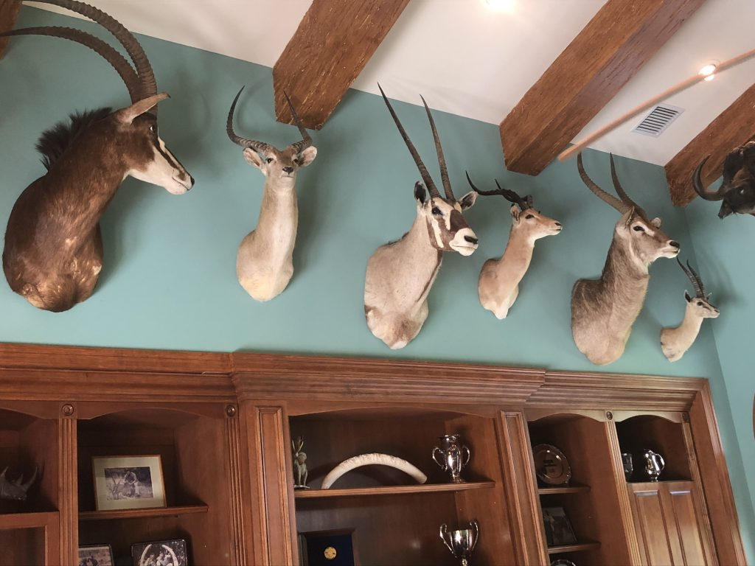
Future Plans
Acquire better means of storage, such as a warehouse
Philanthropy
I will donate 5% of my annual net profits to the U.S. Substance Abuse and Mental Health Services Administration
(SAMHSA)
Notes:
By 2021, I would like to acquire better means of storage, such as a warehouse. Taxidermy requires a lot of storage room to keep forms and supplies as well as freezers and minerals such as salt. With my net profit, I will donate 5% of my annual net profits to the United States Substance Abuse and Mental Health Services Administration.

Slide 15
Bringing Beauty Back
Thank you for your consideration of
Rainbow Bridge Taxidermy, LLC
Website: Under Construction
Email: RBTaxidermyLLC@gmail.com
Instagram: RBTaxidermy
Tumblr: rbtaxidermyllc.tumblr.com
Notes:
Thank you for your consideration of Rainbow Bridge Taxidermy, LLC where I’m bringing beauty back. You can find me at the links provided for more information about myself and my work.

