Slide 1
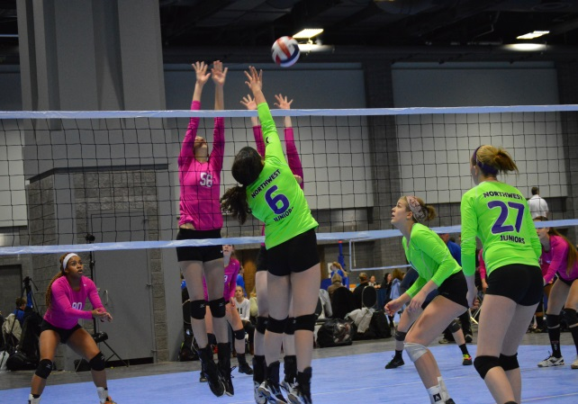
Recruit Me Photography
Alyssa Carlson & Hannah McKee
Sport and Medical Sciences Academy
Hartford, CT
Notes:
Alyssa- Goodmorning, My name is Alyssa Carlson
Hannah- And my name is Hannah Mckee, and our business is called Recruit Me Photography

Slide 2
Problem
Colleges require recruitment videos/stills to be considered
Most athletes use home videos of poor quality
Most athletes don’t know the basic requirements of a recruitment video
Notes:
Alyssa- Colleges require recruitment videos and stills to be considered on a college level sports team. Most athletes will have their coach or parents video tape them, using amateur devices that produce lower quality videos. Also, most athletes do not know what colleges look for in the videos, for example GPA, weight and height.

Slide 3
Solution
We have high quality cameras designed for shooting videos
We know what colleges look for in these videos
We know the timing of specific sports
Notes:
Hannah- We have high quality cameras designed specifically for shooting fast-pace videos. We also know what colleges look for in these videos, and what they want to see from an incoming student athlete. Along with that, because both Alyssa and myself have an athletic background, we know the set up of the sports that we specialize in, resulting in the best angles and timing for both videos and stills. We can anticipate what is going to happen next, and therefore know where and when to shoot. For example, in horseback riding, someone who knows the sport would know to take pictures from the side of the horse, so that a coach can see the riders position over the jump, where someone who does not know the sport might take a picture from the front or back of the horse.

Slide 4
Description of Service
Film and edit college recruitment videos
Provide content that satisfies college coaches
Provide 3 CD copies for easy distribution
Able to re-film by request
Photograph stills and senior portraits
Convenient
Notes:
Alyssa- Recruit me photography films and edits your college recruitment videos. We highlight the content that college coaches seek in players. With the purchase of each recruitment video, each athlete will receive 3 cd copies of their video, or more if needed for an additional charge. If an athlete is having an off day we are able to come back and film again for an additional charge. Recruit Me Photography also specializes in Photograph stills and senior portraits for athletes. We make our business convenient by coming to you and making this experience as easy as possible.

Slide 5
Mission Social Impact
To provide an athlete with the proper material to stand out to coaches
To increase the odds of an athlete being accepted onto a college sports team
Help athletes receive scholarships
Notes:
Hannah- Our mission is to provide athletes with recruitment videos that stand out to college coaches. We plan to increase the odds of an athlete playing in college and receiving athletic scholarships. This lessens the financial stress for athletes in the future.

Slide 6
Business Model
Definition of One Unit
One 3 minute recruitment video (3 copies)
Description of Expenses
Variable Material Expenses | Total: $.93
3 CD-Rs | $.51
3 CD-R Cases | $.42
Fixed Expenses | Total: $4,405.00
Depreciation | $44.00
Advertising | $11.00
Rent | $100.00
Learning Internship | $0.00
Salary | $4,200.00
Insurance | $50.00
Economics of One Unit
Selling Price |  | $499.99
Cost of var. materials exp. | .93
Cost of labor | 54.90
Other variable costs | 2.54
Total COGS/ COSS |  | $58.37
Contribution Margin |  | $441.62
Monthly Break Even Units
$4,405.00 | = | 9.97 | = | ~10 3 min videos
$441.62
Notes:
Alyssa- Our economics of one unit is based on our most sold product; the 3 minute recruitment video. The cost of our materials is $0.93 and includes 3 cd-r’s and 3 cd-r cases. Our cost of labor is 54.90, which is roughly 6 hours of work. This includes the time it takes to travel to our costumers, record, travel back and edit the video. You might think this is not enough time but we’ve done it before, and it indeed is enough time. Our variable cost is the price of gas which is required for us to travel to our clients. This is based on the Hartford county, to travel to other areas we would include an additional charge. We also include a learning internship in our fixed expenses. This is where we would take 1-2 college students each semester and help them gain experience in the photography field. With a selling price of 499.99, we are able to double or better. We must sell 10 units each month to break even

Slide 7
Market Analysis
Market Statistics
Industry Name: | Photography | Annual Industry Sales: | $10 Billion
Description of Target Consumer
Demographics | Geographics
Junior and Senior Varsity Athletes | Hartford County, Connecticut
Psychographics | Buying Patterns
Want to play their sport in college Want to impress college | Varsity Athletes who are willing to pay for a high quality recruitment video
Target Market Size
Total Population
898,300
Target Market Population
48,800
Market Size
488
coaches
Notes:
Hannah- The annual sales for our industry, which falls under photography, is 10 billion dollars per year. We start with Hartford county, with a population of 898,300. Out of all these people 48,800 are high school varsity athletes. From this we plan to target the varsity athletes that wish to expand their athletic career through college. We believe that our market size can be 1% of our target market, which is 488 athletes. (139 total high schools in Hartford county, 27 sports (average) per school, 13 (average) varsity athletes per team). We know that this is a good number for us to start with because we conducted a marketing research survey, which taught us that 48% of varsity athletes are willing to pay for a professionally filmed recruitment video. Our demographics are based on Hartford County, but we can travel further for an additional cost.

Slide 8
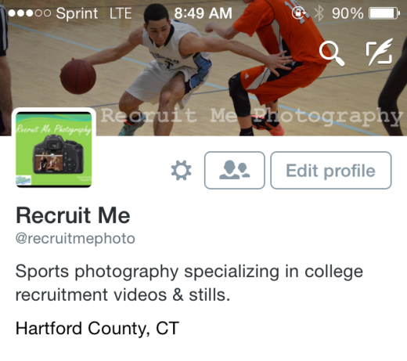
Marketing and Sales
48% of Varsity Athletes are willing to pay for a professionally filmed recruitment video
Social Media
Instagram
Twitter
Website/Email/Phone
Maxpreps.com
Word of Mouth
Business Cards
SMSA discount
Notes:
Alyssa- Recruit Me photography is advertised mostly by Social Media. Our company has an Instagram as well as our own twitter. We use these to give viewers short clips of our products and potentially gain costumers. We have our own website, email and phone which makes us very easy to contact. We also use a website called Maxpreps which shows the best athletes in all of America. We filter it by state, town, conference, sport and position. We use this to find the best athletes in all of Connecticut and let them know about our business. Recruit Me Photography plans to attend several tournaments throughout the year such as the volleyball winterfest to spread our business through word of mouth and business cards. We also offer a discount to SMSA athletes. Because our school consists of students that come from more than 20 different towns. We believe that if they are satisfied with our product they will let others know about our business. We are able to afford this discount because we do not have to travel to these costumers.

Slide 9
Competition
 | Recruit Me Photography | Art Rich Photography | Game On!
Experience | Sports: 16 years Photography: 5 years | Photography: 43 years | Photography: 25 years
Products | Recruitment Videos Stills | Stills | Recruitment and Highlight videos
Price | $499.99 | $15.00 per photo | $150 per hour ($900 for 6 hours)
Your Competitive Advantages
1. We offer both Stills and Recruitment Videos 2. Affordable 3. Many years of sports and photography experience
Notes:
Hannah- Our competitors are Art-Rich photography and Game On!. Both of these companies have large amounts of photography experience, however neither business has as much sports background as Recruit Me Photography. Along with that, we have relations with college coaches which allow us to know the exact content coaches desire. Recruit me photography offers both recruitment videos and stills, while our competitors only offer one or the other. We are very affordable compared to our competitors.

Slide 10
Qualifications
Together we have 16 years of athletic experience
Taken photography classes at University of Hartford, Fletcher Farm School for the Arts and CCSU
Personally know college coaches
Both have exceptional math skills
Members of our own target market
Have taken a NFTE Entrepreneurship and Marketing class
Notes:
Alyssa- Together we have many qualifications that make us the perfect pair for the Sports photography business. Combined we both have 16 years of athletic experience. My partner has been an equestrian for 8 years, and has been playing volleyball for 5 years. I’ve been playing a variety of sports including basketball and softball for 8 years.
Hannah- Along with this, I’ve taken several photography classes through the years. Both my partner and I are photographers and have been since an early age. In addition to this, we have been coached and still have connections with several college coaches for various sports. They have shared with us what they look for in athletes and videos. Also, we both take high level math courses including but not limited to AP Calculus.
Alyssa- Both my partner and I are members of our own target market, and plan to make our own recruitment videos next year. We both have also taken a Marketing and Entrepreneurship class.

Slide 11
Sales Projections
Total Units
134
Gross Revenue
$66,998
Net Profit
$5,370
Notes:
Alyssa- We believe that our highest selling point would be the months from September to March, which is when students will be sending in college applications hence sending in their recruitment videos. Out lowest selling point would be in the summer where high school athletics are not taking place. However, we will still be able to sell units because of sports that run all year long such as horseback riding. Throughout the year we would sell about 134 recruitment videos, and make a gross revenue of 66,998. At the end of our first year we will have a net profit of 5,370 dollars.

Slide 12
Start-up Funds
Item | Why Needed | Cost
Cell phone/Computer | Advertising/Business Records | $1,449.00
DBA | To Do Business | $5.00
Video Equipment | To Do business | $2,250.00
Business Cards | Advertising | $10.00
Car Wrap | Advertising | $333.00
Car | Traveling | Owned
 | Total Startup Expenditures | $4,047.00
 | Emergency Fund | $2,024.00
 | Reserve for Fixed Expenses | $13,125.00
 | Total Startup Investment | $19,196.00
ROI: Return on Investment
$5,370.00 | = | 28% | ≈ | $0.28
$19,196.00
ROS: Return on Sales
$5,370.00 | = | 8% | ≈ | $.08
$66,998.00
Notes:
Hannah- Our total start up fund Is $19,196, this includes our startup expenses, emergency fund and a reserve for our fixed expenses. Our startup expenses include a cell phone, a high quality laptop for editing, video equipment, a DBA, business cards, a car and a car wrap for advertising when we travel to our customers, which are all needed to start our business. Our return on investment is 28% and our return on sales is 8%.

Slide 13
Future Plans Philanthropy
We will improve our photography equipment
We will hire 5 additional employees with different sports backgrounds by year 2
5% of our net profits will be used as a scholarship eligible to athletes in CT
The recipient will also receive a free recruitment video
Notes:
Hannah- In the future we would like to improve our photography equipment in order to keep up with todays fast moving technology. By our second year, we would also like hire 5 more employees with different sports backgrounds, in order to provide a greater variety of sports for our consumers. We plan to give back to the community through a scholarship called ______ which is composed of 5% of our profits. We will have athletes send in applications, the winner will be chosen based on vote. The application will include information such as GPA and an essay. The winner will also receive a free recruitment video.

Slide 14
“What you need, what colleges want”
Thank you for your consideration of
Recruit Me Photography
Instagram: @recruitmephotography
Twitter: @recruitmephoto
Website: recruitmephotography.wix.com/recruitmephotography
Email: recruitmephotography@gmail.com
Notes:
Hannah- We’re “What you need and what colleges want”
Alyssa- Thank you for you consideration of Recruit Me Photography

