Slide 1
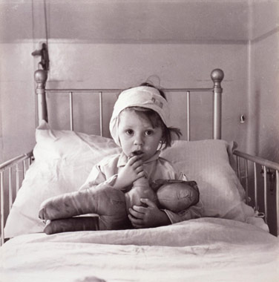
Notes:
See that face with those eyes full of despair? She feels helpless and alone, but guess what, she isn’t. 50% of children in America suffer from a chronic illness. A chronic illness is diabetes, to ADHD, birth defects, to autism, and so much more. Parents feel nervous leaving their innocent baby with an inexperienced teenager because they want to keep their child safe. No longer will they have to be scared. No longer will they be stuck home when they want to go out and be an adult. Thanks to us, they will now have their life back.

Slide 2
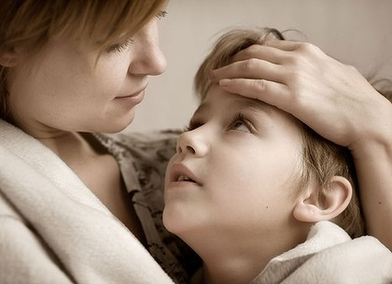
Safe Haven, LLC
Victoria Parisi
Sport & Medical Sciences Academy
Hartford, CT
Notes:
Good morning, my name is Victoria Parisi and I would like to present “Safe Haven.”

Slide 3
The Problem
Notes:
My whole life I have grown up dealing with a chronic neurological disease. My parents were unable to leave me alone with a babysitter because I had to take certain medicines at specific time and eat particular food. My parents did not want to put the pressure on a teenager with all of this responsibility. Across the nation families deal with similar situations and they are crying out for help.

Slide 4
Safe Haven
Notes:
Safe Haven is a website where parents can look for qualified babysitters to watch their child who has a particular health problem. The babysitters are background checked and must go have specific certifications to work for Safe Haven.

Slide 5
What We Do
Connect qualified babysitters to parents through website
Website is easy to use
Guaranteed response in 24 hours
Notes:
Safe Haven is the website to connect highly qualified babysitters to parents. The website is functional and easy to use but if necessary there is customer service that ensures a response in a 24 hour window and the best babysitter for any child’s needs. Our goal is your satisfaction.

Slide 6
Economics of One Unit
Definition of One Unit
4 hours with a highly qualified babysitter
Economics of One Unit
Selling Price |  | $120.00
Cost of materials | $00.00
Cost of labor | $00.14
Other variable costs | $60.00
Total COGS/ COSS |  | $60.14
Contribution Margin |  | $59.86
Monthly Break Even Units
$664.99 | = | 11.10 | ≈ | 12 connections
$59.86
Notes:
My economics of one unit is 4 hours with a highly qualified babysitter at $25.00 an hour for a child with a major health problem. On average parents go out for 4 hours at a time. The selling price is $100.00. The labor is only $0.14 of my time because I just have to connect the highly qualified babysitter with the parent. My variable costs is $60.00 because I have to pay the babysitters which make $15.00 an hour. Although I get only $10.00 an hour I still make a return of over 285% because it is only costing me $0.14 of my time.

Slide 7
Market Analysis
Market Statistics
Industry Name: | Child Care Services | Annual Industry Sales: | $20 Billion
Description of Target Consumer
Demographics | Geographics
Parents who have one or more children with chronic illness | Connecticut
Psychographics | Buying Patterns
Parents who want to be able to go out more or need a respite | Goes out one or more times per week Spends over $1,000 a year on health care for child Parents willing to pay more to care for children with chronic illness
Target Market Size
Total population of targeted geographic area
3,590,347
Population of target market
80,500
Market size
8,050
Notes:
My target geographic area is about 3,600,000 people. There are 170,000 people who are under the age of 18. According to statistics 50% of children under 18 have a chronic illness. That is about 80,500 children which is my target market size. My market size is 8,050 because that is 20% of my target market which I felt was a practical market size for my first year.

Slide 8
Promotions and Sales
Yearly membership to Safe Haven ($25.00)
Support Groups
Website
Word of Mouth
Business Cards
Pediatricians
Benefits of Membership
$2.00 off an hour
Special promotions
Notes:
Safe Haven tries to give you the best opportunities for a reasonable price. Anyone who purchases a yearly membership to Safe haven receives $2.00 off an hour. Support Groups who endorse Safe Haven can give members $10.00 off a yearly membership. Also, pediatricians will be affiliated with safe haven and recommend our service to parents who have children with chronic illnesses and give them our business card. Our website will be very beneficial to our clients to go and see just what Safe Haven is. We hope that parents who enjoy Safe Haven will tell other people they know who have children with chronic illnesses about us.

Slide 9
Competition
Direct Competition:
Care.com
Sittercity.com
Sitters.com
Regular babysitters
Indirect Competition
Parents can stay at home with child
Advantages:
Babysitters are highly qualified
Fast and easy
Great customer service
Notes:
My competition is care.com, sittercity.com, babysitter.com, and regular babysitters. Safe Haven’s indirect competition is that parents can stay at home with their children. My advantages are that the babysitter is highly qualified and can deal with the child’s needs better than a regular babysitter. The process is also fast, easy, and there is always someone to help you at Safe Haven.

Slide 10
Qualifications
I am a member of my own target market
Taking a Graphic Design course
My mother is qualified in Sales and Marketing
Degree in Pediatric Health (2020)
Notes:
I am a member of my own target market. Being sick as a child, my parents could never go out. They would have loved to have something that could have helped them find a babysitter who could take care of me. As a high school student, I am completing a graphic design class that will help me design and build the Safe Haven website. My mother can help me market my company and help with the publicity aspect of it, the business plans, and sales. Also, I plan on getting a degree in pediatric health before I begin my business. That way I can prove that I am qualified to determine if a babysitter has the proper skill set to take care of a child.

Slide 11
Sales Projections
Total Connections
286
Gross Revenue
$34,320
Net Profit
$7,770
Connections Sold
Notes:
In January I expect to have 18 connections and have it gradually rise in sales till the month of may. I hope that parents who enjoy the service of safe haven will come back and use our service repetitively at least once a month. In the month of June, July, and August we project a huge spike in sales because children are out of school and parents will need care for them during the day while at work. There is a drop in sales in September because children go back to school and no longer need care during the day. We also expect a drop in sales in the months of November and December because of the holidays. Family members are home who are able to care for the child with a chronic illness.

Slide 12
Startup Funds
Item | Why Needed | Cost
Computer/Cell Phone | Communication and book keeping | Pre-Owned
Business Cards | 250 for advertisement | $10.00
500 hrs of my time | To find and determine the highly qualified babysitters | $4,125.00
LLC Paperwork in Simsbury, CT | Necessary to start business | $500.00
Background Checks and Drug Screenings | Make sure babysitters are reliable | $6,000.00
 | Total Startup Expenditures | $10,635.00
 | Emergency Fund | $5,000.00
 | Reserve for Fixed Expenses | $1,995.00
 | Total Startup Investment | $17,630.00
Notes:
It will cost $17,630 to start Safe Haven. The majority of the startup expenditures goes to time. It will take me about 500 hours of my own time to find and determine who can work for Safe Haven as a highly qualified babysitter and go towards background checks that will be available for parents. I would buy 250 business cards to get the word out about Safe Haven. To work in Simsbury, CT costs about $500 for the paperwork. Another major costs goes to background and drug screenings. For 50 independent contractors it costs $6,000.00 at about $120.00 a person. Making our total startup expenditures to $10,635.00. Then Safe Haven must have an emergency fund and reserve for fixed expenses making our total cost $17,630.00

Slide 13
Giving you piece of mind
Thank you for your
consideration of
Safe Haven, LLC!
Visit www.inasafehaven.webs.com
*website under construction*
Notes:
Safe Haven, giving you piece of mind. Visit our website at inasafehaven.webs.com. Thank you for your consideration!

