Slide 1
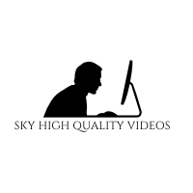

Slide 2
Sky high quality videos
By: GIO VALENTIN
Notes:
Hello my name is Giovanni valentin and my business is sky high quality videos

Slide 3
The issue
Events tend to get crowded
Real estate market pictures don’t contain full display
Its hard to gain clear footage
Sometimes can’t get a good angle
Notes:
When trying to capture a memory these issues often come about. Lots of cameras don’t capture wide view photos and not to mention Events like weddings and concerts tend to get crowed and for a camera man its hard to get high quality footage with people moving around in the cameras line of view.

Slide 4
Solution/How Business Fills Need
It gives the viewer a birds eye view
Video footage looking at 180 degrees view
Recording from a steady camera drone
Using a high definition camera
Notes:
At first I had a passion for flying drones when I came across a phantom drone that came equip with a high quality camera that was capable of taking pictures and videos from 100’s of feet in the air I noticed that you could expand the horizons of filming with these high tech drones. They can fly up to 4 miles away from the pilot and more than 350 feet high in the air allowing them to reach even the tallest buildings

Slide 5
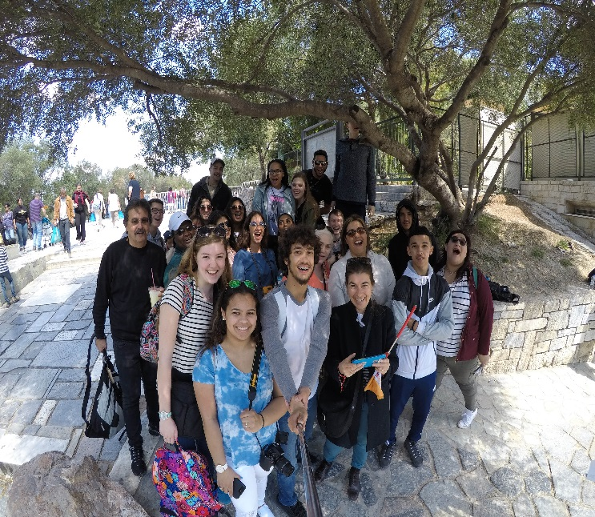
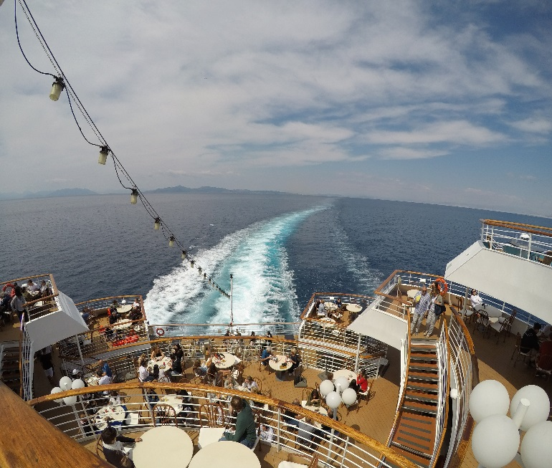
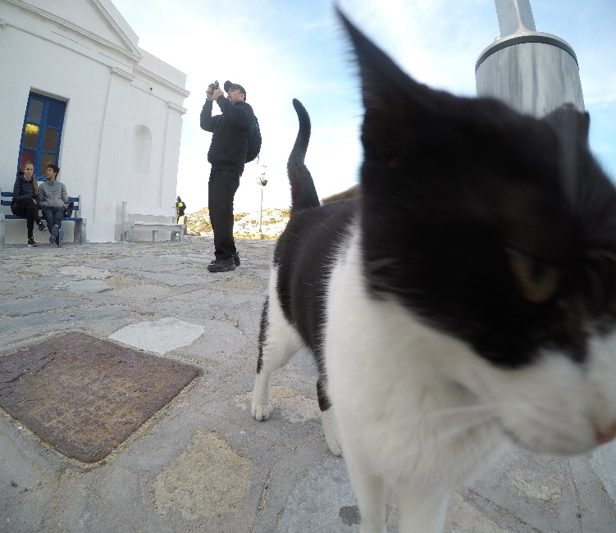
Description of Service
Professional drone pilots come and take requested angles and views with multiple drones for recording video, taking pictures, and live streaming to different social media's
Notes:
An assessment team comes and helps recommend the best conditions for flight witch insures the highest quality possible for video footage and photos guarantee,Clients may also customize there footage by adding music, filters, and subtitles.

Slide 6
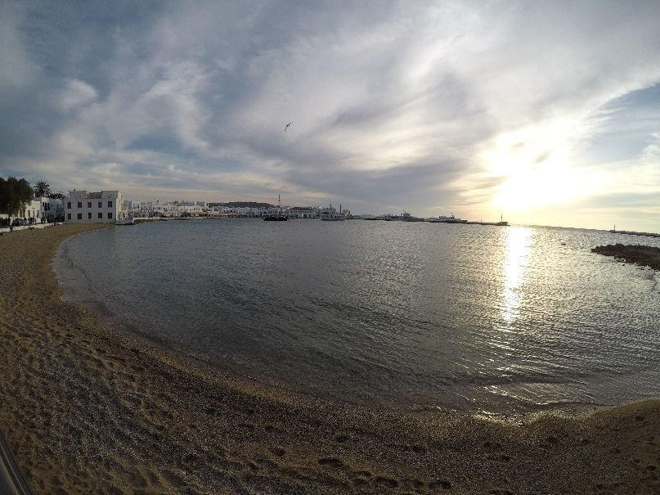
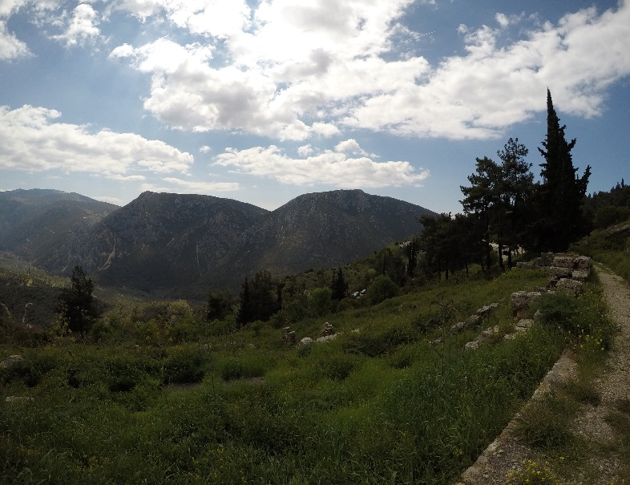
mission
To provide customers with the highest possible quality videos & photos for an affordable price
social impact
Being able to survey large areas during an emergency or natural disasters
Notes:
Our mission at sky high quality videos is to help our costumers produce the best quality video ensuring satisfaction guarantee and our social impact is taking our drone technology to help respond to natural disasters all around the world and inspire other drone pilots to do the same

Slide 7
Business Model
Definition of One Unit
20 min drone over watch session
Economics of One Unit
Selling Price |  | $200.00
Cost of var. materials exp. | $4.33
Cost of labor | $10.10
Other variable costs | $0.00
Total COGS/ COSS |  | $14.43
Contribution Margin |  | $185.57
Description of Expenses
Variable Material Expenses | Total: $4.33
4GB flash drive | $4.33
Fixed Expenses | Total: $1740.00
Depreciation | $30.00
advertising | $10.00
Insurance | $125.00
rent | $20.00
Salary | $1,500.00
Utilities | $15.00
Monthly Break Even Units
$1740.00 | = | 9.3 | ≈ 10 | Over watch drone sessions
$185.57
Notes:
Sky high quality videos chose one 20 min drone over watch session as a definition one unit because it is the smallest unit of time the drone can be operational if our customers wish to have longer drone sessions they must buy multiple units. We set our selling price at $120 due to various cost like material, labor witch sets our contribution margin at $105.57

Slide 8
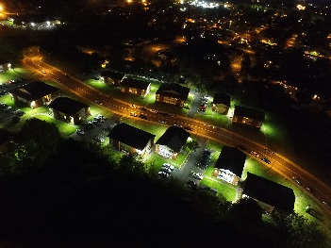
Market Analysis
Market Statistics
Industry Name: | Media | Annual Industry Sales: | $600 Billion
Description of Target Consumer
Demographics | Geographics
Athletes celebrities Realtors high income | Connecticut
Psychographics | Buying Patterns
People who love social media and need constant coverage | Willing to buy more then one session (higher total sum of time)
Target Market Size
Total Population
3,456,000
Target Market Population
500,000
Market Size
5,000
Notes:
Sky high quality videos is focusing on people who love live streaming and constant coverage in the Connecticut area witch might include athletes and celebrities even realtors that have homes they need to advertise on the market due to research and previously administered surveys that leaves our market size at 500,000

Slide 9
Marketing and Sales
Website
Word of Mouth
livestreaming
Social Media
Facebook
Instagram
Twitter
Snapchat
Notes:
At sky high we plan to let our work impress and attract on our website where customers can preview old work and watch showcase videos to see what sky high quality videos is about

Slide 10
Competition
 | Sky high quality videos | Dragonfly drone media | Helicam aerial media
Price | Affordable price | Very expensive | Very expensive
Capabilities | Indoor and outdoor | Outdoor | Outdoor
Media | Livestreaming | No livestreaming | No livestreaming
Your Competitive Advantages
1. Time in comparison to service rather then quotes per session 2. Indoor and outdoor capability’s camera can also be hand held 3. Livestreaming capability’s and posting to different social medias
Notes:
Sky high quality videos trumps its completion with an affordable price also we have other competitive advantages like precisely controlled drones that allow for indoor and outdoor flying capabilities and cameras that can live stream on the spot

Slide 11
Qualifications
Took a class in adobe Photoshop
Will be a certified drone pilot
A member of my own target market
Have a strong background in real-estate
Notes:
As for my qualifications I am currently taking a course on adobe Photoshop and will soon be a certified drone pilot how ever my passion for drone flying mixed with my passion for photography makes for satisfaction guarantee

Slide 12
Sales Projections
Total Units
195
Gross Revenue
$39,000
Net Profit
$13,000
Notes:
Sales projections are at an average of 10 units per month with some spikes in the summer and winter time. A yearly sale of 137 units brings in $16,440.00 gross revenue and a total net profit of $2705.54

Slide 13
Start-up expenses
Item | Why Needed |  | Cost
Website | Customers can preview and order |  | $46.00
LLC papers | To provide insurance |  | $375.00
Business cards | Contact for further business |  | $8.00
Phone/computer | For business transactions |  | Owned
Phantom 4 pro | Drone |  | $1,700.00
Go pro karma | Drone and camera |  | $900.00
Go pro hero 5 | High resolution camera |  | Owned
 | Total Startup Expenditures |  | $3,029.00
 |  | Emergency Fund | $1,500.00
 |  | Reserve for Fixed Expenses | $5,220.00
 |  | Total Startup Investment | $9,749.00
ROI: Return on Investment
$13,000 | = | 133% | ≈ | $1.33
$9,749
ROS: Return on Sales
$13,000 | = | 33% | ≈ | $0.33
$39,000
Notes:
Our total start up expenses is $5469.00 due to our sum of start up expenditures, emergency fund, and reserve for fixed expenses this gives us a 49% return on investment and a 16% return on sales

Slide 14
Future Plans
To become operational by the year 2019
To upgrade my drone equipment by the end of my year one
Philanthropy
Donate 8% of net profit to good sports charity
Notes:
Future plans for sky high quality videos are to become licensed and operational by the 2019 and make profits to donate money to good sports charity witch provides new sports equipment to those In need helping to Creating future clients

Slide 15
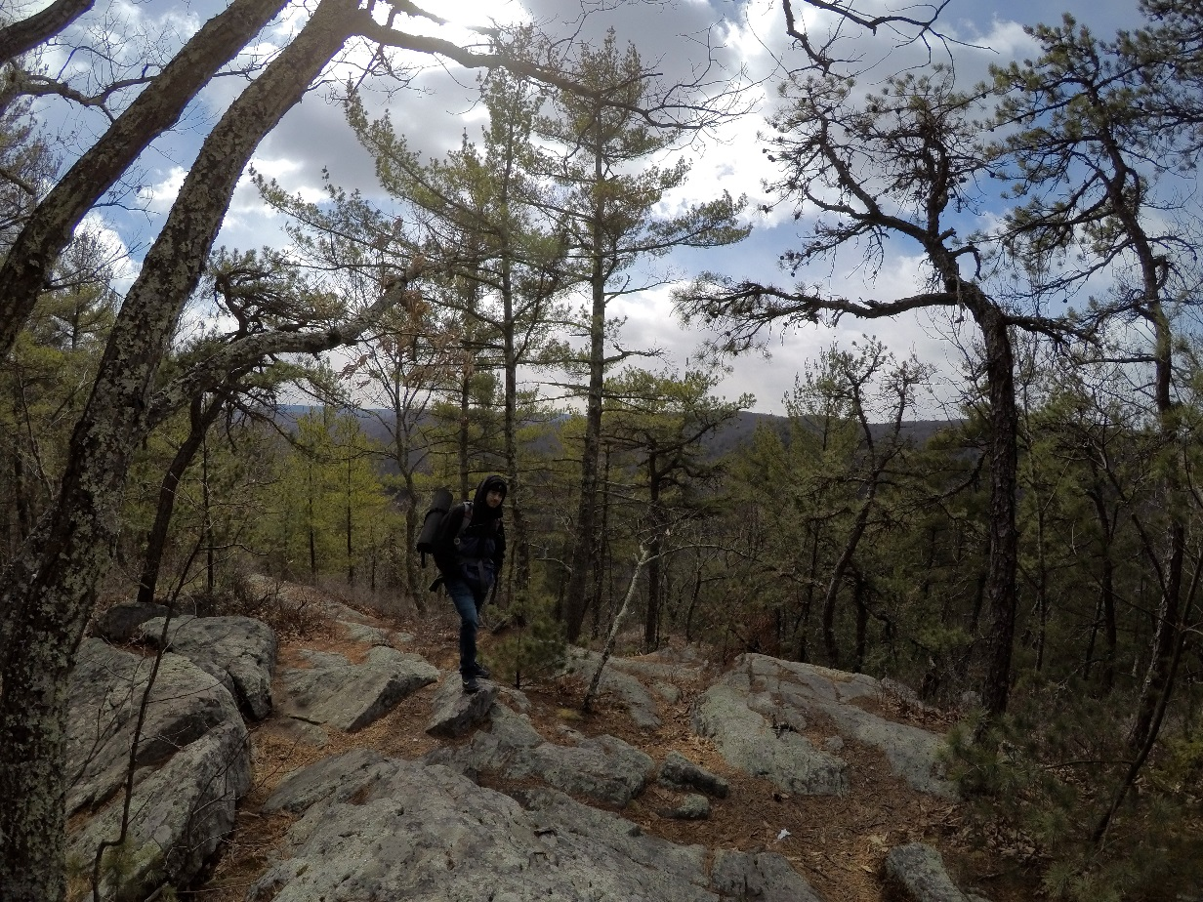
FLY HIGH BECAUSE EVERYTHING IS SEEN FROM THE SKY
Thank you for your consideration of
sky high quality videos
Email: giov2122@gmail.com
Show case Website available!
Giov2122.wix.com/skyhigh
Notes:
Thank you for your consideration of Sky high quality videos and remember to fly high because every thing is seen from the sky website coming soon and feel free to email me for further information

