Slide 1
Notes:
Yes, those are cupcakes. A sweet treat that’s defiantly satisfying to eat. But we don’t just pipe a huge glob of frosting on ours, we delicately and artistically make toppings for our cupcakes that are amazing to look at and eat. These mum flower cupcakes are made with marshmallows and sugar. Beautiful aren't they? Hi I’m Noah Connor, and I’m Allison Laska and this is Sweet Insanity Desserts.

Slide 2
Noah Connor & Allison Laska
Sport and Medical Sciences Academy
Hartford, CT
Notes:
Our business, Sweet Insanity Desserts, takes advantage of the demand that people have for customizable desserts. Whether the desserts are for a party, celebration, or even just to have for fun, there is a vast amount of opportunities for us to take orders for and sell our desserts. I’m sure that everyone can recall at the time where they were at a birthday party, and there was some type of theme to it with a dessert to go along with it. All of the pictures in our presentation are those of past orders that we have done.

Slide 3
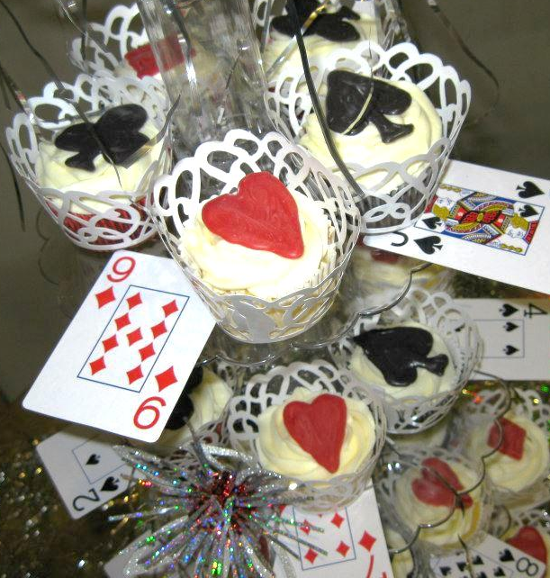
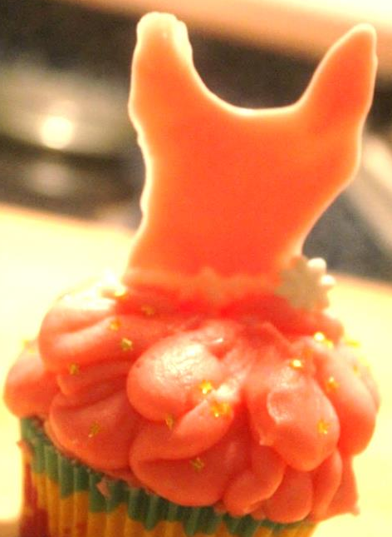
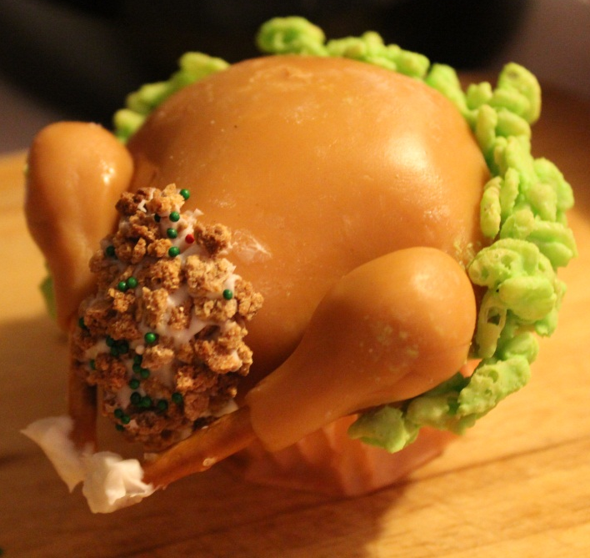
Unmet Need
Many people want themed desserts for parties or gatherings
Few people are skilled in this area of baking
Supermarkets do have themed desserts, but mainly cakes. In most cases they aren’t customizable, and lack quality as well as style
Notes:
The problem/ unmet need is that many people desire themed desserts for parties or gatherings. Whether it be cupcakes, cakes, cookies or so on. The problem they run into though, is that they aren’t skilled in designing their desserts, and they often come out looking very poor. They may try another outlet, such as a supermarket, but run into problems there, because most ones don’t have customizable desserts, they are very poorly designed, and often only design cakes.

Slide 4
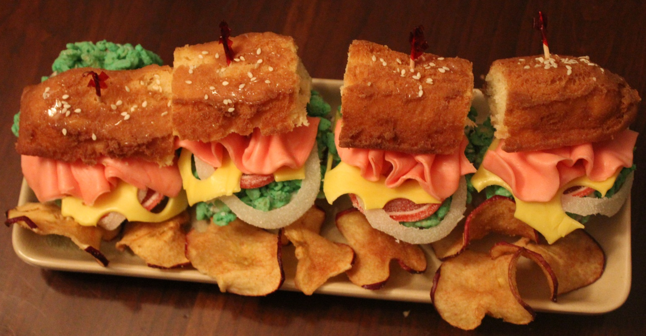
our Solution
We specialize in the customization of desserts
People can place an order with us in person, online, or over the phone
Impressive edible art
Notes:
We have been designing desserts since 2011, and have been perfecting our skill over time since then. When people place orders with us, they can either place a customized one, or even place an order of the desserts we have during the season. Whenever people have ordered with us, they usually feel like they are getting what they have seen in pictures from other people, but when they get the dessert they often feel like they are better than what they thought they were going to be.

Slide 5
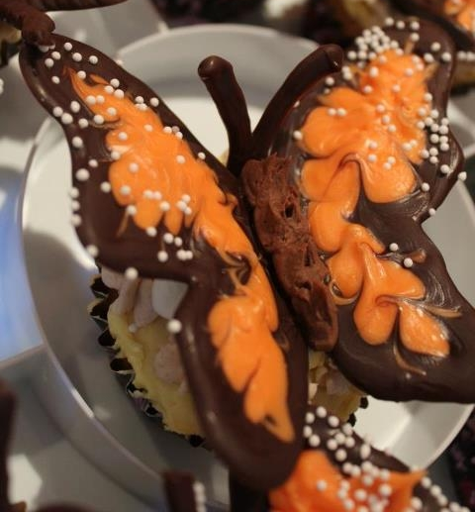
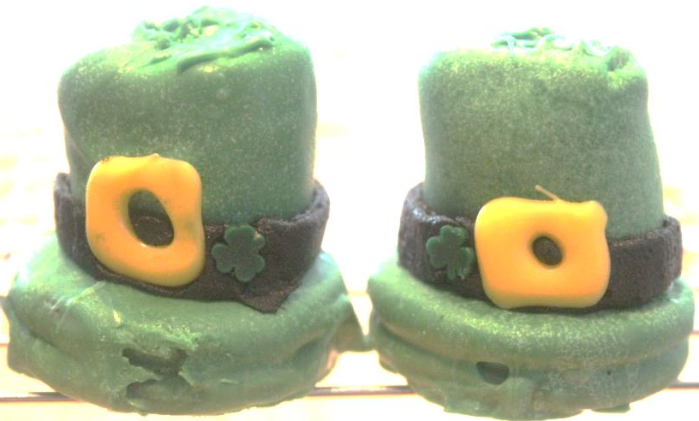
Description of Service
We stick to the theme of your party/gathering
Inexpensive and creative
Variety
Impress guests
Delivery option ($10+)
Active Facebook page with online
ordering (1yr)
Notes:
Our business customizes desserts to fit the theme of your party/gathering. Our prices are less expensive then our competitors and we also have the option of delivery to anywhere in the state. Your guests will be blown away with how creative our desserts are and also the variety of designs. Our Facebook page is continuosly updated and is fun and interactive.

Slide 6
Business Model
Definition of One Unit
1 Dozen Mum Cupcakes
Economics of One Unit
Selling Price |  | $30.00
Cost of materials | $2.04
Cost of labor | $8.25
Other variable costs | $0.00
Total COGS/ COSS |  | $10.29
Contribution Margin |  | $19.71
Monthly Break Even Units
$107.50 | = | 5.45 | ≈ | 6 dozen
$19.71
Notes:
Our definition of one unit is one dozen mum cupcakes. Our total cost of materials would be $2.04 and it would take us about an hour to make them. At $8.25 an hour, it would cost a total of $8.25 for labor. Total COGS is $10.29 and our contribution margin $19.71. Our selling price would be $30.00 which does not include an additional $10.00 for delivery.

Slide 7
Market Analysis
Market Statistics
Industry Name: | Bakery Product Manufacturing | Annual Industry Sales: | $3 Billion
Description of Target Consumer
Demographics | Geographics
Middle to upper income adults between the ages of 25 and 65, mainly females but not exclusively | Tolland & Hartford Counties
Psychographics | Buying Patterns
Families who often plan themed parties for their children, family members, or friends | Willing to spend money to impress their guests and avoid stress
Target Market Size
Total population of targeted geographic area
3,590,347
Population of target market
552,131
Market size
(based on
survey)
276
Notes:
The industry category that our business would fall under is bakery product manufacturing. The total annual sales of this industry is $3 billion. Our target market consists of working class adults, mainly caucassion females, between the ages of 25 and 65, and in most cases living within Tolland and Hartford county. They would have at least one themed party per year, and would be willing to spend money to impress their guests and also relieve themselves of stress. The total population of our geographic area, Connecticut, is 3,590,347 as of 2012. Of this number, 552,131 are Female causcassions within the age of 25 and 65. Our market size is based upon .05% of the population of our target market, which is 276

Slide 8
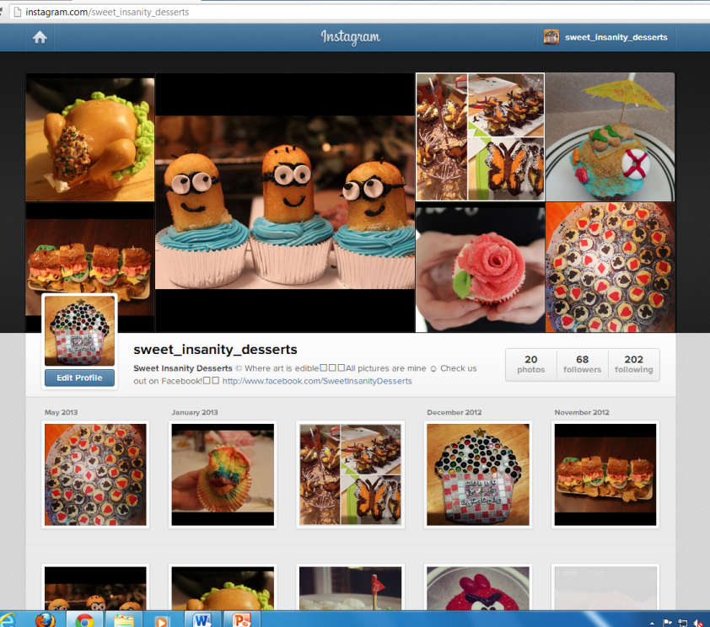
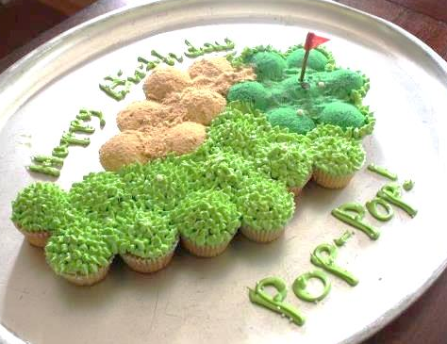
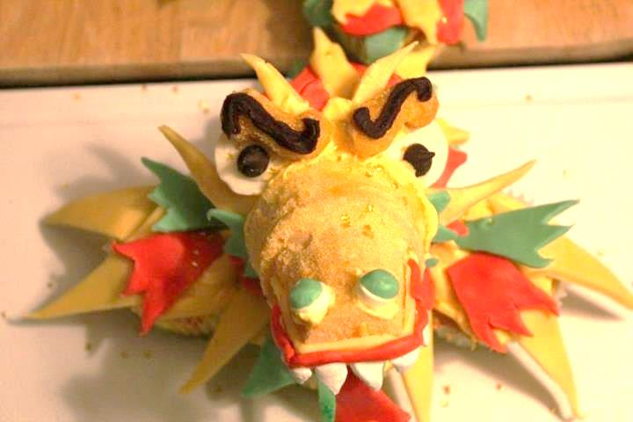
Promotion and Sales
Special school events
Online Advertising and Marketing
Social Media
Business cards
Word of mouth
Notes:
How we promote ourselves is very important when it comes to how much business we receive. One of the ways we are going to promote our business is through social media. Our Facebook page currently has 128 “likes” and receives more each week. Another way we market our business is through important events at our school such as open houses or PTO meetings. We have our business cards available along with pictures and samples of our desserts.

Slide 9
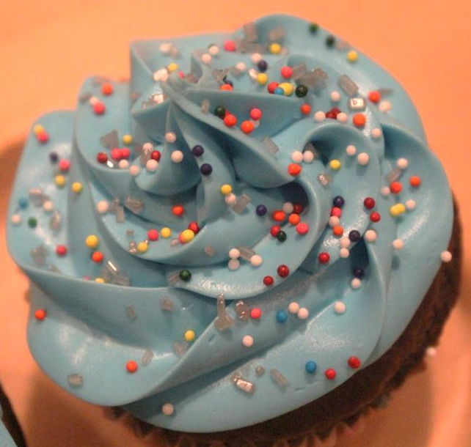
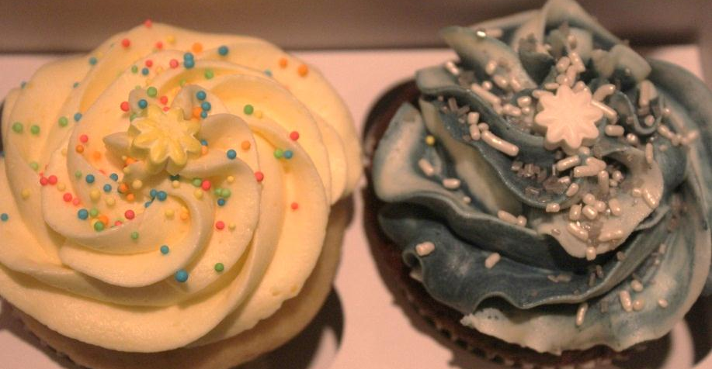
Competition
Direct
-Sweet Spot Bake Shop in Windsor CT
- Mr. D’s CT Bakery in Wallingford CT
Indirect
- A Little Something Bakery in West Hartford CT
- Julia’s Bakery in Orange CT
Notes:
Although there are several bakery’s and desserts stores throughout Connecticut, we feel like our business is superior to theirs. We have items on our menu that you don’t have to customize, and are much easier to order such as our mum cupcakes. You can also customize cupcakes with us though, for example we made a dragon styled cupcake chain for Mrs. Nguyen, and we have never done anything like that before. Also part of our menus is to order the cupcakes made from scratch or simply from a box mix. Sweet Spot Bake Shop only sells customizable orders, and you have to order more than a week in advance or you pay a fee. Mr. D’s CT Bakery only sells items off of their set menu, and they really only specialize in the flavors of their cupcakes, and not the style. A Little Something Bakery is mainly a bakery selling items such as cookies, scones, and tarts. So is Julia’s Bakery. Although these two places are completely different from our business, they make customers from us who just want to walk into a store and buy a pastry then leave.

Slide 10
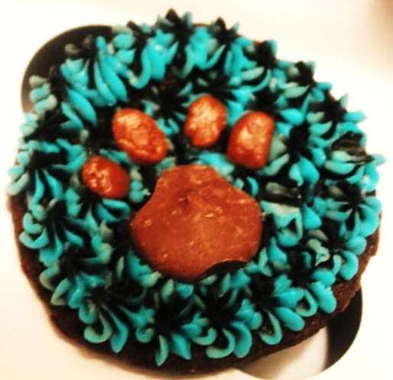
Qualifications
We have been operational since 2011
100% satisfaction of our edible art
We make edible creations at least once a week, so we are continually improving and testing
Excellent customer service and quick turnaround
Notes:
What qualifies us to run a customizable and decorative desserts business? First off we have been customizing and decorating desserts since 2011. We started selling them in 2012, and have been operational since then. We have had several orders since we started marketing our desserts, and every time we delivered our desserts the customers were more than satisfied with what they received and how good they looked. Also, we are constantly making desserts whenever we get the chance to. Whether it is for an order or simply just to practice, we are always trying to improve our skills whenever we get the chance to.

Slide 11
Sales
Total Units
96
Gross Revenue
$2,880
Net Profit
$
Notes:
Our sales projections for 1 dozen mum cupcakes is 96 units for one year. This does not include other desserts and orders we complete. Our gross revenue would be $2,880.00 and our net profit would be $1,892.16 . We were able to foretell when we will sell the most because we are already fully operational. Most of our orders will occur around the holidays, with thanksgiving being the busiest time. We will still have business throughout the year though because of birthdays, gatherings, etc. Our philanthropy plan is to donate 5% of our net profits to orphanages over in Vietnam. We were inspired to do so by pictures that Mrs. Nguyen showed us from a trip her husband took over there

Slide 12
Startup Funds
Item | Why Needed | Cost
Kitchen equipment | To bake and style desserts | Currently have
DBA | To protect our business | $10.00
Baking supplies | To make and style our desserts | $50.00
Cell phones/computer | So people can contact us and place orders | Currently have
Decorating supplies | To decorate our desserts | $10.00
Insurance | Protect us in case anything goes wrong | $37.50
Serv Safe certification | So we are qualified to deal with this are of food | Currently have
 | Total Startup Expenditures | $107.50
 | Emergency Fund | $150.00
 | Reserve for Fixed Expenses | $322.50
 | Total Startup Investment | $580
Notes:
In order for our business to start off there a few items that we will need. We need a DBA so that we can operate our business under the name Sweet Insanity Desserts without having to create a formal legal entity such as an LLC. or corporation. We need baking supplies such as cake mixes or candy so we have something to make our desserts as. We need decorating supplies such as piping bags and cupcake liners. There also other items that we need in order to run our business that we already have so we don’t have to pay for them including kitchen equipment, cell phones, and a computer. We also need insurance, in case we bail last minute on an order for an important event such as a wedding. Also, we need Serv Safe certification so we are actually qualified and licensed to deal with food and serve it to people. Our reserve for fixed expenses includes advertising, depreciation of our equipment, rent, and insurance.

Slide 13
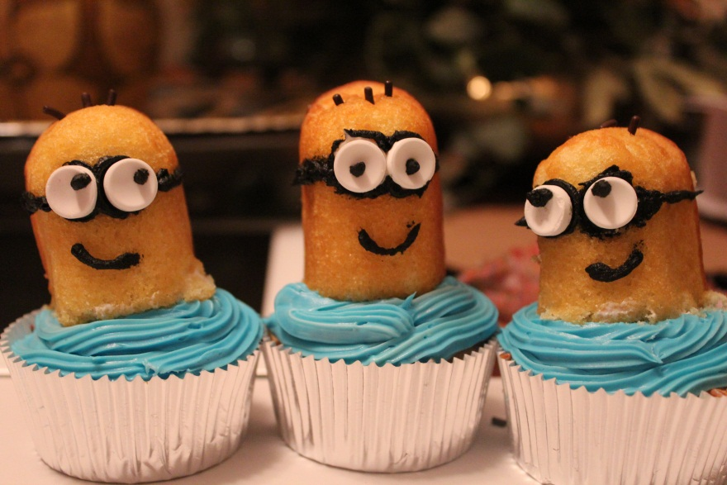
Sweet Insanity Desserts Where art is edible
Thank you for your
time and
consideration
Visit us at
www.Facebook.com/SweetInsanityDesserts
Instagram: @Sweet_Insanity_Desserts
Notes:
Thank you for considering our business plan Sweet Insanity Desserts, where art is edible. Come check us out on facebook Sweet Insanity Desserts, and also email us at sweetinsanitydesserts@yahoo.com if you would like to place an order.

