Slide 1
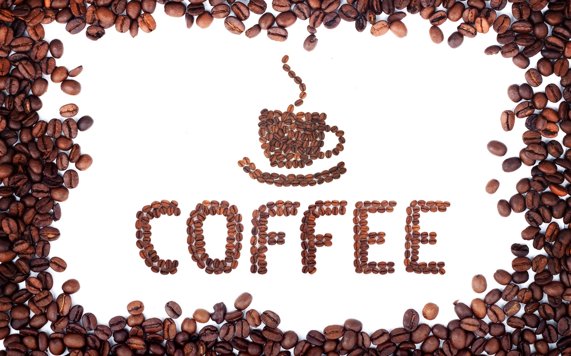
Notes:
Over 50% of Americans over 18 years of age drink coffee and espresso based drinks every day and 65% of coffee and espresso drinkers prefer to add sugar and/or cream.
Have you ever experienced a time where you were unsatisfied with the taste of your coffee or espresso? Maybe it wasn’t sweet enough, maybe there wasn’t enough cream. But what did you do? Did you drink it anyway? Did you throw it away? Did you have time to get another one?
Well you don’t have to worry anymore. Barista Bundles provides a solution to the problem of being unsatisfied with your coffee.

Slide 2
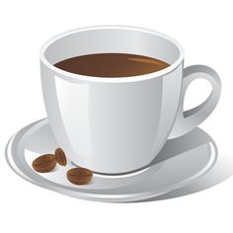
Barista Bundles
Shaniyah Williams
Sport & Medical Sciences Academy
Hartford, CT
Notes:
Good morning, my name is Shaniyah Williams and my business is Barista Bundles

Slide 3
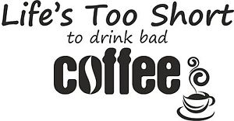
Problem
Buy/ receive coffee that doesn’t taste right
In a rush and don’t have time to get another
Notes:
Let’s say that you wake up in the morning and need a pick me up.
You go to your local coffee shop on your way to work and just as you are pulling away and take that first sip, the taste of your coffee just isn’t right.
You just got on the highway and don’t have time to turn around and get another, you’ll be late.

Slide 4
Solution
Provides the materials needed to satisfy your taste buds
Provides a quick fix
You don’t have to spend more money on another drink
Notes:
Instead of throwing your coffee away or wasting your time turning around to get another, you remember you have a Barista Bundle
You have all the sugar, cream, and stirrers you need to fix up your coffee right in the palm of your hand.
You didn’t have to get off the highway and turn around, you didn’t have to spend anymore money and you got to work on time.

Slide 5
Description of Product
Ready to go
Provides sugar, creamer, napkins, stirrers, etc.
Customizable
Non-refrigerated creamers
Contact through E-mail
Notes:
A barista bundle is an on the go kit of coffee supplies such as sugar, cream, stirrers, napkins, mints and wipes that can be kept in cars, on office desks, etc
Each bundle is made for your satisfaction. You can request the type of sugar and the flavor of creamer for your bundle
The creamer in the bundles do not need to be refrigerated
I can be contacted by e-mail at barista.bundles@yahoo.com about bundles

Slide 6
Mission and Social Impact
Mission
Provide customers with the items needed to ensure their coffee satisfaction
Social Impact
Use biodegradable napkins which are kind to the environment
Notes:
Barista Bundles mission is to provide customers with on the go creamers, sugars and flavors for ensuring their coffee satisfaction
Barista Bundles social impact is to use biodegradable napkins which are kind to the environment

Slide 7
Business Model
Description of Expenses
Variable Material Expenses | Total: $1.10
Item | $
Sugar | $0.10
Creamer | $0.66
Bags | $0.03
Stirrers | $0.05
Napkins | $0.01
Wipes | $0.10
Mints | $0.15
Fixed Expenses | Total: $1,845.88
Item | $
Insurance | $100.00
Rent/Utilities | $68.30
Website | $25.00
Advertising | $25.00
Depreciation | $27.58
Salary | $1,000.00
Definition of One Unit
One Barista Bundle (containing 6 creamers, 10 sugars, 5 stirrers, 5 napkins, 3 mints, 1 wipe)
Economics of One Unit
Selling Price |  | $6.00 + S+H
Cost of var. materials exp. | $1.10
Cost of labor | $0.64
Other variable costs | $0.00
Total COGS/ COSS |  | $1.74
Contribution Margin |  | $4.26
Monthly Break Even Units
$1,845.88 | = | 433.31 | ≈ | 434 Barista Bundles
$4.26
Notes:
My economics of one unit for Barista Bundles is one barista bundle which includes 6 original creamers, 10 sugars, 5 stirrers, 5 napkins, 3 mints and 1 wipe
I chose this unit because this is the standard bundle a customer would receive prior to customizing a bundle and all bundles will be the same size.
After conducting a market research survey, I learned that 88% of my target market said they would be interested in buying a Barista Bundle.
My selling price is $6.00 plus shipping and handling. Shipping and handling prices will vary depending on the amount of bundles and the weight.
Not everyone who orders a bundle will need the product to be shipped to them.
My cost of labor is $0.64 It will take me about 4 minutes to order materials, organize them and make one Barista Bundle
After I subtract my costs, I am left with a contribution margin of $4.26 per bundle.
My material expenses are $1.10 and my fixed expenses are $1,845.88 a month
My monthly break even is 434 Barista Bundles per month

Slide 8
Market Analysis
Market Statistics
Industry Name: | Coffee Creamer Production Industry | Annual Industry Sales: | $3 Billion
Description of Target Consumer
Demographics | Geographics
Male and Female Coffee Lovers Ages 15+ | State of Connecticut
Psychographics | Buying Patterns
Prefer to add sugar or cream to coffee | Purchase coffee or espresso at least once a day
Target Market Size
Total Population
3.6 Million
Target Market Population
1,944,000
Market Size
survey)
9,720
Notes:
Shaniyah
Barista Bundles is in the coffee creamer production industry. Americans spend $3 billion on this industry every year.
We believe our target market are male and females, ages 15 and older that are from the state of Connecticut for our first year.
They often spend money on purchasing coffee or espresso based drinks at least once a day and they prefer to add sugar or cream to their drink.
I started with Connecticut’s population and brought it down to the number of male and females, ages 15+ who are coffee lovers.
I found that 54% of the population are coffee drinkers and drink at least one cup a day.
I then found my market size. I feel that with my marketing and sales , I can touch ½% of my target market which would be 9,720 people in my first year

Slide 9
Marketing and Sales
Customized products
Featured in box subscriptions
Word of Mouth
Business Cards
Email
Social Media (Twitter & Pinterest)
Website (coming soon)
Notes:
Barista Bundles will have customized products such as napkins and creamers with our business name
We will also have our bundles featured in subscription boxes
Barista Bundles will mainly advertise through word of mouth and business cards.
We also have a website coming soon and can be contacted through
Twitter @Barista_Bundles , Pinterest @ Barista Bundles or Email @ Barista.Bundles@yahoo.com

Slide 10
Competition
 | Barista Bundles | Trader Joe’s Instant Coffee Packet | Going out and purchasing your own materials
Location | New Britain/ Hartford, CT | CT, MA, RI, NY, NJ | Your neighborhood
Price | $6.00 (+S+H) | $19.38 | $21.16
Convenience | Local delivery and shipping | Go out and pick up in store | Must go out on your own time
Your Competitive Advantages
1. Barista Bundles is located in the New Britain and Hartford Area 2. Barista Bundles helps you save money 3. Barista Bundles saves you time
Notes:
Barista Bundles is in competition with Trader Joes Instant coffee packets and customers going out and purchasing their own materials.
We are located in the New Britain/ Hartford area but ship our bundles all over the country.
Barista Bundles saves the customer time and money.
Barista bundles are also very reasonably priced but shipping varies with amount and weight of bundles ordered.
Compared to trader joes instant coffee packet, barista bundles provides stirrers, napkins, mints, and wipes

Slide 11
Qualifications
I’m a member of my own target market
I’ve witnessed incidents where others were unsatisfied with their coffee
I have excellent math skills
I have taken a Marketing and Entrepreneurship class
Notes:
I am highly qualified to have my business, Barista Bundles, because I am a member of my own target market.
I have witnessed many incidents where myself or others have been unsatisfied with the taste of their coffee.
I also have excellent math skills and have taken a Marketing and Entrepreneurship class.

Slide 12
Sales Projections
Gross Revenue
$37,800
Total Units
6,300
Net Profit
$10,104
Notes:
Barista Bundles predicts we will sell 6,300 Barista Bundles in our first year
We predict that Barista Bundles sales projections will be the highest in January, June, July, and December
This is because the most hot coffee is purchased in January and December because it is colder and the most ice coffee will be purchased in June and July because it is hotter
Sales projections will be lowest in April, September, and October because in April it is often very rainy and in September and October the weather starts to change
However this doesn’t take away from the fact that customers are still drinking at least one cup a day
My gross revenue is $37,800 and my net profit is $10,104

Slide 13
Start-up Funds
Item | Why Needed | Cost
Website | Provide a way to order product | $25.00
Computer/Cell Phone | Business Communications | Owned
DBA | Prove my business is functioning legally | $10.00
Business Cards | Advertising and Communication | $10.00
Bundle Materials | To make product | $176.00
 | Total Startup Expenditures | $221.00
 | Emergency Fund | $110.50
 | Reserve for Fixed Expenses | $5,537.64
 | Total Startup Investment | $5,648.14
ROI: Return on Investment
$10,104 | = | 179% | ≈ | $1.79
$5,648.14
ROS: Return on Sales
$10,104 | = | 27% | ≈ | $0.27
$37,800
Notes:
Barista Bundles will need about $5,700 to start our business.
This is mainly because I will need a website, a DBA, business cards, and bundle materials.
I already own a computer and cell phone.
I will also have an emergency fund and a cash reserve for my fixed expenses.
My Return on investment is 179% and my return on sales is 27%

Slide 14
Future Plans
Become operational as soon as possible
Begin selling my product in stores and farmers markets
Have customized products
Philanthropy
Give 10% of net profit to The Friendship Service Center of New Britain, Connecticut
Notes:
Barista Bundles plans to become operational as soon as possible.
Also, we would like to sell our product to stores such as BJ’s whole sale or Costco and farmers markets by the end of my second year
We will also be getting customized merchandise with our business name and logo
Barista Bundles’ philanthropy is to give 10% of the net profit to the Friendship Service Center of New Britain, CT.
The center provides service to the poor and needy, like housing and three meals a day to residents, and it provides lunch to the homeless.
I chose this service center because I am from New Britain and I have seen how much of an impact the center has on the community.

Slide 15
Sip, Slurp, Chug… Satisfaction
Thank you for your consideration of
Website coming soon
Contact: barista.bundles@yahoo.com
Twitter: @Barista_Bundles
Pinterest: Barista Bundles
Notes:
I can be contacted at barista.bundles@yahoo.com, Twitter @Barista_Bundles, and Pinterest @BaristaBundles
We also have a website coming soon
Thank you for your consideration of Barista Bundles; where I want to help you sip, slurp, chug… satisfaction.

