Slide 1
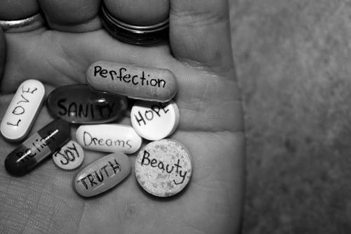
Notes:
Shanice- Every 40 seconds someone in the world commits suicide. By the end of our presentation there will be about 11 people that have given up on life and chosen what they thought to be the easy way out.
Gabriela- Not talking to someone about your situation will only make it worst. These suicides can be easily prevented if everyone has at least one person they can turn to. Fight to Fearless will be the support system that will hear the silent screams for help.

Slide 2
Gabriela Figueroa & Shanice Lopez-Rivera
Age: 16
Sport and Medical Sciences Academy
Hartford, CT
Notes:
Shanice: Good morning, I’m Shanice Lopez
Gabriela: I’m Gabriela Figueroa, and we are Fight to Fearless

Slide 3
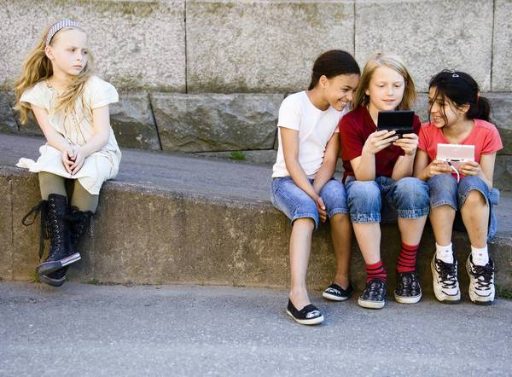
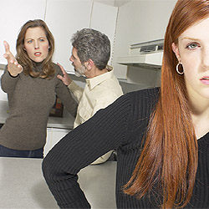
Their Story…
82% of middle school girls have felt insecure
Notes:
Shanice: Our Fighters have faced or are facing issues similar to those as stress from school, the pressure to look perfect from the media, feeling like an outcast, and anxiety put on them by their guardians. Fight to Fearless facts are statistics we were able to determine based on a survey we distributed to the middle school girls at SMSA, one of them being that 82% of middle school girls have felt insecure at some point in their life

Slide 4
Their Fight to Fearless
Afterschool program that will inspire middle school girls in the Hartford District to love their bodies, honor their voices, embrace their gifts and see their beauty.
100% of middle school girls believe there should be more art programs in schools
Notes:
Gabriela: Fight to Fearless will inspire middle school girls to love their bodies, honor their voices, embrace their gifts and acknowledge their beauty

Slide 5
Training for The Fight
Ice Breakers
Writing Exercises
Theater Exercises
Stress Relieving Conversations
End of Program Talent Show
80% of middle school girls would like to express themselves through the arts
Notes:
Shanice: Training for The Fight to Fearless will consist of an afterschool program twice a week where we will offer ice breakers for the young ladies to create immediate friendships among each other. We will also offer theater exercises because my partner and I have been in The Arts most of our lives and we have noticed that theater majors have a unique and admirable confidence, and we want our Fighters to have that self-assurance so that they may inspire their peers to believe in themselves. Make-up and Hair tutorials will be offered for the ladies who want to further embrace the confidence they will gain throughout our program. Stress relieving conversations will allow the girls a chance to create stronger bonds between one another and at the end of our program we will have a showcase that will be determined by the girls for them to show their parents their new-found fearlessness.

Slide 6
Mission Statement
Fight to Fearless will motivate middle school girls in the Hartford District to think positively and express themselves in a unique way
Social Impact
Fight to Fearless allows middle school girls to become leaders and role models for peers experiencing similar situations to those they have overcome
80% of middle school girls know someone facing emotional or physical issues
Notes:
Gabriela: Fight to Fearless will motivate middle school ladies in the Hartford District to have a more optimistic perspective on life and change the negatives to positives
Shanice: and in doing so, we will create role models for peers experiencing similar situations to those that our Fighters have been able to overcome
Gabriela: Fight to Fearless fact, 80% of middle school girls know someone that is facing or has faced physical or emotional distress

Slide 7
Business Model
Definition of One Unit
2 hours twice a week per month for 20 girls
Description of Expenses
Variable Material Expenses | Total: $60.00
Item | $
Writing Journal | $20.00
Snack | $40.00
Fixed Expenses | Total: $182.55
Item | $
Utilities/Rent | $70.00
Advertising | $10.00
Depreciation | $30.55
Insurance | $72.00
Economics of One Unit
Selling Price |  | $800.00
Cost of var. materials exp. | $60.00
Cost of labor | $348.00
Other variable costs | $15.00
Total COGS/ COSS |  | $423.00
Contribution Margin |  | $377.00
Monthly Break Even Units
$182.55 | = | .48 | ≈ | 1 session per month
$377.00
Notes:
Gabriela: Our definition of one unit is 2 hours twice a week per month for 20 girls. We chose this unit because 2 hours twice a week will not interfere with other extra curricular activities, and will give us enough time to leave the girls with a life long impact. Our selling price is 800 dollars which will result in 5 dollars per session per girl. We have priced it this way because it is affordable for the middle school girls, however if we can find a way for the district to pay for our program to be in the schools we will charge more. After we subtract our total costs it leaves us with a profit of $377.00. Our monthly break even unit is one session per month.

Slide 8
Market Analysis
Market Statistics
Industry Name: | Mental Health Services | Annual Industry Sales: | $13 Billion
 | Performing Arts |  | $14 Billion
Description of Target Consumer
Demographics | Geographics
Middle school Girls | Hartford, CT
Psychographics | Buying Patterns
Leadership potential Willing to expand their comfort zone | During the school year (September- May)
Target Market Size
Total Population
124,900
Target Market Population
3,750
Market Size
375
Notes:
Shanice: Fight to Fearless falls under the Mental Health Services and the Performing Arts industries which combined, Americans spend about 27 billion dollars annually in these industries. Our demographics consists of middle school girls living in Hartford, Connecticut. These girls show leadership potential and will be willing to expand their comfort zone. The

Slide 9
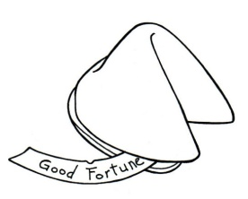
Marketing and Sales
Social Media
Recognition Days
Fight to Fearless Fortunes
Showcases/Conferences
75% of middle school girls say they would like to meet peers going through similar situations
Notes:
Gabriela: Fight to Fearless will be advertised through social media such as twitter, where will we post inspirational quotes every day. We have a blog where the girls can join our conversations and share their own stories. We will also have Awareness and recognition days when we will sell yellow bracelets to remember the people who have taken their lives. Fight to Fearless will distribute fortune cookies that we call “fearless fortunes” throughout schools which will have inspirational quotes inside. My partner and I will attend youth forums and conferences where we will share our own personal stories and inspire them to overcome and win their battles.

Slide 10
Competition
 | Fight to Fearless | Names Can Really Hurt Us | Looking In Theatre
Time | Eight day program | One day program | One day performance
Focus | Teen issues and solutions | Anti-Bullying | Teen issues
Results | Role models | Raise awareness | Raise awareness
Fight to Fearless Competitive Advantages
1. After school program 2. Large variety of activities and focuses 3. Discuss common teen issues and provide solutions
Notes:
Shanice: Fight to Fearless has two direct competitors; Names Can Really Hurt Us and Looking In Theatre. Names Can Really Hurt Us is a one day program where the school is invited to share their stories about having been bullied. Looking In Theatre is a one day performance that raises awareness about the many issues teens face every day. Fight to Fearless competitive advantages are that we are an eight day program afterschool meaning we do not interfere with the student’s class time or other extra curricular activities, we have a larger variety of activities and focuses, and we not only raise awareness for common teen issues, we find a solution for them

Slide 11
Qualifications
Bilingual
Names Can Really Hurt Us Leaders
Looking in Theatre Actors
CPR and Babysitter Certification
90% of middle school girls prefer to go to someone close in age when they have a problem
Notes:
Gabriela: My partner and I qualify to create Fight to Fearless because we are both bilingual which will allow some of our Fighters to feel more comfortable if they prefer to speak their native language. We have been leaders in the Names Can Really Hurt Us anti-bullying program allowing us to learn how to let people feel comfortable sharing their personal stories with us. My partner Shanice is an Actress for Looking In Theatre which provides us with the experience to teach our Fighters about the performing arts world and give them the confidence to express themselves in a unique way. My partner and I also have our CPR and Babysitter certifications

Slide 12
Sales Projections
Total Units
9
Gross Revenue
$7,200
Net Profit
$1,124
Notes:
Shanice: Fight to Fearless will sell for nine months out of the year; September through May. We chose to sell during this time because that is when the school year occurs and we want our Fighters to be able to attend all of our sessions and still be able to enjoy their time off during their summer vacation. Selling for nine months out of the year will result in a gross revenue of $7,200 and leave us with a net profit of $1,124

Slide 13
Start-up Funds
Item | Why Needed | Cost
Business computer/phone | To contact and keep files | Already owned
DBA | City of Hartford | $10.00
Partnership Agreement | To be fair | $500.00
Office Supplies | To write in journals | $20.00
250 Fortune Cookies | Advertise | $50.00
100 Yellow Bracelets | Raise suicide awareness and advertise | $54.00
 | Total Startup Expenditures | $634.00
 | Emergency Fund | $300.00
 | Reserve for Fixed Expenses | $100.00
 | Total Startup Investment | $1,034.00
ROI: Return on Investment
$1,124.04 | = | 108% | ≈ | $1.08
$1,034.00
ROS: Return on Sales
$1,124.04 | = | 16% | ≈ | $0.16
$7,200.00
Notes:
Gabriela: Fight to Fearless needs about $1,024 to start because we will need a DBA from the city of Hartford and a partnership agreement, office supplies such as journals to give our Fighters when they begin out program, and fortune cookies and bracelets to advertise. Our Return on Investment is 109%... And our Return on Sales is 16%

Slide 14
Future Plans
Expand to middle school girls in more districts
Major in Social Work and Communications
Promote former Fighters to become Leaders
Philanthropy
Fight to Fearless will donate 5% of its net profit to the American Foundation for Suicide Prevention
Notes:
Shanice: My partner and I would like to major in social working and communications in the near future. Fight to Fearless would like to expand to middle school girls in other districts as well as promote our former Fighters to become volunteer leaders in our program so that they may complete their community service hours doing something they enjoy and continue being role models even years after they complete our program. The Fight to Fearless philanthropy is to donate 5% of our net profit to the American Foundation for Suicide Prevention. We chose this philanthropy because in the past two years there have been 2 suicides at the Greater Hartford Academy of the Arts, one of which was a close friend of ours and an extremely talented performer

Slide 15
“Have Faith, Have Fun, Be Fearless”
Thank you for your consideration of Fight to Fearless
Follow us on Twitter
@FightToFearless
Visit our blog: www.fight2fearless.wix.com/fighttofearless
Notes:
Gabriela: Thank you for your consideration of Fight to Fearless
Shanice: Where you learn to have faith, have fun, and be fearless
Gabriela: visit our blog and follow us on twitter and instagram at fight to fearless
Both: thank you!

