Slide 1
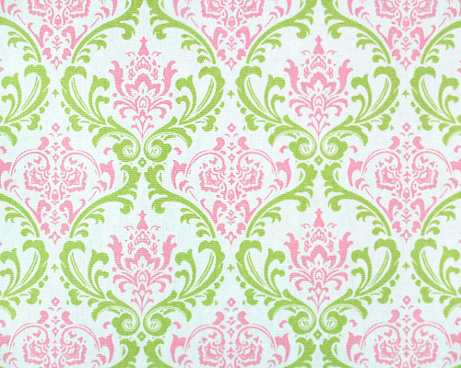
Notes:
Between work, school, and getting errands done, it’s hard to find a chance to pamper yourself with a trip to the spa. But for most people, the spa is too big o

Slide 2
Just Charming
Sport and Medical Sciences Academy
Hartford, CT
Bella Chan
Notes:
Good morning, my name is Bella Chan and my business is Just Charming

Slide 3
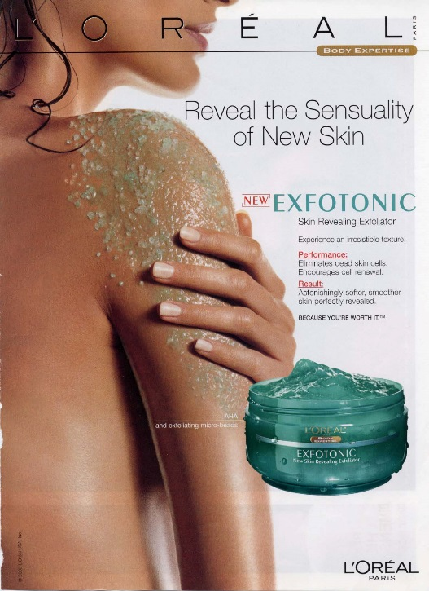
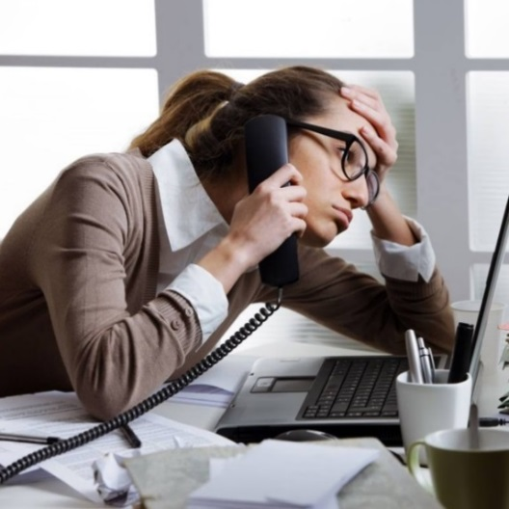
Problem
People can’t afford to go to the spa
Body scrubs contain toxic ingredients
Notes:
Most people find that they can’t afford to go to the spa, and when I say afford I don’t only mean financially but also time wise as well. Many spa treatments can cost as much as $100-$300 which is something that most people can’t splurge on. And even if one can afford to spend that much for a treatment, they don’t have the time to do so due to their hectic schedules
Also in many industries today, toxic ingredients such as mineral oils and synthetics ingredients (such as abrasive plastic beads) are added to body scrubs and they are harmful to the body. Artificial scents are also known to cause irritation to about 25% of the nation, this is leaving the skin to be damaged and unhealthy.

Slide 4
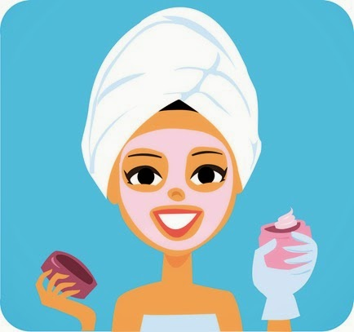
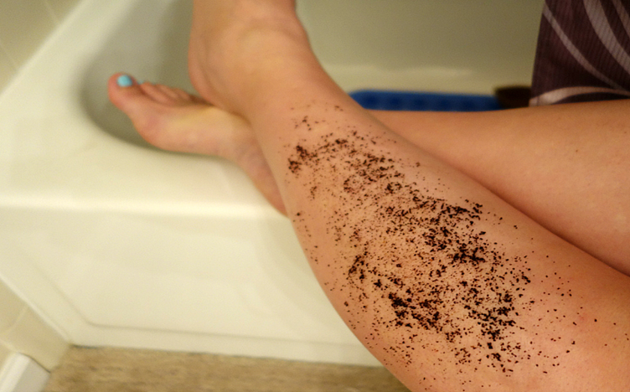
Solution
Create a spa experience at home
Provide customized, organic body scrubs
Notes:
My solution is to provide people with a spa like experience from home by using customized, handmade body scrubs made from all organic ingredients.

Slide 5
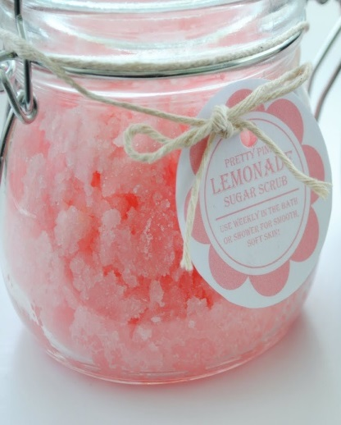
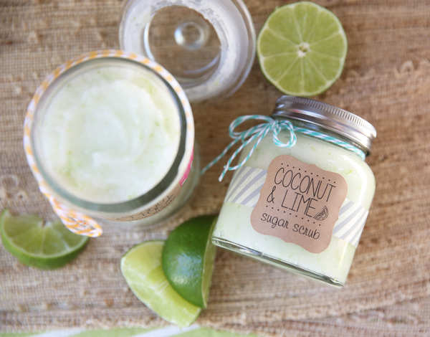
Description of Product
Online delivery website
Made from organic ingredients
Seasonal and year-round scrubs
Offer a “scrubscription”
Notes:
Just Charming will be an online website where customers can go online and create their own, custom body scrubs that can be sent to their homes. They’ll start by choosing what kind of scrub they’d like, and work their way down to what organic ingredients and oils they’d like incorporate in them.
Not only will I provide the option to customize your own scrub but I will also have a collection of pre designed scrubs that customers can choose from. This will vary between year round scrubs, like coffee and honey brown sugar, to seasonal scrubs, like peppermint and lemonade.
Lastly, I will offer a scrubscription, which is when the body scrub of the month is sent to customer’s homes on a monthly basis. This is great as a gift to others and yourself because you deserve to enjoy the spa from the comforts of your own home.

Slide 6
Mission Social Impact
To provide consumers with an organic body scrub that can fit to the body’s wants and needs
Use organic ingredients that are good for the body
Reusable and recyclable packaging
Notes:
My mission is to provide consumers with organic body scrubs that can fit to their body’s wants and needs
My social impact will be to use organic ingredients that’re healthy for the body and use reusable and recyclable packaging

Slide 7
Business Model
Description of Expenses
Variable Material Expenses | Total: $3.23
Item | $
Organic Brown Sugar | $0.99
Premium Olive Oil | $0.69
Raw Honey | $1.00
Mason Jar | $0.55
Fixed Expenses | Total: $340.00
Item | $
Salary | $200.00
Advertising | $20.00
Depreciation | $20.00
Rent/ Utilities | $100.00
Definition of One Unit
8oz. Honey Brown Sugar Scrub
Economics of One Unit
Selling Price |  | $15.00
Cost of var. materials exp. | $3.23
Cost of labor | $0.40
Other variable costs | $2.00
Total COGS |  | $5.63
Contribution Margin |  | $9.37
Monthly Break Even Units
$340.00 | = | 36.3 | ≈ | 36 Body Scrubs
$9.37
Notes:
My definition of one unit is one 8 oz honey brown sugar body scrub. This is scrub is chosen because honey is a great moisturizer for the body and also because sugar scrubs are gentler on the body. My selling price will be $15 and that will leave me with a contribution margin of $9.37. As you can see my cost of labor is fairly low but that is due to the fact that it takes me inly a small amount of time to make my body scrubs.
My fixed expenses comes out to be $340 due to my salary, advertising, depreciation, and rent and utilities. My numbers do appear to be low but that is only because Just Charming is a part time business, I will be working from home, and because my equipment is limited.
To break even, I will need to sell about 36 body scrubs a month.

Slide 8
Marketing Analysis
Market Statistics
Industry Name: | Personal Care Products Manufacturing | Annual Industry Sales: | $50 Billion
Target Market Size
Description of Target Consumer
Demographics | Geographics
Women Ages 15-50 | US internet users
Psychographics | Buying Patterns
People that enjoy beauty products People who enjoy organic products | People that would like to sign up for my monthly “scrubscriptions”
Total Population
2.9 Million
Target Market Population
1.3 Million
Market Size
13,000
Notes:
Just Charming is in the personal care products manufacturing industry and people spend about $50 billion on this industry every year. As you can see, I focused on the total population of people of who use the internet, I narrowed it down to women between the ages of 15-50. Finally, I decided to focus on 1% of my target market in my first year which is about 13 thousand.
I hope to attract customers who enjoy trying new beauty products and organic products so they will sign up for my monthly scrubscriptions

Slide 9
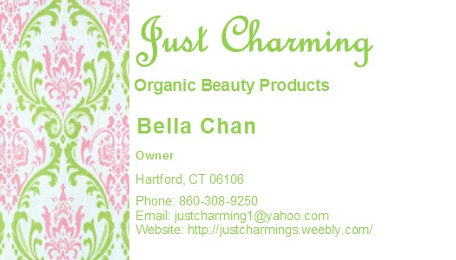
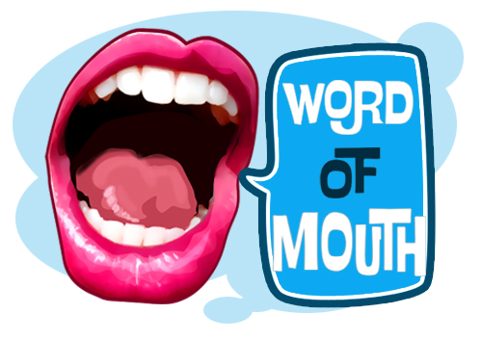
Marketing and Sales
Social Media
Facebook
Instagram
Twitter
Pinterest
Website/ Email/ Phone
Business Cards
Word of Mouth
In-store Displays
Notes:
Just Charming plans on marketing itself mainly through social media on websites like instagram, twitter, and facebook to interact more with potential buyers. I also hope to use pinterest and etsy so customers will buy my product through other domains.
I will use my website, email, and phone to contact my customers in case of any questions
With every purchase of a just charming body scrub I will add a business card
I hope through happy customers my business will be promoted through word of mouth
Lastly, in the future just charming hopes to have in store displays of our products in stores such as whole foods and farmer’s market’s so customers may try samples and truly understand what Just Charming is all about.

Slide 10
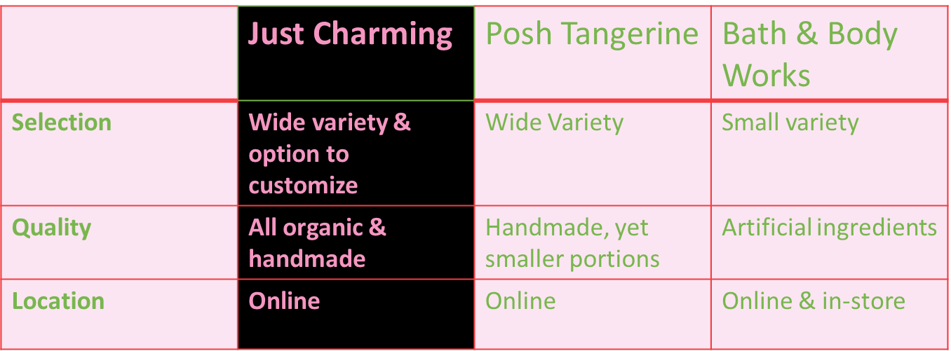
Competitive Advantages
Notes:
As you can see Just Charmings biggest advantage to it’s competition is the variety of body scrubs we offer our customers and the customization option that other businesses do not offer. We also provide better quality since our scrubs are made with organic ingredients and are handmade. While other companies such as Bath & body works do not use ingredients that’re healthy for the body. And although posh tangerine does make their own body scrubs and uses natural ingredients, their portion sizes are only 4 oz. compared to the average 8 oz. that Just Charming offers. Lastly, my business is online so customers can order a body scrub at any time of day.

Slide 11
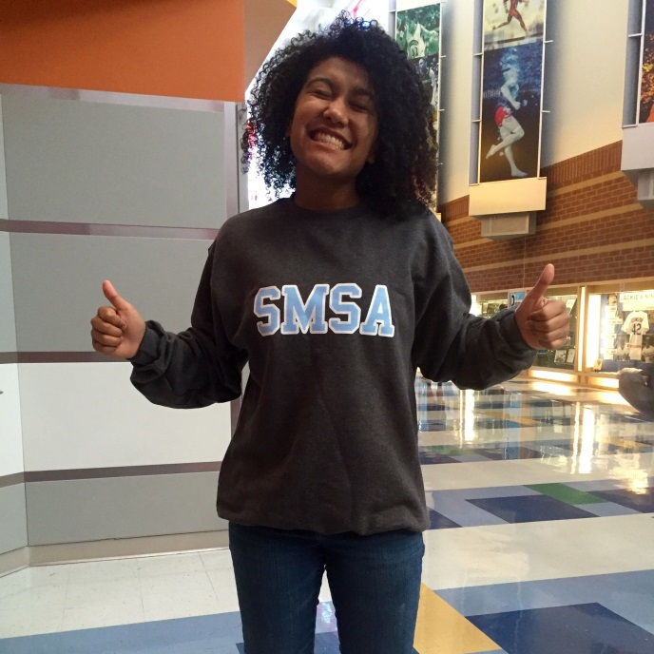
Qualifications
Currently operational
Have made body scrubs for 4 years
Have excellent social skills
Placed 2nd in my Fall competition
Have a Masters degree in Business by 2022
Notes:
As you can see, I am qualified to run my business because I have sold quite a few body scrubs so I am operational. With my 4 years of experience with body scrubs, I know how to make a variety of scrubs by hand and know exactly what I am doing.
My social skills also help interact with customers and learn more about their wants and needs for scrubs.

Slide 12
Sales Projections
Total Units
680
Gross Revenue
$10,200
Net Profit
$1,950
Notes:
Just Charming projects that in our first year we will sell about 680 scrubs, my sales will steadily increase in May because of mother’s day and also through out the summer and winter months because the skin deals with lots dehydration during that time of year. As you can see, my sales will be the highest in December because of the holidays.
My gross revenue is $10, 200 and my net profit is roughly $1,950

Slide 13
Start-Up Funds
Item | Why Needed | Cost
Phone/ Computer | Communication | Owned
LLC |  | $325.00
Start-Up Ingredients | To create products | $50.00
Packaging | To send out products | $30.00
Office Supplies | For the office | $20.00
 | Total Startup Expenditures | $425.00
 | Emergency Fund | $220.00
 | Reserve for Fixed Expenses | $255.00
 | Total Startup Investment | $900.00
ROI: Return on Investment
$1,950 | = | 216% | ≈ | $2.16
$900
ROS: Return on Sales
$1,950 | = | 19% | ≈ | $0.19
$10,200
Notes:
To start up my business, Just Charming will need $900 to which has come from startup expenditures of 425 and money put to the side for fixed expenses and emergency funds.
My return on investment is 216% and my return on sales is 19%

Slide 14
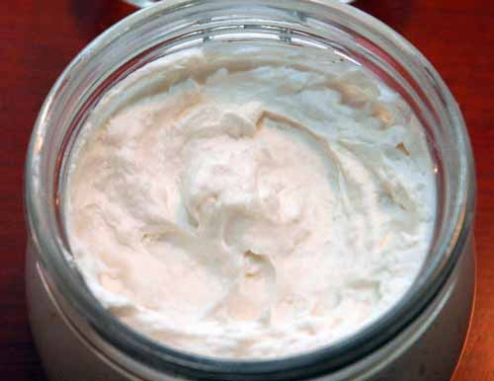
Future Plans Philanthropy
Expand my business to sell other beauty products
To donate 10% of our net profit to The Hole In the Wall Gang in Ashford, CT
Notes:
In the future Just charming plans to expand to other beauty products such as body butters and creams and plans on selling spa packages as well
We plan on donating 10% of our net profit to the hole in the wall gang in ashford, ct. This is a program that provides summer camp like experiences to children with special illnesses, such as cancer, leukemia, and lupus.

Slide 15
Your spa in a jar…
Thank you for your consideration of
Just Charming
justcharming1@yahoo.com
http://justcharmings.weebly.com/
Notes:
Thank you for your consideration of just charming. I can be contacted with the email below or visit my website below, and remember don’t be disarming, just be charming.

