Slide 1
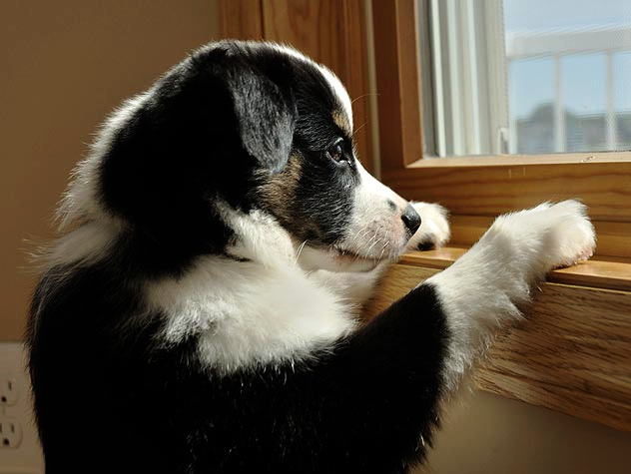
Notes:
What do we do with our pet while on vacation? This is a very difficult question for many pet owners to answer. You can ask one of the local children to dog sit for you….but can you really trust them to be responsible? Or you can drive across town to a kennel, but that is a misuse of time. This is where my business comes in.

Slide 2
Pet Tails LLC
Ryan Holland
Sport and Medical Sciences Academy
Hartford, Connecticut
Grade 11
Notes:
Hello my name is Ryan Holland and my business is Pet Tails.

Slide 3
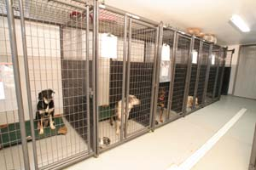
Unmet need
No easy source of traveling pet care for most areas in Connecticut
There is no personalized pet care that can be scheduled around the customers’ needs
Notes:
The unmet need that Pet Tails addresses is that there is no form of traveling pet care available for pet owners.
There is also no form of personalized pet care that is designed around the customer and their needs.

Slide 4
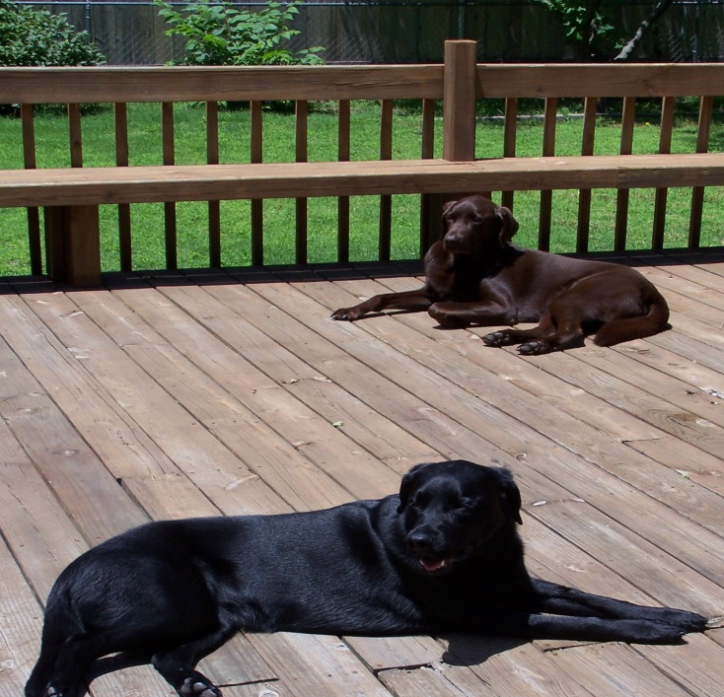
Solution
Eliminate time consuming preparations for your pet
Personalized pet care that is flexible to you and your needs
Notes:
Pet Tails will fulfill this need by providing our customers with a traveling form of pet care that is personalized for our customers
Pet Tails will shape our schedule around any requirements that customers may have.
Such as medical needs or specific feeding times.

Slide 5
Mission and Social Impact
Mission Statement
Pet Tails aims to simplify some the hassles of owning a pet by providing customers with a personalized form of pet care that is specifically designed around their needs.
Social Impact
Pet Tails will help to relieve the stress of our customers
Notes:
Pet Tails has a mission is simplify some of the hassles of owning a pet by providing our customers with personalized pet care that is designed around the customers needs.
Pet Tails will impact society by helping to relieve the stress of our patients.

Slide 6
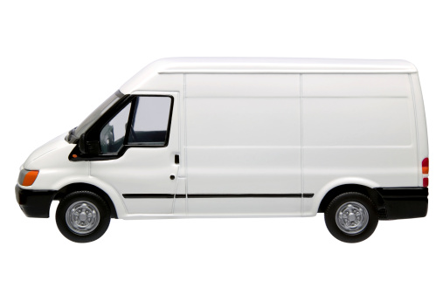
Description of Service
Traveling pet care
Personalized pet care
Flexible schedules
Experienced pet sitters
Notes:
Pet Tails provides its customers with the benefit of saving precious time while preparing their pets for when they are gone.
All we ask is that you leave your required pets supplies within easy access for our experienced pet sitters and we will take care of the rest.
Pet Tails shapes our schedule around the needs of all of their customers so we can accommodate any medical issues or other problems their pets may have.
We guarantee our customers that the sitter watching their pet is fully experienced in dealing with animals allowing our customers to relax knowing they left their pet in good hands.

Slide 7
Business Model
Definition of One Unit
3 visits per day for 2 days (weekend package)
Description of Expenses
Variable Material Expenses | Total: $1.15
Item | $
Treats | $0.46
Waste Bags | $0.69
Fixed Expenses | Total: $50.00
Item | $
Rent/Utilities | $20.00
Insurance | $10.00
Depreciation | $10.00
Advertising | $10.00
Economics of One Unit
Selling Price |  | $55.00
Cost of var. materials exp. | $1.15
Cost of labor | 14.50
Other variable costs | 7.39
Total COGS/ COSS |  | $23.04
Contribution Margin |  | $31.96
Monthly Break Even Units
$50.00 | = | 1.56 | ≈ | 2 weekend packages
$31.96
Notes:
Ryan Holland – Pet Tails EOU is 3 visits per day for two days on a weekend package. The selling price for this package will be $55.00. After I subtract my costs, which includes the 7.39 required for gas I am left with a profit of $31.96 per weekend. Because the pet owner will be leaving their supplies within easy access the only necessary materials for Pet Tails to supply is waste bags and treats. My breakeven point is 2 weekend packages per month
Talk about 7.39 being gas
My breakeven point is 2 weekend packages per month
Mention customers within walking distance

Slide 8
Market Analysis
Market Statistics
Industry Name: | Pet Care | Annual Industry Sales: | $$51 Billion
Description of Target Consumer
Demographics | Geographics
Adults ages 25 and over who own a pet | Northern Hartford County residents
Psychographics | Buying Patterns
People who care a lot about their pets | People who are willing to spend money for the best pet care
Target Market Size
Total Population
30,130
Target Market Population
2,729
Market Size
(based on
survey)
576
Notes:
Pet Tails is in the Pet Care Industry and Americans spend $51 Billion every year on this industry
I am targeting individuals 25 and older in Northern Hartford county
These individuals more than likely have a willingness to spend money in order to make their pets as comfortable as possible
In a survey that Pet Tails conducted we found that __% of people in our area have had troubles finding quality pet care which allowed me to find the estimated size of our target market.
1st #= ½ simsbury + granby + east and north granby
2nd #= 1st X 28.3% pet owners in Connecticut according to American Veterinary Medical Association / 2= 2728.53
3rd #= 2728.53 X .64 owners who had trouble finding pet care =1746.26 X .66 willing to pay $55 = 1152.53 /2 =576.3

Slide 9
Marketing and Sales
Word of Mouth
Discount for customers who refer other customers
Personal Selling
I have a small social media plan
Notes:
Pet Tails will increase its business mainly through word of mouth by giving customers who refer two or more people to us a small discount. I am also going to be providing personal selling which will enable me to build stronger customer relations.
***************
Social Media:
Because our business is mainly confined in Northern Hartford County at this time we are only able to have a small social media plan.
As we gain more customers through the social media and word of mouth this plan will grow.
The small plan we have established involves the construction of a Facebook page in which customers to post about our business enabling their friends in the area to learn about our business.
***************
5 ways of selling *4 required* (website facebook page (social media), personal selling, word of mouth, business cards, discount for customers who refer other)
When you present explain each bullet including any possible cost
Include a picture

Slide 10
Competition
 | Pet Tails | Pet Smart | Wagging Tails
Quality | Personalized care | No personalized care | Personalized care
Location | North Granby, CT | East Hartford, CT | Enfield, CT
Speed | Faster visits | Care provided in a day care | Longer visits
Your Competitive Advantages
1. Faster visits allowing customers to get the same services for a lower price 2. Located in North Granby which is more convenient for a lot of pet owners 3. Quality personalized care to your home which is more convenient
Notes:
Ryan Holland - Pet Tails compared to a company like Pet Smart offers their customers a home personalized care which is more convenient for the pet owner. Pet Tails compared to companies similar to us with a personalized home care provides pet owners with faster visits so you can get the same quality for a lower price. Pet Tails is located in North Granby which is easier for some pet owners and will keep the price even lower than someone coming from Enfield.
Show what some competitors do
Start : Pet tails has many competitors and two are shown here and this is what they do
This is what we do

Slide 11
Qualifications
Have entrepreneurs in family
Operational for 3 years
Strong customer base
Experience with animals
In process of being bonded
Notes:
I have quite a few qualifications that will help me to start this business. I have entrepreneurs in my family that have committed themselves in assisting me with expanding my business. Pet Tails has been operational on a small scale for 3 years allowing me to obtain a good amount of experience with animals, and a strong customer base. I also have entrepreneurs in my family that can give advice. Pet Tails is also in the process of becoming bonded.

Slide 12
Sales Projections
Gross Revenue
$2,970
Total Units
54
Net Profit
$957
Notes:
At Pet Tails we estimate that we can sell a total of 51 units annually which is about $2,805 for gross revenue. After subtracting the taxes and expenses we will be left with a net profit of about $927

Slide 13
Start-up Funds
Item | Why Needed | Cost
Car | Transportation to homes | Already Owned
Computer | Business productivity | Already Owned
Car Visor | Advertising for business | $80.00
Uniform | Advertising and professionalism | $25.00
Brochures | Advertising | $25.00
LLC Filing Fee | To become an LLC | $120.00
 | Total Startup Expenditures | $250.00
 | Emergency Fund | $400.00
 | Reserve for Fixed Expenses | $135.00
 | Total Startup Investment | $785.00
ROI: Return on Investment
$956.96 | = | 122% | ≈ | $1.22
$785.00
ROS: Return on Sales
$956.96 | = | 32% | ≈ | $0.32
$2,970.00
Notes:
Ryan Holland
Pet Tails will require a startup investment of $635.00
This includes our fixed reserve for $135 and our emergency fund of $500
Because I already own a car and a means to obtain car magnets my startup expenditures totals $0
Total startup investment
Detail of Item
ROI is probably greater than 100%
ROS must be less than 100%
Pet Tails needs a total sa
My return on investment comes out to 146%
And my return on sales comes out to 33%

Slide 14
Future Plans
Expand to dog walking and grooming services after 1 year and hire the first employee by the end of the first year
Philanthropy
Will donate 7% of our net profit to the Juvenile Diabetes Research Foundation (JDRF)
Notes:
Pet Tails has plans to expand our business to provide dog walking and grooming services by the end of the first year, and to hire our first employee before the end of the second year.
Our plan for philanthropy is to donate 7% of our net profit to the JDRF because my brother has had type 1 diabetes for 12 years.

Slide 15
“Pet care that is all about you”
Thank you for your consideration of
Pet Tails LLC
Notes:
Thank you for your consideration of Pet Tails

