Slide 1
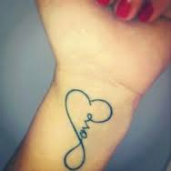
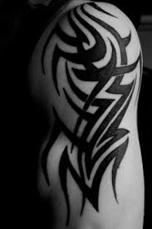
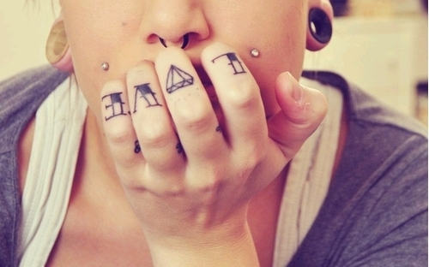
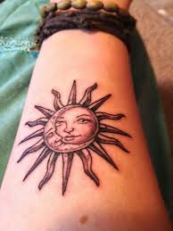
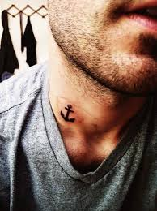
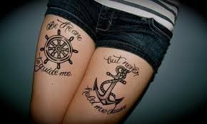
Notes:
Every tattoo is different. Each one needing different care. Depending on the person, this care can range from anything that has to do with going to the beach and needing some sunscreen, to having a job interview and needing to cover it up. But where do you go to find all of the products you need?

Slide 2
Tattoo Love and Care
Sport and Medical Sciences Academy
Hartford, CT
Makayla Kordas
Notes:
Good afternoon, my name is makayla akordas and I am here to introduce tyou to tlc

Slide 3
Problem
Tattoos need special care
Care products are individually distributed
Necessary products are hard to come across
Notes:
If you are an art lover like myself, you might consider getting a tattoo. However Some people may lack the knowledge of what to get for their tattoos. If you do know what to gfet, thes products are few and far between.and do you really want to make twenty different stops?

Slide 4
Solution
Box of all the products you need
Customizable to match your needs
Corporate research for best quality products
Notes:
TLC will provide our customers with a customizable and convenient box of what ewver your tattoo needs. We do all the research for you and you, to save you time, and to ensure that you have the correct products to keep your tattoo in tip top shape

Slide 5
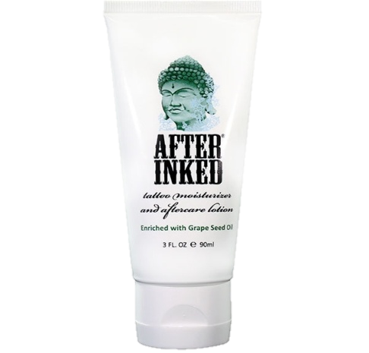
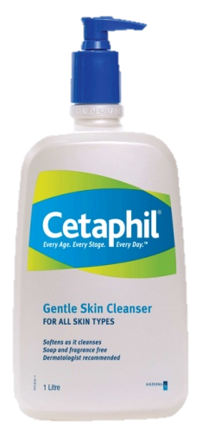
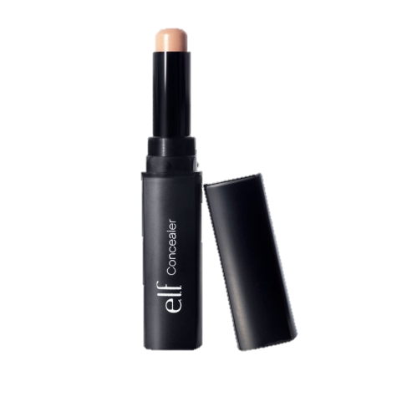
Description of Product
Tattoo care packages
Online
Customizable
Notes:
TLC is an online business that is devoted to keeping your tattoos looking and feeling great. We will provide our customers with a variety of tattoo care packages, anywhere from a “day at the beach” kit to a “new tattoo kit” or our signature “invisible ink” package to help you cover your tattoos when you are in need. We offer our customers with a size option of large, medium, or small, with pre-chisen products. And because we are very customizab;e, you can exchange products . Say you order our day in the sun package, and you don’t want the rub on sun scree, you can change it outr for a small stick of sun block WITH THE CONSIDERED PRICING

Slide 6
Mission
Social Impact
To provide those with tattoos, a convenient place to get all of their tattoo care
Recycled and reusable packaging
Products are not tested on animals
Notes:
Our mission at tlc is to provide convenance to those who want to take ccare of their tattoos. Our impact on society will be usine recyclable packaging and cruelty free products

Slide 7
Business Model
Definition of One Unit
One Medium Invisible Ink Package
Description of Expenses
Variable Material Expenses | Total: $15.00
Item | $
Small Concealer | $3.00
Concealer Primer | $5.00
Concealer Powder | $2.00
Wipes | $3.00
Brush | $1.00
Packaging | $1.00
Fixed Expenses | Total: $312.00
Item | $
Advertising | $20.00
Depreciation | $42.00
Rent/Utilities | $50.00
Salary | $200.00
Economics of One Unit
Selling Price |  | $35.00 +S&H
Cost of var. materials exp. | $15.00
Cost of labor | $0.80
Other variable costs | $0.00
Total COGS |  | $15.80
Contribution Margin |  | $19.20
Monthly Break Even Units
$312.00 | = | 20.8 | ≈ | 21 packages
$15.00
Notes:
Ladies and gentleman, we are all business people here and for that reason, I have chosen a medium invisible ink package for my def of one unit. This will include everything you se here to cover your tattoos. We do offer other tattoo care packages such as lotions to take care of your new tattoos. with a fixed expense at $312 and Our variable costs are $15 our contribution margin will be 1920, leaving us with 21 packages as our break even.

Slide 8
Market Analysis
Market Statistics
Industry Name: | Cosmetic and Beauty Products | Annual Industry Sales: | $50 Billion
Target Market Size
Description of Target Consumer
Demographics | Geographics
Adults 16+ Have tattoos | USA
Psychographics | Buying Patterns
People who like body art People who need to care for their tattoos consistently | Adults willing to order a new TLC package every other week to care for their tattoos daily
Total Population
300,000,000
Target Market Population
60,000,000
Market Size
600,000
Notes:
Tlc is in the cosmetic and beauty industry which americans spend about 50 bill every year. We will target people 16 and up since this is how old you must be to have a tattoo. We will also focus on people who have or like body art, and are willing to buy one package once a week to tend to their needs. After taking all of this into consideration, our total market size will fall at about 6 hundred thousand people that we hope to reach

Slide 9
Marketing and Sales
Business cards
Website
Customer referral program
Social media plan
Corporate referral program
Notes:
At tlc business cards will be passed out with every package to inform customers of who we are if they would like to return. We have a working websight along with a social media plan to inform customers of sales, provide pictures, and coupons,a nd allow them to leave comments on the product. This will also be a p\art of our customer referral program where people will be exchanging their satisfactgion therough word of mouth. Lastly we will have a sorperate referral program where we will be selling our product in tattoo parlors people;e can pick up a package while they get a tattpp

Slide 10
Competition
 | TLC | Tattoo Goo | Billy Jealousy
Price | $35.00 | $30.00 | $32.00
Options | Customizable | Pre-chosen | Pre-chosen
Products | Variety | Lotions | Lotions
Your Competitive Advantages
1. Product diversity 2. Competitively priced 3. Variety of options
Notes:
Tattoo foo only havs care lotions, and billy has lotions but only one pack of them. The rest is for facial hair and other stuff, not just tattoos. Tlc focuses on those who have tattoos, making us more focused on your needs as a tattoo owner. We have a sustomazibility option that they don’t and we also have a competitive price due to our prior mentioned optionds

Slide 11
Qualifications
Passionate about Art
Strong Entrepreneurship network
2 years customer service experience
Background in Marketing
Notes:
I,myselfam very passionate about art, and because tattoos are a form of aart, I fall into my own target market. i currently have a tattoo on my thigh and always needed a product such as this to help my tattooi have also worked with an entreprenure for the past 2 years so I have a close network along with the skills neded to run my own business

Slide 12
Sales Projections
Total Units
1,662
Gross Revenue
$58,170
Net Profit
$23,431
Notes:
Tlc projected that we can sell 1662 units in 1 year. In the summer months our sales will be a bit higher due to the fact that our target market doesn't want to wear long sleeves in the summer to cover tattoos they also need special sunlotion to avoin sun poisoning and fading. , and needs a cool alternative. Our gross revenue is 58170 and our net profit is 23431 dollars every year.

Slide 13
Start-up Funds
Item | Why Needed | Cost
Computer/phone | Business communications | $300.00
LLC paperwork | Protect my business | $600.00
Website | Business is online | $100.00
Advertisement | Get the product out there | $10.00
Inventory | Prepared for orders | $200.00
 | Total Startup Expenditures | $1,210.00
 | Emergency Fund | $650.00
 | Reserve for Fixed Expenses | $936.00
 | Total Startup Investment | $2,796.00
ROI: Return on Investment
$23,431 | = | 838% | ≈ | $8.38
$2,796
ROS: Return on Sales
$23,431 | = | 40% | ≈ | $.40
$58,170
Notes:
At tlcwe need a $1296.06start up investment. We have a $111.06 cash reserve and a $390 saved for any kind of emergency that may happen. Our patent will cost us a total of $521 so we can protect our product. We are aware that this paten is a bit low at the moment, however we are currently working on research so we can aquire a better one. the manufacturing cost is $250 for our first run which

Slide 14
Future plans
Philanthropy
Develop our own line of products
Corporate referral program
10% of Net Profit to cancer patients
Notes:
As of now, my company produces single, small patches for small tattoos, however in the future we will produce larger strips for those who have bigger tattoos. I also plan sell my product at tattoo parlors, instead of just having my name incorporated with theirs. These will be returning customers who knoe their number of pigment color, so they dopnt need to order a sample. Also people getting tattoos will see our name and product even if they don’t purchase. Invisible ink will be donating 5 percent of annual net profit to cancer patients to help them pay bills because my uncle just beat cancer and I feel it important for familys to feel the same happiness I felt when I found out he was better.

Slide 15
Thank You for Your Consideration of
Tattoo Love and Care
Website: http://tattoolovecare.wix.com/tattoocare Email: tattoo.love.care@gmail.com
Tumblr: tattoo-love-and-care Instagram: tattoolovecare Twitter: @tattoolovecare
Notes:
Thank you for your consideration of TLC. Be sure to check out our website and our social media outlets.

