Slide 1
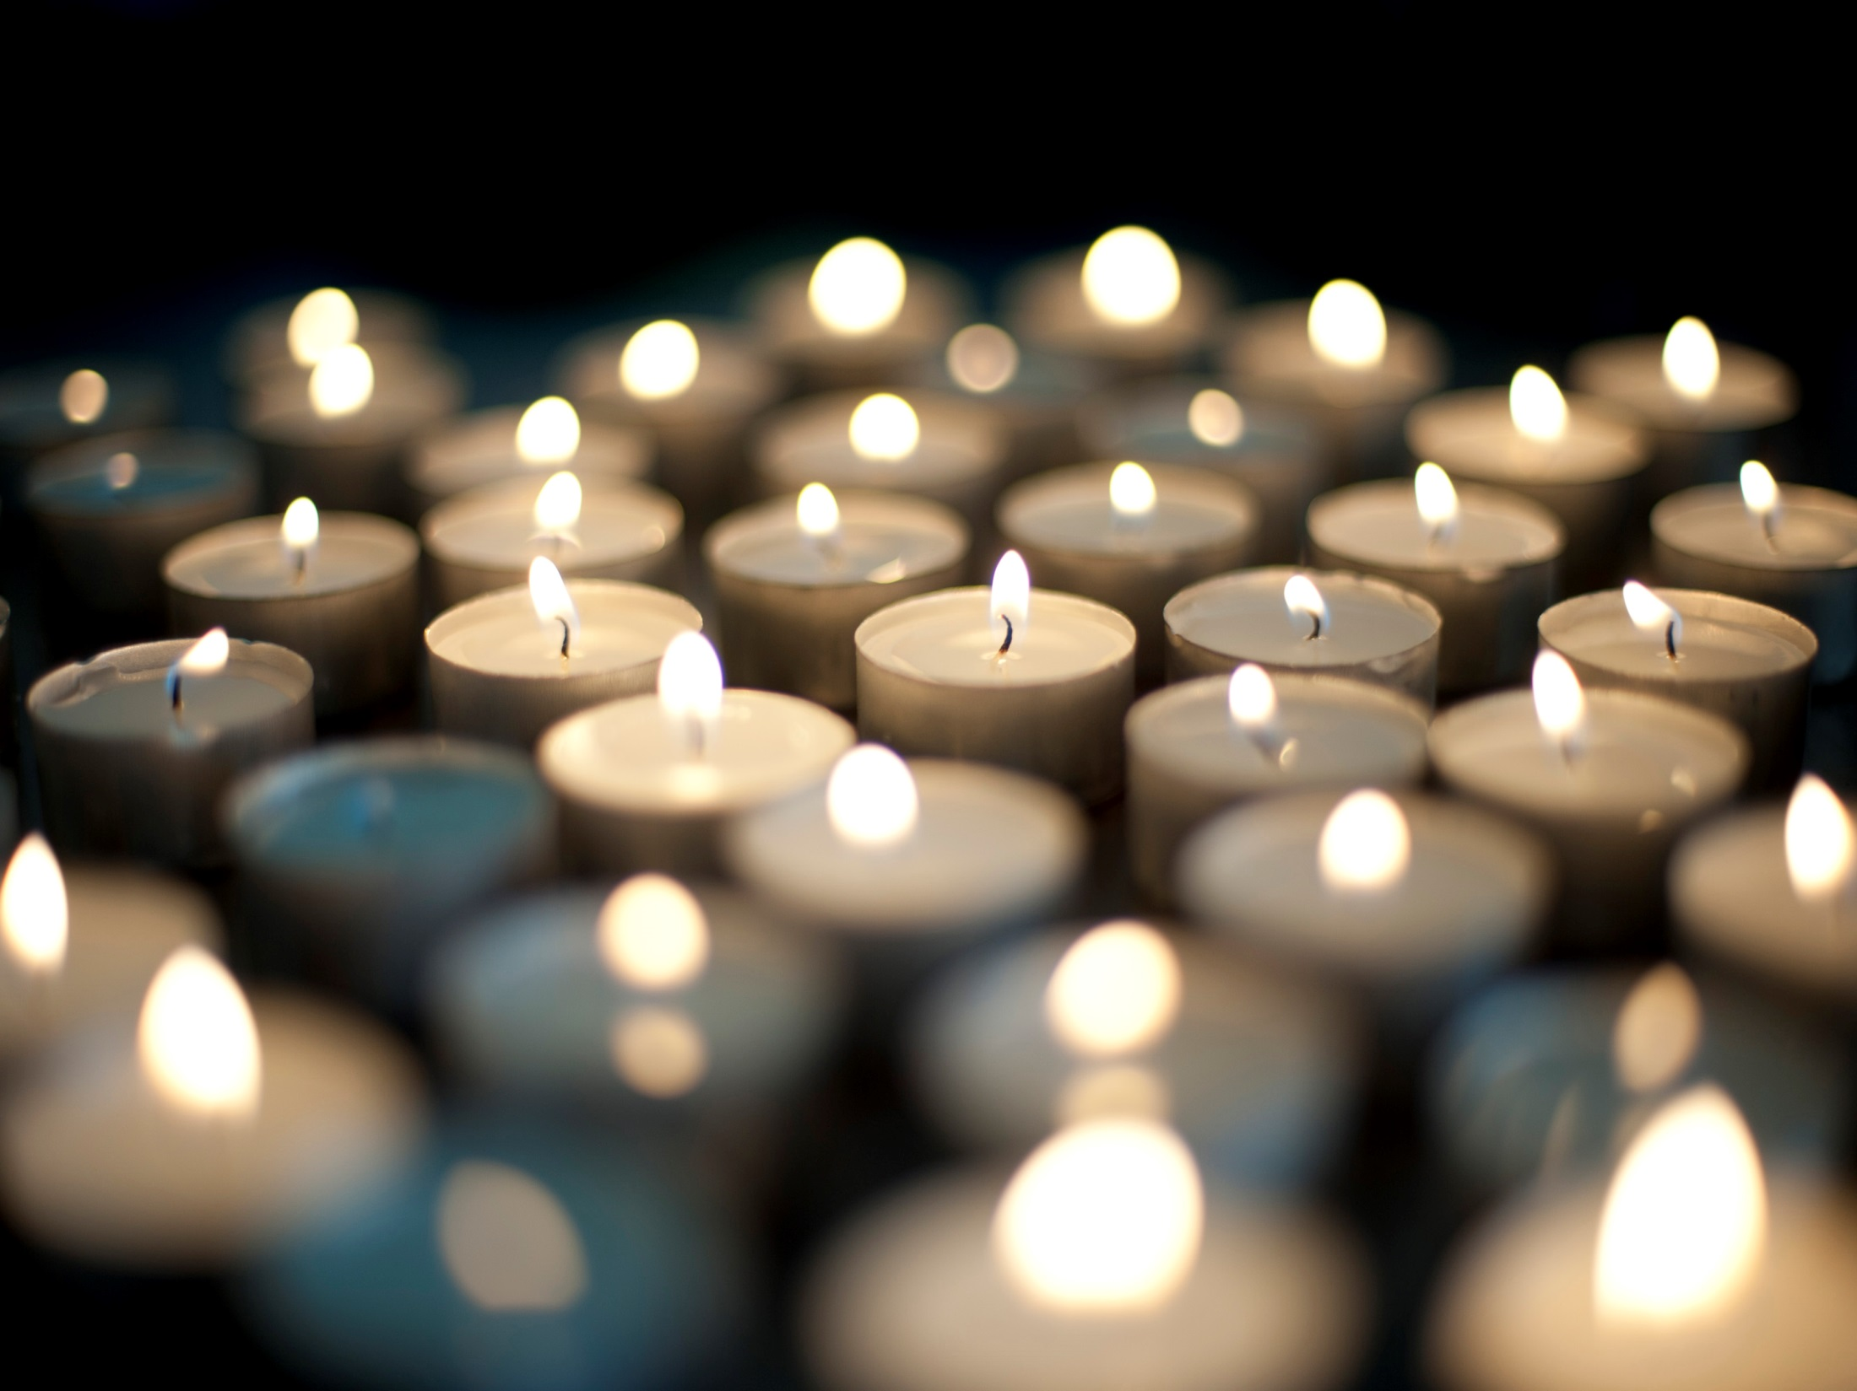
Notes:
Selma M: Candles have been around for as long as 5,000 years. Over time, they went from being used as an only source of light to being utilized in many settings ranging from home and event décor to holidays and celebrations, even as gifts themselves.
Selma A: While you can purchase a candle just about anywhere, many retailers don’t allow you the luxury of being able to customize your own look and scent, pick your own ingredients or even give you the ability to purchase a candle making kit and let you experiment at home!
Selma M: So Scentsational provides candle products that not only embody personality, creativity and long lasting scents, but give you the additional benefits of being eco-friendly, hypoallergenic, and sustainable – a combination of offerings that is not found on the market today.

Slide 2
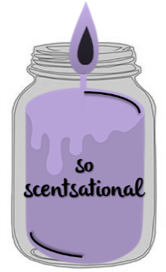
So Scentsational, LLC
Selma Ahmetovic & Selma Mustabasic
Sport & Medical Sciences Academy
Notes:
Selma A: Good morning ladies and gentlemen, my name is Selma Ahmetovic
Selma M: and I am Selma Mustabasic, and we’d like to present to you: So Scentsational.

Slide 3
Problem
Mainstream retailers do not offer candle customization or personalization options
Traditional candles contain harmful chemicals that emit toxic fumes and irritate people with allergies
Most candle glass jars and packaging cannot be recycled and retailers do not encourage re-use
Notes:
Selma A: While the retail candle market is filled with mainstream companies such as Yankee Candle that offer varieties of products to widespread consumers, their business models and sheer size have created gaps that our business can address. Customers who are seeking customization or personalization options are likely to be disappointed by many candle retailers today while other segments of people with allergies and skin sensitivities are unable to find a candle that caters to their needs. Though many people think candles are harmless, regular scented candles are a huge source of indoor air pollution and they release chemicals that are considered just as dangerous as second-hand smoke. Most candles are made of paraffin wax, which omits two carcinogens, benzene and toluene - the same fumes found in diesel fuel. Lastly, traditional candle retailers don’t prioritize sustainability or take pride in providing eco-friendly products. This is where So Scentsational fills the gaps.

Slide 4
Solution
Customization
Personalization
Hypoallergenic
Eco-Friendly
Price Conscious
Notes:
Selma M: Whether you’d prefer to purchase your fragrant candle directly from our site, or select carefully chosen ingredients for a home kit, all aspects of our candles are customizable and can be personalized just for you. We ensure our candles are completely hypoallergenic as they are made using all natural cotton wicks and with an alternative beeswax base in order to ensure our candles do not release any fumes, chemicals, or traces of airborne metals. While we can’t compete on price alone due to the high quality nature of our products, we recognize that price sensitivity is a key factor in making purchasing decisions. This is why we target different levels of price conscious customers by providing a range of candle products starting on the lower price end towards the higher.
Customization: Whether it is the design of the candle itself or the ingredients and scents that go into making one of our candles, we believe each customer should have the ability to customize their own candle products.
Personalization: Candles are used in many special occasions from birthday gifts to wedding favors. We give our customers the ability to personalize a batch of candles to a certain theme, color, scent, or message.
Hypoallergenic: We will be using all natural beeswax instead of paraffin wax in order to cleanse the indoor air and eliminate pollution.
Eco-Friendly: We believe in sustainability and being environmentally conscious, this is why our products are minimally packaged but durable for shipping. Our candles are made in mason jars which have a wide range of use and can be recycled over again – even after you finish your candle. More jars at home means less in the landfill. Along with this notion, we would like to start a program where customers can return 5 empty mason jars and receive a 6th candle product for free. This provides an incentive for customers to recycle while receiving a free product – and for us, it means buying less jars as they can be recycled for future products.
Price Conscious: While we can’t compete on price alone due to the high quality nature of our products, we recognize that price sensitivity is a key factor in making purchasing decisions. This is why we target different levels of price conscious customers by providing a range of candle products starting on the lower price end towards the higher.

Slide 5
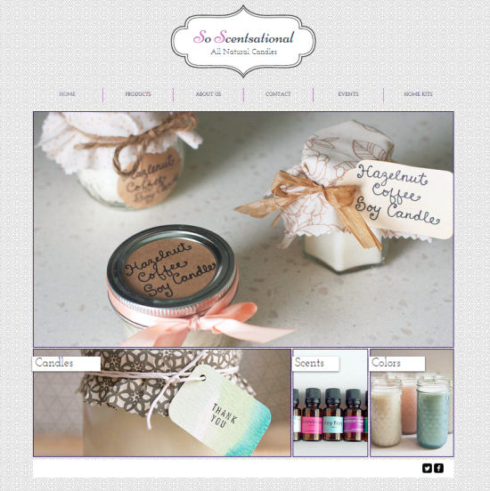
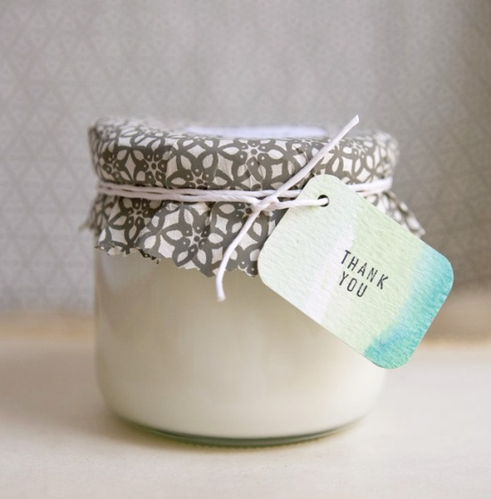
So Scentsational
Company
Online e-commerce platform with mobile compatibility - User friendly, easily accessible, simple to use
Products
Variety of candle scents
Wholesale ingredient supplier relationships
In-house production, labeling & packaging
Domestic shipping through USPS
Three size jars available – price range - Categories: Classic, Holiday & Specialty - Customization & Personalization options
Product promotion through social media
Incentive & Recycling Programs
Notes:
Selma A: Our company produces, labels and packages a variety of scented candles through an online e-commerce platform that has mobile compatibility. In order to cater to our customers and provide them with great service, our site is easily accessible, user friendly and simple to navigate. We source and purchase our candle ingredients from carefully selected wholesale suppliers and then create scented combinations that are long-lasting and fragrant. Our customers can purchase three different size jars across a variety of categories which we plan to expand in the future but currently promote through a variety of social media platforms. We want to engage our customers on a variety of levels which is why we have established an initial recycling program, not only as a commitment to sustainability but to incentivize purchases.

Slide 6
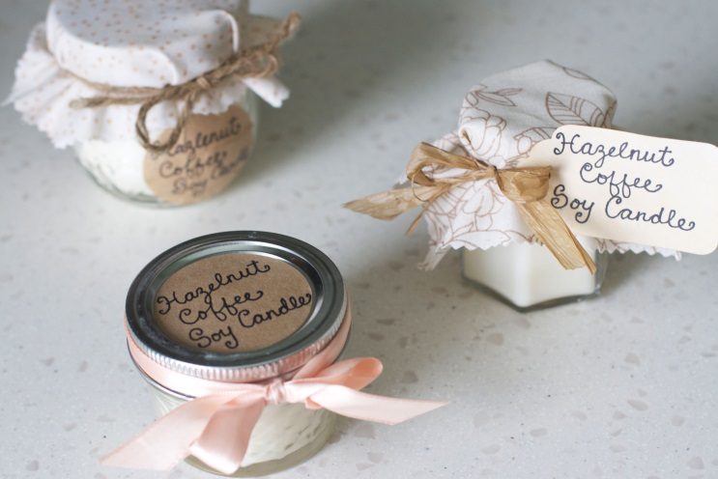
Business Responsibility
Mission Statement
Social Impact
We promise to provide superior candles that are carefully handmade with quality ingredients that are not only fragrant but more importantly hypoallergenic.
Our candles are:
Made in recyclable and reusable mason jars
Made with ingredients that do not pollute the air
Minimally packaged and labeled but durable for shipping
We further encourage our customers to:
Repurpose their jars by providing them with creative tips
Recycle their jars through our Return to Recycle program
Notes:
Selma M: Our mission is to provide our customers with exceptional candles that combine a variety of solutions unfound in the market today. We seek to be environmentally friendly in our product development and business practices while giving our customers the creative freedom to customize and personalize their products. We believe in sustainability and being environmentally conscious, this is why our products are minimally packaged but durable for shipping. Our candles are made in mason jars which have a wide range of use and can be recycled over again – even after you finish your candle. This means that there will be more jars at home and less in the landfills. We firmly believe that our business is vested in not only the wellbeing of our customers, but also our environment.

Slide 7
Business Model
Definition of One Unit
One 12 ounce candle + shipping & handling
Description of Expenses
Variable Material Expenses | Total: $6.12
Jar/Lid/Label | $0.99
Beeswax | $3.20
Ribbon | $0.16
Fragrance Oils | $1.09
Color Dye | $0.50
Cotton Wicks | $0.07
Bubble Wrap | $0.11
Fixed Expenses | Total: $312.24
Rent/Utilities | $20.00
Advertising | $12.24
Depreciation | $30.00
Salary | $250.00
Economics of One Unit
Selling Price |  | $24.99
Cost of var. materials exp. | $6.12
Cost of labor | $2.75
Other variable costs | $0.00
Total COGS/ COSS |  | $8.87
Contribution Margin |  | $16.12
Monthly Break Even Units
$312.24 | = | 19.37 | ≈ | 20 units
$16.12
Notes:
Selma A: We defined our economic unit as one 12 ounce candle plus shipping and handling. We believe this size candle will represent a majority of our purchases which is why we have selected to break down it’s expenses. As you can see, the table on the right represents all of the individual items that make up the cost of goods figure which includes the cost of labor that totals at $8.87.
Selma M: Our most expensive material is our all natural beeswax that is 100% pure and lacks all the harmful impurities typically found in a commercial paraffin based candle. At a selling price of $24.99, which is competitively priced, this leaves us with a contribution margin of $16.12.

Slide 8
Market Analysis
Market Statistics
Industry Name: | Candle Manufacturing | Annual Industry Sales: | $2.3 Billion
Description of Target Consumer
Demographics | Geographics
• 95% female • 25 to 65 years old • Middle to high income • Highly educated | • Connecticut
Psychographics | Buying Patterns
• Allergies/skin sensitivities • Enjoy interior design • Creative | • Increase during holidays because 35% of candles sales go up during holidays
Target Market Size
Total Population
3,600,000
Target Market Population
600,000
Market Size
(based on
survey)
1,500
Notes:
Selma A: So Scentsational is in the Candle Manufacturing business and Americans spend 2.3 billion dollars on it yearly. We decided to focus our sales in Connecticut which has a population of 3.6 million people. Although we are focusing on Connecticut, we realize that we will have customers who ordering all across the United States. However, realistically speaking, the majority of our purchases will be in the Connecticut area.
As the chart shows, we defined our target market as mainly females aged 25 to 65 who have a middle to high income in the Connecticut area which makes 600,000 people in our target market population. Our market size is roughly 1,500 people which we figured out by concentrating our marketing and sales efforts on about a quarter of a percent of our target market.

Slide 9
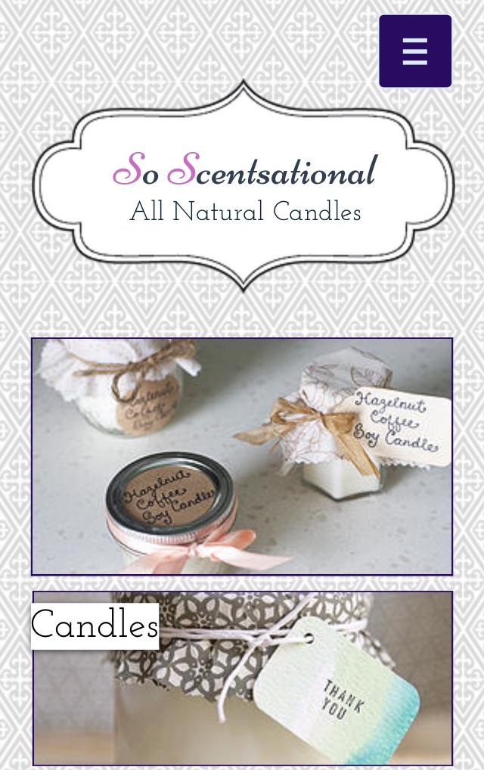
Marketing and Sales
Social Media
Website
Business cards
Email
Direct mail
Word of mouth
Notes:
Selma M: In order to expand our sales channels, we will sell our products on Etsy in addition to our own site. We plan to promote our company and the products we sell through various social media platforms such as Instagram and Pinterest, creatively designed business cards and interactive e-mail blasts. Lastly, we rely heavily on word of mouth promotion to sell our products as we want our customers to not only remain loyal to our brand, but also act as ambassadors for our products.

Slide 10
Competition
 | So Scentsational
Average Price | $2.08/oz.
Hypoallergenic | Yes (Natural Beeswax)
Customizable | Yes
Yankee Candle Co.
$1.72/oz.
No (Paraffin Wax)
No
Bath and Body Works
$1.55/oz.
No (Vegetable Wax)
No
Our Competitive Advantages
1. Our prices are very affordable for our multi-faceted candles 2. Our candles are made of beeswax that is hypoallergenic and eco-friendly 3. Our customers can personalize & customize every feature of their candle
Notes:
Selma A: For our competitive analysis, we took a look at our top two competitors. We assessed each company on the basis of the 3 distinct features that So Scentsational has integrated into our products and business model. Yankee Candle Co and Bath and Body Works are direct competitors as they offer a variety of fragrant jar candles. While they are both less expensive, on average, neither of the two are hypoallergenic and neither of the two retailers offer customization options.
Selma M: The weaknesses of these competitors creates a gap in the market that So Scentsational fills and turns into competitive advantages. Our products are competitively priced and much more affordable than many, are completely hypoallergenic, customizable, personalizable and eco-friendly. This is why there is a significant opportunity in this market that we believe we can take advantage of.

Slide 11
Qualifications
Five years of combined candle making experience
Fluent bilingual speakers, currently learning Spanish
Enrolled in Marketing/Entrepreneurship course
Website and mobile design knowledge
Notes:
Selma A: In year 2016, So Scentsational will be fully operational. By then, we will have five years of combined candle making experience and have previously taken a class learning how to make different candles at home. Additionally, we have experience with website and mobile design which we have utilized in the creation of our site. We are fluent bilingual speakers of Bosnian and English, and are currently learning Spanish as well. Lastly, we are enrolled in a marketing and entrepreneurship course that is providing us with the necessary knowledge to run our company.

Slide 12
Sales Projections
Total Units
450
Gross Revenue
$11,245
Net Profit
$2,981
Notes:
Selma A: We projected our sales to a total of 450 units per year. We believe this number is attainable due to the fact that we will be selling on two platforms. As you can see, the chart spikes sales for certain months which have holidays in them because 35% of candle sales increase during the holiday season. We will be left with a gross revenue of $11,245 and a total net profit of $2,981.

Slide 13
Start-Up Funds
Item | Why Needed | Cost
Computer/phone | Business communications | Pre-owned
Business cards/website | Business advertising | $20.00
LLC paperwork | Business protection | $300.00
Start up inventory/packaging | To make our product | $300.00
Total Startup Expenditures $620.00
Emergency Fund $300.00
Reserve for Fixed Expenses $950.00
Total Startup Investment $1,870.00
ROI: Return on Investment
$2,981.05 | = | 160% | ≈ | $1.60
$1,870.00
ROS: Return on Sales
$2,981.05 | = | 27% | ≈ | $0.27
$11,245.50
Notes:
Selma M: In order to make our business operational, we require a total investment of $1,870. We have set aside an emergency fund and a cash reserve.
Selma A: The major expenses that we must cover are corporation paperwork to legally establish and protect our business, and start up supplies to create our products and manage our inventory.
Selma M: Our return on investment is 160% and our return on sales is 27%.

Slide 14
Future Plans & Philanthropy
Personal
- Attend top universities to study entrepreneurship
- Develop ecommerce technology skills and networking abilities
Philanthropy
- Donate 7% of our net profit to Saint Jude Children’s Research Hospital
Business
- Expand product offering and variety of current candle scents
- Provide candles for special occasions such as birthday parties and weddings
Notes:
Selma A: In year 2 of our business, we would like to expand our horizons and offer a wide variety of products that not only include candles, but scented bath products. Additionally, we would also like to be able to cater and accommodate larger orders of candles that are event based like for weddings and birthday parties.
Selma M: So Scentsational LLC will donate 7% of our net profit to Saint Jude Children’s Research Hospital. Our families have been huge supporters of this amazing organization that researches illnesses which is why we’d like to extend our business and help.

Slide 15
We make scents!
Thank you for your consideration of
So Scentsational
Please visit our website and Instagram account!
www.soscentsational.com
- SoScentsational
- SoScentsationalCT@yahoo.com
Notes:
Selma A: Thank you for your consideration of So Scentsational, please be sure to check out our website and our social media.
Together: We make scents!

