Slide 1
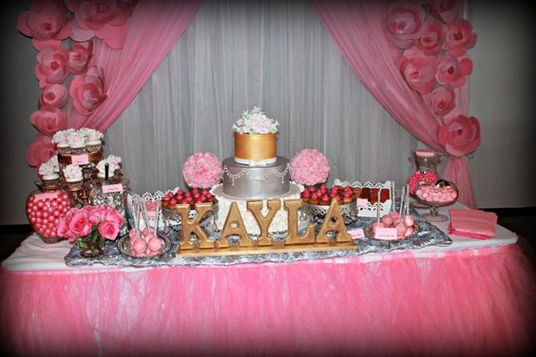
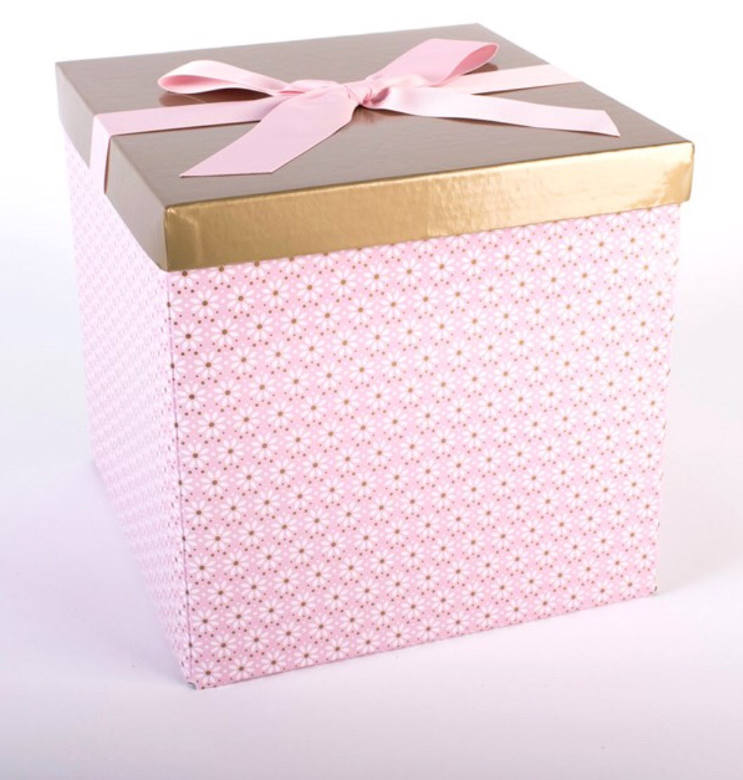
Notes:
Jainelys: “Is your child’s birthday coming up but you don’t have time to plan a party?...don’t you wish there was a place where you could order and have it shipped right to your door with all of the supplies?
Ayesha” well now there is...”
Jainelys” what if you could get all of this…in this ? with a click of a button”

Slide 2
The Fiesta Box!
Ayesha Nazir & Jainelys Sierra
Notes:
Ayesha: “Good Morning. My name is Ayesha Nazir.”
Jainelys: “And my name is Jainelys Sierra…. And our business is The Fiesta Box!

Slide 3
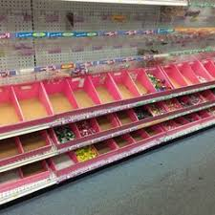
Problem
People don’t have time
Can’t find all the supplies in one place
The boxes are not eye appealing
Can’t customize everything
Notes:
Ayesha: “When the time comes for parents to plan their child’s birthday party, their busy day just keeps getting busier. They have to pick the perfect theme to make their child have a memorable birthday…. Along with their already busy life, this task seems to be like another burden on their shoulders.”
Jainelys: “Along with not having enough time, it is very difficult to find all the needed party supplies in one place. Many stores run out of stock quickly or do not even carry the decorations you need….. According to the Fiesta Box survey 83.9 % of our target market don’t find all their needed party supplies in one place. “……..
Ayesha: “Even if they can find everything online and get them shipped to their house, whose child wants to open up a boring shipping box. The boxes that party supplies are sent in today cannot be reused as gift boxes.”
Jainelys: “There’s always a limit to what online party supply shopping can get you. The themes are not as endless as they are said to be. Many decorations today can’t be customized to a certain theme. “

Slide 4
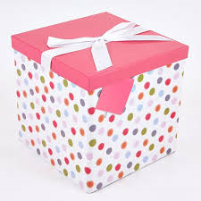
Solution
Ships directly to your house
Comes in one box
Decorated boxes
Different custom options
Notes:
Ayesha “The Fiesta Box! will ship your box so everything will come on the same day and it makes party supply shopping quick and easy.”
Jainelys “ The boxes we ship your supplies in match the theme of the birthday party. There are many options to choose from and can be customized to your liking.”

Slide 5
What We Do
We save you time
We create customized party boxes
We ship the box to you
Everything arrives on the same day
Notes:
Ayesha: “We provide customers with all the things they need to have a great hassle free party experience. Our boxes will include decorations, invitations, tableware, and decorating tips and tricks, that all match and go with their party theme. we decorate the box to your liking so it can be reused to put a present in.”
Jainelys: “The Fiesta Box! will be shipped straight to the buyers door, saving them time and preventing them from having to go to the store and finding everything themselves. Ordering online can lead to your supplies coming at different times. The Fiesta Box will deliver everything in one box guaranteeing that everything arrives at one time to your door.”

Slide 6
Mission Statement
The Fiesta Box! provides customers with customized party supplies in a box
Social Impact
Bonding between parent and child through a great party experience
Notes:
Ayesha “The Fiesta box's mission is to give parents the ability to buy everything they need for their child’s birthday party all in one box, no matter the theme.”
Jainelys” The Fiesta Box! Allows parents to impress and surprise their children by buying them the perfect party supplies that go with the party’s theme, creating a great bond between parent and child.

Slide 7
Business Model
Definition of One Unit
One Pink Princess Fiesta Box! (8)
Description of Expenses
Variable Material Expenses | Total: $8.69
1 Gift Box with Lid | $0.08
Contents of Box | $8.61
Fixed Expenses | Total: $155.00
Rent/Utilities | $40.00
Advertising | $35.00
Depreciation | $35.00
Salary | $45.00
Economics of One Unit
Selling Price |  | $${70}_{+SH}$
Cost of var. materials exp. | $8.69
Cost of labor | $5.05
Other variable costs | $2.24
Total COGS/ COSS |  | $15.98
Contribution Margin |  | $54.02
Monthly Break Even Units
$155.00 | = | 2.8 | ≈ | 3 Boxes
$54.02
Notes:
Ayesha: ‘”Our economics of unit is one pink princess fiesta box for a party of 8, that is right in front of you. We chose this unit because we feel that this is a common birthday party theme for young children. We chose a party of 8 because it is the ideal size for a child’s party.
Jainelys “ Besides this box we give a variety of different options for party themes which include, but are not limited to; superheroes, animals, and cartoon characters.”
Ayesha:” It costs us 8.69 to make the product. This box includes: decorations, tableware, invitations, party favors, and other tips and tricks.We will sell the box for $60 plus shipping and handling. We chose this price because it is close to what our competition is selling at, but still more affordable. Our cost of labor is about $3. The other variable costs are for the packaging for the boxes. Our profit on the box is $46.54.”
Jainelys: “The majority of our costs are total fixed expenses, which will be $155. We depreciated a laptop for 3 years and phone for 2 years because since our business is online based, we would like to keep up with the latest technology. We break even at 4 boxes a month.”

Slide 8
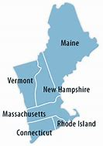
Market Analysis
Market Statistics
Industry Name: | Internet and Mail Order Retail | Annual Industry Sales: | $460 Billion
Description of Target Consumer
Demographics | Geographics
Parents of children ages 1-10 Middle to high income | New England
Psychographics | Buying Patterns
Family oriented Busy | Throw parties at least twice a year
Target Market Size
Total Population
15 Million
Target Market Population
1.6 Million
Market
Size
8,000
Notes:
Ayesha: ” The Fiesta Box! Is in the internet and mail order retail industry. Americans spend $460 billion every year towards this industry. The Fiesta Box! targets busy parents of children ages 1-10 with a middle to high income.”
Jainelys: “ Our target market lives in the new England region we started off with a population of 1.6 million people, we used half a percent to concentrate on 8,000.”

Slide 9
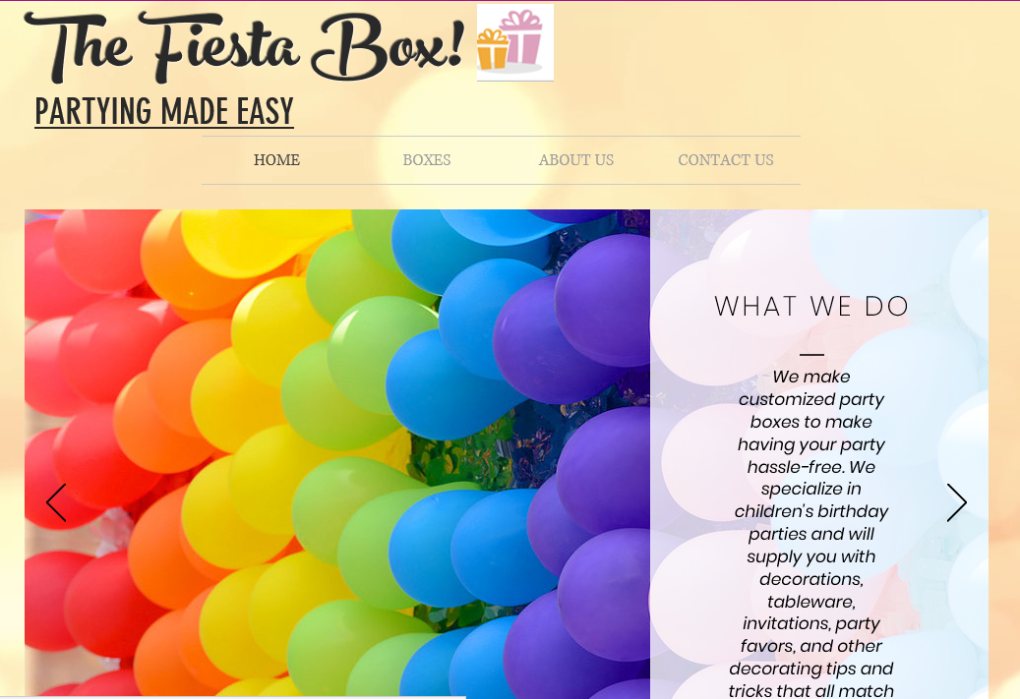
Marketing and Sales
Website
Social media
Business cards
Pens
Discounts
Pop-up ads
Instagram:
Monday | Wednesday | Friday | Saturday
Post a party picture | Post an update on the website | Post different party options | Promote website
Notes:
Ayesha:” we plan to reach our target market by using Instagram to promote our business. We have developed a schedule of posting every other day, showing customers different party options as well as promoting our website.”
Jainelys: “We have created an informational website about our business that will be later developed into a functioning ordering site.”
Ayesha: “Inside of each Fiesta Box!, we plan on giving each customer a business card and pen so they can refer us to their family and friends and be constantly reminded of our business.”
Jainelys: “ We plan on using pop up ads on online platforms to attract customers to The Fiesta Box!”

Slide 10
Competition
 | The Fiesta Box! | Birthday in a Box | Birthday Express
Price | $70.00 | $82.93 | $99.95
Selection | More options and customizable | Limited options | Limited options
Quality | Reusable gift boxes that match themes | Comes in brown shipping boxes | Comes in brown shipping box
My Competitive Advantages
1. More affordable for parents 2. More customization options and themes 3. Comes in higher quality gift boxes
Notes:
Ayesha: “The Fiesta Box’s two main competitors are birthday in a box and birthday express. For a princess birthday box our competitors charge from $80 to $100. The Fiesta Box! has decided the price of $70, making it affordable for our target market. “
Jainelys” After researching both our competitors’ websites we discovered that they both have limits to party theme options. On the other hand, The Fiesta Box! provides customers with more options and can be customized as well.”

Slide 11
Qualifications
We are currently operational
We are part of our target market
Have 8 years of combined experience
Have excellent customer service skills
Notes:
Ayesha: “The Fiesta Box!’s major qualification is that we are operational. With our 8 years of combined party planning experience ,we have felt the need for a product that can provide us with all the necessary party supplies in a hassle free way”
Jainelys : “we have great skill and experience with interacting and helping others. By the end of this school year we will have completed a Marketing and Entrepreneurship class, which will give us knowledge and insight towards starting our own business.”

Slide 12
Sales Projections
Total Units
54 boxes
Gross Revenue
$3,780
Net Profit
$899
Notes:
Ayesha:” the Fiesta Box has projected we can sell about 54 boxes our first year, of different themes and sizes.”
Jainelys “We start off at 3 boxes because we are not well known yet. As we market, our sales will go up as we become more known. Our gross revenue is $3,240 and our net profit is $833.”

Slide 13
Start-up Funds
Item | Why Needed | Cost
DBA | Paperwork to do business | $5.00
Phone/computers | Communications with customers | Owned
Start up supplies | To make boxes | $280.00
Website | Domain for customers to order from | $16.00
Business cards/pens/ads | For advertising | $19.00
Packaging | To ship the boxes | $20.00
 | Total Start-Up Expenditures | $340.00
 | Emergency Fund | $170.00
 | Reserve for Fixed Expenses | $465.00
 | Total Startup Investment | $975.00
ROI: Return on Investment
$899 | = | 92% | ≈ | $0.92
$975
ROS: Return on Sales
$899 | = | 23% | ≈ | $0.23
$3,780
Notes:
Ayesha: “ The Fiesta Box has a total start up cost of $345 which will cover things like the DBA which will allow us to do business as a partnership and $16 to create our website domain where customers can order their Fiesta Boxes from. Majority of our costs are put towards buying start up supplies, this money will allow us to make 20 Fiesta Boxes, which are enough to start up the business.”
Jainelys: We have given ourselves a $173 emergency fund and $465 reserved for fixed expenses for 3 months. Our return on investment is 90% and our return on sales is 27%”

Slide 14
Future Plans
In 2 years, we plan to expand The Fiesta Box! by providing people with supplies for parties other than children’s birthdays
Philanthropy
We will donate 5% of our net profit to the
Make A Wish Foundation
Notes:
Ayesha: “ In 2 years we plan to expand the Fiesta Box! by providing people with supplies for a variety of parties, … like Halloween, Easter, and graduations.”
Jainelys: “ We plan on donating 5% of our net profit to the Make a Wish Foundation. We chose this organization because we decided to share our success and help make a childs wish come true.

Slide 15
𝓟𝓪𝓻𝓽𝔂𝓲𝓷𝓰 𝓜𝓪𝓭𝓮 𝓔𝓪𝓼𝔂
Thank you for your consideration of The Fiesta Box!
Website: officialfiestabox.wixsite.com/thefiestabox
Email: officialfiestabox@gmail.com
Instagram: _thefiestabox_
Notes:
Ayesha: “Thank you for the consideration of The Fiesta Box!”
Jainelys: “Partying Made Easy”
Ayesha: “We can be contacted by email and found on Instagram. The Fiesta Box! has an up and running informational website.”
Jainelys: “Thank You”

