Slide 1



Slide 2


T.U.F.F.
Cheyenne Capobianco
Sport & Medical Sciences Academy
Hartford, CT

Slide 3

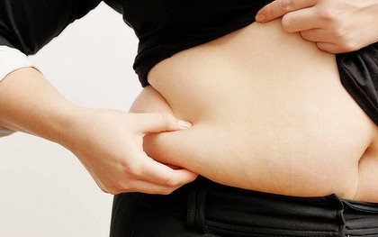

Americans are What?!
65% of adults are overweight

Slide 4
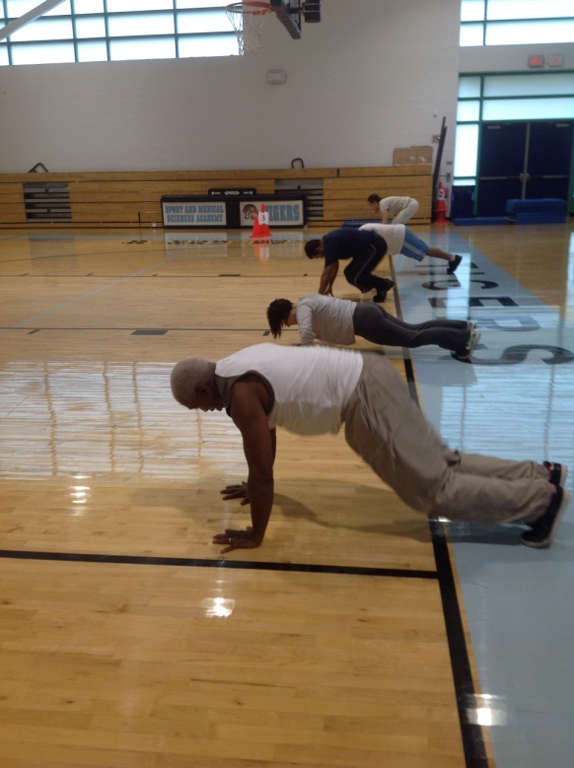
T.U.F.F.
Teachers and staff uniting together and motivating each other
Atmosphere is less intimidating
Convenient location at your own school/workplace
Less expensive than an exercise studio

Slide 5
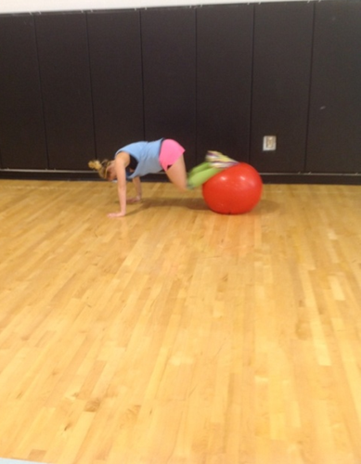
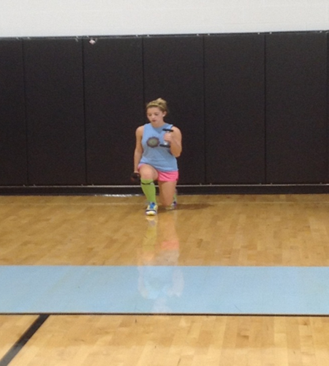
Who We Are...
“T.U.F.F” work out series
Come to your school
Support with exercise and nutrition

Slide 6
T.U.F.F Pricing
Convenient location
All staff environment
Timing
Pricing
Definition of One Unit
6 week boot camp for 10
Economics of One Unit
Selling Price |  | $1,000.00
Cost of materials | $0.00
Cost of labor | $240.00
Other variable costs | $0.00
Total COGS/ COSS |  | $240.00
Contribution Margin |  | $760.00
Monthly Break Even Units
$20 | = | .02 | ≈ | 1 boot camp or 3 classes
$760
Notes:
My definition of one unit is a 6 week boot camp class for ten people. For this six week time period the selling price would be $1,000. I have no cost of materials because all of the materials I would be using will be taken from either the schools gym, or weight rooms. My cost of labor is $240 and no other cost of materials leaving my contribution margin at $760. I only have to sell one unit a month to break even. If teachers are interested they can do a drop in class for $10, but it would work in their favor to buy the six weeks.

Slide 7

Market Analysis
Market Statistics
Industry Name: | Fitness Center | Annual Industry Sales: | $3 Billion
Description of Target Consumer
Demographics | Geographics
Teachers in the Hartford area who want to take care of their health & reduce stress | Hartford, CT area
Psychographics | Buying Patterns
Understand the need for working out Want to be fit Don’t have a lot of time | Exercise twice a week
Target Market Size
Total population of targeted geographic area
124,867
Population of target market
7,500
Market size
(based on
survey)
84
Notes:
My business would be considered a fitness center, which makes 2 million dollars a year. We plan to target teachers in the Hartford area who want to take care of their health. They would be teachers who exercise twice a week, and don’t have tons of time to travel to and from a gym. My total target population is 124,867 people, this is the population of Hartford as a whole. The population of the target market is 7,500 which is just teachers and staff members in the area. I am starting to target 84 teachers, because this is the number off staff in my building.

Slide 8


Promotions and Feedback
“She almost killed, me but I’m going back.”
“I participated in the class yesterday and Cheyenne was very good! The class was TUFF and I’m sore today!”
“It was the TUFF-est workout I’ve ever had! And I loved it!”

Slide 9
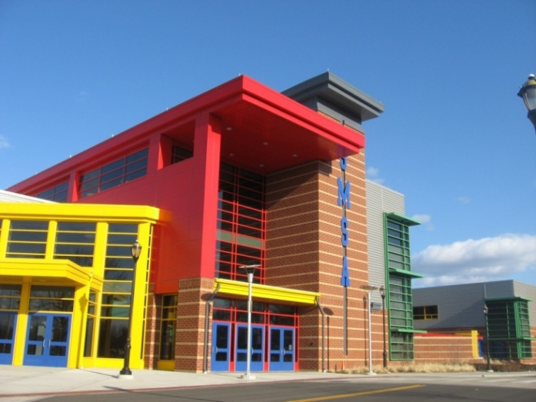
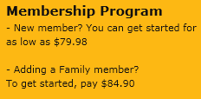
Compare and Contrast
Competition:
Gyms
    Golds
    L.A. Fitness
Fitness Studios
    Core
    Bloom
Home videos
    P90x
    Insanity
Why T.U.F.F.
Location
Environment
Timing
Pricing
$10 per class
Notes:
It is hard to compare T.U.F.F. to any kind of work out program that is out right now. The only thing that can come close to comparing to it is personal home training , or a fitness video. I say this because you can do these things at the convenient location of your home. But, they still can’t compare to T.U.F.F.. To start off, we are inexpensive compared to the other options just mentioned. With all of the money saved, you could treat yourself to a new outfit, now that you have more confidence in your body from working so hard. Also environment is key in situations like these. When you are at home by yourself, and no ones watching you, and no one is their to push you, are you really going to work as hard as you possibly can? NO! with an instructor their motivating you, you can push your body to do things you never thought it could, leaving you feeling confident and accomplished. Nothing feels better, than going home and being relaxed, because you don’t have to leave to go to the gym since your work out was done at school!

Slide 10
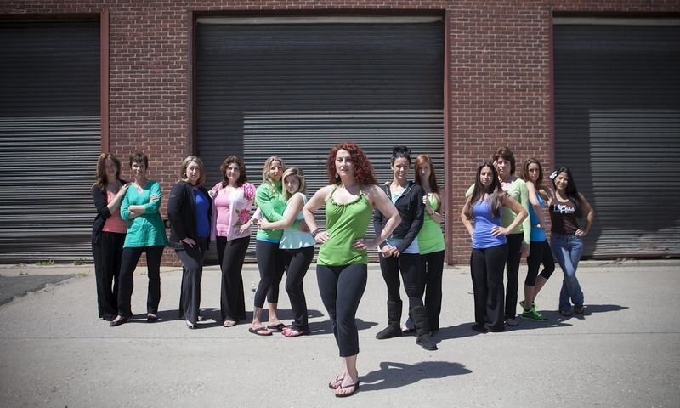
Yes I Can!
Certified in CPR/First Aid/AED
Certified in Yoga
Family has been in fitness business for 13 years
Taking Exercise Physiology class
Taking UConn Molecular Biology class

Slide 11
Sales Projections
Total Units
11
Gross Revenue
$11,000
Net Profit
$6,902

Slide 12
Startup Funds
Item | Why Needed | Cost
Laptop | Business records, and music planning | Already owned
Blank CDs (50 in a case) | Music for class | $15.00
Paperwork for LLC | File business with the state | $320.00
 | Total Startup Expenditures | $335.00
 | Emergency Fund | $167.00
 | Reserve for Fixed Expenses | $60.00
 | Total Startup Investment | $562.00

Slide 13

Thank you for your consideration of T.U.F.F…
ARE YOU T.U.F.F ENOUGH?
Please visit us online at www.cmcapo22.wix.com/tuffteachers

