Slide 1
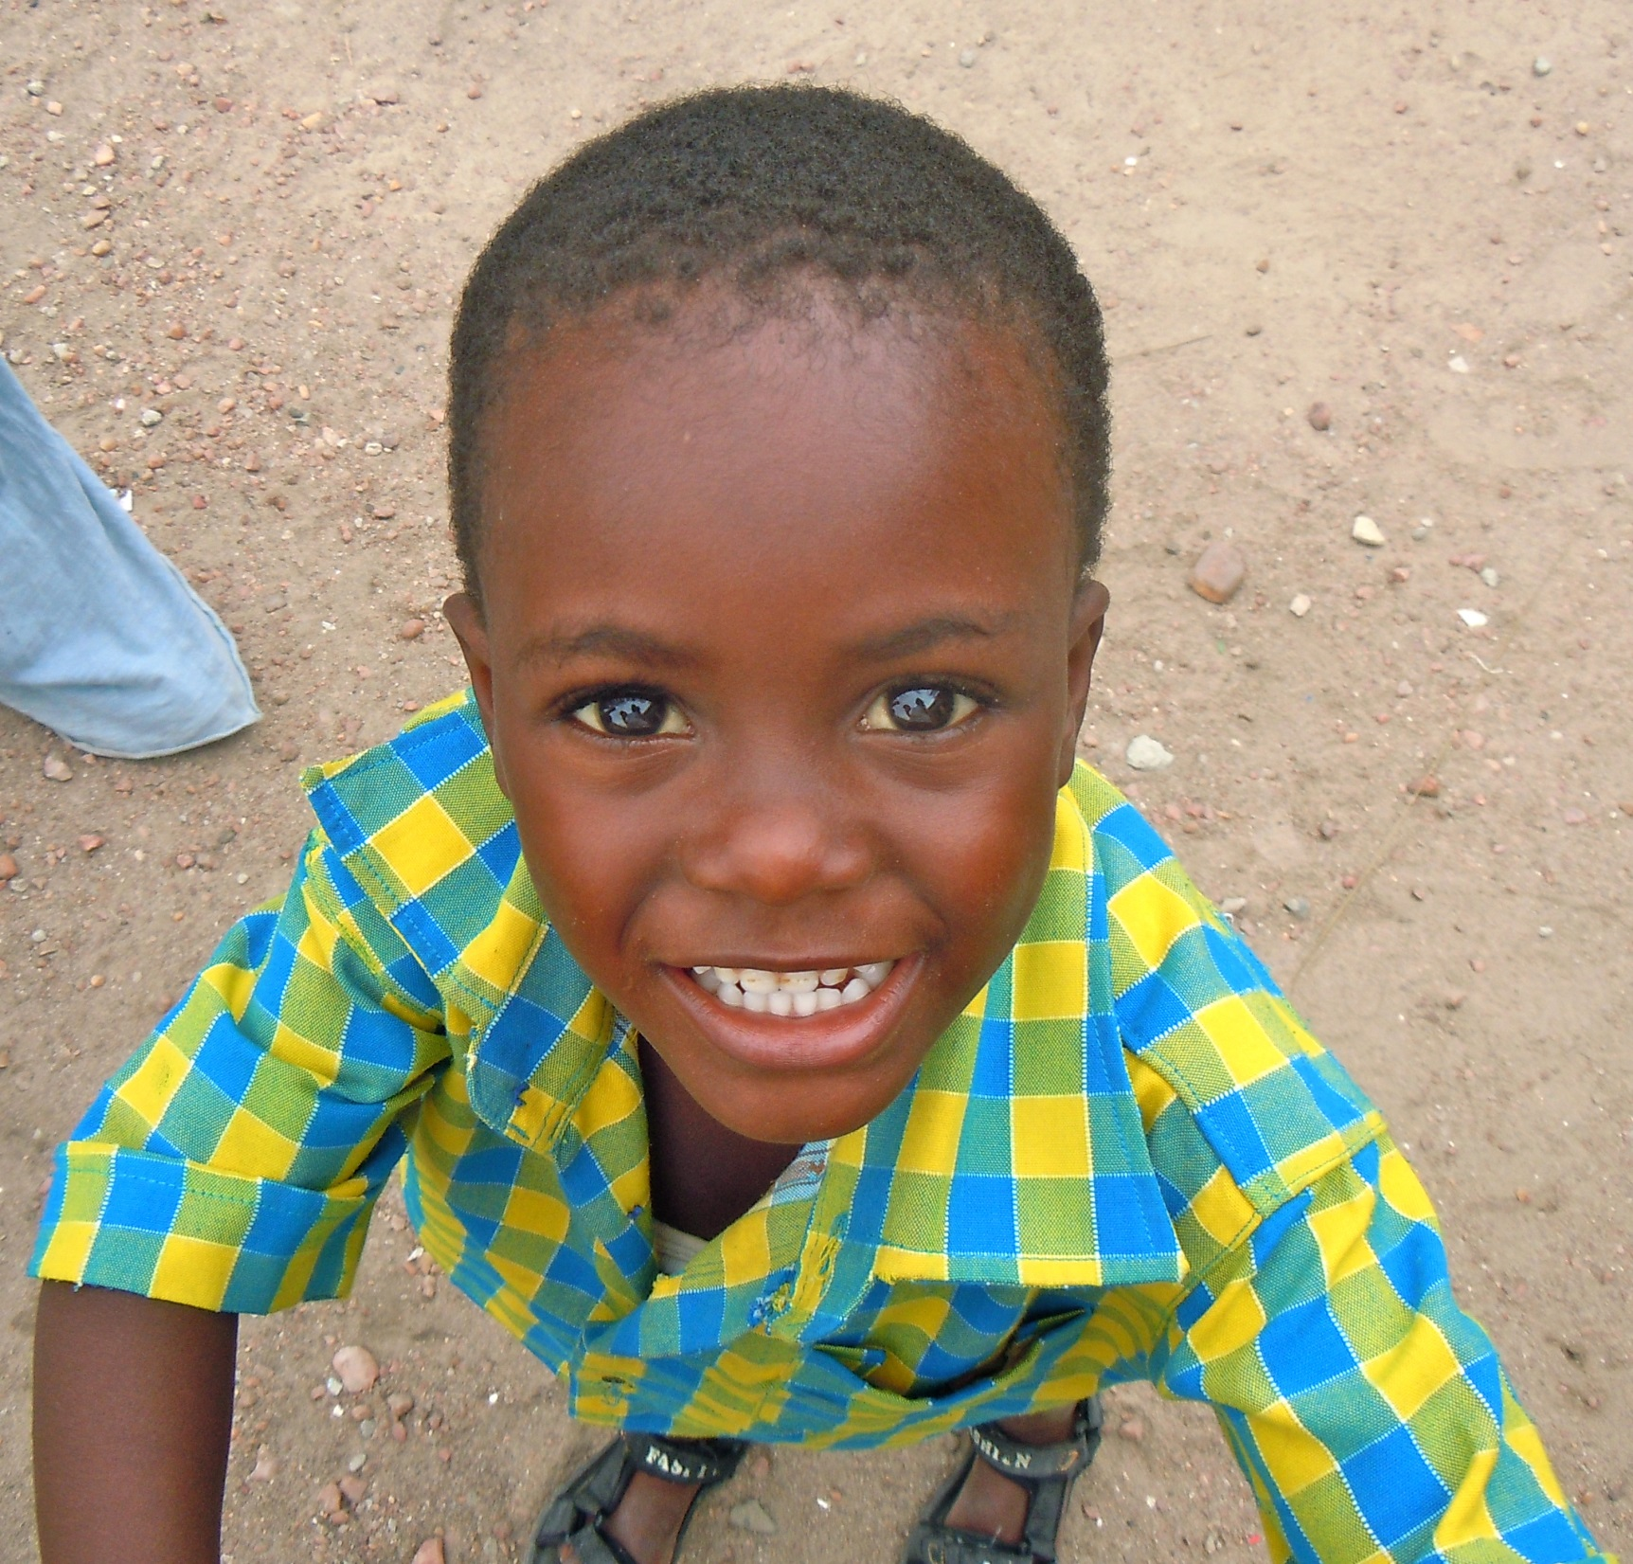
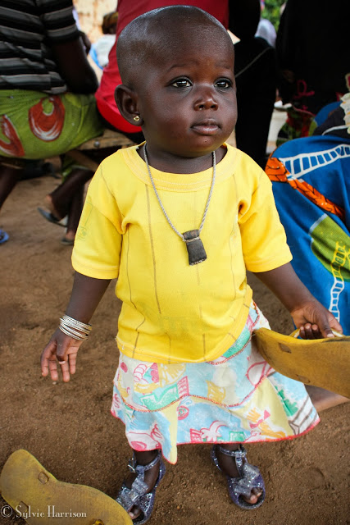
Notes:
Don’t you hate it when you get fully dressed to go out, but you can’t find any accessories to pair with your outfit? Wouldn’t you love to be able to get your hands on unique, one-of-a-kind jewelry and accessories at an affordable price? If the answer is yes, then I think I can help you.

Slide 2
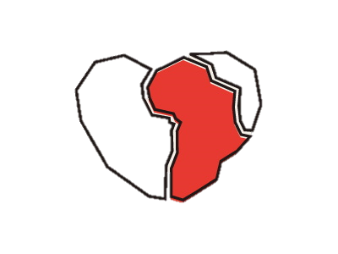
With Love,
Afrikka
Elsie Acquah
Grade 12

Slide 3
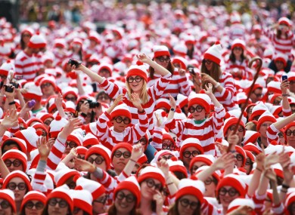
Notes:
There’s nothing worse, in my opinion, is having something so mainstream that anyone else can have it as well. I love having unique pieces that I know no one else will have and I’m sure I’m not the only person who feels that way. People want to be able to stand out in a unique, yet affordable way.

Slide 4
Solution
I offer beautiful, authentic handmade jewelry at an affordable price.

Slide 5
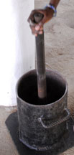
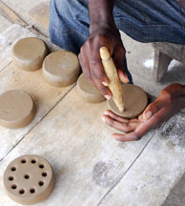
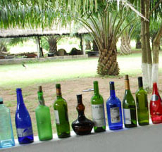
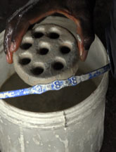
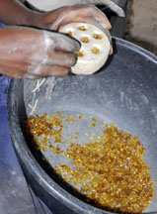
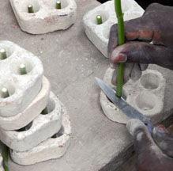
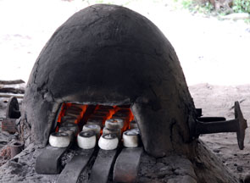
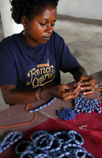
Description of Product
Notes:
My accessories are handmade and even though they’re glass, they’re a lot more durable than you’d think so they’re very good quality. Since each product is made by hand, no two pieces are exactly alike. The accessories are beautiful as well and they’ll definitely catch people’s attention.

Slide 6
Social Impact
Mission
I will be selling authentic African jewelry that is both beautiful and unique.
Recycling glass waste
Employing more Africans
Notes:
The mission of With, Love Afrikka is to help customers get quality jewelry and accessories at an affordable price. I will be giving people from my country, Ghana, the opportunity to be able to feed their families because I will be buying their products, therefore generating more business for them which will result in more money being brought in.

Slide 7
Business Model
Definition of One Unit
One Love Afrikka Bracelet
Description of Expenses
Variable Material Expenses | Total: $0.80
Bubble mailers | 0.14
Cellophane bags | 0.02
Labels | 0.13
Bracelets | 0.50
Fixed Expenses | Total: $69.00
Rent/Utilities | 15.00
Inventory | 20.00
Depreciation | 7.00
Advertising | 27.00
Economics of One Unit
Selling Price |  | $20.00
Cost of var. materials exp. | $0.80
Cost of labor | 0.14
Other variable costs | 1.00
Total COGS/ COSS |  | $1.94
Contribution Margin |  | $18.06
Monthly Break Even Units
$69.00 | = | 3.820 | ≈ | 4 bracelets
$18.06

Slide 8
Market Analysis
Market Statistics
Industry Name: | Family Clothing Stores | Annual Industry Sales: | $98 Billion
Description of Target Consumer
Demographics | Geographics
Young adults | Hartford, CT
Psychographics | Buying Patterns
People who enjoy standing out and being the center of attention | Shop online frequently
Target Market Size
Total Population
3,574,097
Target Market Population
124,775
Market Size
(based on
survey)
74,865
Notes:
My business falls under the industry of Family clothing stores, which generates about 98 billion dollars annually in the U.S alone. The people who fall under my target market are young adults, mostly late teens to late 20s, in the Harford area who shop online frequently and enjoy being the center of attention. The total population of Connecticut is 3,574,097, but since that is too large a number to tackle I decided to look at the Hartford population (124,775). 60% of the people who took my survey actually fall into my target market, bringing my market size to 74,865 which is still a pretty large number, but workable.

Slide 9
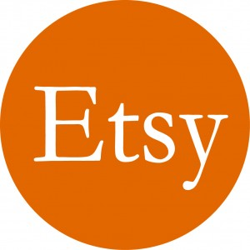
Marketing and Sales
Word of Mouth
Website
Business Cards
Social Media
Personal Selling
Craft/Trade Shows
Etsy
Notes:
I plan on using social media and my website to get the word out about my products and when I start to get customers that are satisfied with my service, word of mouth will be another way of promotion. I’ll also use business cards to promote. For sales I’ll go to smaller businesses and shops and ask them if they can sell my items in their shops. I’ll also sell myself and go to trade and craft shows in order to enlarge my potential customer pool.

Slide 10
Competition
 | Love, Afrikka | Pandora | AtelierChokerbali
Price | Moderate | High | Moderate
Quality | Good | High | Good
Available Where | Online | Online & in stores | Online
Your Competitive Advantages
1. Recycled material and eco friendly 2. High Quality 3. Aesthetically pleasing

Slide 11
Qualifications
Already Operational
I have taken an Entrepreneurship & Marketing course
I have connections to Ghana
I am a member of my own target market
I’m very creative

Slide 12
Sales Projections
Total Units
225
Gross Revenue
$4,500
Net Profit
$3,152

Slide 13
Start-up Funds
Item | Why Needed | Cost
Computer | To keep records | Owned
Cell Phone | For communication | Owned
Inventory | To be able to start up right away | 25.00
Packaging | To be able to start up right away | 15.00
Advertising | To get the word out | 27.00
DBA | To legitimize my business | 5.00
 | Total Startup Expenditures | $72.00
 | Emergency Fund | 36.00
 | Reserve for Fixed Expenses | 207.00
 | Total Startup Investment | $315.00
ROI: Return on Investment
$3152 | = | 1001% | ≈ | $10.01
$315
ROS: Return on Sales
$3152 | = | 70% | ≈ | $0.70
$4500

Slide 14
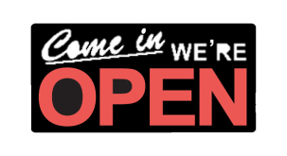
Future Plans
Notes:
I plan on renting a small storefront in around three years. I also plan on expanding my products from mostly Ghana, to all African countries as well as countries in the African Diaspora.

Slide 15
“Helping you accessorize, with love.”
Thank you for your consideration of
With Love, Afrikka
Visit http://loveafrikka.webs.com/
*WEBSITE UNDER CONSTRUCTION*

