Slide 1
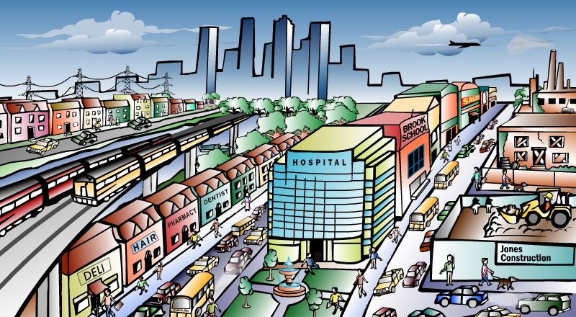
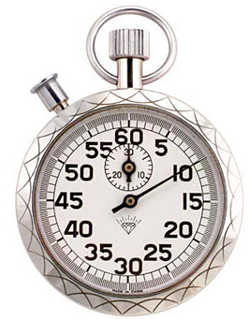
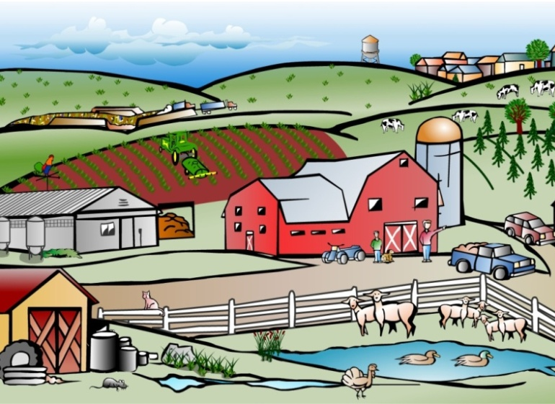
Notes:
You may not have the space, time, knowledge or desire to tend your own garden…
At Your Farm Plot, we know that nothing tastes better than ripe from the vine, which is why we bring your personal garden plot right to you with

Slide 2
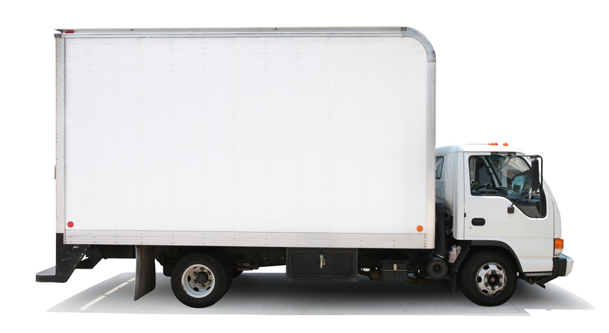



Shamira Chappell, Co-CEO
Meliha Korkutovic, Co-CEO
1

Slide 3

Mission Statement
YFP
Mission Statement
  provides delivery of fresh produce from Community Supported Agriculture (CSA) farms to their members, giving members their time and convenience back.
Your Farm Plot
Describe the Opportunity
  Majority of CSA farms are 20+ miles from target market
  No CSA delivery services currently available
  Increasing CSA shares by eliminating distance barriers results in:
      Greater consumption of healthy produce
      Financial security for local farmers
      Reduced transportation costs / environmental impact
2
Notes:
Opp= csa is limited by difficulty pick-up and money up front- we have bank and one drive to you

Slide 4
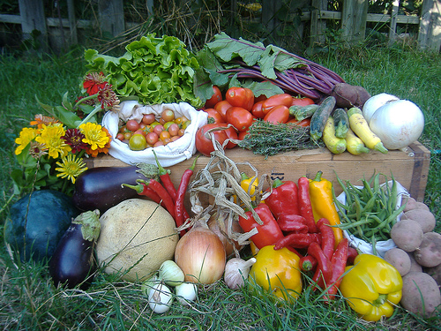
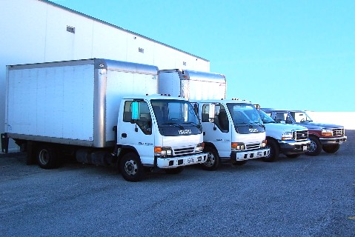
Business Profile
YFP
Type of Business
  is a delivery service for farm fresh produce from CSA farms to customers’ doors
Legal Structure
  Limited Liability Corporation
  Provides legal protection to the owners of the business
Your Farm Plot
3

Slide 5
Qualifications
YFP
Your Farm Plot
  owners’ families are CSA members and produce farmers
  NFTE entrepreneurship courses have provided preparation for business ownership and operation
  Understand customers’ needs through market research survey conducted by
  Licensed to drive delivery vehicles
YFP
4
Notes:
We are bilingual in Bosnian and English; currently learning Spanish
In contact with csa farms in the hartford county who agree with feasibility of business
Licensed to drive
Have taken an Entrepreneurship/marketing class

Slide 6
Market Analysis
YFP
Industry Name: | Community Supported Agriculture
Industry Size: | $640,000
877,312
Total Population in Hartford County
Total Population | Hartford County, CT
Target Market | 8 CSA farms, each with 400 shares
Potential Market Size | 2 CSA farms, each with 400 shares survey data: 77% of existing CSA customers interested in weekly home delivery
3,200
Households with CSA shares
800
YFP
Target
Households
616
Potential Households
5
Notes:
http://www.localharvest.org/csa/M24527
http://www.ctnofa.org/CSAs.htm

Slide 7

Consumer Profile
YFP
By Location
    Hartford County, CT
By Population
    3,200 current CSA customers
By Personality / Behavior
    Existing CSA members willing to pay for convenience
    Health conscious households
    Environmentally conscious
By Income
    Middle to upper income
6
Notes:
Ages 25 to 95
Target existing csa members or those that plan to do it

Slide 8
Competitive Advantage
YFP
Pea Pod
Farm
Pick-Up
YFP
Delivery
Factors
Quality of
Delivery Service
Good
Poor
Excellent
Price
$199/20 deliveries
$500+/season
$200/season
Location
No Trip
Weekly Trip
No Trip
Brand/Reputation
Good
Poor
Excellent
Unique Knowledge
Moderate
Moderate
High
7
Notes:
Our unique knowledge- website, recipes, extras = high
Pea Pod- Minimum order $50; delivery fee $9.95 or $6.95 for orders over $100.
We did 9.95x20 = 199
Economies of scale- expensive for one person for one batch, yet we do many at once

Slide 9
Marketing Mix
YFP
Marketing
Plan
Price
More affordable than weekly travel to CSA farm
Place
Hartford County, CT
Product
Convenient farm to home delivery, saving both time and money
Promotion
Website
Tote Bags
Farm Displays
People
Middle to upper income households who value convenience
8

Slide 10
Marketing Plan
YFP
Awareness
Purchase
Retention
Current & Short Term (1 month - 6 months)
Point-of-pick-up advertising
Reusable, environmentally friendly tote bags with logo
Delivery service priced 60% below actual cost to the customer
Added convenience of virtual access to farm through online interaction
Superior service
Home delivery and freshness is unbeatable
Measurable reduction in carbon footprint
Long Term (6 months -1 year)
Advertise on community TV
Tax deduction funds delivery
Customer interactive chat
Monthly cost, by phase:
$50.00
$0.00
$0.00
9
Notes:
100 cards, 50 posters
Website= diet, weight watchers, recipes, how to use veggies
purchase= agreement with bank? Pay off gradually not all up front
64.6018% savings with us @ $200 versus $565 alone

Slide 11
Cost of Materials/Direct Labor
YFP
Definition of One Unit: | 1 CSA Seasonal Delivery (includes 20 at-home deliveries)
Cost of Sales Per Unit
Direct Labor (Labor Cost per Hour) | Time (in hours) to make 1 unit | Direct Labor Cost Per Unit
$8.25 per hour | 2 people x 16.5 hours x 20 deliveries / 150 customers = 4.4 hours | $36.30
Total Direct Labor Per Unit |  | $36.30
Material Description | Cost/Total Quantity | Cost Per Unit ($)
Weekend Day Truck Rental with Insurance | $110 per weekend x 20 days / 150 customers | $14.67
Truck Mileage ($0.89/mile) | 100 miles per weekend x 20 days / 150 customers | $11.87
Gasoline per day ($3/gallon) | 10 gal. per weekend x 20 days / 150 customers | $4 .00
Business Management | 1 hour per contract | $8.25
Total Material Cost Per Unit |  | $38.79
Total Other Variable Costs Per Unit |  | $0.00
Cost of Sales Per Unit |  | $75.09
10
Notes:
11
Business management = thinking, website updates, strategize, calling ppl, etc

Slide 12
Economics of 1 Unit
YFP
Definition of One Unit: 1 CSA Seasonal Delivery (includes 20 at-home deliveries)
Selling Price per Unit | * $200.00
Direct Labor per Unit | $36.30
Materials per Unit | $38.79
Total COGS per Unit | $75.09
Total Other Variable Costs per Unit | $0.00
Total Cost of Sales | $75.09
Contribution Margin | $124.91
* Actual cost if CSA member picks up share is approximately $565 per season (vehicle expense @ $0.50 per mile and personal time valued at $8.25 per hour)
11
Notes:
Value pricing- based what it means to customer
We are service, can be charged by value pricing. Personal service
So we go below that at 275 = more value = 85% to catch their attention
Avg csa share worth= 30 to 75+ bucks
$565 figure based upon:
-40 mile roundtrip, 1 hour weekly, for 20 weeks
-40 miles x 20 weeks = 800 miles/season
-800 miles/season x $0.50 gov’t rate = $400 for car wear and tear
-20 hours spent/season x $8.25 = $165 for time
-$400 + $165 = $565 cost to customer to get share from farm by themselves / season

Slide 13
Average Monthly Fixed Costs
YFP
Type of Fixed Cost | Monthly Cost
Entrepreneurial Stipend | $100
Insurance ($1 M liability) | $150
Advertising (tote bags, website) | $50
Depreciation (computer) | $20
Utilities (internet, cell phone) | $30
Rent (home) | $45
Total Monthly Fixed Costs | $395
12
Notes:
Do we need liability insurance?

Slide 14
Time Management Plan
YFP
Business Schedule for a Typical Week (168 hours)
Meliha and Shamira
13
Notes:
Business 20
Free time 47
Sleep 56
School 45

Slide 15
Monthly Sales Projections
YFP
Jan. | Feb. | Mar. | Apr. | May | June | July | Aug. | Sept. | Oct. | Nov. | Dec.
13 | 17 | 24 | 32 | 44 | 0 | 0 | 0 | 0 | 0 | 12 | 8
Break-Even Units
28 units / season
Total Units
150 units
Full Capacity
200 units
14
Notes:
Break-Even Units
-Monthly Fixed Costs / Gross Profit Per Unit
-$395 monthly fixed cost x 5 delivery months = $1,975 monthly fixed costs from June to October
-$1,975 / $124.91 gross profit per unit = 15.81 = 16 break-even units

Slide 16
Projected Yearly Income Statement
YFP
Selling Price Per Unit | $200
# of Units Sold | 150
Total Sales | $30,000
Total COGS | $11,264
Other Variable Costs | $0
Total Variable Costs | $11,264
Gross Profit | $18,736
Yearly Fixed Costs (seasonal) | $3,515
Other Costs/Unforeseen | $400
Total Fixed Costs | $3,915
Profit before Taxes | $14,821
Less Estimated Taxes @25% | $3,705
Net Profit | $11,116
15
Notes:
Yearly Fixed Costs
-$395 x 5 months (June to October) = $1,975
-$220 (insurance, advertising, depreciation) x 7 months = $1,540
-$1,975 + $1,540 = $3,515 total yearly fixed costs

Slide 17
Start-up Investment
YFP
Item | Where I will buy this? | Cost of Item
Paperwork for LLC | Secretary of State | $320
Rental Truck Signage | Sign-A-Rama | $250
Garmin Portable GPS | Best Buy | $200
Website | GoDaddy.com | $200
Office Supplies | Staples | $140
CASH RESERVE |  | $1,185
Estimated TOTAL START-UP INVESTMENT |  | $ 2,295
160 hours
$8.25/hour
Total Time Investment
of $1,320
x
=
Total: $3,615
16

Slide 18
Return
YFP
…on Investment
307%
Annual Net Profit
$11,116
=
$3.07
(dollar equivalent)
Start-Up Inv.
$3,615
…on Sales
37%
Annual Net Profit
$11,116
$0.37
(dollar equivalent)
=
Total Sales
$30,000
17

Slide 19
Financing Strategy for Total Start-up Investment
YFP
Source | Amount | Debt | Equity | Gift
Personal Savings [part-time jobs] | $3,000 |  | X
Relatives | $615 |  |  | X
Business is debt-free
100% equity ownership
Total: $3,615
18
Notes:
Equity- we are 100% owners of company
Debt free company

Slide 20

Business Responsibility Plan
Philanthropic Strategy Plan
YFP
At the customers’ discretion, will consolidate and distribute excess produce to:
Owners to volunteer at food bank once monthly
to promote awareness of CT Food Bank through business cards and website
Your Farm Plot
YFP
19

Slide 21
Business & Educational Goals
YFP
Business
Personal
  To graduate from high school and attend a prestigious university
  To gain first-hand knowledge of business ownership through actual operations
  Attain goals as set forth in business plan
  To increase operational efficiencies through streamlining processes
Short Term
  To obtain commissions from farmers for new CSA members
  To purchase a delivery vehicle and expand routes
  To gain valuable life lessons and skills through business ownership
  To position the business for future acquisition
Long Term
20

Slide 22
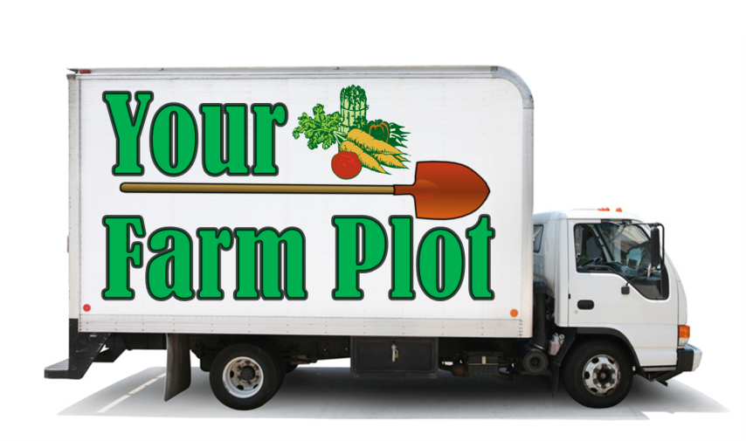
“Let Us Bring Your Farm Plot to You”
YFP
Thank you for your consideration of
Please visit our website at
www.yourfarmplot.com
21

